Slide 1
Git and Github
计65 王元炜 2016011383
davidwangthu@gmail.com

Slide 2

What is Git
https://git-scm.com/
Git is a free and open source distributed version control system designed to handle everything from small to very large projects with speed and efficiency.
The Usage of Git.

Slide 3
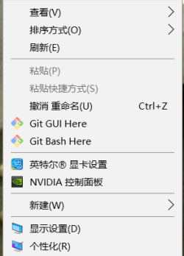
Install and Run Git
Linux:
  in the terminal
  sudo apt-get install git
Windows
  https://git-for-windows.github.io/
  download git for windows. and install it. Right Click at your root and
  select “Git Bash Here“
Max OS
  in the terminal
  apt-get install git

Slide 4
Using Git For Individual Project
commandline commands
git init
git status
git add <FILEPATTERN>
git commit -m <COMMENT>
git branch <BRANCH_NAME>
git checkout -b <BRANCH_NAME>
git checkout <BRANCH_NAME>
git checkout -- <FILEPATTERN>
git merge <BRANCH_NAME>

Slide 5
The Internal of Git
Modification Management.
Tree Structures.

Slide 6

GitHub
Github is an online reposity management tool using git. github is also the biggest open-source software/tool community.
https://github.com/

Slide 7
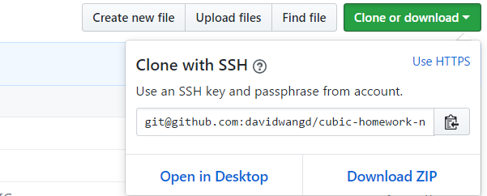
Using Github for Team Project
New repository in github
github fork
git remote add origin git@github.com:username:repositoryname.git
git clone
git push -u origin remoteBranch:localBranch
git fetch origin

Slide 8


