Slide 1
Reddit Distributed Database
Joshua Payapulli, Armand Patel, Paul Yoo

Slide 2


Tech stack
ReactJS was used to develop the front end of the website
Live Table was created to display reddit entries
Several buttons created to navigate website
Flask was used on the backend to create functionality behind the buttons on the app
GitHub repository stored all of our data and code

Slide 3
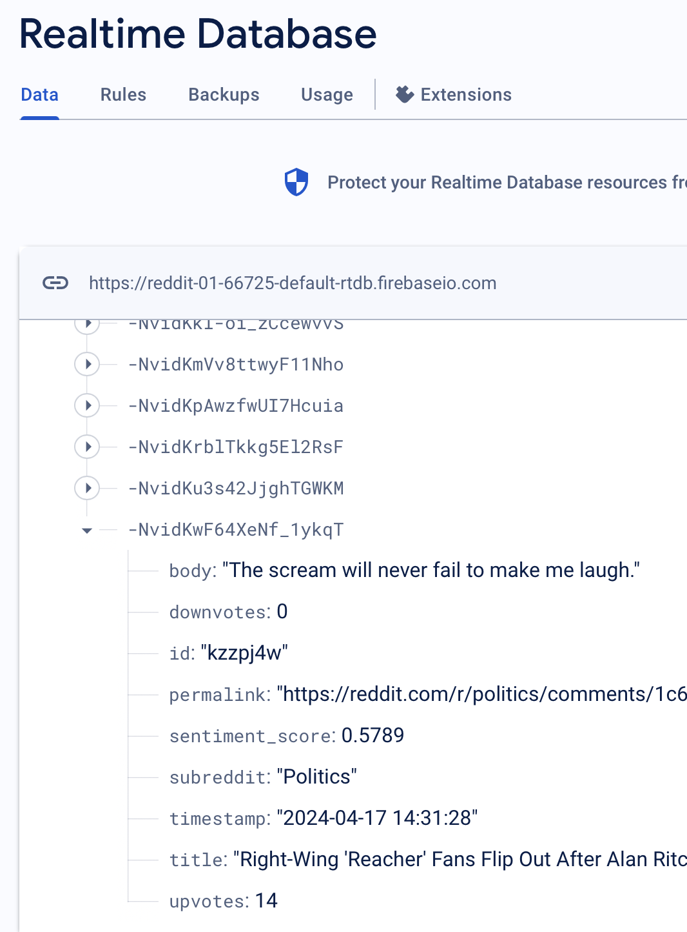
Integration with Firebase Realtime Database
The “praw” library was used to scrape information about the upcoming election from Reddit posts
Firebase Realtime Database used to store all information about posts in JSON format
Firebase was integrated with the web application along with query functions/buttons

Slide 4
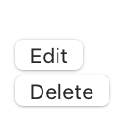
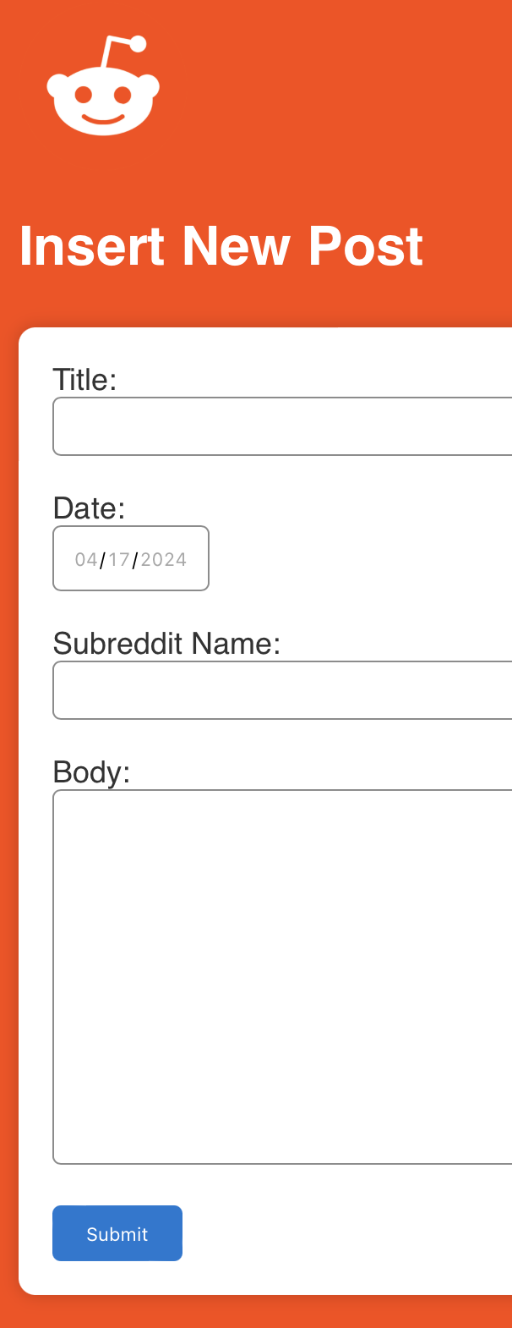
Data Management Functionality
Implemented functionalities in the app that allow users to:
Insert new Reddit posts:
Date
Title
Content
Subreddit Name
Update existing Reddit posts:
Allow users to select a post from the displayed list
Edit details
Delete Reddit posts:
Provide options for users to delete specific posts from the database

Slide 5
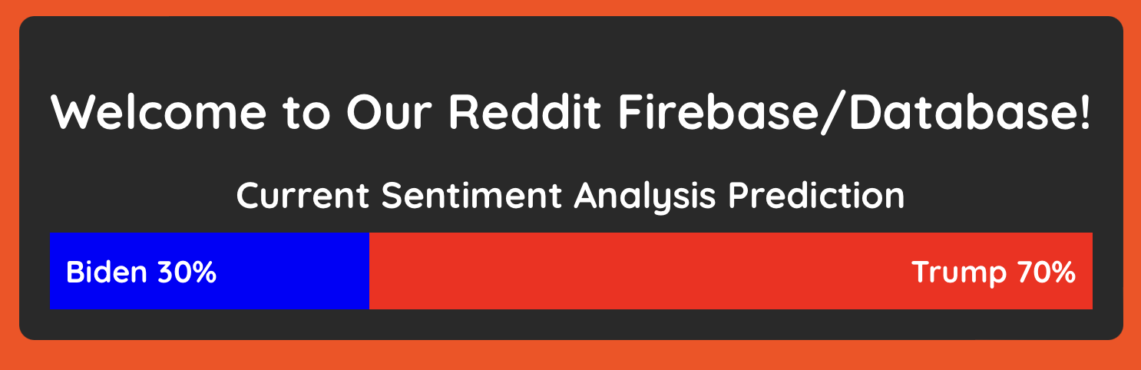
Sentiment Analysis
NLTK package
Score every words in Reddit comment for quantification of expression
compound the scores for ‘sentiment_score’ data value in database
‘Sentiment_score’ represents positive or negative impression using the scale between 1 and -1
The closer to 1, the positive, the closer to -1, negative. Neutral for 0
By parsing the ‘title’, the title of reddit post where the comment left, to find whether the keywords Trump, Biden, Republican, Democrat included in the title. If yes, the score is related to the keywords.
Using the keywords and score, find average

