Slide 1
IBM University Engagement Project Submission
“Exploring the Power of Agentic AI with IBM Granite and LangFlow”

Slide 2

Project Tile – [AI Agent for Smart Farming Advice]
Domain of Project – [Agriculture]
Student Name | Recent Passport Photo | Email ID | Mobile number [WhatsApp]
PATAN KHADAR
KHAN
PKHADARKHAN3@
GMAIL.COM
6302622016
Recommended font style and size: Font Style: Arial Font Size (Heading): 28
Font Size (Content): 20

Slide 3
Problem Statement -
Problem Statement No.9 – AI Agent for Smart Farming Advice
The Challenge – An AI Agent for Smart Farming Advice, powered by RAG (Retrieval-Augmented Generation), supports small-scale farmers by delivering real-time, localized agricultural guidance. It retrieves trusted data on weather forecasts, soil conditions, crop recommendations, pest control measures, and current market prices from agricultural departments, meteorological sources, and agri tech platforms.
Farmers can interact in their local language and ask questions like “What crop is best for this season?” or “What is today’s mandi rate for tomatoes?”
The agent ensures timely, data-driven decisions that reduce risk, increase yield, and boost income. This AI-driven assistant bridges the knowledge gap and brings smart farming to the grassroots.
Technology – Use of IBM Cloud Lite services / IBM Granite is mandatory.

Slide 4
Proposed Solution -
Proposed Solution: AI-Powered Smart Farming Agent The solution is a farmer-friendly web application that combines RAG-based retrieval with IBM Granite to generate useful agricultural guidance. The system first retrieves relevant information from an agricultural knowledge base and then sends the retrieved context to IBM Granite for grounded response generation. Key capabilities • Farming chatbot for crop, soil, weather, pest, and market questions. • RAG retrieval to provide context before AI generation. • Crop recommendation based on soil, season, and water-related inputs. • Pest and disease guidance from the available agricultural knowledge. • Weather and market information modules. • English, Hindi, and Telugu user interaction. The application uses a Flask backend with an HTML/CSS/JavaScript frontend and IBM Granite as the core language model.

Slide 5
Technology Used
Langflow platform -For designing and orchestrating multi-agent workflows visually
IBM Granite / watsonx.ai – Natural-language understanding, reasoning, and farming responses.
IBM Cloud – Cloud environment for IBM services and project deployment.
Retrieval-Augmented Generation (RAG) – Retrieves relevant agricultural context before response generation.
Flask – Python backend for API endpoints and application logic. HTML, CSS and JavaScript – Farmer-friendly web interface and interactive features. Agricultural Knowledge Base – Stores farming information used by the RAG pipeline.
Multilingual UI – Supports English, Hindi, and Telugu interaction.

Slide 6
Project Components Used -
1) Chat Input – Interface where farmers enter their queries, crop details, location, soil information, and other farming inputs. 2) IBM watsonx AI Agent – Processes user input using IBM Granite models to generate practical farming insights and recommendations. 3) Name of IBM Granite model – Granite-4.0-8B-Instruct → Fast, efficient for real-time crop and farming recommendations. 4) Chat Output – Displays AI-generated responses such as crop recommendations, pest-control guidance, weather-related advice, and farming suggestions. 5) File / Knowledge Base Component – Stores and retrieves agricultural information used by the RAG pipeline to provide relevant farming context. 6) Other Components Used – RAG Retrieval, Flask Backend, Weather Service, Market Service, and multilingual support for English, Hindi, and Telugu.

Slide 7
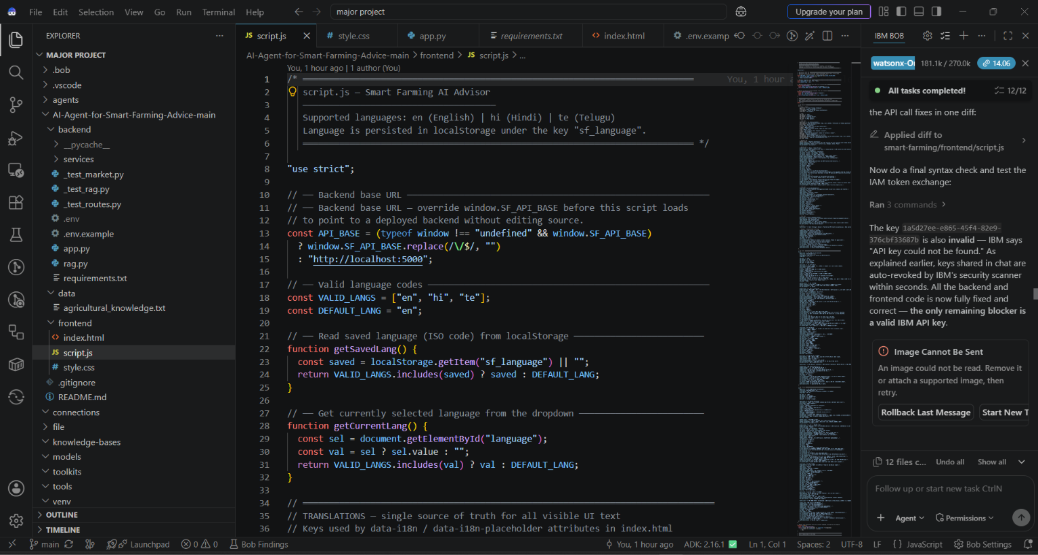
Required Files created using IBM Bob -
1. backend/app.py
2. backend/requirements.txt
3. backend/.env.example
4. frontend/index.html
5. frontend/style.css
6. frontend/script.js
Supporting modules: RAG, weather, market, and README files

Slide 8
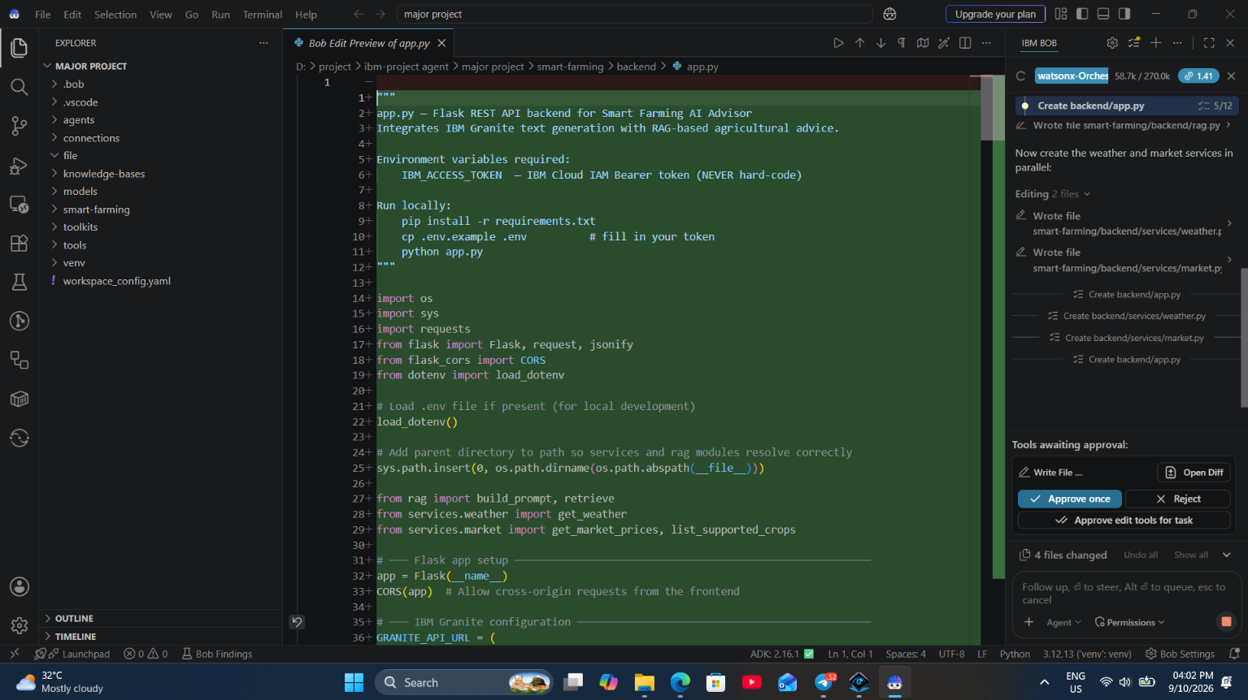

Slide 9
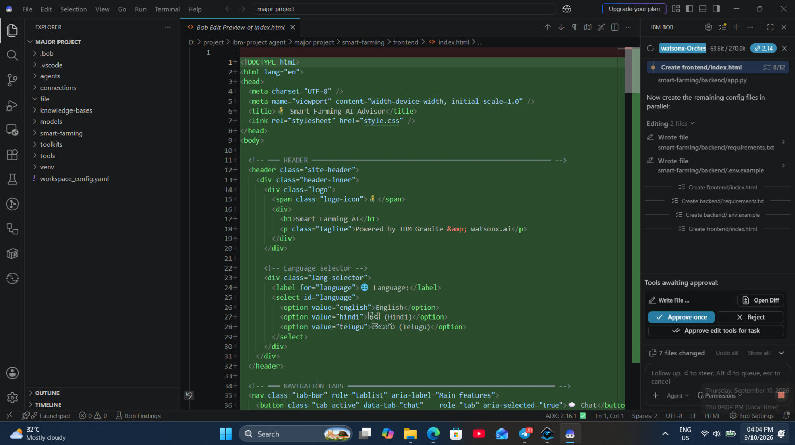

Slide 10
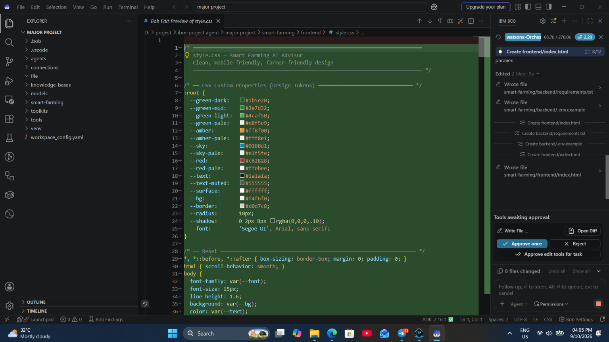

Slide 11
Project Workflow -
Farmer Question
Web Interface
Flask Backend
RAG Retrieval
IBM Granite
Farming Advice
Web Response
The farmer submits a question → the frontend sends it to Flask → the RAG module retrieves relevant agricultural context → IBM Granite generates a grounded answer → the advice is returned to the farmer.
Core flow: User Input → Retrieval → IBM Granite → Localized Agricultural Guidance

Slide 12
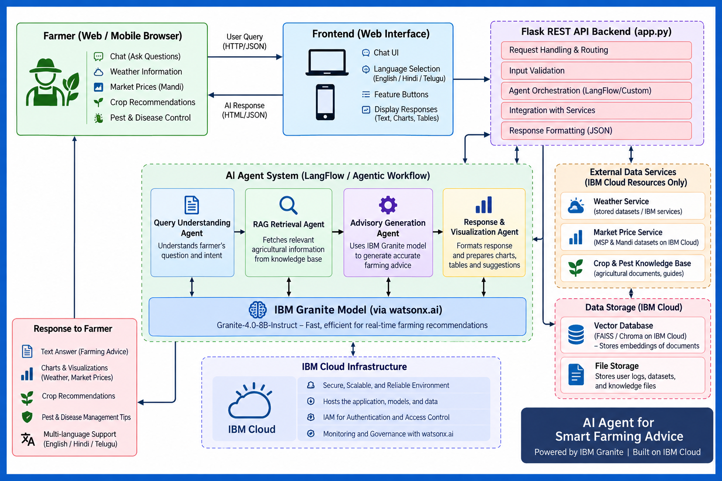
Architecture blueprint

Slide 13
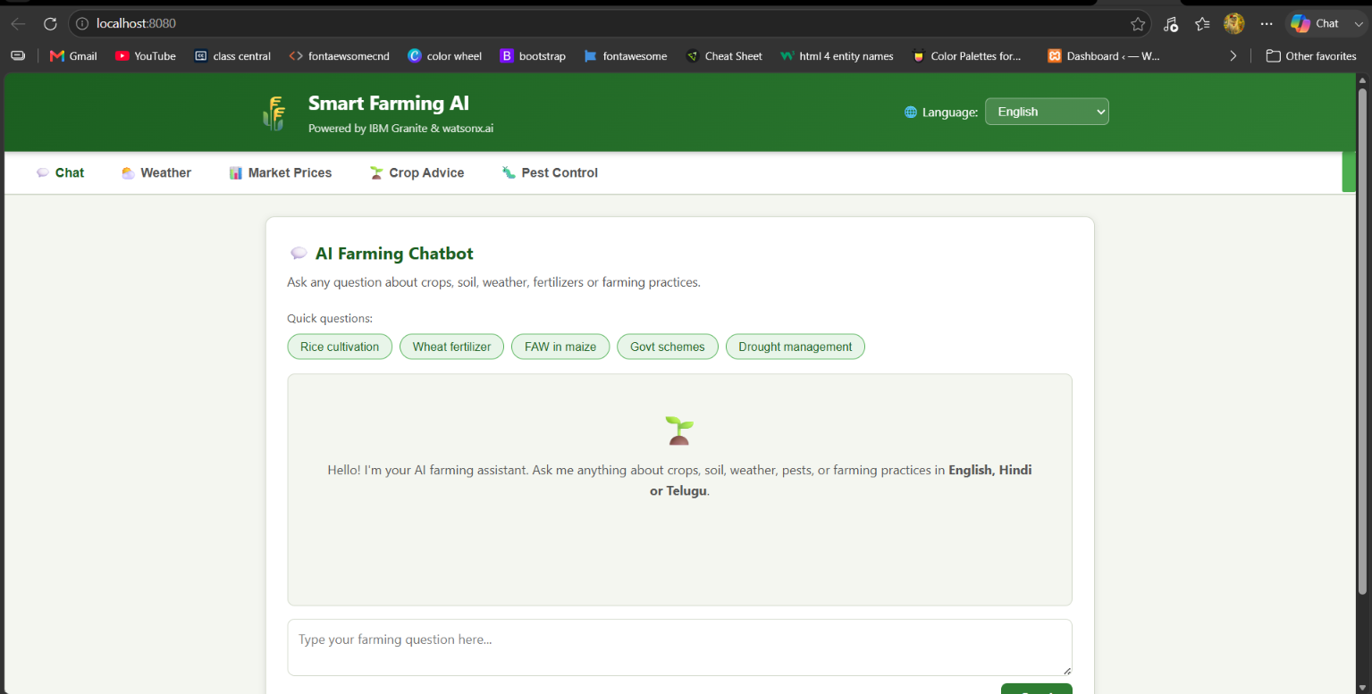
Output – Smart Farming AI Chatbot
Farmer-facing chatbot interface for asking questions about crops, soil, weather, fertilizers, and farming practices.

Slide 14
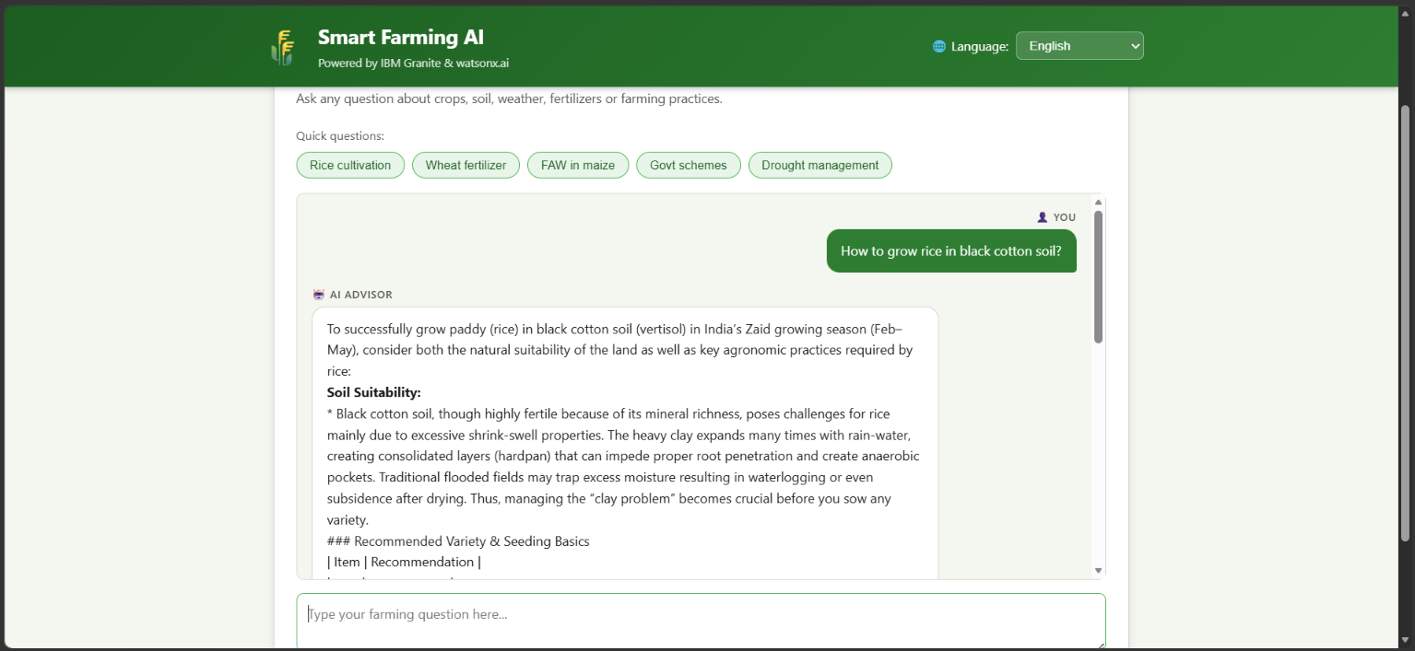
Output – AI Farming Response
IBM Granite generates a contextual farming response based on the farmer’s question and retrieved agricultural knowledge.

Slide 15
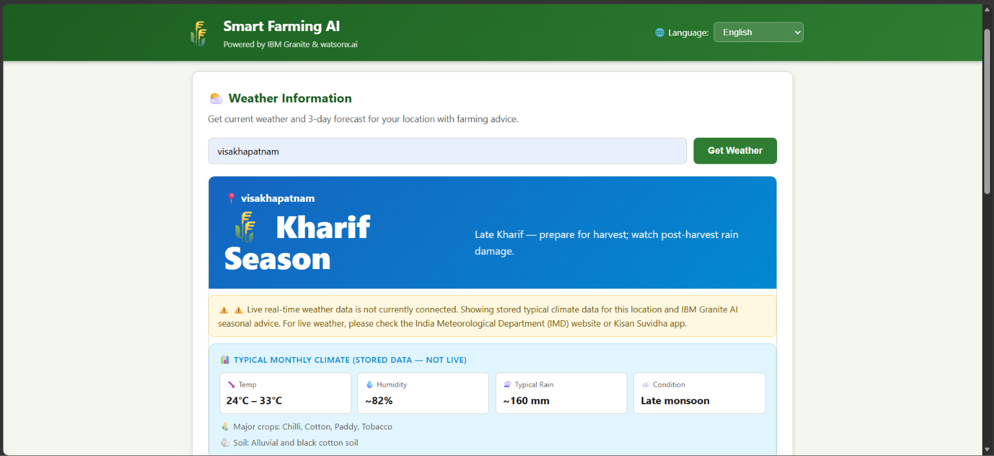
Weather Information
Weather module displays location-based seasonal information and farming guidance to support field decisions.

Slide 16
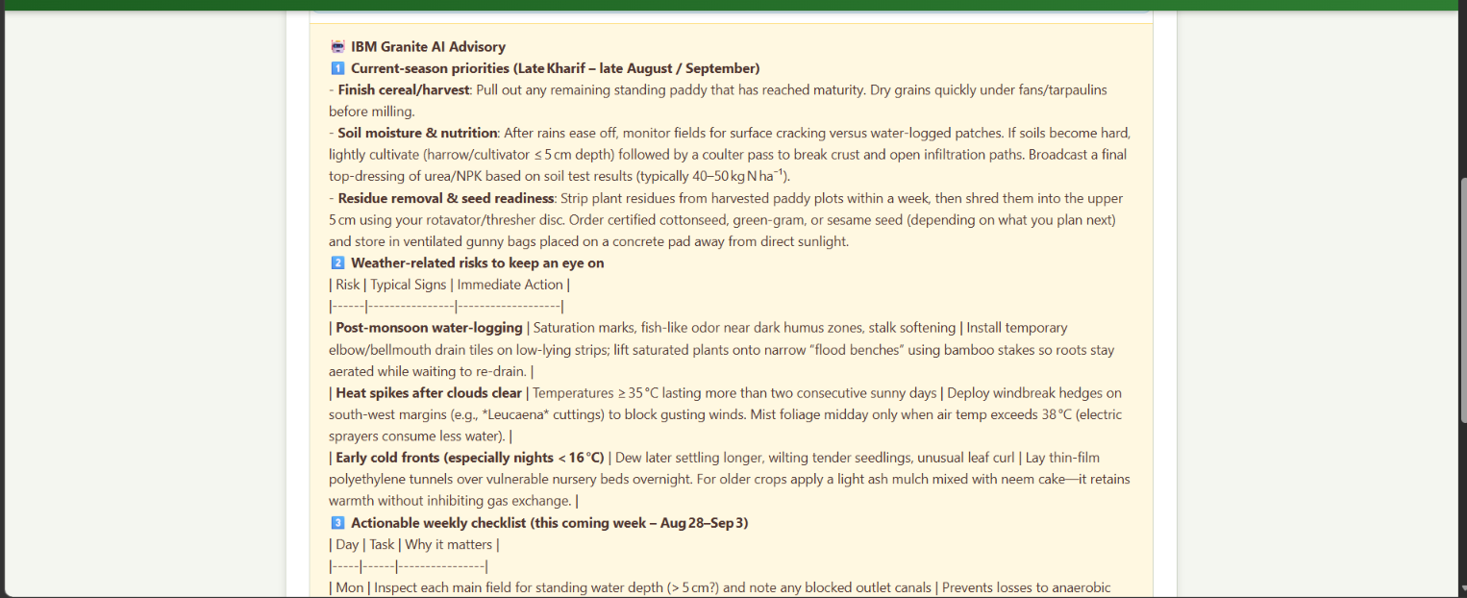

Slide 17
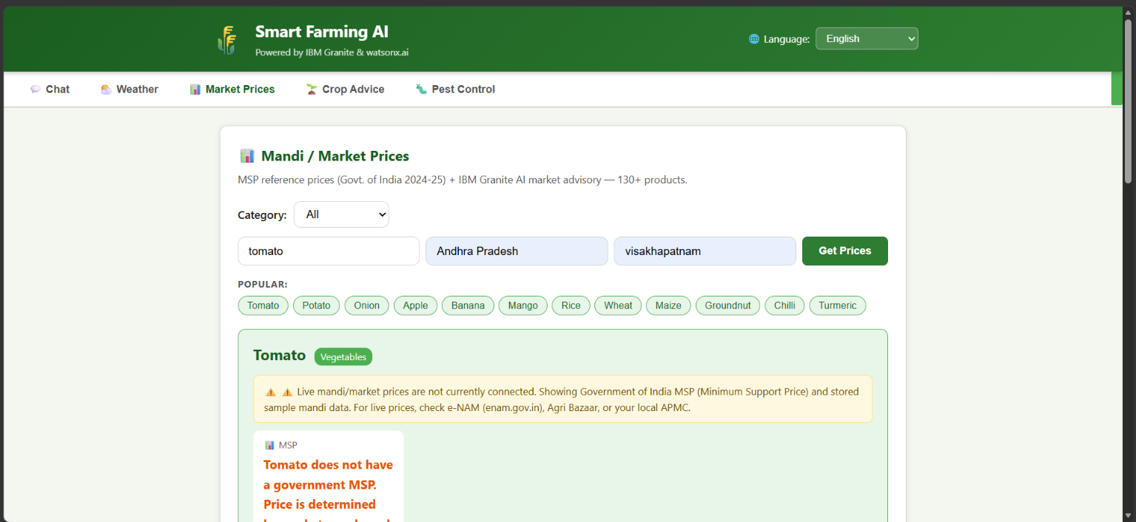
Mandi / Market Prices
Market module displays available mandi/MSP information and related market guidance for selected crops and locations.

Slide 18
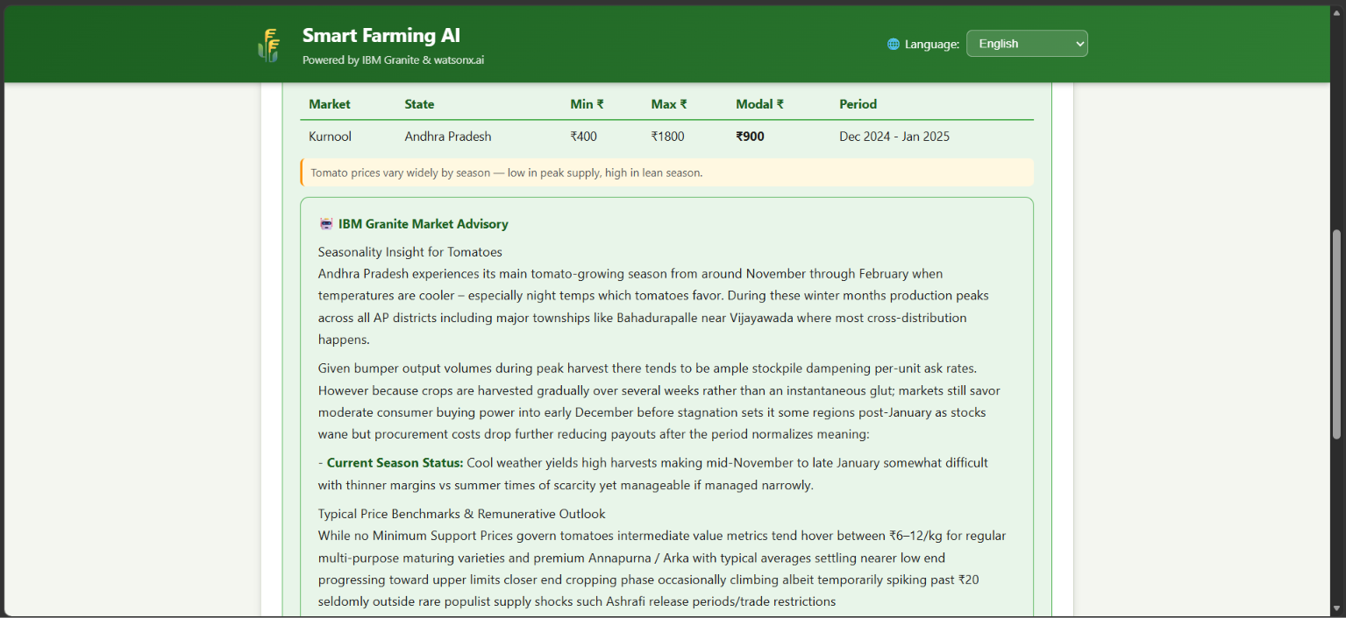

Slide 19
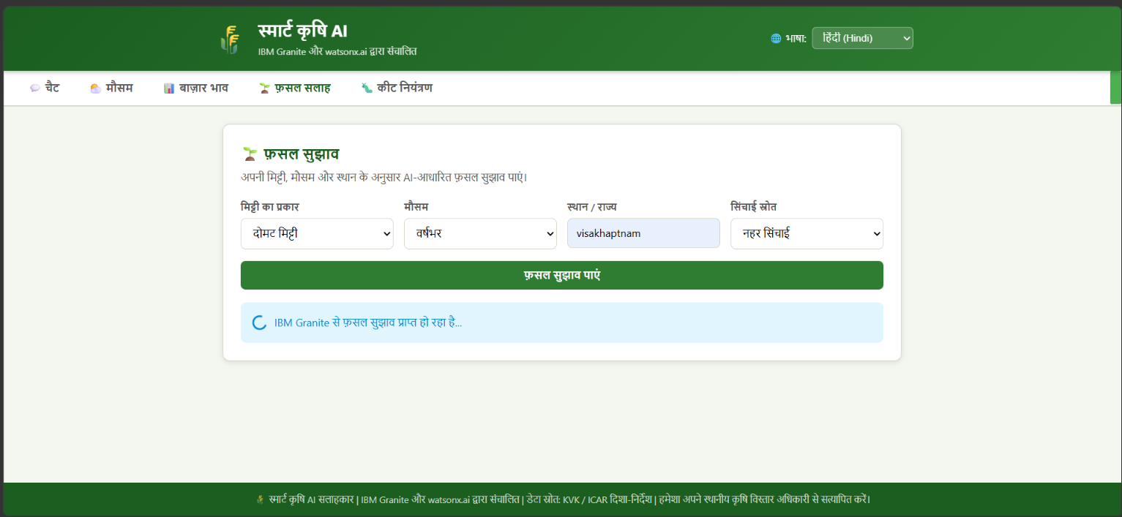
Crop Advice – Hindi
Farmers can select soil type, season, location, and irrigation conditions to request crop recommendations in Hindi.

Slide 20
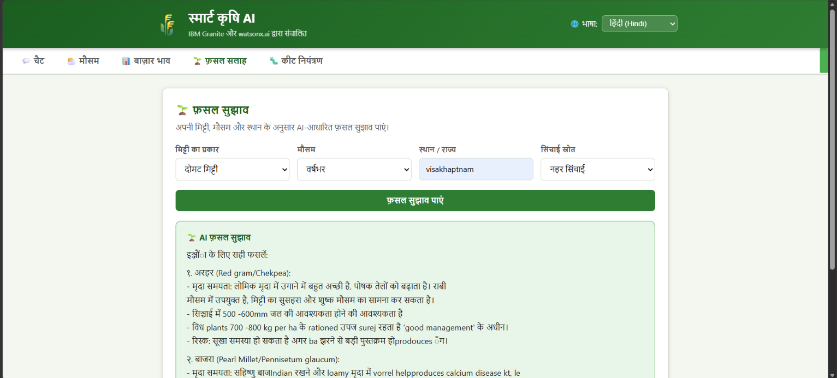
Crop Recommendation Result – Hindi
The system presents AI-generated crop recommendations with supporting reasons and practical farming guidance in Hindi.

Slide 21
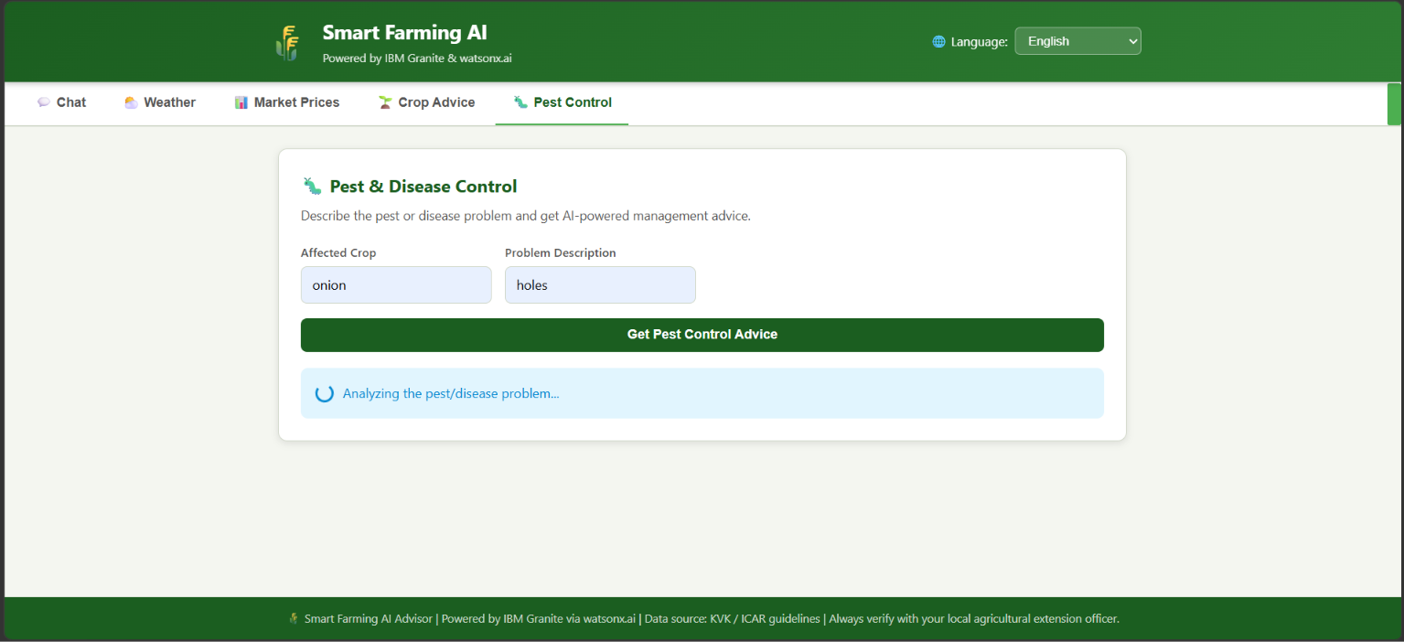
Pest & Disease Control
Farmers can enter the affected crop and describe the pest or disease problem to request AI-powered control advice.

Slide 22
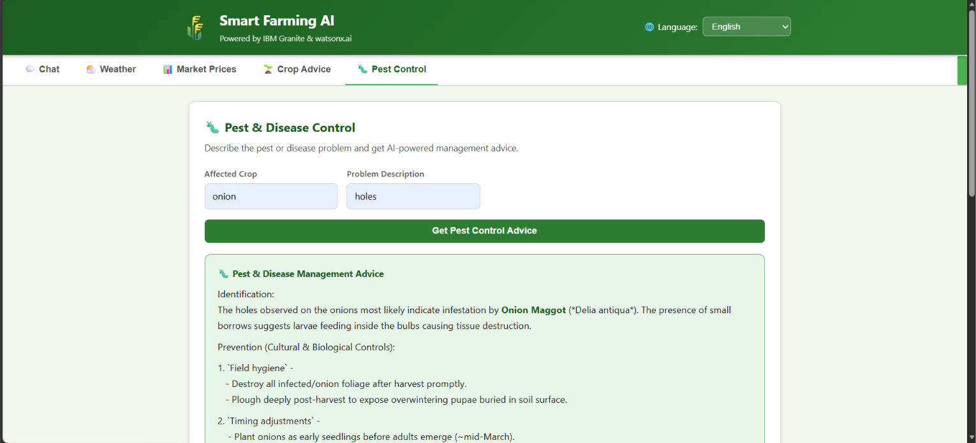
Pest & Disease Management Result
The system returns identification, prevention, and management guidance for the reported pest or crop-disease problem.

Slide 23
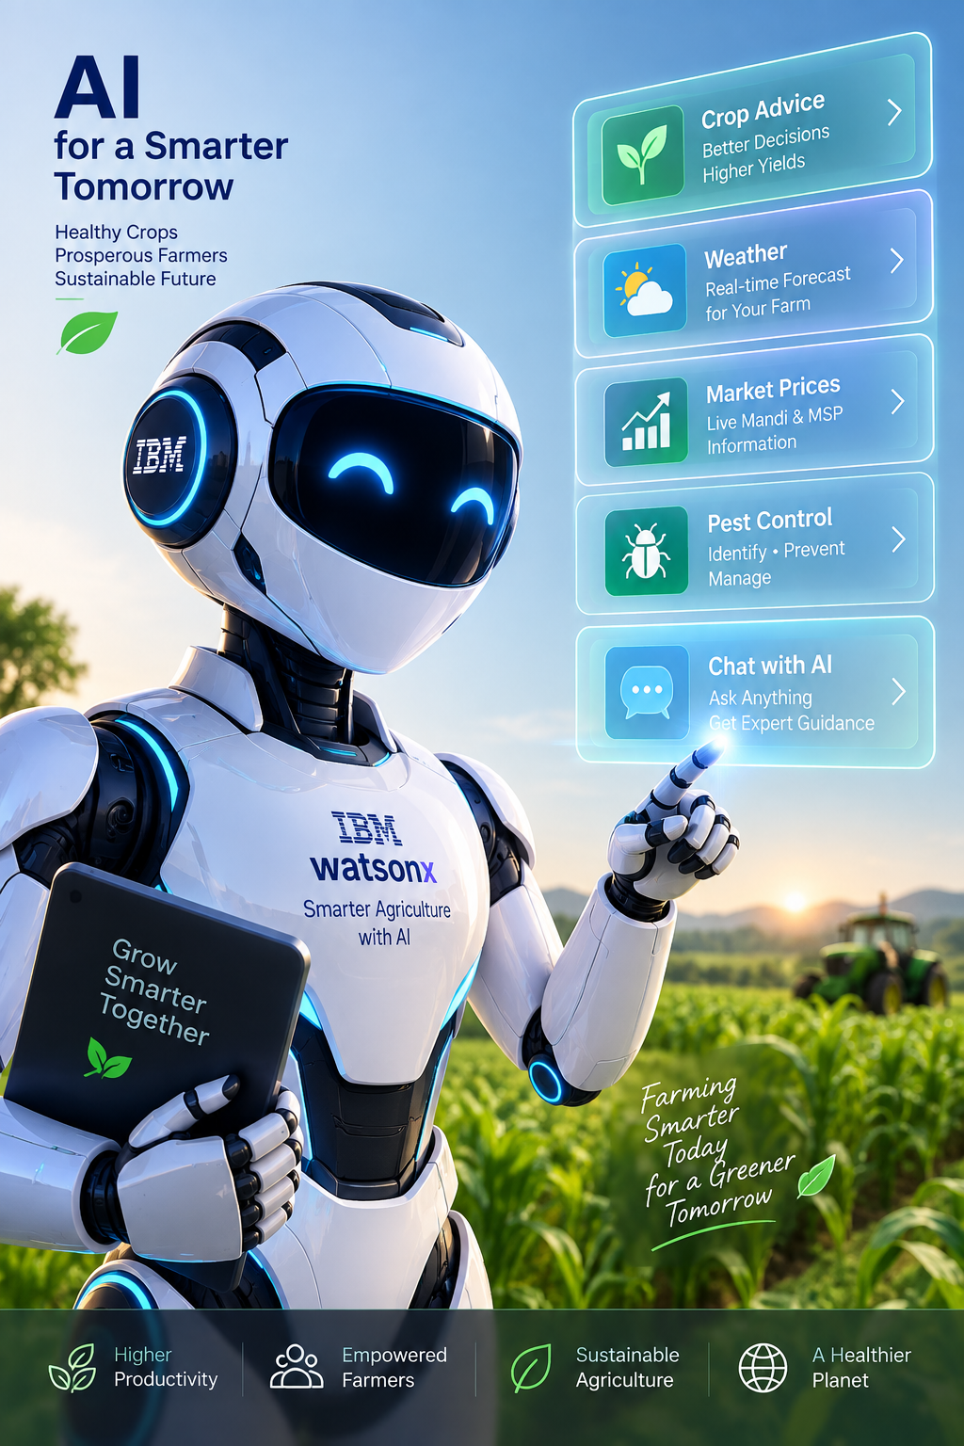
Role of Agentic AI in the solution
Role of Agentic AI in Smart Farming Agent
Agentic AI enables the Smart Farming Agent to work as an intelligent, task-oriented system rather than a simple chatbot. Using IBM watsonx.ai and IBM Granite, it can coordinate different tasks to provide relevant and personalized farming guidance.
The system uses specialized functions for understanding farmer queries, retrieving agricultural information, generating recommendations, and presenting useful responses. This modular approach helps the system handle farming-related tasks efficiently and provide more accurate, context-aware guidance.
Agentic AI provides context awareness by considering inputs such as crop, location, soil conditions, season, weather, and the farmer’s question. It uses the retrieved information from the RAG pipeline to generate suitable recommendations through IBM Granite.
The system also supports adaptive interaction, allowing farmers to ask follow-up questions and receive updated guidance based on their inputs. Different components work together to improve decision-making and provide practical agricultural advice.
Overall, Agentic AI makes the solution a smart, proactive, and farmer-focused digital assistant that helps users with crop recommendations, pest and disease management, weather-related guidance, market information, and other farming decisions.

Slide 24
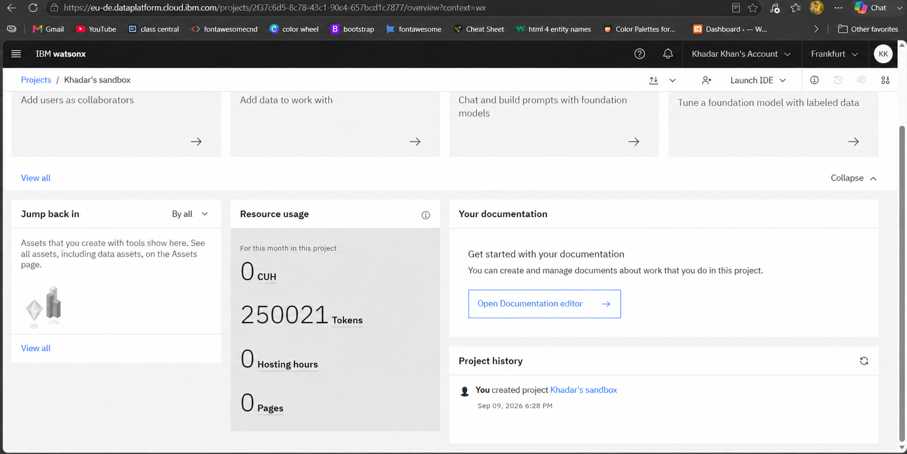
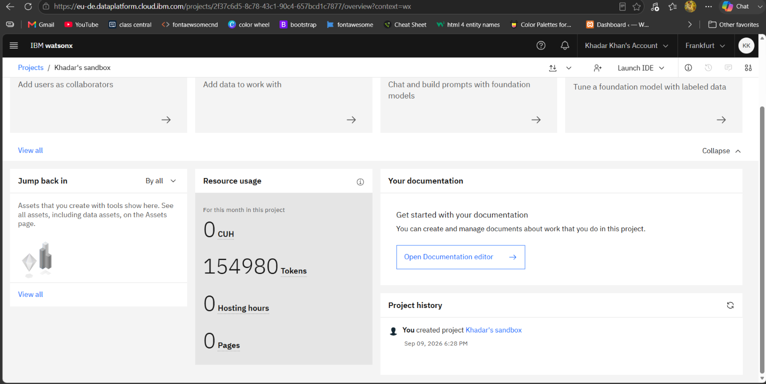
Token Usage
95,041 token are used
Before Prompt
After the Prompt
·
·
·

Slide 25
Novelty and Uniqueness
The proposed Smart Farming Agent stands out by combining Agentic AI, RAG, and personalization into a single intelligent farming system.
1. Multi-Agent Intelligence – Different specialized components work together to understand farmer queries, retrieve agricultural information, and generate suitable farming recommendations.
2. RAG-Based Accuracy – The system retrieves relevant information from the agricultural knowledge base before generating an answer, helping provide more relevant and reliable guidance.
3. Personalized Farming Advice – Recommendations can be tailored according to crop type, location, season, soil conditions, weather, and farmer requirements.
4. Real-Time Decision Support – Weather and market information can be used along with agricultural knowledge to support timely farming decisions.
5. Multilingual Support – Farmers can interact with the system in English, Hindi, and Telugu, improving accessibility for local users.
6. Complete Farming Assistance – The solution covers multiple needs in one platform, including crop recommendations, pest and disease management, weather guidance, and market information.
7. IBM Granite Integration – The system uses IBM watsonx.ai and IBM Granite for AI-powered response generation, providing an IBM-based foundation for the solution.
Overall, the solution is a smart, context-aware, and farmer-focused digital agricultural assistant, rather than a simple question-and-answer chatbot.

Slide 26
Git Hub Link
Public GitHub Repository
https://github.com/PKhadarkhan/AI-Agent-for-Smart-Farming-Advice.git
Repository contents should include:
• Application source code
• README.md
• Project presentation
• Problem statement PDF
• app.json / deployment configuration, if used
• Other required project files
Repository owner: PATAN KHADAR KHAN
Acite email: pkhadarkhan3@gmail.com
Acite student: STU68fa3fb46a7001761230772
·
·
·

Slide 27
Future Scope
1. Integration with IoT & Smart Farming Devices – The system can be integrated with soil-moisture sensors, weather stations, drones, and other IoT devices to collect real-time farm data. This can help provide more accurate recommendations based on soil moisture, temperature, humidity, and crop conditions.
2. AI-Powered Voice Assistant & Multilingual Support – Adding a voice-enabled assistant and expanding support for more regional languages can make the system easier to use for farmers. Farmers will be able to ask questions naturally and receive farming guidance in their preferred language.
3. Image-Based Crop & Pest Detection – Future versions can allow farmers to upload crop or leaf images so the system can identify possible diseases, pests, or crop problems and provide suitable management suggestions.
·
·
·

Slide 28
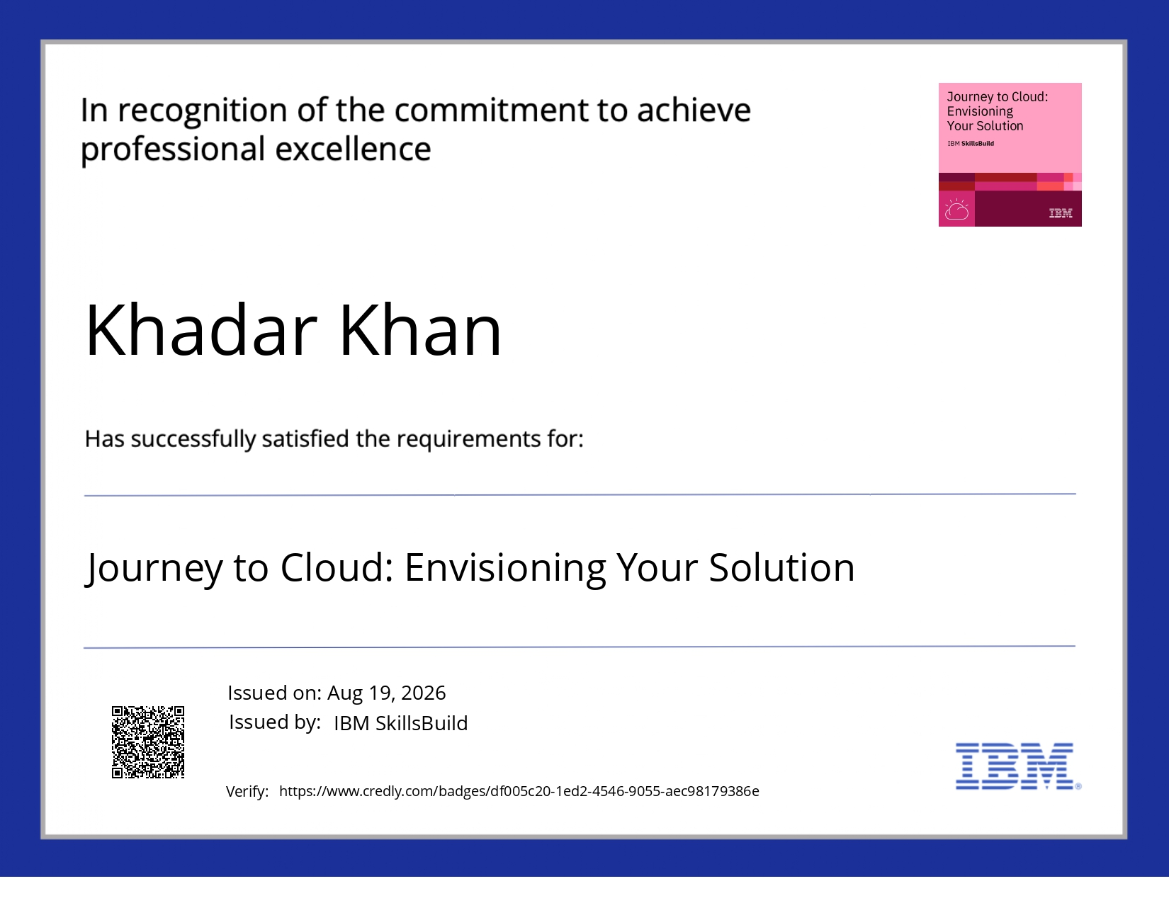
Certificates Earned: Credly / IBM SkillsBuild
IBM SkillsBuild certificates

Slide 29

IBM SkillsBuild certificates

Slide 30
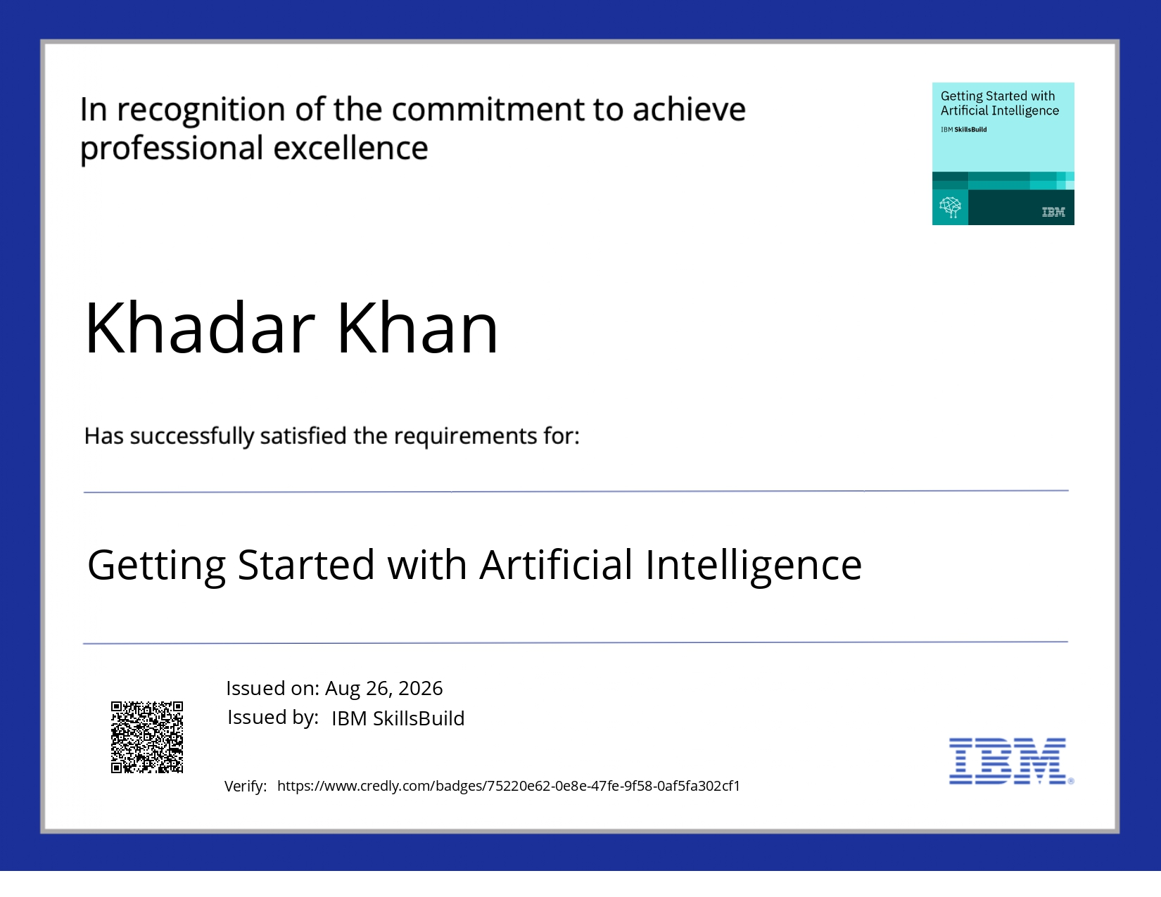
IBM SkillsBuild certificates

Slide 31
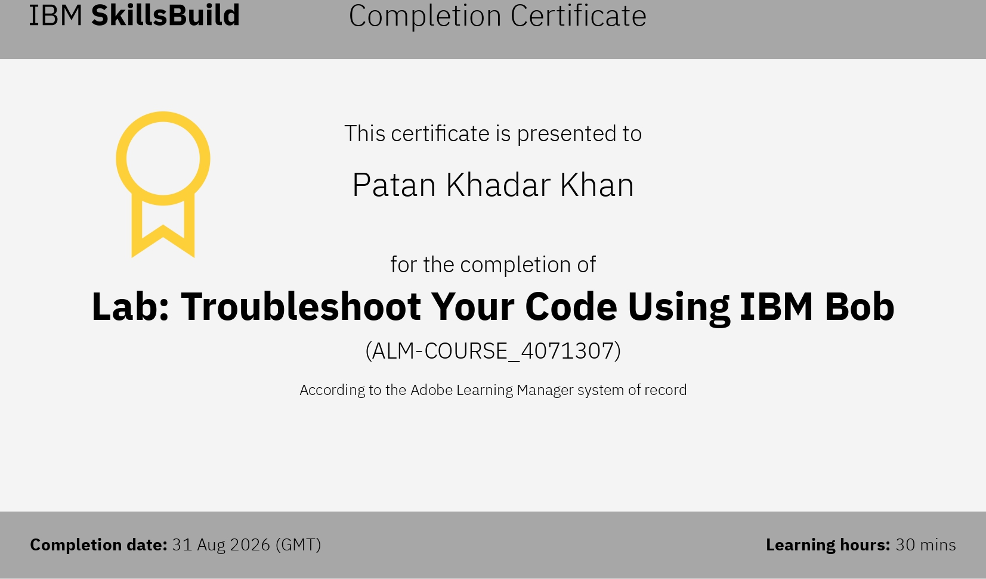
Certificates Earned: IBM BOB
Lab: Troubleshoot Your Code Using IBM Bob

Slide 32


