Slide 1

Project Title -
Seasonal Agriculture Performance Analysis
Name: PATAN KHADAR KHAN
College Name: Raghu Engineering College
AICTE STU ID : STU68fa3fb46a7001761230772

Slide 2

PROBLEM STATEMENT
Agricultural activities are influenced by seasonal variations in environmental conditions, farming practices, resource availability and market conditions. As a result, agricultural performance may differ from one season to another.
However, raw agricultural data does not clearly explain how agricultural performance changes across seasons or what patterns can be observed in different seasonal conditions. The project analyzes the given agricultural dataset to identify meaningful seasonal patterns, trends, relationships and variations.

Slide 3
Project Description
Seasonal Agriculture Performance Analysis studies farm-level agricultural records across Kharif, Rabi and Zaid seasons. The analysis examines environmental conditions, farming practices, resource usage, production, profitability and irrigation.
The notebook performs data exploration and cleaning, descriptive statistics, univariate, bivariate and multivariate analysis, outlier review, seasonal comparisons, group comparisons and a Kruskal-Wallis test. The purpose is to understand how agricultural performance changes across seasons and to communicate evidence-based findings.

Slide 4

WHO ARE THE END USERS?
Farmers and farm managers – for comparing seasonal performance.
Agricultural analysts and planners – for identifying seasonal patterns and differences.
Irrigation and resource managers – for reviewing water use and efficiency.
Agricultural researchers and students – for evidence-based seasonal analysis.
Decision-makers – for using data-driven seasonal insights in planning.

Slide 5

Technology Used
Python
Pandas and NumPy
Matplotlib and Seaborn
SciPy (Kruskal-Wallis test)
Google Colab / Jupyter Notebook

Slide 6
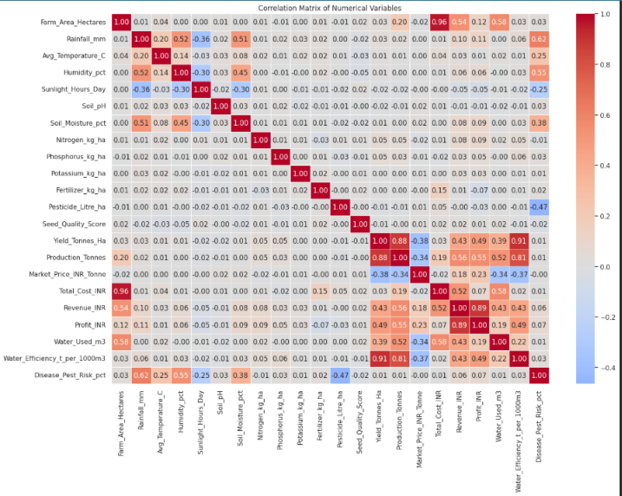
RESULTS

Slide 7
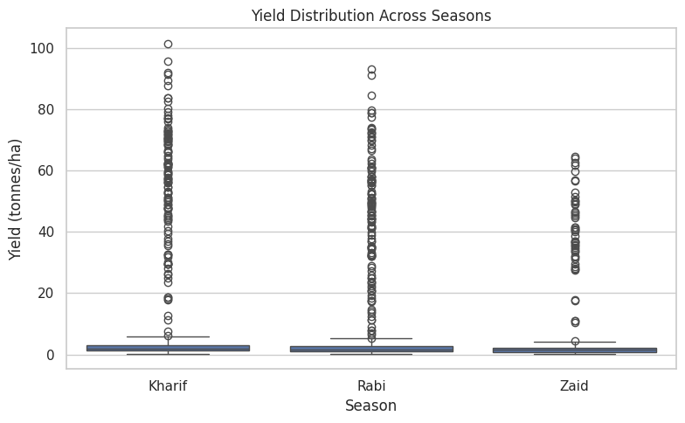
RESULTS
Yield is highest on average in Kharif, followed by Rabi and Zaid.

Slide 8
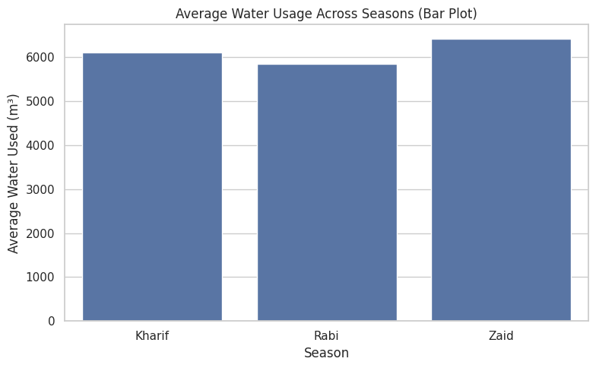
RESULTS
Rabi uses the least water on average, while Zaid has the highest average water use.

Slide 9
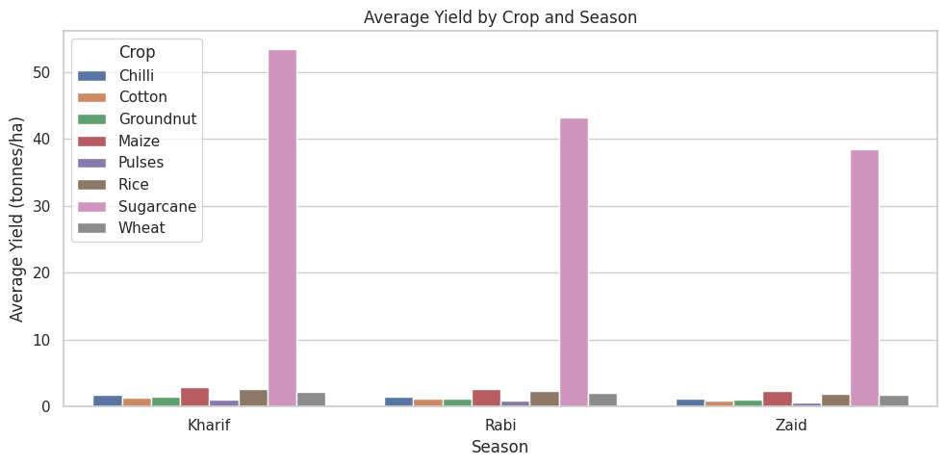
RESULTS
Sugarcane is the highest-yielding crop in all three seasons in the executed analysis.

Slide 10
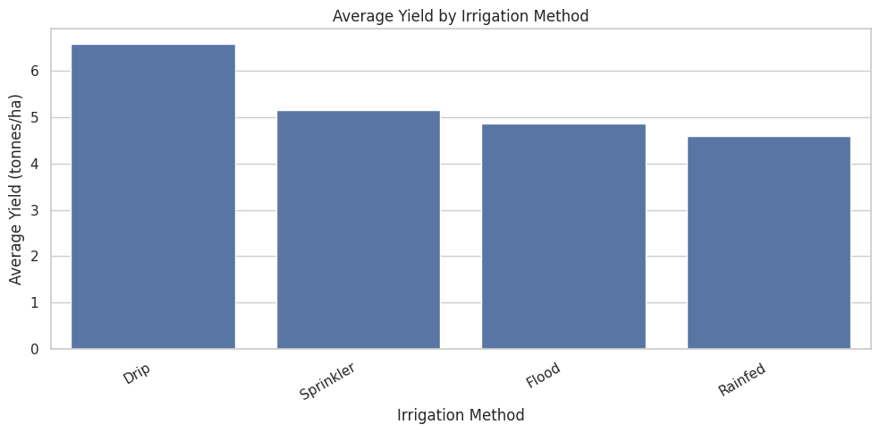
RESULTS
Rainfed has the highest average water efficiency, while Drip has the highest average yield among irrigation methods.

Slide 11
Future scope
Include additional years and wider regional coverage for stronger seasonal comparisons.
Add weather and soil observations from external sources for deeper seasonal analysis.
Extend the analysis with forecasting or predictive models when suitable data is available.
Develop an interactive dashboard to present seasonal indicators and comparisons.
Automate seasonal reports for regular agricultural planning and resource monitoring.

Slide 12
GitHub Link
https://github.com/PKhadarkhan/Seasonal-Agriculture-Performance-Analysis.git

Slide 13
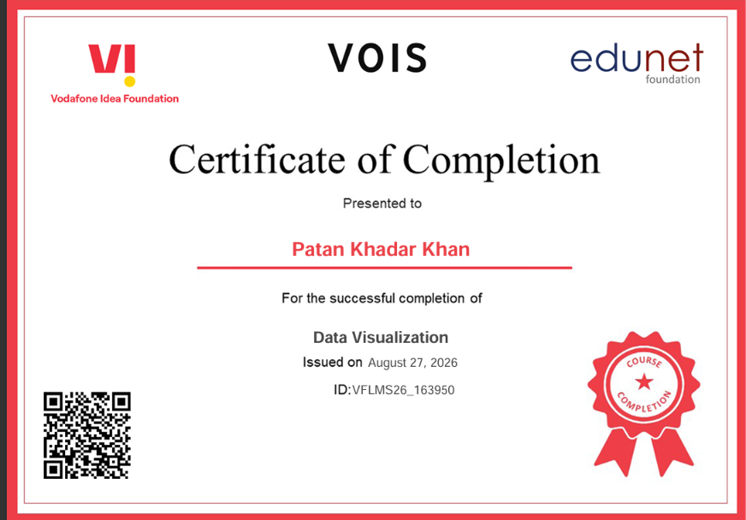
VOIS Course completion certificate - Course name- Data Visualization

Slide 14
Thank you
Seasonal Agriculture Performance Analysis
Understanding seasonal patterns, agricultural performance, resource usage and data-driven insights
Presented by: Patan Khadar Khan Raghu Engineering College
.
.

