Slide 1
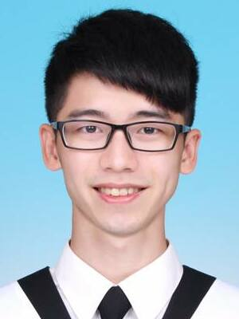
PoKai Huang
Fast Learner
Communicate
Enthusiastic
DETAILS
PROFILE
Phone
0932732142
Email
pokaihuang.tw@gmail.com
I am a lively and enthusiastic person. I am familiar with communicating with teams and find compromises that everyone can agree on.
I have learned System Verilog and UVM from online resources, and hope to be part of the DV team.
EMPLOYMENT HISTORY
LINKS
Firmware Engineer, Silicon Motion
Jan 2021 – Present
Develop TCG Security features
Design verification flow and develop verification scripts
Secure Boot Authentication
Firmware Update Verification
Threat Analysis and Risk Assessment
Modularize features into Libraries
Develop automation scripts to improve efficiency
Personal Link
https://pkhuang-tw.github.io
Github
https://github.com/PKhuang-TW
SKILLS
EDUCATION
System Verilog
UVM
C
C++
Python
Master, Computer Science
National Chiao Tung University (Sep 2018 – Aug 2020)
Machine Learning
Deep Learning
Computer Vision
VR and AR
User Center Interaction Design
Bachelor, Communication Engineering
National Central University (Sep 2013 – Jun 2017)

