Slide 1
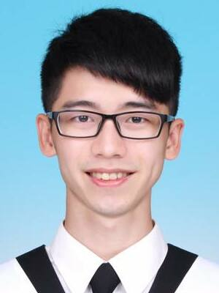
PoKai Huang
Fast Learner
Communicate
Enthusiastic
DETAILS
PROFILE
Phone
0932732142
Email
pokaihuang.tw@gmail.com
I am a lively and enthusiastic person. I am familiar with communicating with teams and find compromises that everyone can agree on.
I have been working as a firmware engineer since 2021. I am a fast learner with strong logical reasoning skills, which makes me identify issues more efficiently.
EMPLOYMENT HISTORY
LINKS
Firmware Engineer, Silicon Motion
Jan 2021 – Present
Develop & Verify TCG Security features
Secure Boot Authentication
Firmware Update Verification
Threat Analysis and Risk Assessment
Modularize features into Libraries
Develop automation scripts to improve efficiency
Personal Link
https://pkhuang-tw.github.io
Github
https://github.com/PKhuang-TW
SKILLS
EDUCATION
C
C++
Python
Master, Computer Science
National Chiao Tung University (Sep 2018 – Aug 2020)
Machine Learning
Deep Learning
Computer Vision
VR and AR
User Center Interaction Design
Bachelor, Communication Engineering
National Central University (Sep 2013 – Jun 2017)

