Slide 1
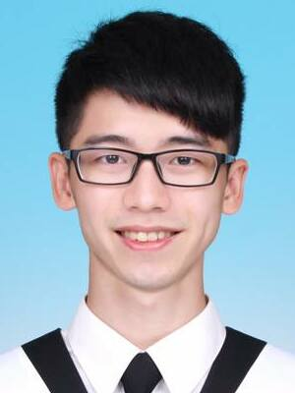




National Central University
Bachelor’s Degree ( 2013 – 2017 )
Department of Communication Engineering
PoKai Huang
National Chiao Tung University
pokaihuang.tw@gmail.com
Master’s Degree ( 2018 – 2020 )
Institute of Computer Science and Engineering
https://pkhuang-tw.github.io

Slide 2
Courses
Machine Learning
Deep Learning
Computer Vision
VR / AR
User Center Interaction Design
PoKai Huang
pokaihuang.tw@gmail.com
https://pkhuang-tw.github.io

Slide 3



C Programming
- Teacher Assistant ( 2018 )
Python
- Teacher Assistant ( 2018 )
- Tutor ( 2019 )
PoKai Huang
pokaihuang.tw@gmail.com
Senior High School Math
https://pkhuang-tw.github.io
- Tutor ( 2013 - 2020 )

Slide 4

PoKai Huang
Firmware Engineer
pokaihuang.tw@gmail.com
2021 - Present
https://pkhuang-tw.github.io

Slide 5

What I have done
Develop & Verify FW according to TCG specifications
Secure Boot Authentication
Firmware Update Verification
Modularize features into Libraries
Threat Analysis & Risk Assessment
Automation scripts
Firmware Engineer
2021 - Present

Slide 6
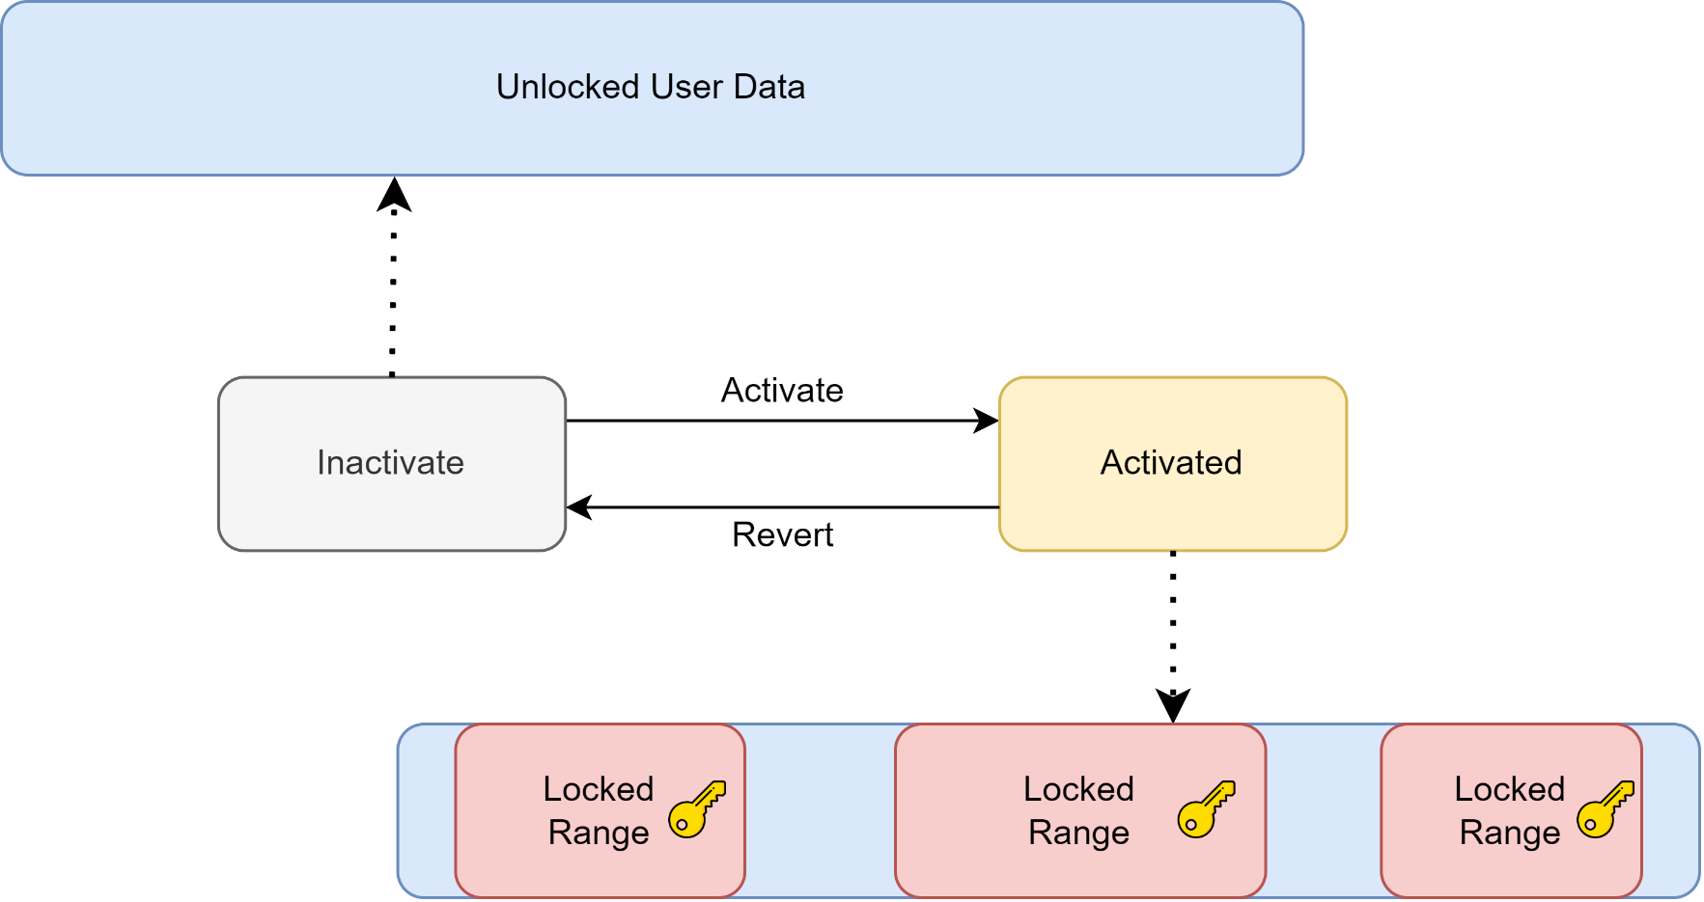
Develop FW according to TCG specifications
Firmware Engineer
2021 - Present

Slide 7
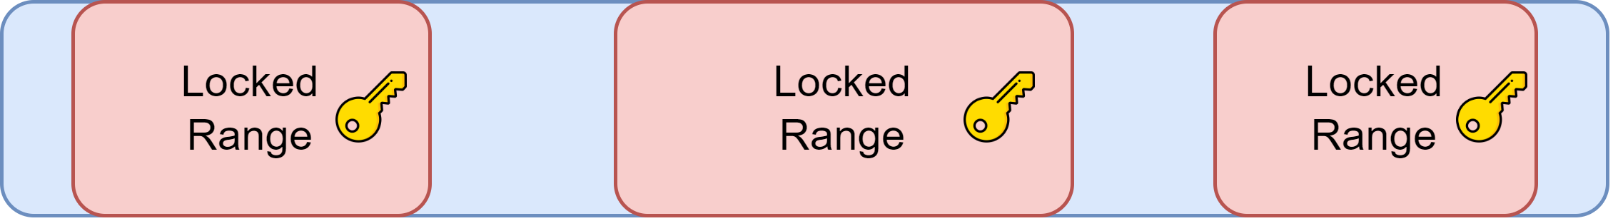
Develop FW according to TCG specifications
Firmware Engineer
2021 - Present
This range?
Which Authority owns this range?
How about this range?

Slide 8
Develop FW according to TCG specifications
Firmware Engineer
2021 - Present
Shared range? Single use range?
AES key protection
Key maintenance after Power Cycle / Power State Transition

Slide 9
Develop FW according to TCG specifications
SSCs
Opal
Pyrite
Opalite
Ruby
Features
BlockSID
PSID
CNL
Additional DataStore Tables
Single User Mode
Shadow MBR
Firmware Engineer
2021 - Present

Slide 10
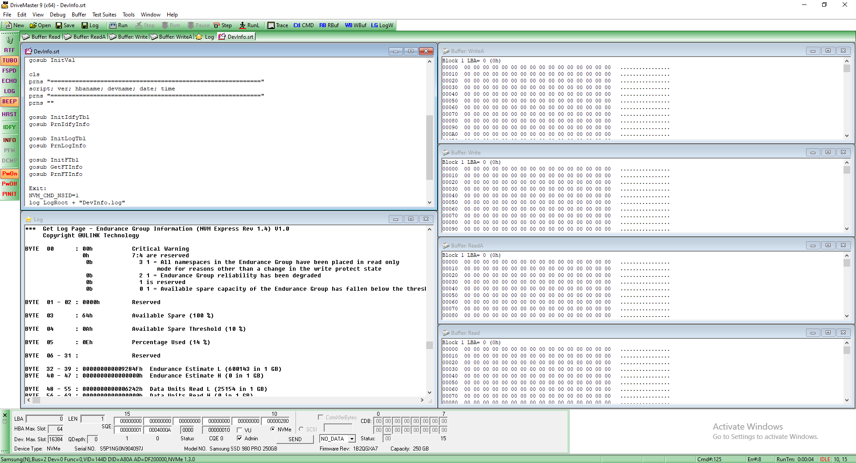
Verify FW by scripts
Firmware Engineer
2021 - Present

Slide 11
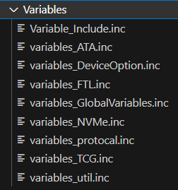
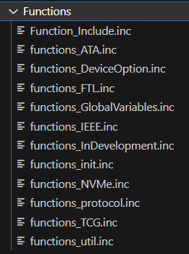
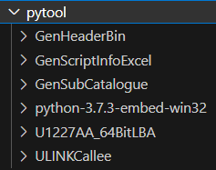
Verify FW by scripts
Firmware Engineer
2021 - Present
Automatic script by Python

Slide 12
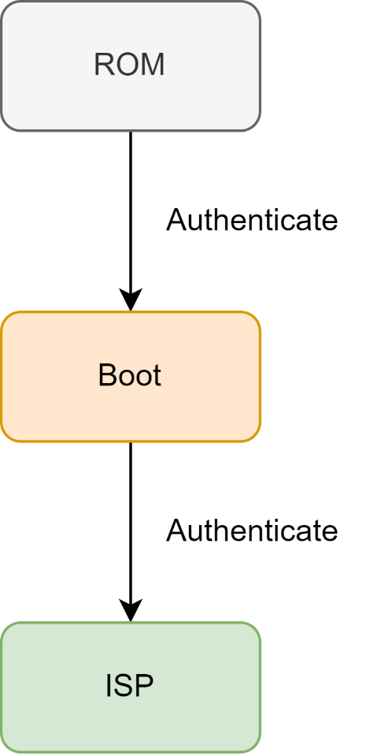
Secure Boot Authentication
Authenticate Methods
Root of Trust
Efuse
SHA / HMAC / RSA
Vendor Specific Commands
Firmware Engineer
2021 - Present

Slide 13
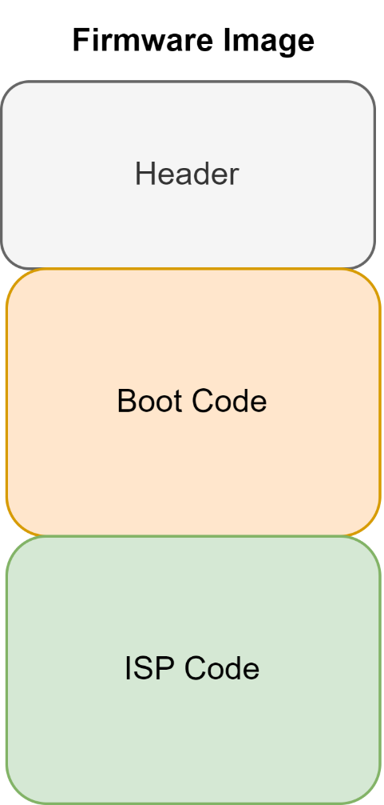
Firmware Update Verification
Verification Methods
SHA 256 / 384
HMAC
RSA 2048 / 3072
Firmware Engineer
2021 - Present

