Slide 1
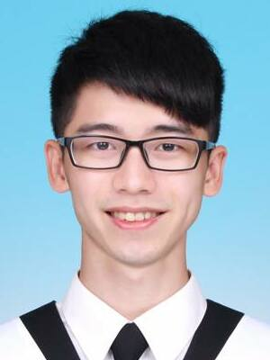
PoKai Huang
Fast Learner
Communicate
Enthusiastic
PROFILE
DETAILS
I am a lively and enthusiastic person. I am familiar with communicating with teams and find compromises that everyone can agree on.
I have been working as a firmware engineer since 2021. I am a fast learner with strong logical reasoning skills, which makes me identify issues more efficiently.
Phone
0932732142
Email
pokaihuang.tw@gmail.com
EMPLOYMENT HISTORY
LINKS
Firmware Engineer, Silicon Motion
Jan 2021 – Present
Develop TCG Security features
Design verification flow and develop verification scripts
Secure Boot Authentication
Firmware Update Verification
Threat Analysis and Risk Assessment
Modularize features into Libraries
Develop automation scripts to improve efficiency
Personal Link
https://pkhuang-tw.github.io
Github
https://github.com/PKhuang-TW
SKILLS
EDUCATION
System Verilog
UVM
C
C++
Python
Master, Computer Science
National Chiao Tung University (Sep 2018 – Aug 2020)
Machine Learning
Deep Learning
Computer Vision
VR and AR
User Center Interaction Design
Bachelor, Communication Engineering
National Central University (Sep 2013 – Jun 2017)

