Slide 1
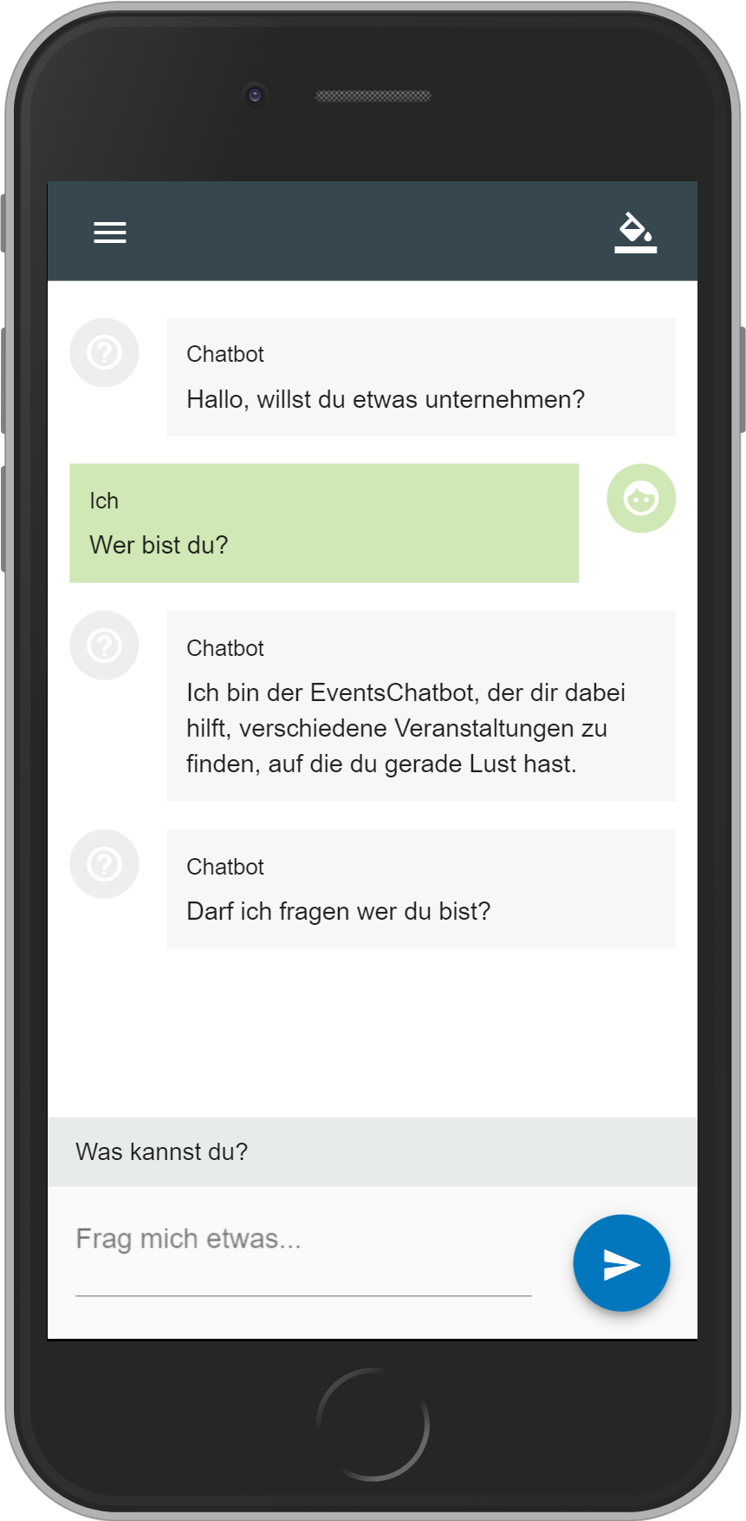
Change Theme
Menu
Initial Bot Message
Suggested answers
Send Button
User Input

Slide 2
