Slide 1

Technology Review Local Interpretable Model-agnostic Explanations (LIME)
Data 515, Spring 2019
M.S. Data Science
Suman Baghavathula
Patrick King
Javier Salido

Slide 2
Interpretability in Machine Learning
Some approaches to ML yield highly accurate models that are not “interpretable”
Random Forests
Support Vector Machines
Neural Networks
Why this is a problem
Model may be biased, and bias may not be obvious
Model may yield great results in the lab, terrible results in the field
The law may require an explanation of why outputs are what they are
LIME provides model-agnostic local explanations
Explain one instance, as opposed to the entire model
Fitting a simple model that explains output in a small section of decision space

Slide 3
Three Parts to Our Project
Need a complex (non-interpretable) ML model
Neural Networks
Random Forests
Decision trees?
Need a group of functions that implement LIME
Build vs. download discretizing + sampling functions
Build vs. download weight + LASSO regression functions
Need to present results
How do we know explanations are related to what is going on in the complex model?

Slide 4
Machine Learning Models: Output
from sklearn import svm
from sklearn.naive_bayes import GaussianNB
from sklearn import datasets
# Naïve Bayes
iris = datasets.load_iris()
gnb = GaussianNB()
clf = gnb.fit(iris.data, iris.target)
out = clf.predict(iris.data)
print(out)
# SVM
clf = svm.SVC(kernel='rbf', gamma=0.7, C=1.0)
clf = clf.fit(iris.data[:, :2], iris.target)
out = clf.predict(iris.data[:, :2])
print(out)

Slide 5
Machine Learning Models: Output is not Interpretable
array([0, 0, 0, 0, 0, 0, 0, 0, 0, 0, 0, 0, 0, 0, 0, 0, 0, 0, 0, 0, 0, 0, 0, 0, 0, 0, 0, 0, 0, 0, 0, 0, 0, 0, 0, 0, 0, 0, 0, 0, 0, 0, 0, 0, 0, 0, 0, 0, 0, 0, 1, 1, 2, 1, 1, 1, 1, 1, 1, 1, 1, 1, 1, 1, 1, 1, 1, 1, 1, 1, 2, 1, 1, 1, 1, 1, 1, 2, 1, 1, 1, 1, 1, 1, 1, 1, 1, 1, 1, 1, 1, 1, 1, 1, 1, 1, 1, 1, 1, 1, 2, 2, 2, 2, 2, 2, 1, 2, 2, 2, 2, 2, 2, 2, 2, 2, 2, 2, 2, 1, 2, 2, 2, 2, 2, 2, 2, 2, 2, 2, 2, 2, 2, 1, 2, 2, 2, 2, 2, 2, 2, 2, 2, 2, 2, 2, 2, 2, 2, 2])

Slide 6
Imperfect Solution: tree + graphviz
import graphviz
from sklearn import tree
from sklearn import datasets
# Tree
clf = tree.DecisionTreeClassifier()
clf = clf.fit(iris.data, iris.target)
out = clf.predict(iris.data)
# Graphviz for presentation
dot_data = tree.export_graphviz(clf, out_file=None,
feature_names=iris.feature_names,
class_names=iris.target_names,
filled=True, rounded=True,
special_characters=True)
graph = graphviz.Source(dot_data)
graph

Slide 7
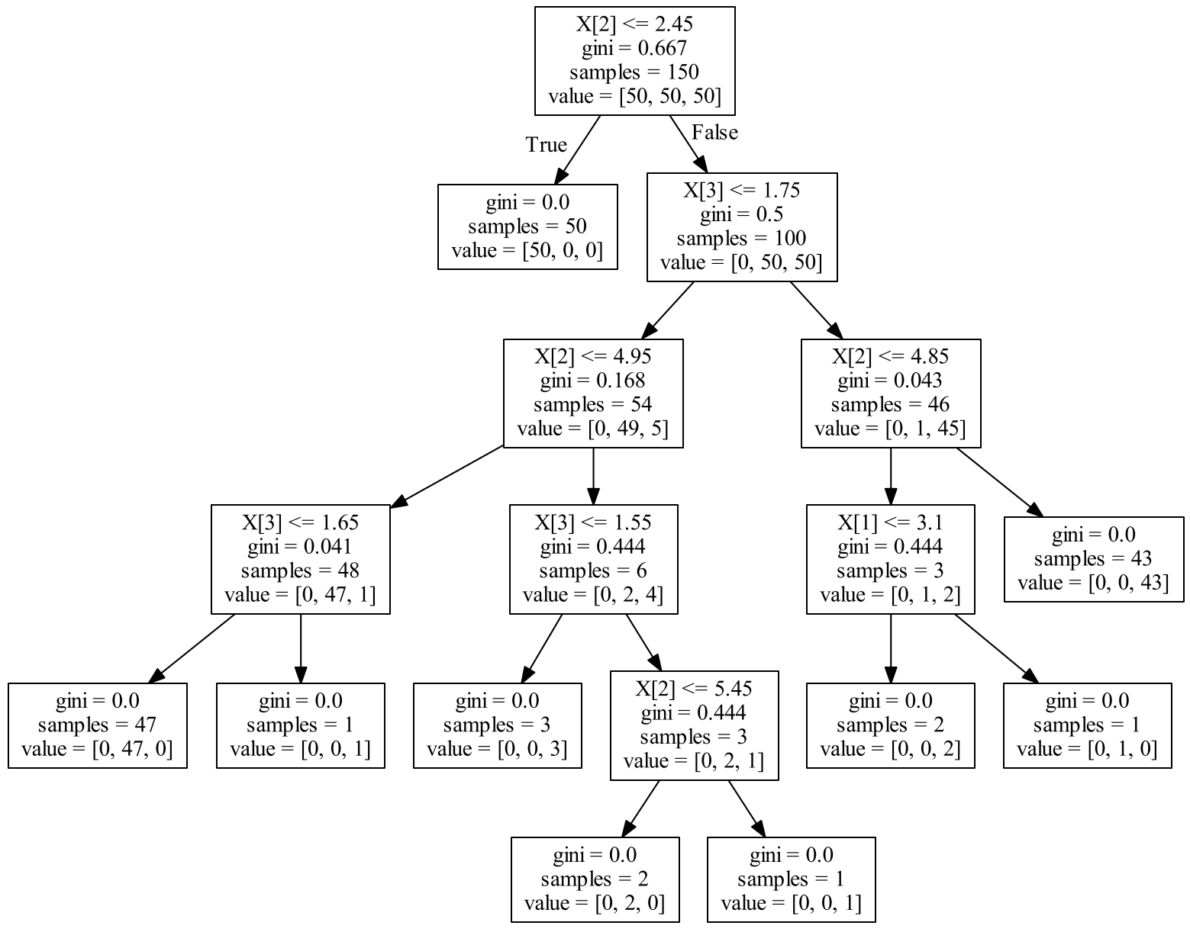
Imperfect Solution:
Compare Tree to LIME Output

Slide 8
Comparison
Complex models
Are not interpretable
Outputs:
Classification
Abstract model description
Decision tree + graphviz
Interpretable (in its own way)
Output:
Classification
Human-interpretable model description
Conclusion
Use complex models for solutions
Use decision tree + graphviz and see how comparable they are

Slide 9
Questions?

