Slide 1

LIMEaid Local Interpretable Model-agnostic Explanations (LIME)
Data 515, Spring 2019
M.S. Data Science
Suman Bhagavathula
Patrick King
Javier Salido

Slide 2
Interpretability in Machine Learning
Some highly accurate models are not “explainable”
Neural networks, random forests
Why is this a problem?
Bias, not obvious
High test set accuracy but poor results in the field
Policy or law demands an explanation of any decision
Solution: model-agnostic local explanations
Explain one instance, not entire model
Fit a simple model to explain a small section of decision space

Slide 3
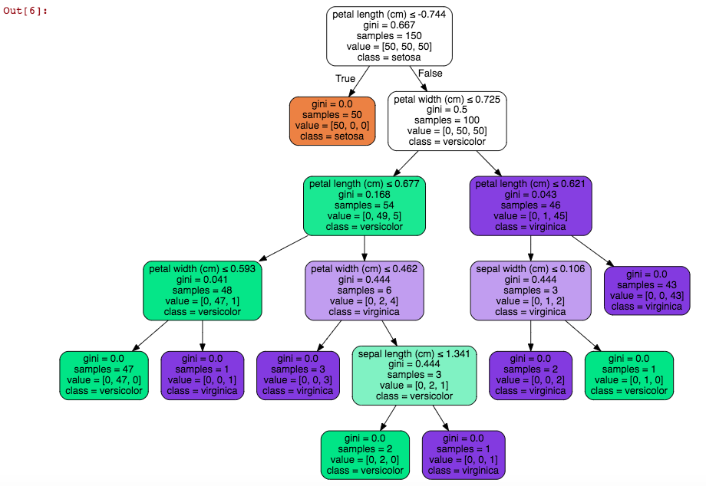
LIMEaid: A LIME solution for tabular data
LIMEaid explanations
Input
A “complex” ML model, fit by sklearn classifier object with .predict
An instance of data (x) and its model output (f(x))
Probability domain for normalized predictor variables (histograms)
Output
Sparse linear models (few features), plottable List significant features
Analysis/verification
Decision-tree comparison

Slide 4
Use Cases
User profile: data scientist with Python programming experience
Model verification scenario - User wants to preempt poor model performance “in the field” - Use LIMEaid to sample test dataset - Show most significant features for decision - Tune or replace model if spurious correlation or other issues
Decision explanation scenario - Classification has already been made by a model - Use LIMEaid to sample whole dataset - Produce easy-to-share “two-dimensional” plot of a linear correlation

Slide 5
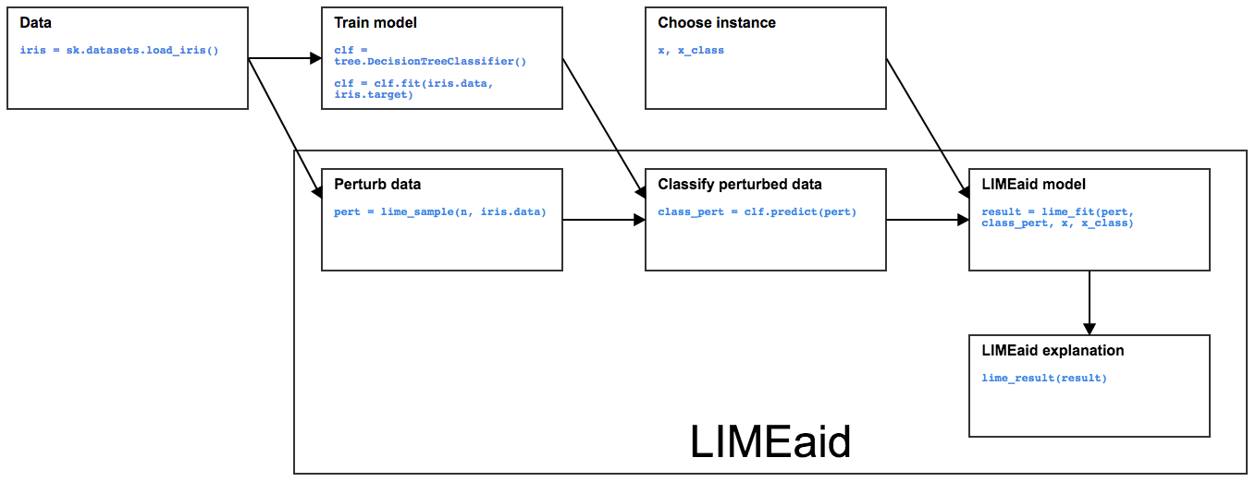
Design

Slide 6
Data
Sources
College Scorecard (data.gov): Annual report of schools and attributes (SAT scores, majors offered, region, cost, public/private/for profit, etc.)
“Where it Pays to Attend College” (Kaggle.com) obtained from (Wall Street Journal), based on Payscale, Inc. (College Salary Report Methodology): Article reporting schools and salaries of graduates, salaries by major, etc.
Merge
Significant cleaning, reformatting to match sets on college name
String manipulation, removal of hyphens, abbreviations, region names, etc.
More
Also tested with Sklearn’s provided “Iris” data, to show comparison to Ribeiro’s original LIME package (“LIME classic”)

Slide 7
Models
Scikit-learn classifiers that predict probabilities (predict_proba implemented)
Multiclass logistic regression (sklearn.linear_model.LogisticRegression)
85% accuracy on College data
Random Forest (sklearn.ensemble.randomforestclassifier)
65% accuracy on College data
Decision tree (sklearn.tree) 65% accuracy on College data
Models not tuned for improved accuracy (default settings)

Slide 8
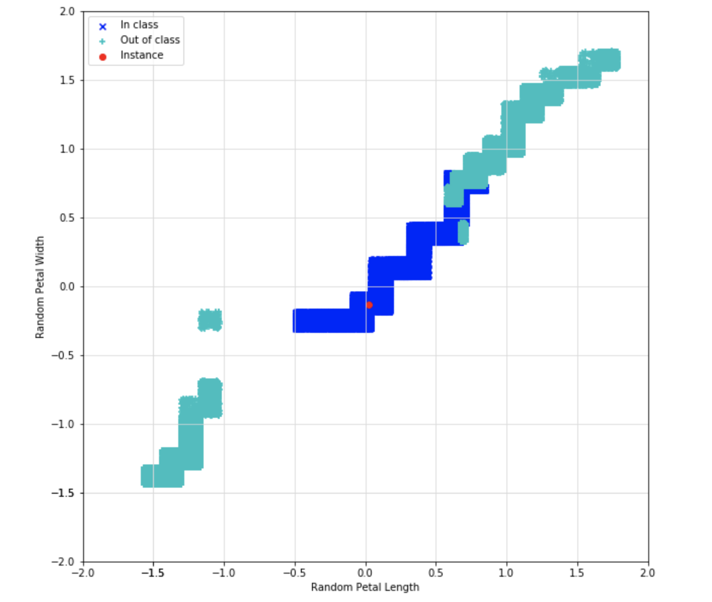
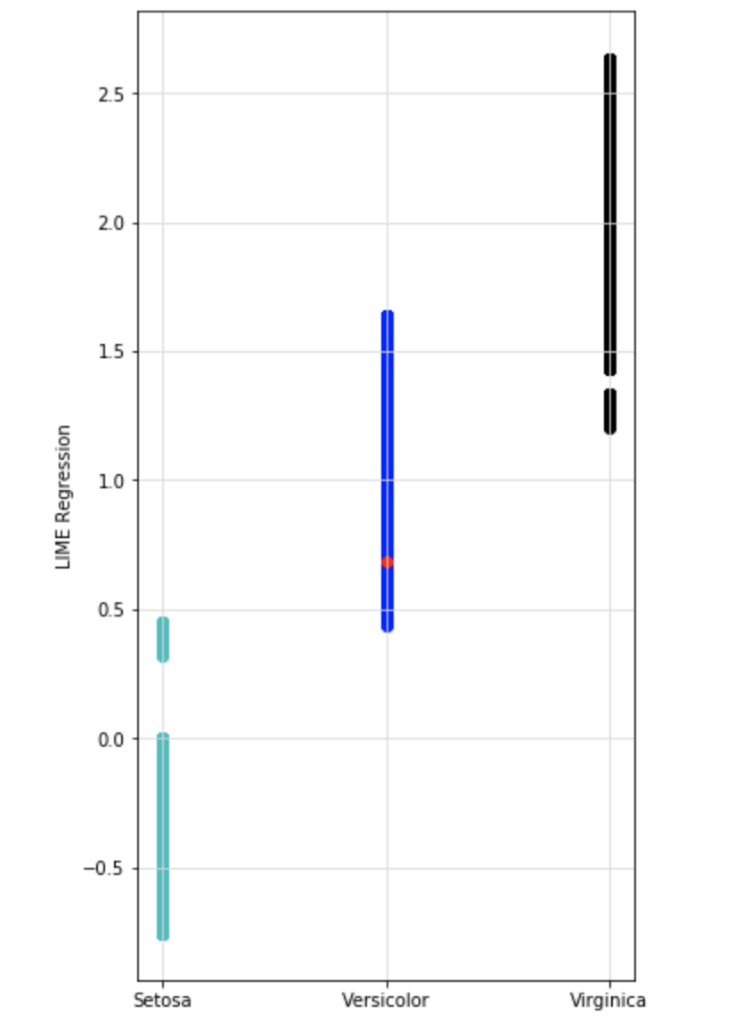
Demo
Iris notebook (LIME_Iris_ex_notebook.ipynb)

Slide 9
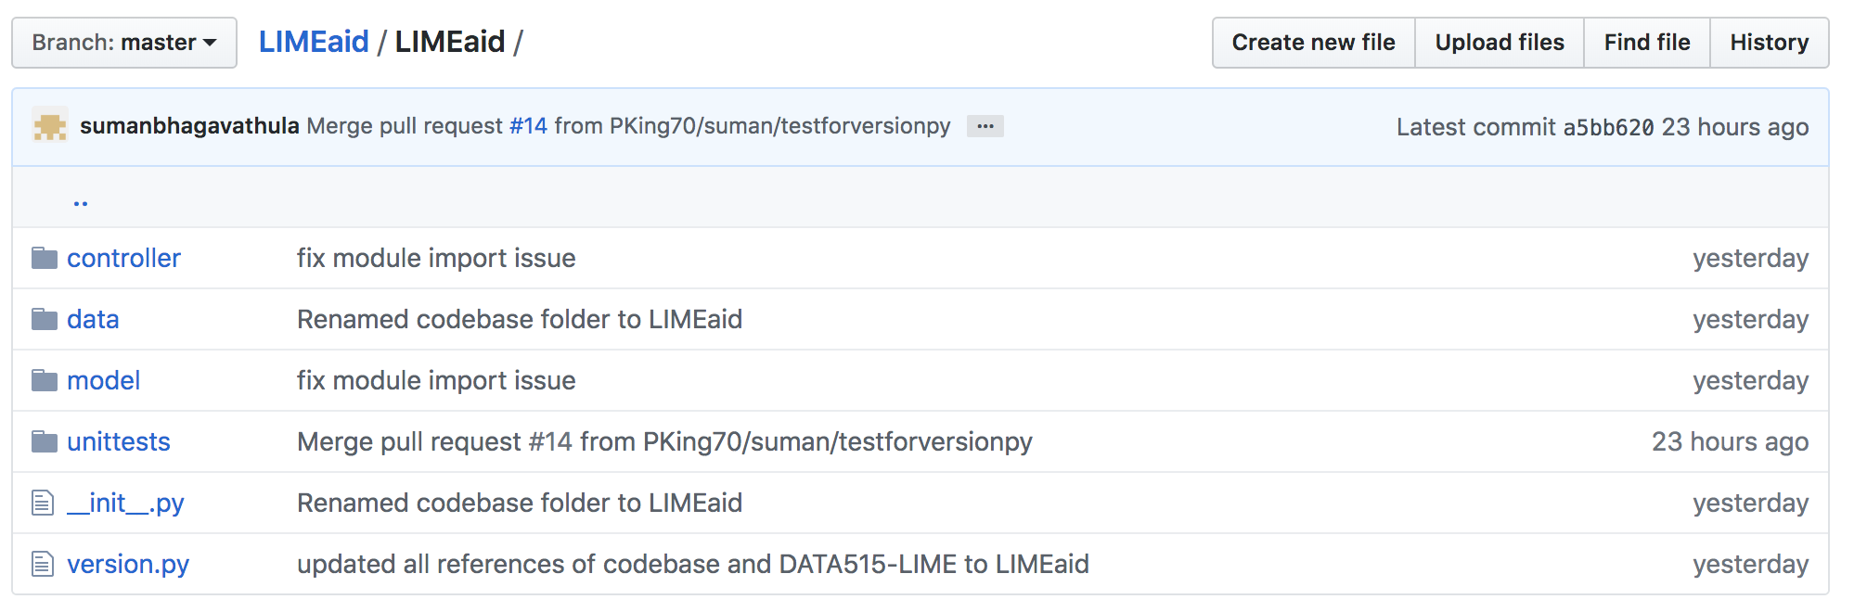
Project Structure
LIMEaid Github Repo based on Shablona
Used “M-V-C” architecture to codebase (Model-View-Controller)

Slide 10
Future Work
API support for data acquisition to support dynamic features:
College Scorecard (data.gov) currently published with new features and data dictionary yearly
Model tuning for examples:
Currently using defaults, could improve accuracy > 65%
Better way to generate random samples
Modify penalty for number of coefficients
More data type and model support: image data, NLP support, support for model objects beyond sklearn classifiers

Slide 11
Questions?

