Slide 1
Cox Proportional Hazards Model Evaluation in One Shot
Polina Kukhareva
Collaborative Studies Coordinating Center, UNC, Chapel Hill, NC, USA
Paper 428-2013

Slide 2
Outline
Survival analysis and survival data
Cox proportional hazards model
Diagnostics of the PH model assumptions
Motivation to write a macro
Advantages of the macro

Slide 3

What is survival analysis and survival data?
Studying the occurrence and timing of events
Example: occurrence and timing of the cardiovascular event such as heart failure
Copyright © 2011 Plenty Of Health.com
Notes:
Not simply binomial data. Survival models relate the time that passes before some event occurs to one or more covariates that may be associated with that quantity of time.
Originally survival analysis was developed to study deaths which explains the name. We are going to talk about a hypothetical study of cardiovascular events. What factors could influence development of cardiovascular event? Tobacco Smoking, Lack of Physical Exercise, Obesity, blood pressure and many others. Survival data a tricky because we are not only interested in the occurrence of event, we are also interested in timing. Will it occur tomorrow or in 10 years?

Slide 4
Cox proportional hazards model
In a proportional hazards model, the unique effect of a unit increase in a covariate is multiplicative with respect to the hazard rate.
Model assumptions:
The relationship between the continuous predictor (ex. AGE) variables and the log hazard should be linear.
The effects of the predictor variables are the same at all values of time. In other words, the hazard ratio is constant over time.
Notes:
The are many ways to analyze survival data but the most popular one is Cox proportional hazard models.
For example, taking a drug may halve one's hazard rate for a heart failure occurring.
Many statisticians underestimate importance of assumptions diagnostics.

Slide 5
Assumption diagnostics
Continuous predictor:
A plot of martingale residuals plotted against the variable being checked
A plot of parameter estimates for dummy variables fitted instead of that continuous variable
Log-negative-log survival curves using the same dummy variables to check proportional hazard assumption
The Schoenfeld residual plot to check proportional hazard assumption
Tables to check for confounding and interaction with other variables
Notes:
I’m not going to go through all the diagnostics in details because we don’t have enough time for that.
A plot of martingale residuals plotted against the variable being checked from a model that excludes that variable to check the assumption of linearity in the log hazard
A plot of parameter estimates for dummy variables designating specific intervals of the continuous variable and fitted instead of that continuous variable to check the assumption of linearity in the log hazard
Log-negative-log survival curves using the same dummy variables to check proportional hazard assumption
The Schoenfeld residual plot to check proportional hazard assumption
Tables to check for confounding and interaction with other variables

Slide 6
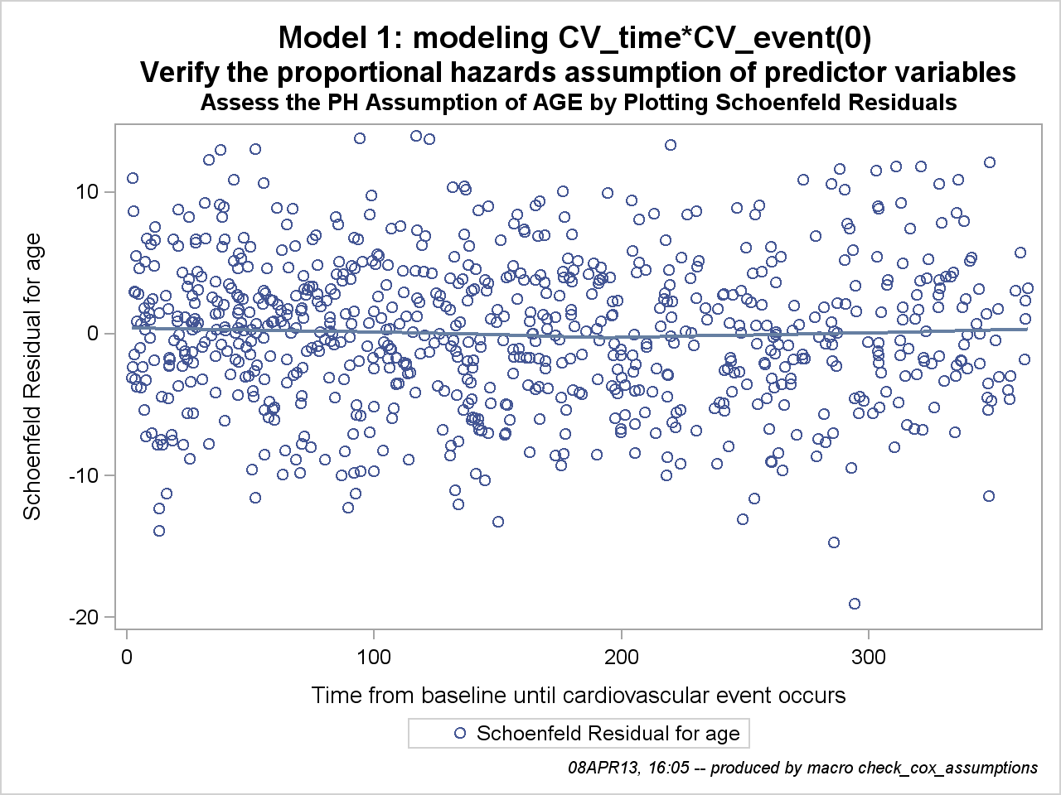
Assumption diagnostics
Categorical predictor:
Log-negative-log survival curves and Schoenfeld residuals plot to check proportional hazard assumption
Tables to check for confounding and interaction with other variables
Notes:
As you could have noticed it’s a long list of diagnostics and it gets worth when you need to right new code every time you specify a new model.

Slide 7
Motivation to write a macro
Producing the correct diagnostics:
Time-consuming
Repetitive
Easy to make a mistake
Hard to make changes
Notes:
I work on a large clinical trial where data are collected on many predictors. For some publications we run a hundred models. It used to take several days to write a code for diagnostics for one model. I’ve come up with idea to consolidate the repetitive task and now writing the code to produce diagnostics takes minutes.

Slide 8
Goals
Describe a macro which:
Verifies the assumptions of the Cox proportional hazards model.
Assesses the model for interactions and confounding between the predictor variables.
Notes:
I’m leaving USA to return to Russia soon, but even after I’m gone my colleagues will be able to use this macro.

Slide 9
Simulated Cardiovascular Outcome Dataset
Variable names:
Response
Occurrence
CV_event
CV_time
Timing
Predictors
Categorical
diabetes
smoking
sex
treatment group
activity (‘low’, ‘high’, ‘average’)
Continuous
age
systolic_bp
diastolic_bp
ldl
bmi
%let predictors=
age systolic_bp diastolic_bp ldl bmi diabetes smoking sex treatment activity;
Notes:
To begin with I created a simulated data set which I could share with everybody.

Slide 10
PROC PHREG
Syntax
PROC PHREG <options> ;
CLASS variables;
MODEL response <*censor(list)> = variables;
RUN;
Example
PROC PHREG data=simcox;
CLASS activity;
MODEL CV_time*CV_event(0) = age activity;
RUN;
Categorical variables go here
Notes:
PHREG uses Cox’s partial likelihood method to estimate regression models with censored data. How many people worked with PHREG before?

Slide 11
Macro parameters
Parameter | Example
Required Parameters
_DATA | rq.simcox
_PREDICTORS | age sex treatment
_CLASS | sex(ref="0") treatment(ref="0")
_OUTCOME | CV_event
_FU | CV_time
Optional Parameters with specified default values
_STOP=_NOT_SPECIFIED | sex
_EXCLUDE=_NOTHING | age
_CHECK=_ALL | sex
_RQ=cox_assumptions | cox_assumptions
_INTERACTIONS=_ALL | sex*age sex*treatment
Notes:
Optional parameters have a default value. Don’t use them if you don’t need them!

Slide 12
How do I call macro for a long list of similar models?
Variable | Model 1 | Model 2 | Model 3
age | + | + | +
systolic_bp |  | + | +
diastolic_bp |  | + | +
ldl |  | + | +
bmi | + | + | +
diabetes |  | + | +
smoking |  | + | +
sex |  | +
activity | + | + | +
treatment |  | +
%let predictors=age systolic_bp diastolic_bp ldl bmi diabetes smoking sex activity treatment;
%let class = diabetes(ref="0") smoking(ref="0") sex(ref="0") treatment(ref="0")
activity(ref="average")
%check_Cox_assumptions_all
(_NUMBER =3,
_DATA =simCox,
_ PREDICTORS=&predictors,
_CLASS=&class,
_OUTCOME=CV_event,
_FU=CV_time,
_STOP=activity,
_EXCLUDE=sex)
Notes:
Order is important in _PREDICTORS, but not in _CLASS.

Slide 13
How do I specify variables for which diagnostics should be run?
_CHECK=age activity
_CHECK=_ALL - default
Iterating through the list of predictors to call internal macro:
%do all_count=1 %to %sysfunc(countw(&_CHECK));
%let CHECK_VAR=%qscan(&_CHECK, &all_count,%str( ));
%check_cox_assumptions (calling internal macro)
%end;
Internal macro call

Slide 14
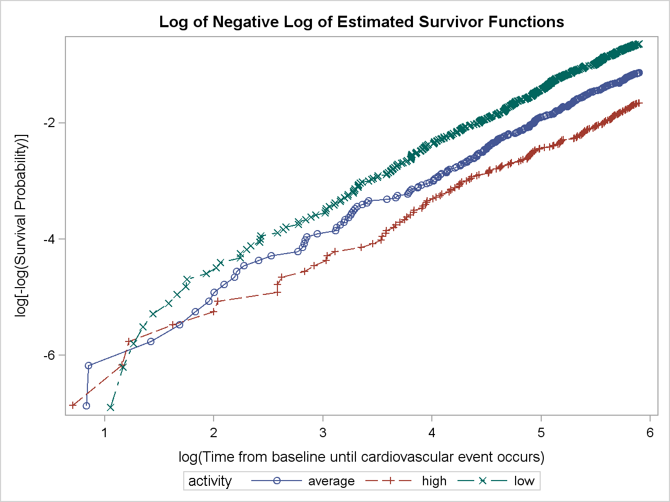
Example of output for categorical variables
If the hazard ratios are constant plot has parallel lines.

Slide 15
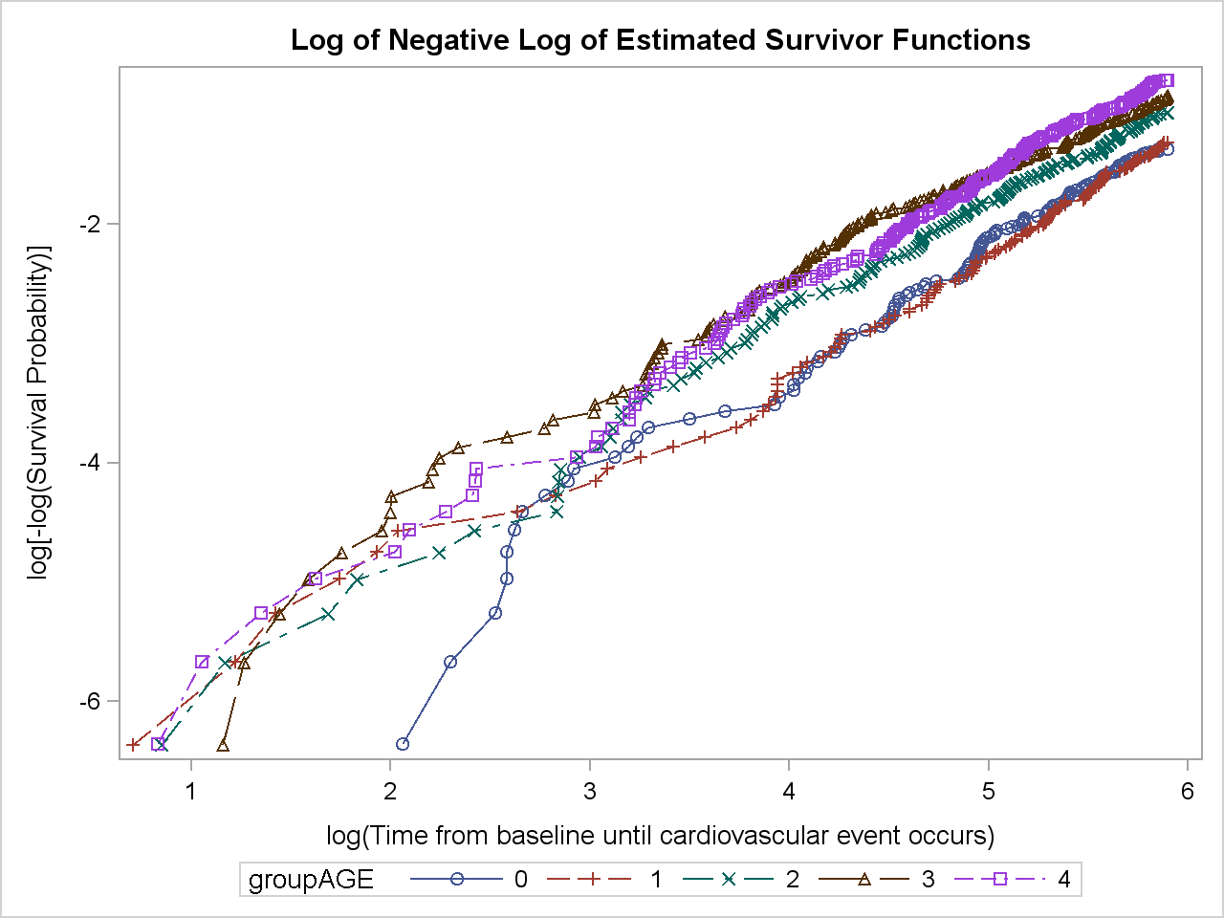
Example of output for continuous variables
If the hazard ratios are constant plot has parallel lines.

Slide 16
Example of test for interactions
All p-values are larger than 0.05 => no significant interactions
Results of a partial likelihood ratio test that compares the model with only the main effects to the model with the main effects and two-way interactions.
P-values less than 0.05 are marked

Slide 17
Example of check for confounding
No change => no confounding
Estimating change between Parameter Estimates for Other variables varies significantly for model without (crude) or with (adjusted) variable of interest.
Notes:
The second table in the macro output (Table 5) displays estimated change between the parameter estimates and standard errors for the model without the variable of interest (crude) and for the model with the variable of interest (adjusted). Variables for which parameter estimates vary by more than 20% are marked in the flag column. Since small changes in the very small parameter estimates can cause a huge percentage difference flag is only up if one of parameter estimates is greater than 0.01.

Slide 18
Macro Advantages
This macro makes it easy to run diagnostics for a long list of similar models.
This macro allows the specification of the variables for which diagnostics should be run.
This macro produces a comprehensive list of plots and tables necessary for evaluation of the Cox proportional hazards model assumptions as recommended in the SAS® course “Survival Analysis Using the Proportional Hazards Model.”

Slide 19
Conclusion
This macro can help to save hours of work for a programmer performing survival analysis.
Also this macro can save time for a biostatistician writing a request.
This time savings can be multiplied with several clinical studies.
It can minimize errors which can be made specifying models.
Also this macro can be helpful if slight changes need to be made for already existing jobs.
Notes:
My personal conclusion: it took me one month to write the first generalizable macro program, one week to write the second one and one day to write the third one. Now if I have repetitive task I’d rather write a general macro which would cover all the possible variations of this task.

Slide 20
Acknowledgements
Collaborative Studies Coordinating Center, UNC:
Kathy Roggenkamp
Myra Carpenter
Stephen Campbell
Kwanhye Jung
My attendance of the conference was supported by:
Collaborative Studies Coordinating Center, UNC
SAS Junior Professional Program Award
SAS Global Forum Presenter Mentoring Program:
Sunil Gupta

Slide 21

Contact Information
Your comments and questions are valued and encouraged. For a copy of the macro contact the author at:
Name: Polina Kukhareva
Enterprise: Collaborative Studies Coordinating Center, UNC at Chapel Hill
Work Phone: (919) 962-6971
Fax: (919) 962-3265
E-mail: p.kukhareva@alumni.unc.edu
Web: www.linkedin.com/pub/polina-kukhareva/29/42a/7a1

