Slide 1

Introduction to Java
Computer Science & Engineering, Khulna University
Dr. Amit Kumar Mondal,
Associate Professor, CSE KU
amit@cse.ku.ac.bd

Slide 2
Introducing Myself

Slide 3
Education & Profession
PhD, University of Saskatchewan, Canada (2022)
MSC, University of Saskatchewan, Canada (2017)
BSC, CSE, Khulna University (2009)
Associate Professor, CSE, Khulna University
Software Engineer, 2010-2012, Dhaka

Slide 4


Slide 5

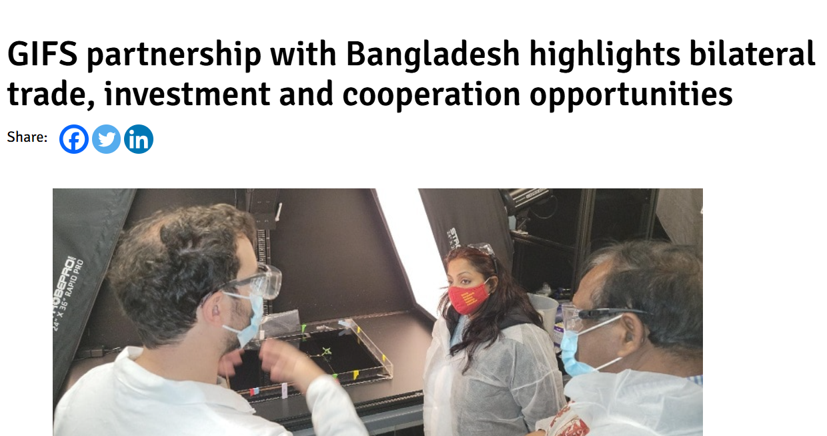

Involvement of Projects

Slide 6
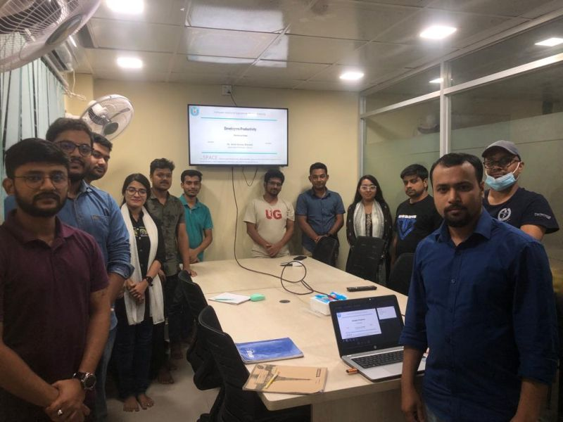
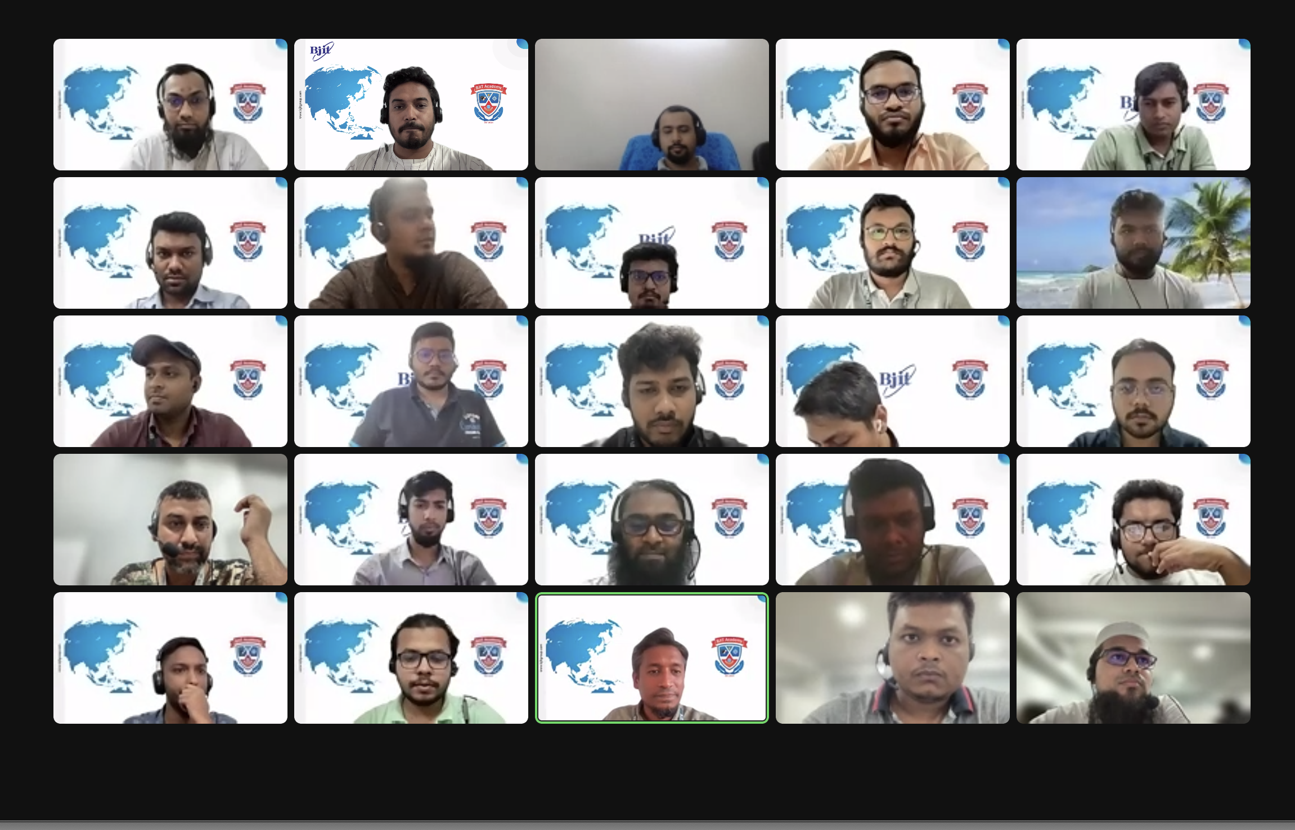
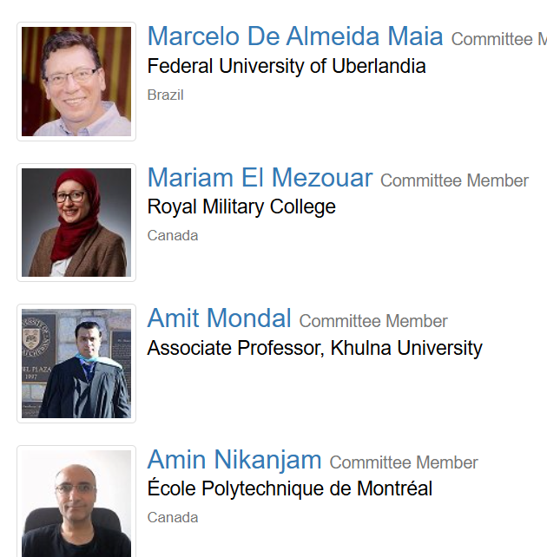
Current Activities
Working on AI Tools for Software Development & Maintenance
Supervising 10 Research Students
AI-based Crops Disease Detection
Workshop, Training on Software Quality Assurance (BJIT, EDGE-ICT)

Slide 7
Application of Java Programming Language

Slide 8
Widely Used Java Applications & Systems
Android Mobile Applications: The Android operating system itself is heavily based on Java, and many Android apps are developed using Java Examples include:
  Spotify
  Netflix
  Twitter
  Uber
  Cash App
  Many other mobile apps you use daily.
*Android phone market, holding 72% share

Slide 9
Widely Used Java Applications & Systems
Enterprise Applications: Java is a dominant force in enterprise-level software due to its scalability, robustness, and performance. This includes:
CRM (Customer Relationship Management) systems
ERP (Enterprise Resource Planning) systems
Large-scale business applications used by major corporations.
Many financial trading applications (e.g., Murex).

Slide 10
Widely Used Java Applications & Systems
Enterprise Applications: Java is a dominant force in enterprise-level software due to its scalability, robustness, and performance. This includes:
CRM (Customer Relationship Management) systems
ERP (Enterprise Resource Planning) systems
Large-scale business applications used by major corporations.
Many financial trading applications (e.g., Murex).

Slide 11
Widely Used Java Applications & Systems
Web Applications and Backend Systems: Java is extensively used for the server-side logic and backend of many prominent websites and web services. Examples include:
Amazon (various critical services and backend)
LinkedIn (fine-tuned Java infrastructure)
eBay (Java-based architecture for millions of transactions)
Gmail (backend functionalities)
Netflix (microservices built with Java)
Google (many server-side applications)
Salesforce (cloud platform development)

Slide 12
Widely Used Java Applications & Systems
Big Data Technologies: Java is fundamental to many big data frameworks and tools, enabling distributed processing and analysis of massive datasets.
Apache Hadoop (a cornerstone of big data, written in Java)
Apache Spark (often used with Java for big data processing)
Apache Kafka (a stream processing platform)

Slide 13
Widely Used Java Applications & Systems
Scientific and Research Applications: Java's strong computational capabilities make it suitable for scientific computing and simulations.
MATLAB (relies on Java for core system and UI)
NASA WorldWind (an open-source virtual globe SDK)
JMARS (Java Mission-planning and Analysis for Remote Sensing) used by NASA scientists.

Slide 14
Benefits of Java Language
Modularity
Reusability
Scalability
Maintainability
Security

Slide 15
My Expertise on Java

Slide 16
AI Adoption Mechanisms
Java Android: 1.5 years experience in Software Company,
Working on advanced Java JPMS: 6 years,
Worked on Java obfuscated code,
Developed a tool for JAVA design pattern detection (published ICSE 19, USA),
Working on Java jar extraction and processing and analysis,
Working on Java architecture,
Working on Java Soot Framework bytecode and security analysis

Slide 17
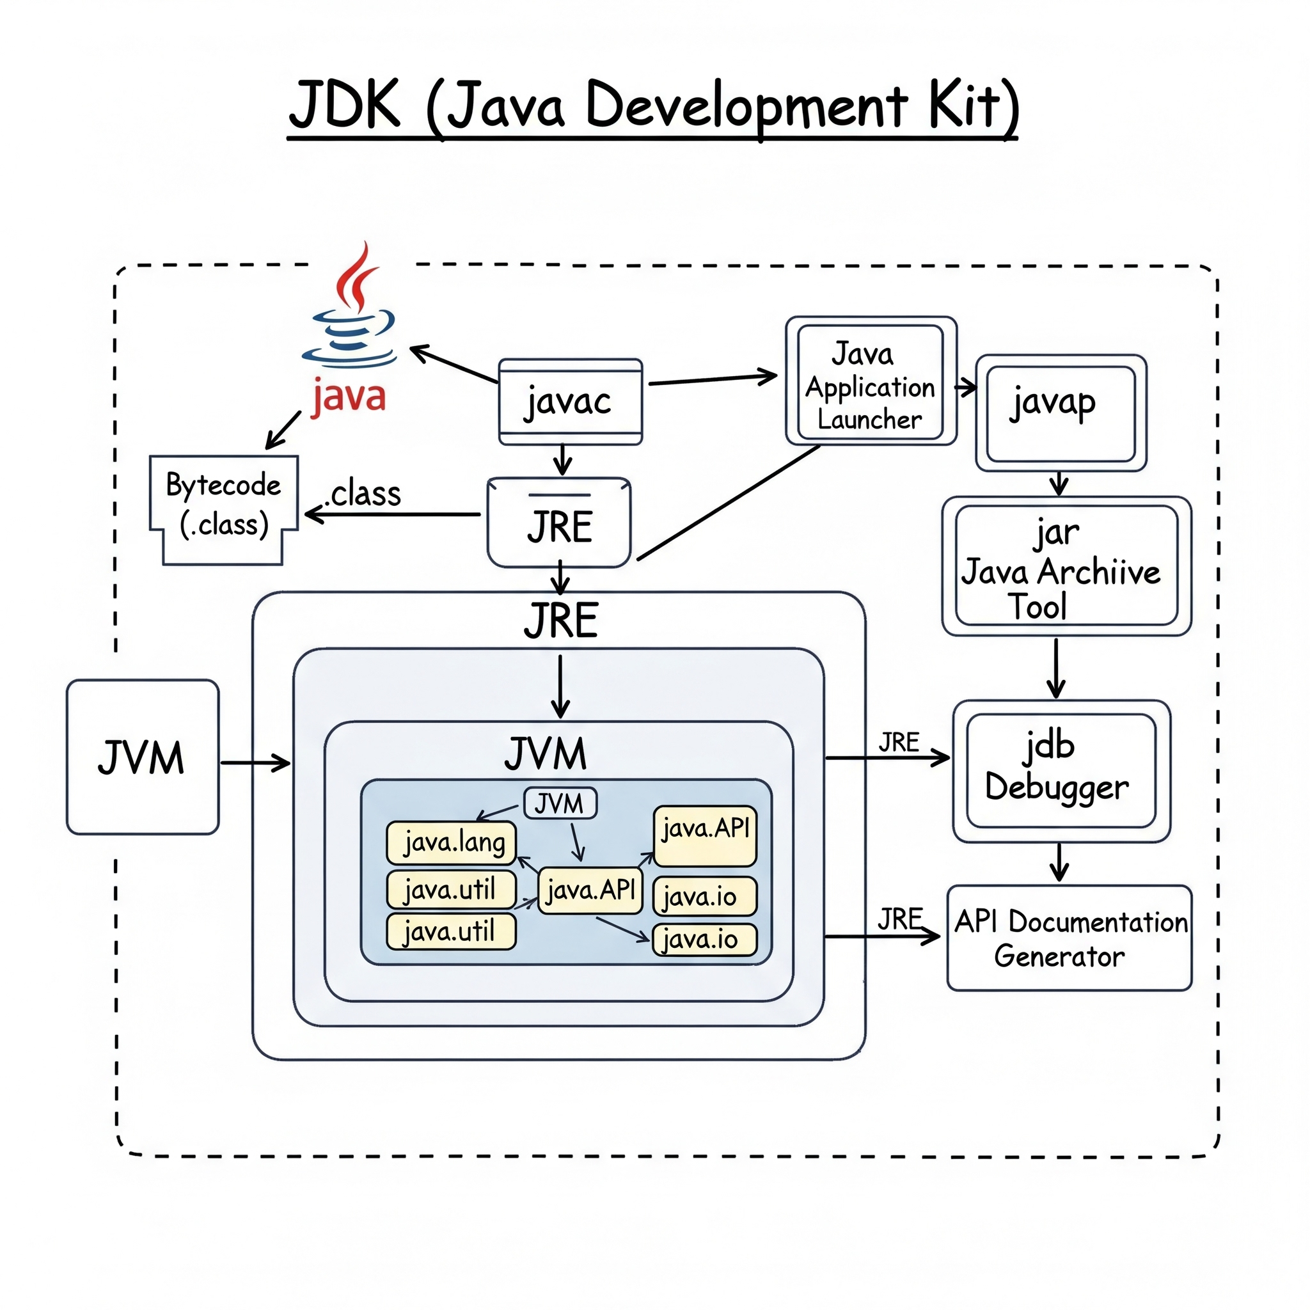
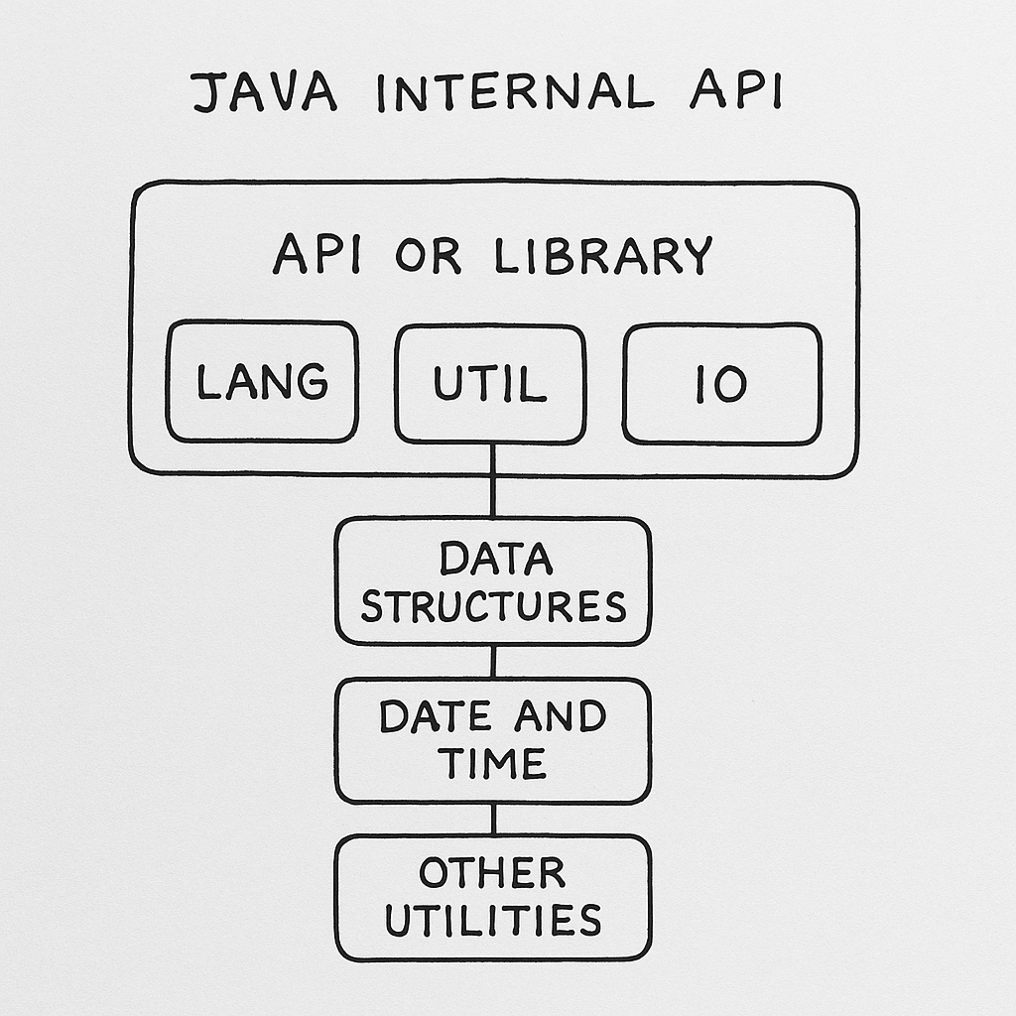

Slide 18
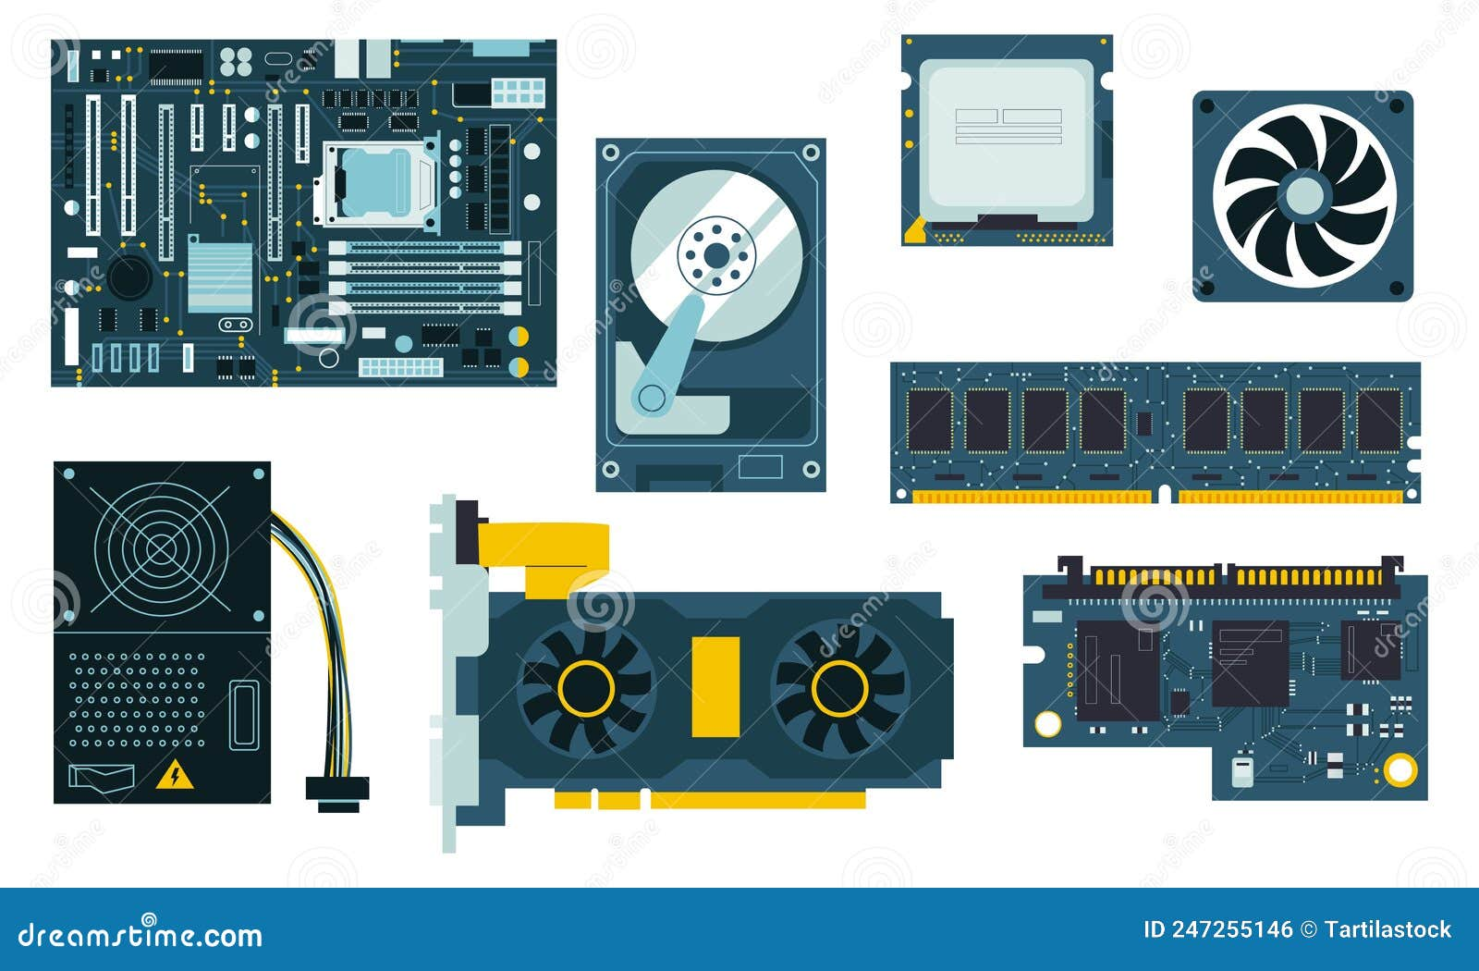

Slide 19
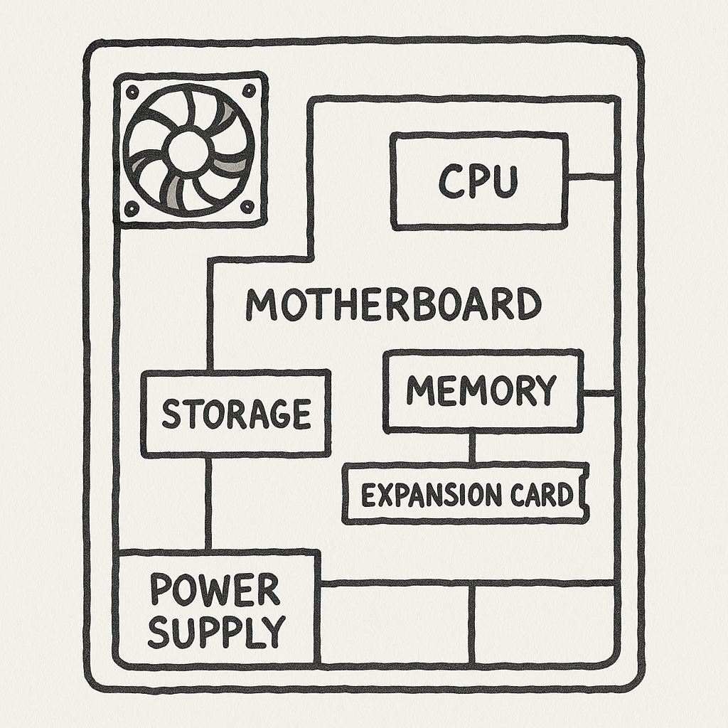

Slide 20
Class Extraction and UML of Real System

Slide 21
Bank Account Management System
A Bank Account Management System should allow users to create, update, and delete customer accounts, each with a unique account number.
Account holder properties must include name, address, phone number, date of birth, account type (savings/current), and current balance.
The system should support core operations like deposit, withdrawal, balance check, and account statement generation. Withdrawals must be validated to prevent overdrafts based on the current balance.
All transactions should be logged with timestamps for tracking and security
Basic authentication should protect account access, and data must be stored persistently using file handling or a simple database.

Slide 22
Bank Account Management System
A Bank Account Management System should allow users to create, update, and delete customer accounts, each with a unique account number.
Account holder properties must include name, address, phone number, date of birth, account type (savings/current), and current balance.
The system should support core operations like deposit, withdrawal, balance check, and account statement generation. Withdrawals must be validated to prevent overdrafts based on the current balance.
All transactions should be logged with timestamps for tracking and security
Basic authentication should protect account access, and data must be stored persistently using file handling or a simple database.

Slide 23
class BankAccount {
- accountNumber: String
- accountHolderName: String
- address: String
- phoneNumber: String
- dateOfBirth: String
- accountType: String
- balance: double
+ deposit(amount: double): void
+ withdraw(amount: double): boolean
+ getBalance(): double
+ getAccountDetails(): String
}
class Transaction {
- transactionId: String
- date: String
- type: String
- amount: double
- accountNumber: String
+ getTransactionDetails(): String
}

Slide 24
class BankSystem {
- accounts: List<BankAccount>
- transactions: List<Transaction>
+ createAccount(account: BankAccount): void
+ deleteAccount(accountNumber: String): void
+ findAccount(accountNumber: String): BankAccount
+ performTransaction(accountNumber: String, type: String, amount: double): void
+ getAccountStatement(accountNumber: String): List<Transaction>
}
BankSystem --> BankAccount : manages
BankSystem --> Transaction : logs

Slide 25
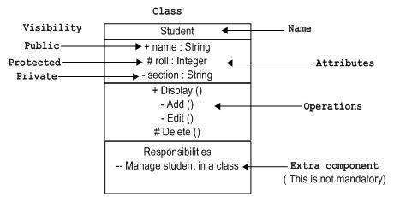
UML Diagram
https://www.tutorialspoint.com/uml/uml_basic_notations.htm

Slide 26
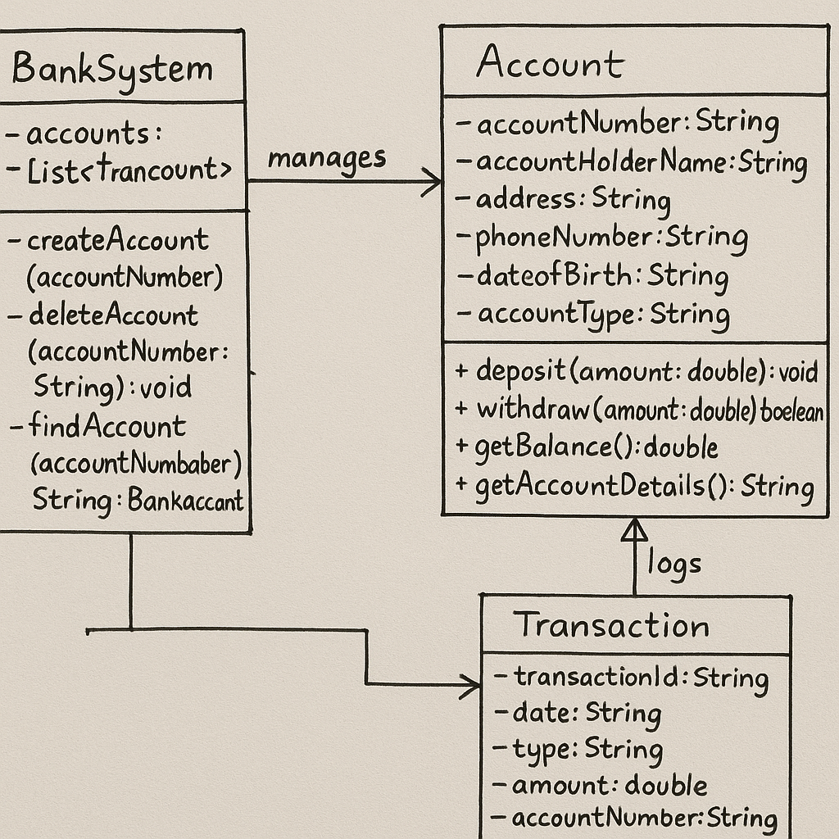
UML Diagram

