Slide 1
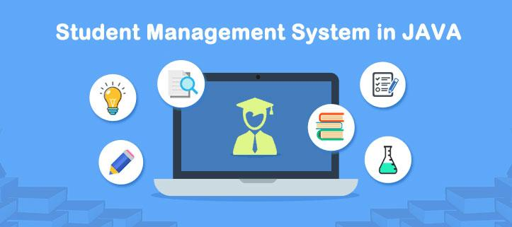
Core Java Project
Pravin Kolate
Guide: Ms. Indrakka Mali
EduBridge

Slide 2
Modules
Introduction
Features
Requirements
Database & Tables
Coding Structure

Slide 3
Introduction
Student Management System (SMS) Is a console based java Application that can manage all student by Admin.In this System important features are added .This project helps to Maintain large number off student. In this project we also provide a dashboard that can be quick overview of student and course.

Slide 4

Features
Add New Student 2. Update Student
3. Delete Student 4. Student List
5. Manage Course 6. DashBoard

Slide 5



Requirements
Programming Language
Database
IDE

Slide 6
Database Requirements
Database Name | javaproject
Table 1 | Student
Table 2 | Course

Slide 7
Class Structure
StudentMainClass
ShowMenu
DataBaseConnection
DataBaseOperation
DashBoard
Check_Validation
Manage_Course
UpdateStudent

Slide 8
StudentMainClass
Admin
Student
Used Username and password to give access.
Call showMenu() method from ShowMenu class and it will show the Menu for admin.
Using ID Student can get access of account.
It will Show All Information of Student
Sname , Semail , Sage , Smobile ,
Cname , Cfees etc.

Slide 9
ShowMenuClass
showMenu()
Add New Student - addStudent()
Show All Student - displayAllStudent()
Update Student - updateStudent()
Delete Student - deleteStudent()
Get Status Of Student - getStatus()
DashBoard - getStatus()
Manage Course - manageCourse()

Slide 10
DataBaseConnection
getConnection()
Driver - com.mysql.cj.jdbc.Driver
UserName - root
Password - root
URL - jdbc:mysql://localhost:3306/javaproject
Class.forName(driver)
conn=DriverManager.getConnection(url,un,up);

Slide 11
DataBaseOperation
displayAllStudent()
getStatus()
deleteStudent()
addStudent()
updateStudent()

Slide 12
DashBoard
getStatus()
Total Student
Total Course
Total Fees Collect
Pending Fees

Slide 13
UpdateStudent
updateName()
updateEmail()
updateMobile()
updateCourse()
updateFees()

Slide 14
ManageCourse
manageCourse()
addnewCourse()
updateCourse()
deleteCourse()
showCourse()

Slide 15
CheckValidation Class
validFees()
CheckStudent()

Slide 16
Thank You !!!

