Slide 1
Multimodal Management Requirements for AI Agent Protocols
draft-xie-ai-agent-multimodal
Gaogang Xie, Yanbiao Li, CNIC, CAS
July 2025

Slide 2
Background
Traditionally, the Internet can be divided into two separate parts:
networking of hosts (devices): IP, routing protocols.
interconnecting of apps (services): HTTP, DASH, webRTC, etc.
between them: transmission control (TCP, UDP, QUIC, etc.)
Agentic AI could fundamentally reshape the requirements toward the Internet by integrating autonomous perception, decision-making, and action execution
networking of AI agents for task collaboration

Slide 3
Multimodal Data Transmission
For complex task collaboration, AI agents require multimodal (text, picture, real-time audio/video, etc.) data transmission.
Asynchronous communication between agents is essential for complex task collaboration:
long-time task execution
multi-task decomposition, further delegation, and hierarchical integration
Asynchronous multimodal data transmission requires holistic optimization to enhance task execution

Slide 4
Shift of Transmission Mode
real-time audio stream
real-time vedio stream
file/text/location/sensor...
Separate data transmission
App-1
App-1
App-2
App-2
real-time audio stream
App-3
App-3
real-time vedio stream
file/text/location/sensor...
Multimodal data interaction
AI Agent
AI Agent
Task Context

Slide 5
Task-driven Orchestration of Multimodal Data Transmission
real-time audio stream
real-time vedio stream
file/text/location/sensor...
Multimodal data interaction
AI Agent
AI Agent
Task Context
REQ #1: Task context alignment for multimodal data orchestration
maintain requirements of every task and its delegator
decompose tasks, track every delegatee and their progress
extract QoS requirements and priorities for multimodal data transmission from specific task contexts

Slide 6
Task-driven Orchestration of Multimodal Data Transmission
real-time audio stream
real-time vedio stream
file/text/location/sensor...
Multimodal data interaction
AI Agent
AI Agent
Task Context
REQ #2: Context-ware orchestration of multimodal data transmission
dynamically select codecs and transmission policies based on contextual constraints: deadlines, data quality, etc
negotiate suitable transmission channels and params
reconfigure them on-demand at runtime

Slide 7
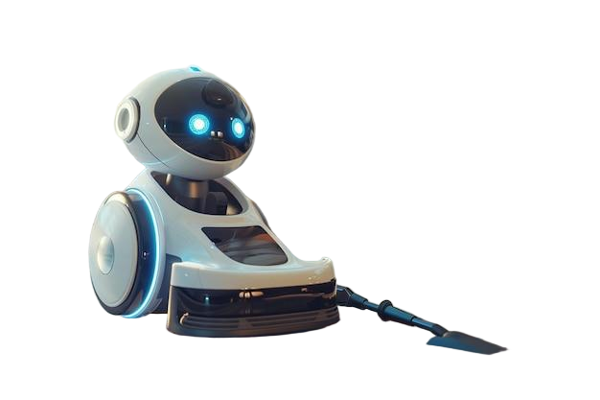
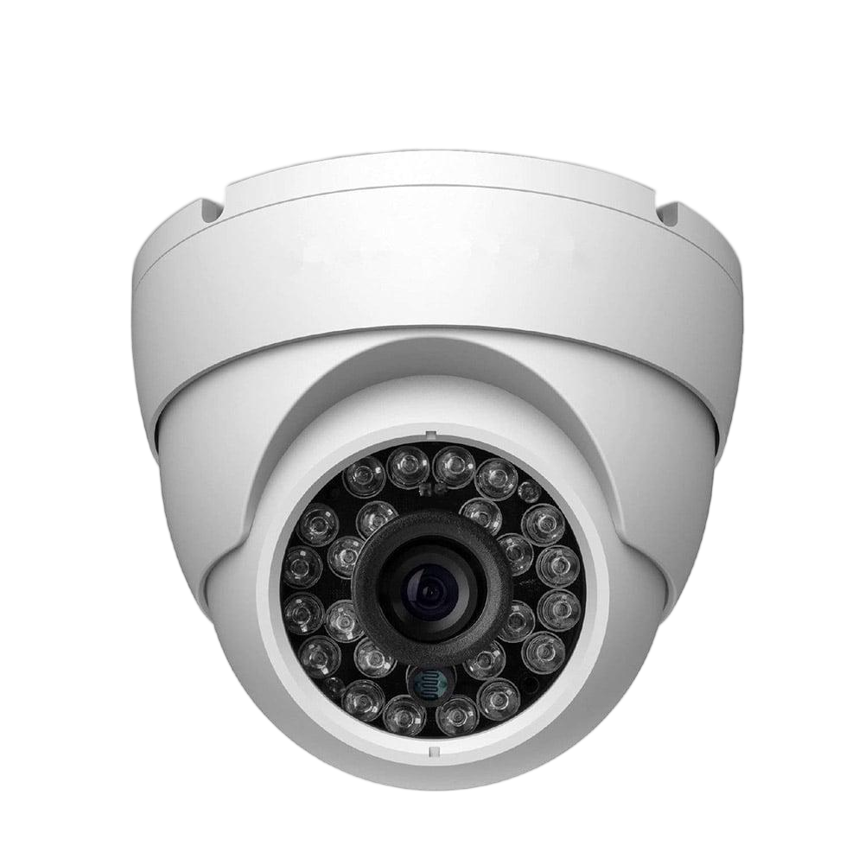
Use Case
Housekeeping Robot
Monitoring Agent
task delegation
1.1 sub-task delegation
whenever there is an incident, record it and clean the room in 1 minutes.
whenever there is an incident, warn me with a high resolution picture in 1 second, and save a video recording the whole process.

Slide 8
Use Case
Housekeeping Robot
Monitoring Agent
task delegation
1.1 sub-task delegation
whenever there is an incident, record it and clean the room in 1 minutes.
whenever there is an incident, warn me with a high resolution picture in 1 second, and save a video recording the whole process.
artifact-1
artifact-2
artifact-3
a warning text with incident summary
a high-resolution picture with labels
a video recording the whole incident
1.2 negotiate multimodal channels
warning text, picture, labels, video

Slide 9
Use Case
Housekeeping Robot
Monitoring Agent
task delegation
1.1 sub-task delegation
whenever there is an incident, record it and clean the room in 1 minutes.
whenever there is an incident, warn me with a high resolution picture in 1 second, and save a video recording the whole process.
artifact-1
artifact-2
artifact-3
a warning text with incident summary
a high-resolution picture with labels
a video recording the whole incident
1.2 negotiate multimodal channels
warning text, picture, labels, video
A glass cup falls dow and breaks
1.3 HTTP: warning text
1.4 HTTP: picture & labels

Slide 10
Use Case
Housekeeping Robot
Monitoring Agent
task delegation
1.1 sub-task delegation
whenever there is an incident, record it and clean the room in 1 minutes.
whenever there is an incident, warn me with a high resolution picture in 1 second, and save a video recording the whole process.
artifact-1
artifact-2
artifact-3
a warning text with incident summary
a high-resolution picture with labels
a video recording the whole incident
1.2 negotiate multimodal channels
warning text, picture, labels, video
A glass cup falls dow and breaks
1.3 HTTP: warning text
1.4 HTTP: picture & labels
2. locate all fragments of the broken cup and clean them
1.5 RTP: real-time vedio

Slide 11
Review of Existing Protocols
Feature | Agent-to-Agent (A2A) protocol | Agent Communication protocol (ACP) | Agent Network protocol (ANP)
Core Model | Decentralized communication​ with centralized discovery | Centralized brokerage | Fully decentralized communication
Data Type Support | Text, audio, video, structured JSON | Mixed types: text + PDF + images | Any type via sematic descriptors
REQ #1: Task Context Aligment | Structured Tasks | Structured Agent Run | Stateless
REQ #2: Context-aware Multimodal Orchestration | Separate optimization; limited adaptability | Separate optimization; limited adaptability | Separate optimization; protocol swtiching
None of them simultaneously supports task context aligment and enables to dynamically orchestrate multimodal data transmission based on task contexts

Slide 12
Conclusion
Task-driven orchestration of multimodal data transmission is essential for efficient AI agent collaboration, which requires AI agents to:
REQ #1: proactively monitor system states and align task context to guide multimodal data orchestration
REQ #2: dynamically orchestrate multimodal data transmission, adapting to task contexts
Protocols can be defined at the application layer, transport layer, or across multiple layers.
Though fundamental and related, security and routing are beyond the scope of this draft.

Slide 13
Thank you !
Comments / Questions ?

