Slide 1
AI Agent Identity Management
draft-yl-agent-id-requirements-00
draft-yao-agent-auth-considerations-00
Kehan Yao, China Mobile
IETF 123

Slide 2
Background and Terminologies
AI agents need verifiable identities to ensure proper functioning, communication security, and accountability, within networked systems.
Terminologies:
Types of AI Agents:
Physical AI Agent: an physical entity with embedded intelligence, usually refers to some AI terminals, e.g., AI robot, embodied AI.
Virtual AI Agent: an virtual entity that can provide intelligence, usually refers to some softwarized AI assistant, e.g., a chat assistant with a mobile application.

Slide 3
Terminologies - Cont’d
Ownership and Roles of AI agents:
OBO(On-behalf-of) User: the agent may require the authorization from user(s) to implement jobs for user(s).
OBO Agent Itself: the agent itself has indentity and implements jobs and represents itself.
OBO Other Agent(s): the agent may represent other agents to implement some jobs, given that other agents may not have the capabilities to implement the jobs.
Domain:
Task-wise Domain: a temporary domain that is created to target on a specific job, when the job is finished, the domain is destroyed. A typical example is a domain that is created by 6G systems.
Application Domain: a durable domain that is created by a specific application, e.g., a web or mobile application offerred by cloud service providers.

Slide 4
Digital Identity Management Requirements
Identity in the context of AI agent communication involves several common requirements to ensure effective, efficient, and secure interactions.
Identity Requirements:
Identifier:
Global Unique Identifier - in a universal interoperable format
User Binding
Attribute:
Skills - key functionalities
Multi-modal Interaction Capabilities - text, voice, image,videos, etc.
Service duration - long term or short term
Key credential - to securely transmit, share, store its digital identity
Security:
Authentication
Authorization
Discovery:
Intra-domain discovery
Inter-domain discovery
Repository Update and Synchronisation

Slide 5
Cosiderations on Agent Auth
Agent OBO User
Example case：Trip planning
AI agent delegates its user to access external resources
ticket booking service
Resource Server
Resource Owner
Trip Planning APP
User
AI Agent
MCP Server
map service
Resource Server
Resource Owner
Auth Server

Slide 6
Cosiderations on Agent Auth - Cont’d
Agent OBO other agent(s) -- chained delegation
Example case：also trip planning, but in case that the trip planning AI agent is not capable to calculate the best budget plan considering the current balance in user’s personal bank account.
AI agent delegates another agent and another agent’s user.
ticket booking service
Resource Server
eBank APP
Resource Owner
AI Agent
MCP Server
map service
Resource Server
Trip Planning APP
Resource Owner
User
AI Agent
Auth Server

Slide 7



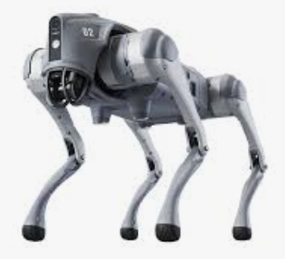
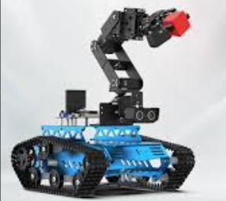
Cosiderations on Agent Auth - Cont’d
Agent OBO itself
Example case：remote rescue
mutiple physical AI agents collaborate to finish some tasks.
Identity Auth
UAV
Network Provisioning
External Agent
6G System
Robot Dog
Robot Arm
ACN
Subnet
task-wise domain

Slide 8
Summary and Discussions
Digital Indentity management of AI Agents is a core topic in interworking between AI agents as well as protocol design.
Terminologies, scenarios still need further discussion and consensus.
Other issues are worth being discussed:
Grant dynamicity - short-lived or long-lived Auth?
Can AI agents represent Users to consent requests?
Spoofying AI agents
Welcome for comments and review of the drafts.

