Slide 1
Climate Risk Premium
Samcheok Coal-Fired Power Plant
Cashflow Assumptions, Physical Risk Methodology & Key Results
February 2026
Model: DCF + Monte Carlo | Physical Risk: CLIMADA + OS-Climate (PLANiT) | 11 Scenarios

Slide 2
Plant Overview & Key Parameters
SECTION 1: CASHFLOW ASSUMPTIONS
Parameter | Value | Unit
Installed Capacity | 2,100 | MW
Baseline Capacity Factor | 85% | ratio
Operating Life | 40 | years
Total CAPEX | 4,900 | million USD
Commercial Operation Date | 2024 | year
Heat Rate | 9.5 | MMBtu/MWh
CO₂ Emissions Intensity | 0.95 | tCO₂/MWh
Base Outage Rate | 3%
Key Highlights
• Largest coal plant in Korea
• Annual generation: ~15.6 TWh
• Baseline revenue: ~USD 1,252M/yr
• 40-year DCF horizon
• Korea-specific climate parameters

Slide 3
Electricity Price & Revenue
SECTION 1: CASHFLOW ASSUMPTIONS
Price Assumptions
Revenue Calculation
• Base power price: 80 USD/MWh
• SMP trajectory: 85 → 58 USD/MWh (2024–2050)
• Carbon price: 15 → 150 USD/tCO₂ (2024–2050)
• Carbon cost = 0.95 tCO₂/MWh × carbon price
• Annual generation = 2,100 MW × 0.85 CF × 8,760 h
• = 15,638,400 MWh/yr (~15.6 TWh)
• Baseline revenue = 15.6 TWh × 80 USD/MWh
• = ~USD 1,252 M/yr
• Revenue formula: Annual MWh × (SMP − Carbon Cost)
Key Insight: Rising carbon costs progressively erode coal plant margins
Under aggressive transition, carbon costs of 150 USD/tCO₂ add ~142 USD/MWh, far exceeding the SMP of 58 USD/MWh by 2050.

Slide 4
Cost Structure & Financing
SECTION 1: CASHFLOW ASSUMPTIONS
Cost Component | Value | Annual Amount
Fuel Cost | 9.5 MMBtu/MWh × 3.2 USD/MMBtu = 30.4 USD/MWh | USD 475 M/yr
Fixed O&M | 35 USD/kW-yr | USD 73.5 M/yr
Variable O&M | 4.5 USD/MWh | USD 70.4 M/yr
Total Operating Cost |  | USD 619 M/yr
Baseline Economics
Revenue: USD 1,252 M/yr
Operating Cost: USD 619 M/yr
EBITDA: USD 633 M/yr
EBITDA Margin: ~51%
NPV (8% disc.): USD 3,103 M
Project IRR: 12.0%
Avg DSCR: 2.15x
Financing Structure
Parameter | Value
Debt / Equity | 70% / 30%
Debt Interest Rate | 6.1%
Debt Tenor | 20 years
Discount Rate (WACC) | 8.0%
Tax Rate | 24%
CAPEX | USD 4,900 M

Slide 5
Physical Risk Framework: PLANiT Pipeline
SECTION 2: PHYSICAL RISK METHODOLOGY
CLIMADA (Wildfire AAI)
PLANiT Adapter
Converts raw hazard outputs to cashflow impacts
Physical Adjustments
• outage_rate • capacity_derate • capex_increase • insurance_increase
CF Impact
OS-Climate PhysRisk (Drought)
OS-Climate PhysRisk (Water Risk)
Source: src/planit/adapter.py, src/planit/config.py | SSP Mapping: baseline→historical, moderate→SSP1-2.6, high→SSP5-8.5

Slide 6
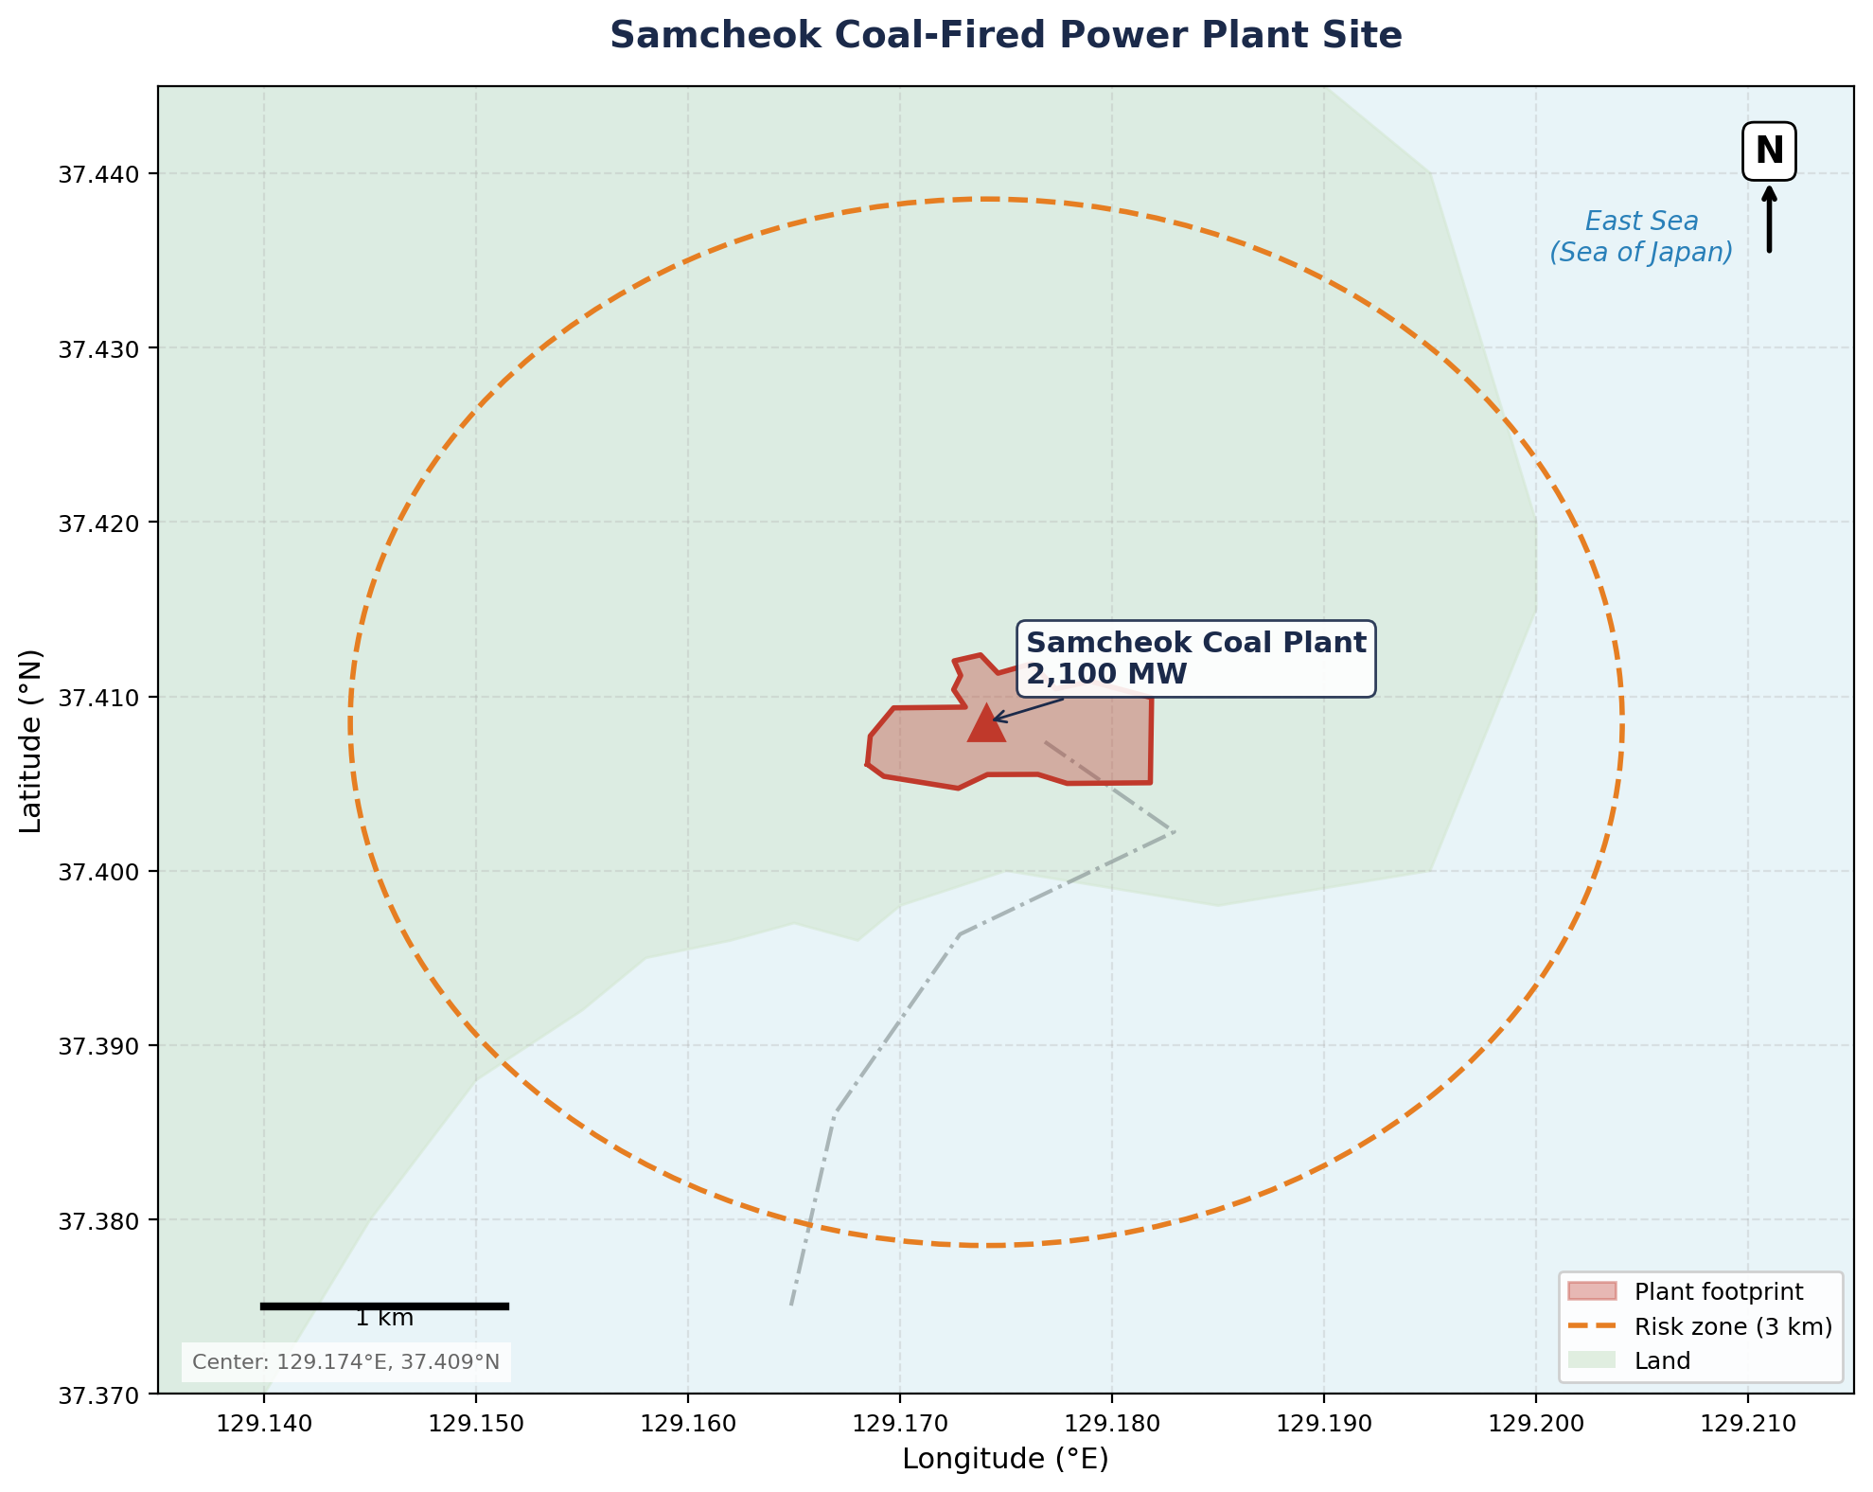
Samcheok Site Location
SECTION 2: PHYSICAL RISK METHODOLOGY
Site Details
Location: Samcheok, Gangwon Province
Coordinates: 129.174°E, 37.409°N
Coastal site on East Sea
Connected via 765kV transmission
Grid: Samcheok → Sintaebaek Substation
Physical Risk Exposure:
• Wildfire: Forest zones to west
• Drought: Water-cooled system
• Water Risk: Coastal cooling intake
Korean name: 삼첩화력발전소

Slide 7
Hazard Interpretation Logic
SECTION 2: PHYSICAL RISK METHODOLOGY
How raw PLANiT outputs become cashflow impacts:
Hazard | Raw Output | Conversion Formula | Example
Wildfire | AAI (KRW) | outage_rate = AAI / replacement_value (4.879T) | 67.9M KRW → 0.001%
Drought | impact_mean | capacity_derate = impact_mean × 1.0 | 0.00094 → 0.094%
Water Risk | impact_mean | water_cap = max(0, 1 − impact_mean) | 0.00702 → 99.3% avail.
Compound Risk Multiplier
• Hazards are not independent — droughts increase wildfire risk
• Compound multiplier range: 1.0x (baseline) to 1.25x (high scenario)
• Based on Zscheischler et al. (2018) compound event framework
• Total CF Loss = (wildfire + drought + water risk) × compound_mult
Source: src/planit/adapter.py, src/planit/config.py | Replacement value: KRW 4.879 trillion (KEPCO asset registry)

Slide 8
Physical Risk by SSP Scenario
SECTION 2: PHYSICAL RISK METHODOLOGY
Scenario | Wildfire | Drought | Water Risk | Total CF Loss
Baseline (2024) | 0.001% | 0.094% | 0.000% | 0.095%
SSP1-2.6 (2040) | 0.005% | 0.257% | 0.559% | 0.820%
SSP5-8.5 (2050) | 0.001% | 0.101% | 0.546% | 0.648%
PLANiT vs Literature Comparison
Source | Wildfire | Flood | Notes
PLANiT (site-specific) | 0.001% | n/a | CLIMADA AAI for Samcheok coordinates
Literature (Korea avg) | 0.055% | 0.003% | Kim et al. 2025 / Kang & Lee 2024
Ratio | 55x lower | n/a | PLANiT more granular; site in low-risk zone
Conclusion: Physical risk at Samcheok is modest (< 1% CF loss even under SSP5-8.5). Transition and policy risks dominate the CRP.

Slide 9
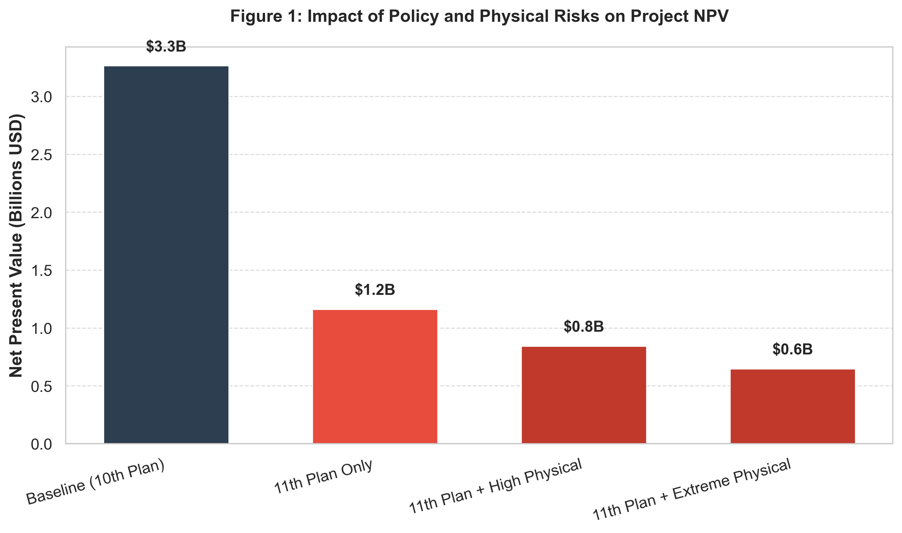
Scenario Comparison Overview
SECTION 3: KEY RESULTS
Scenario | NPV (M) | IRR | DSCR | Rating
Baseline | 3,103 | 12.0% | 2.15 | AA
Moderate Transition | 2,038 | 10.6% | 1.90 | A
Aggressive Transition | -72 | 7.0% | 1.53 | A
Combined Aggressive | -109 | 7.0% | 1.51 | A
Low Demand | 497 | 8.2% | 1.51 | BBB
Enhanced 11th Plan | -2,998 | -8.1% | 0.59 | CC
NPV in million USD, 8% discount rate. IRR = Project Internal Rate of Return. DSCR = Debt Service Coverage Ratio. Rating per KIS methodology.

Slide 10
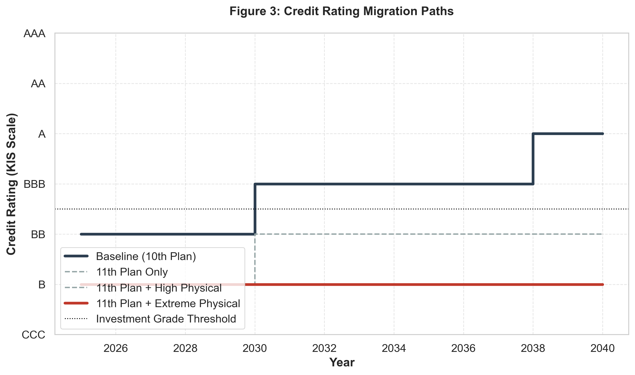
Credit Rating Migration
SECTION 3: KEY RESULTS
Rating Migration Summary
↑ Baseline: A → AA
Upgrade by 1 notch (CRP = -50 bps)
→ Moderate Transition: A → A
No change (CRP = 0 bps)
→ Aggressive Transition: A → A
No change (CRP = 0 bps)
↓ Low Demand: A → BBB
Downgrade 1 notch (CRP = +85 bps)
↓↓ Enhanced 11th Plan: A → CC
Downgrade 5 notches (CRP = +1,020 bps)
Counterfactual: A (150 bps)

Slide 11
Key Findings & Conclusions
SECTION 3: KEY RESULTS
1. Physical Risk is Modest
Physical hazards cause only 0.10–0.82% capacity factor loss. Even under SSP5-8.5, the NPV impact is less than USD 62M (2% of baseline NPV). Physical risk is not the primary driver of climate risk premium.
2. Transition/Policy Risk Dominates
Korea's 11th Basic Energy Plan causes CC-rated distress (NPV −USD 3.0B, DSCR 0.59x). The aggressive coal phase-out policy alone drives a 5-notch downgrade and CRP of +1,020 bps.
3. CRP Range: −50 to +1,020 bps
The climate risk premium spans from −50 bps (baseline upgrade to AA) to +1,020 bps (enhanced 11th plan, CC distress). Investment-grade is maintained through combined_aggressive; breached only under policy acceleration.
4. Investment Implications
Current baseline economics are strong (AA, 12% IRR, DSCR 2.15x). However, investors must price in transition policy tail risk. The 11th Basic Plan scenario represents a realistic near-term threat that could strand the asset entirely.
Climate Risk Premium Model | Samcheok 2,100 MW | 11 scenarios, 40-year DCF | February 2026

