Slide 1
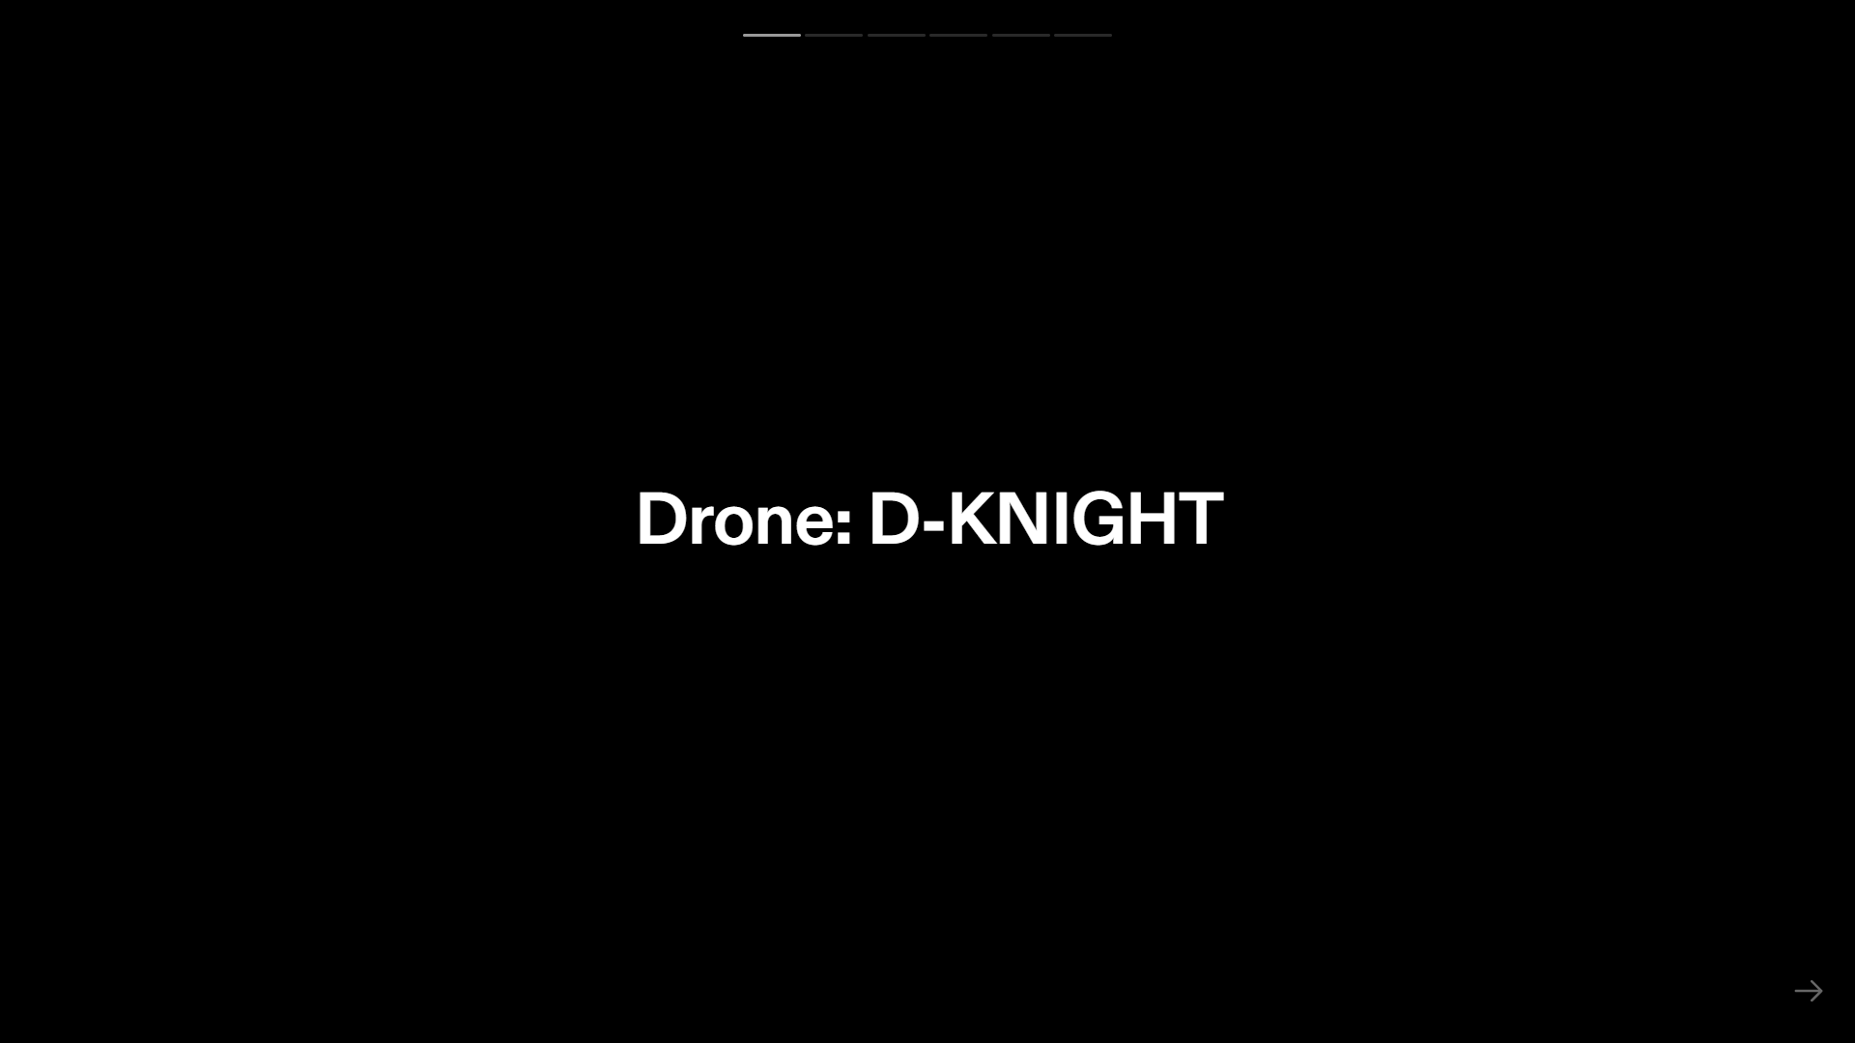

Slide 2
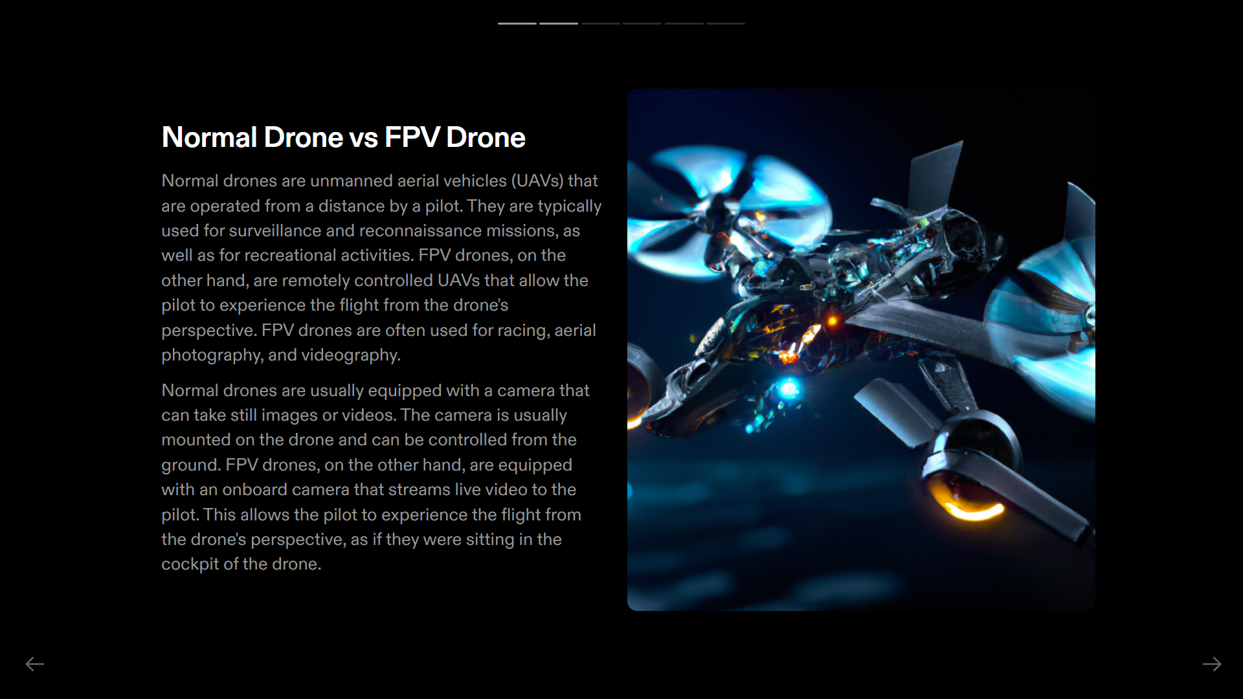

Slide 3
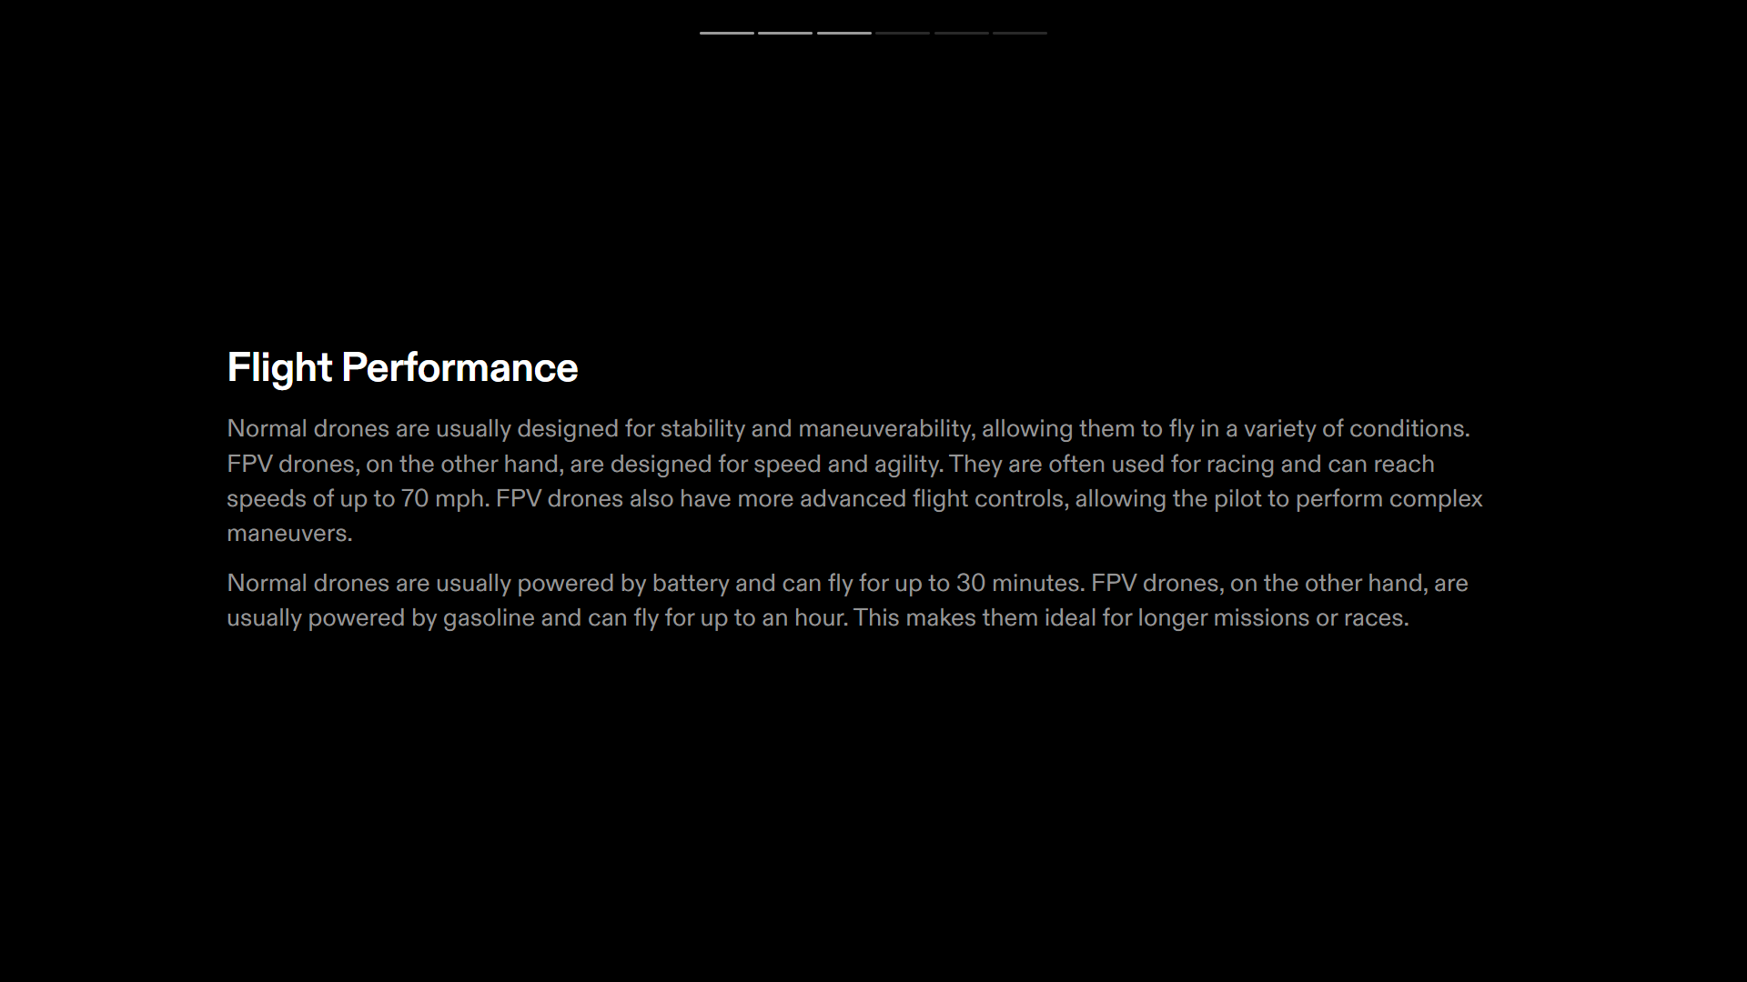

Slide 4
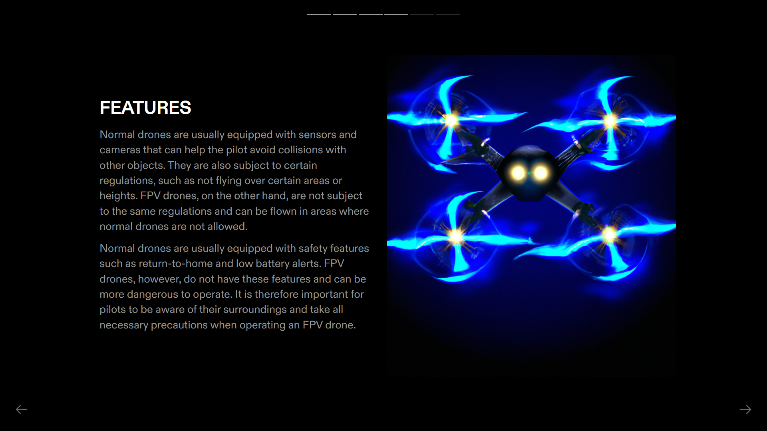

Slide 5
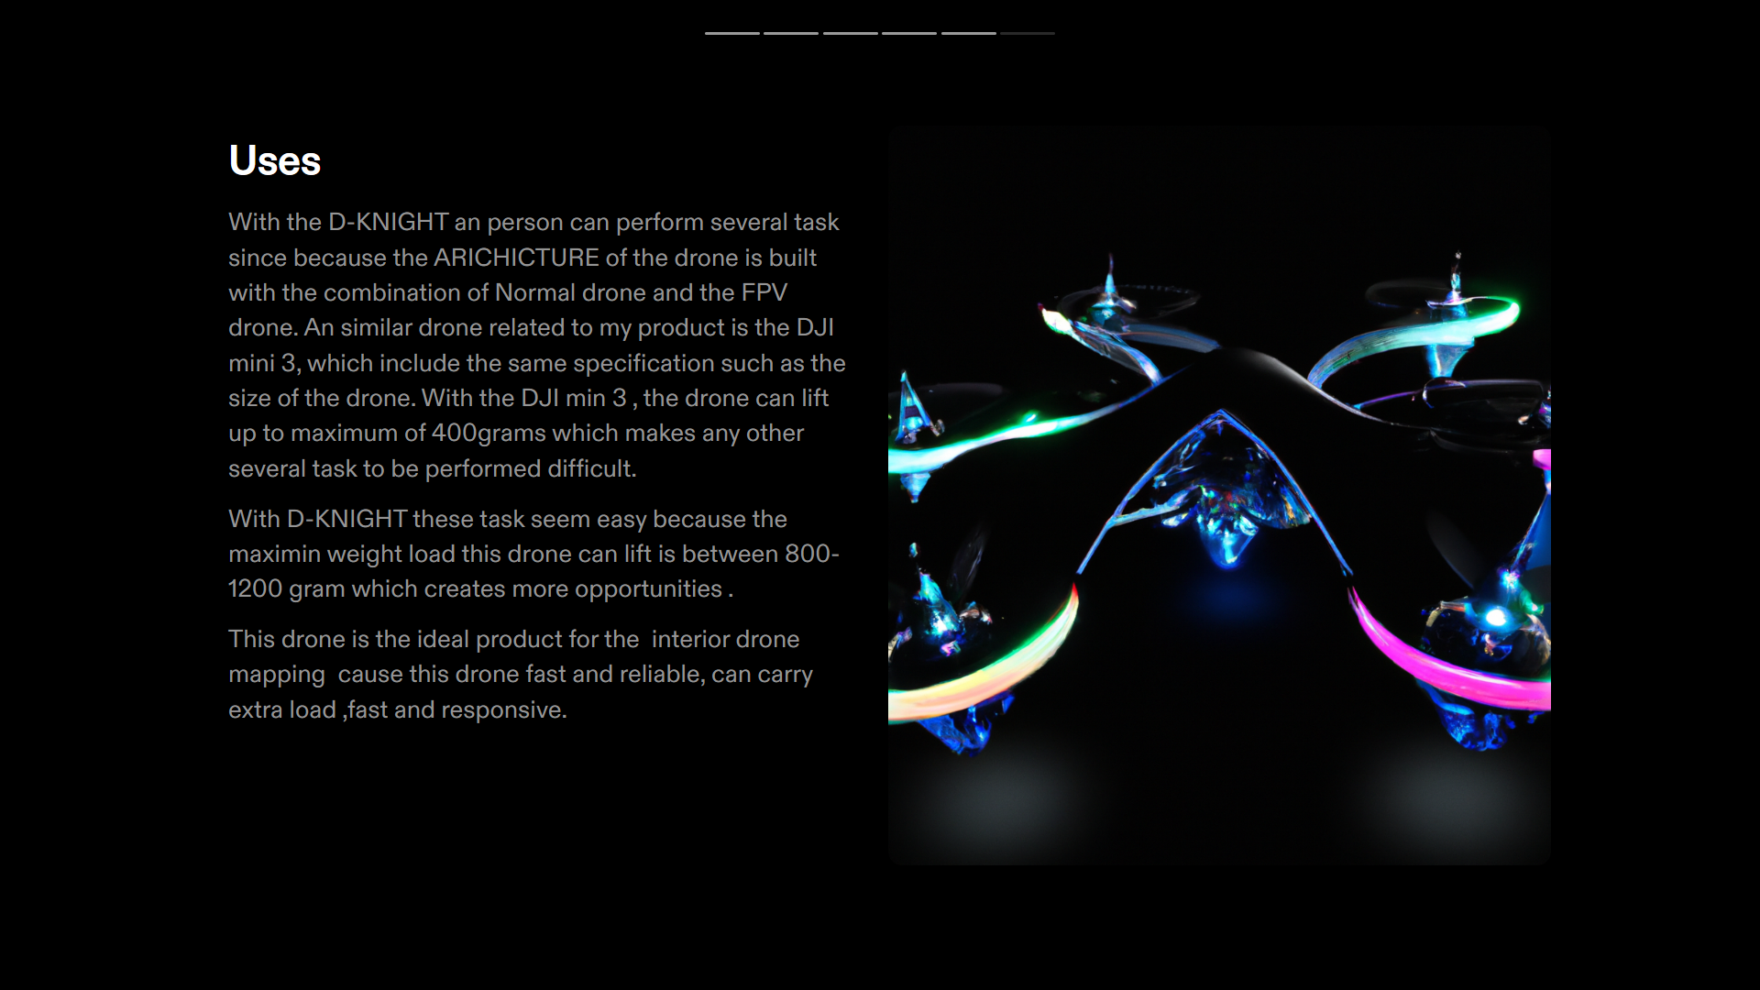

Slide 6
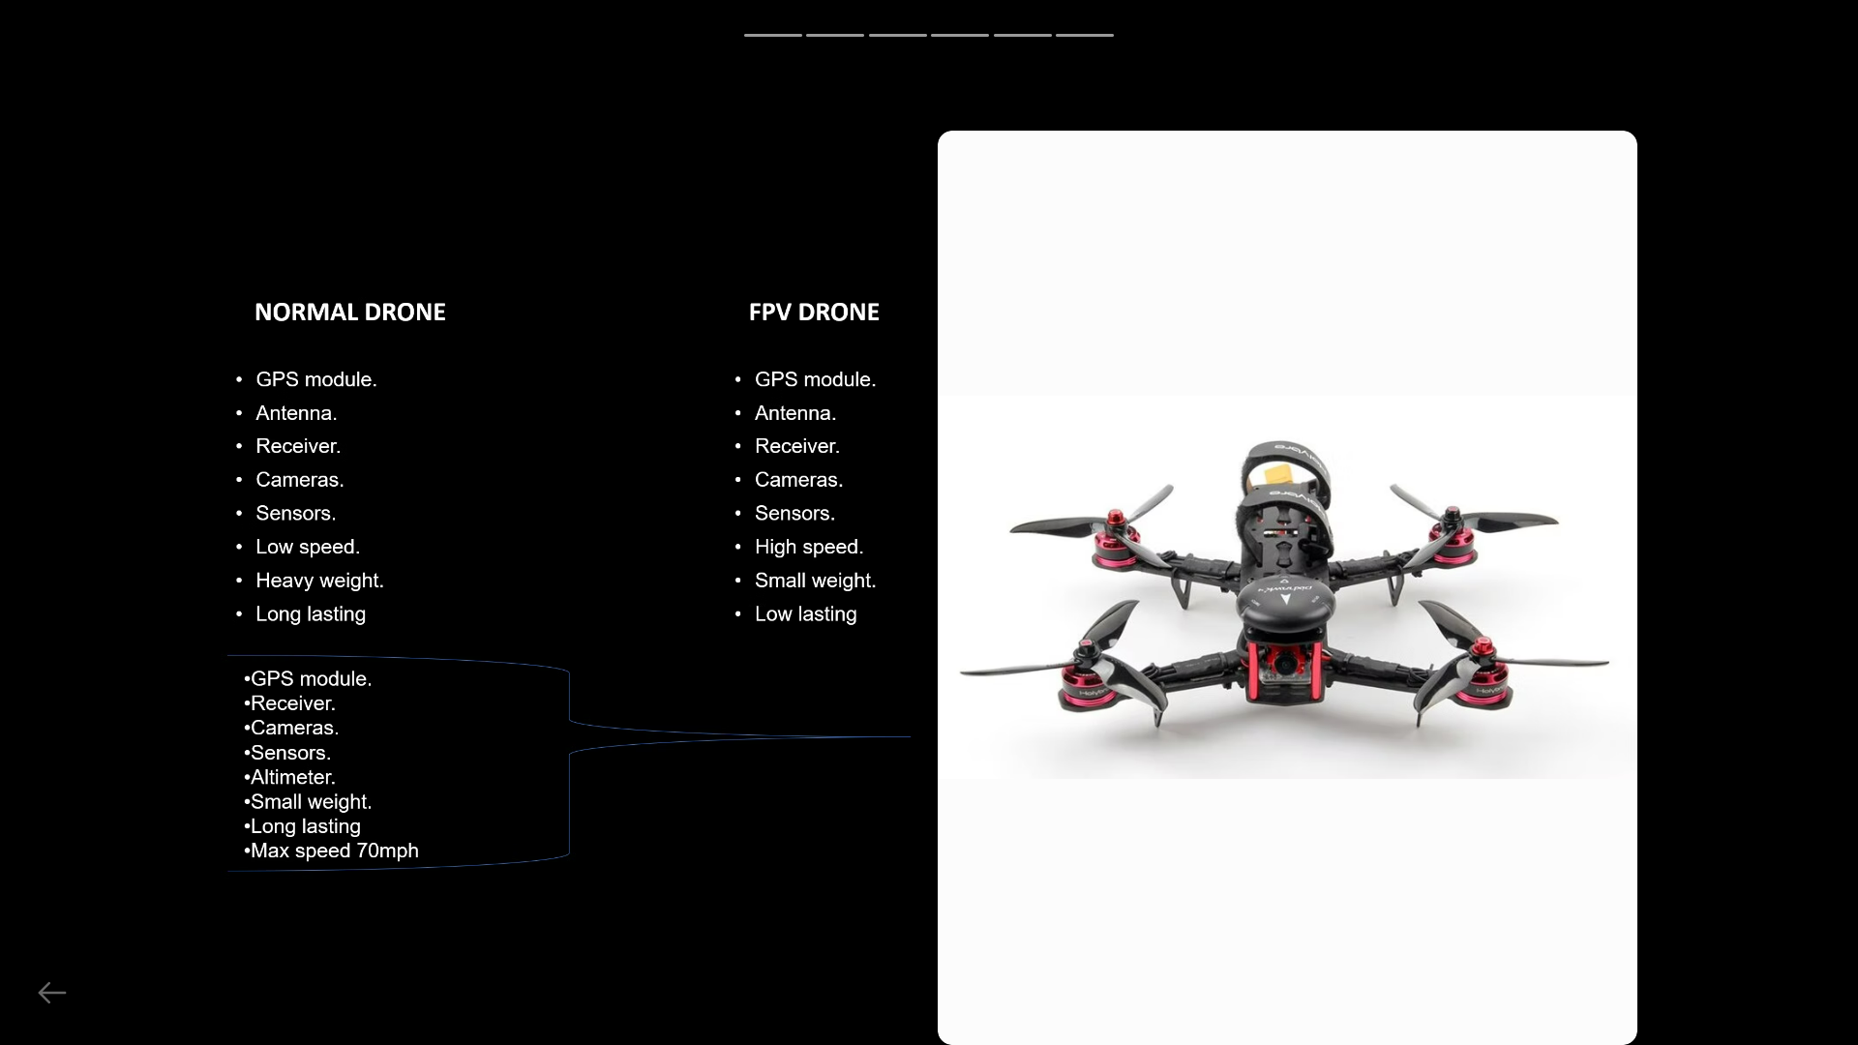

Slide 7
NORMAL DRONE
FPV DRONE
GPS module.
Antenna.
Receiver.
Cameras.
Sensors.
Low speed.
Heavy weight.
Long lasting
GPS module.
Antenna.
Receiver.
Cameras.
Sensors.
High speed.
Small weight.
Low lasting
GPS module.
Receiver.
Cameras.
Sensors.
Altimeter.
Small weight.
Long lasting
Max speed 70mph

