Slide 1
Design of Experiments
Suppose that we wish to improve the yield of a polishing operation. The three inputs (factors) that are considered important to the operation are Rotational Speed (X₁), Linear speed or Feed (X₂), and Depth (X₃). We want to ascertain the relative importance of each of these factors on Yield (Y).
Speed, Feed and Depth have a linear behavior along their respective scales, from a low to a high setting.
High (1) and Low (0) Settings for a Polishing Operation
 | Low | High | Units
Speed | 16 | 24 | rpm
Feed | 0.01 | 0.05 | mm/s
Depth | 0.1 | 0.2 | mm/s

Slide 2
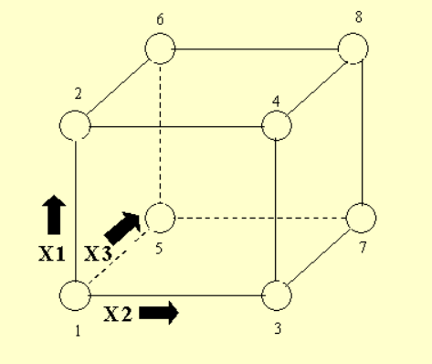
Factor Combinations, example Full Factorial
We want to try various combinations of these settings to establish the best way to run the polisher. There are eight different ways of combining high and low settings of Speed, Feed, and Depth. These eight are shown at the corners of the following diagram.
Note that if we have k factors, each run at two levels, there will be 2^{k} different combinations of the levels. In the present case, k = 3 and 2³ = 8.
Running the full complement of all possible factor combinations means that we can estimate all the main and interaction effects. There are three main effects, three two-factor interactions, and a three-factor interaction.

Slide 3
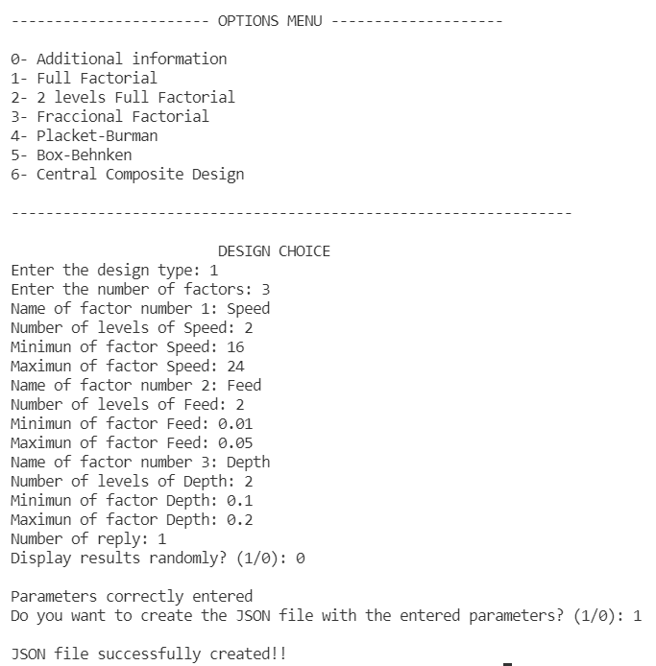
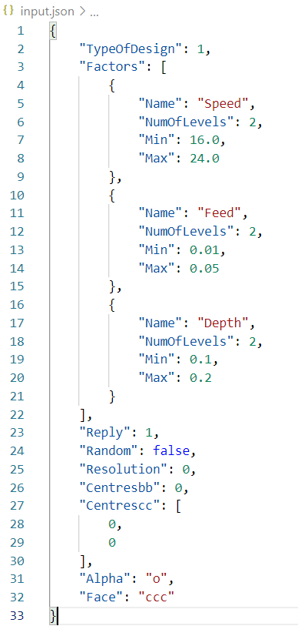
Full factorial (Data input module)
The input data is entered through the user interface, and a JSON file (input.json) will be generated with all the necessary information so that the design can be processed.
input.json
Information entered by de user

Slide 4
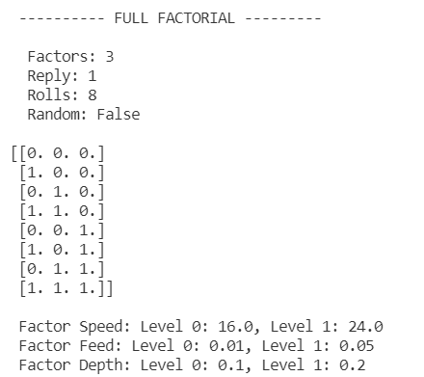
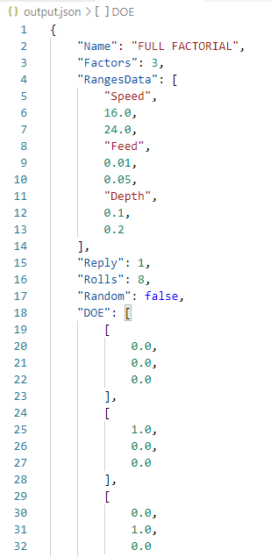
Full factorial (DOE module)
The input.json file is processed in the main module of the application, which will generate the design matrix with the experiments to be performed to obtain all information about the process. This information will be displayed on the screen and a new output.json file will also be generated.
output.json
Matrix with the experiments
. . .

Slide 5
Matrix with the experiments
The following experiments should be carried out to obtain as much information as possible about the process
experiment no. | Speed | Feed | Depth
1 | 16 | 0.01 | 0.1
2 | 24 | 0.01 | 0.1
3 | 16 | 0.05 | 0.1
4 | 24 | 0.05 | 0.1
5 | 16 | 0.01 | 0.2
6 | 24 | 0.01 | 0.2
7 | 16 | 0.05 | 0.2
8 | 24 | 0.05 | 0.2

Slide 6
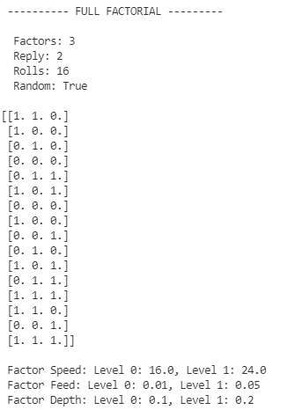
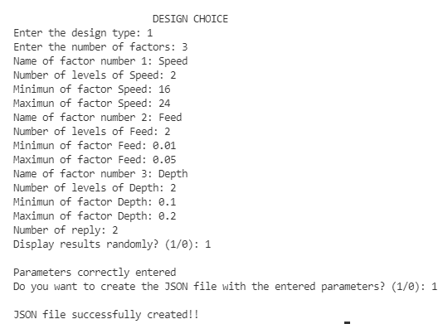
Replication and Randomization
In order to make the series of experiments as homogeneous as possible and to contaminate the results as little as possible, it is possible to randomize and replicate the experiments.
New matrix

