Slide 1
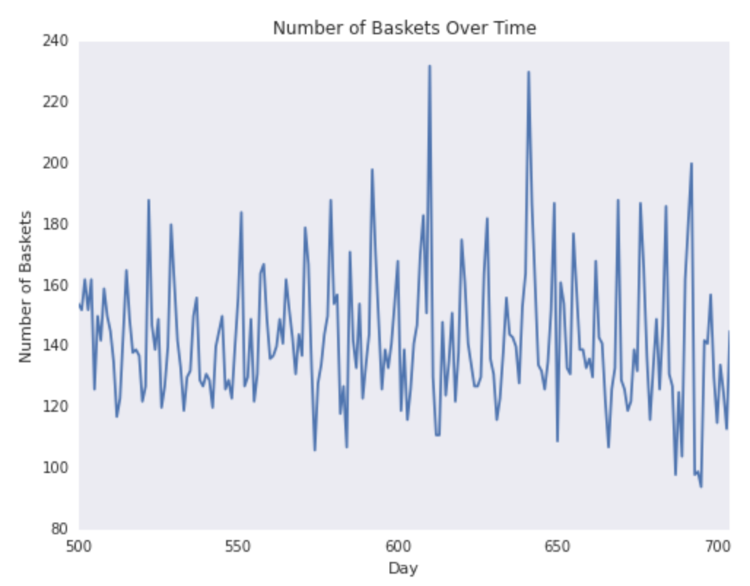
Polar Bears: Exploratory Data Analysis
Large amounts of missing values for demographics
Question usability
High Volatility in basket purchases over time
Egg Purchases seem to be cyclical
Suggests that this is a panel classification problem

Slide 2
Polar Bears: Model Selection
Model | Test Set Accuracy
Mixed Logistic Models | 87.1%
Single Logistic Model | 87.6%
Gradient Boosting Machine | 87.2%
Models Considered:
Mixed Logistic Models for demographic vs. non-demographic observation
One overall logistic model
Gradient Boosting Machine (GBM)
Kernel Regression (Computationally Expensive)
Model Selection Methods
Forward-Backward Regression on AIC
Regularization in GBM
Train-Test Split (70%-30%)

Slide 3

Polar Bears: Inference and Results
Final Model: where
All lags of ”purchased eggs in week” and number of baskets increase the probability of egg purchase next week
Recommendation: get consumers to come to the store often (increases numBaskets) and optimize purchasing cycles for eggs

