Slide 1
hy2Foam Code Review
Mehmet Furkan Tunç
06 August 2025
Thesis Study
Notes:
TASNİF DIŞI

Slide 2
1. Introduction
In order to understand how to implement a new thermochemical library for the upcoming hypersonic solver, hy2Foam solver is selected for code review. Reasons are:
It is written in OpenFOAM framework.
It is validated for most of the hypersonic use cases.
It has extensive thermophysical models that are suitable for hypersonic flow conditions.
Notes:
TASNİF DIŞI

Slide 3
2. hy2Foam General Outlook
hy2Foam
rhoCentralFoam & Additions
reactingFoam & Additions
New Thermophysical Library
New Chemical Library
Solver Template
Two temperature model
Specie Transport Equation Handling
Chemkin Capabilities
Transport Properties
Mixing Rules
Gas Properties
Park and Gupta Models
Custom Reaction Additions
Notes:
TASNİF DIŞI

Slide 4
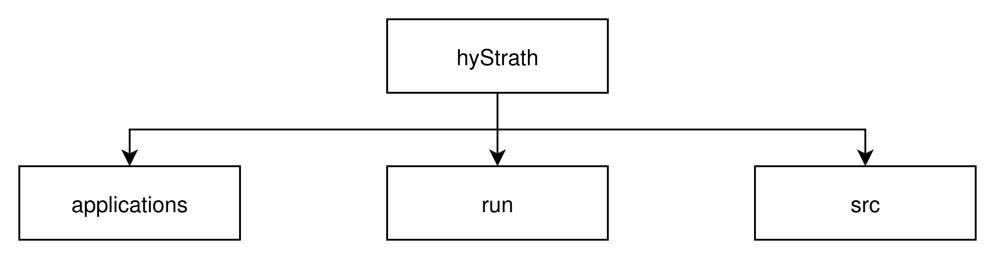
3. hy2Foam Folder Structure
This folder contains solvers and utilities of the hyStrath environment
This folder contains tutorials for each solver
This folder contains libraries that are being employed for each solver
Notes:
TASNİF DIŞI

Slide 5
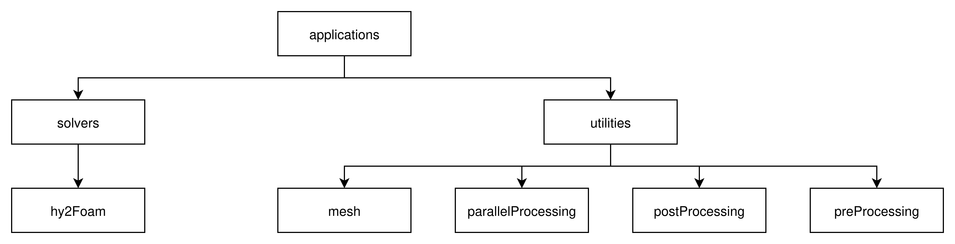
3.1. applications/ Folder
This folder contains hy2Foam solver code and its headers
This folder contains mesh generation methods, will not be expanded further
This folder contains parallel processing methods, will not be expanded further
This folder contains post processing methods, will not be expanded further
This folder contains pre-processing methods that are necessary for DSMC method, will not be expanded further
Notes:
TASNİF DIŞI

Slide 6
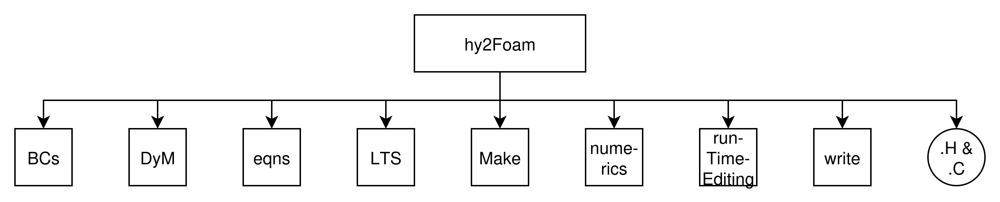
3.1.1. solvers/hy2Foam Folder
In this folder:
BCs/ contain headers for BCs for hypersonic flows such as Smoluchowski and Maxwell.
DyM/ contain hy2DyMFoam solver which is hy2Foam with mesh-motion and dynamic meshes.
eqns/ contain headers for equations modelling hypersonic flows.
LTS/ contain headers for local time stepping numerical model.
Make/ contain files and options files for wmake to compile the solver.
numerics/ contain headers for numerical schemes such as flux calculators, interpolaters etc..
runTimeEditing/ contain headers for selecting models that are valid for the specific run.
write/ contain headers for which quantities will be written into log file.
.H & .C files are field creater headers and main solver function file.
Notes:
TASNİF DIŞI

Slide 7
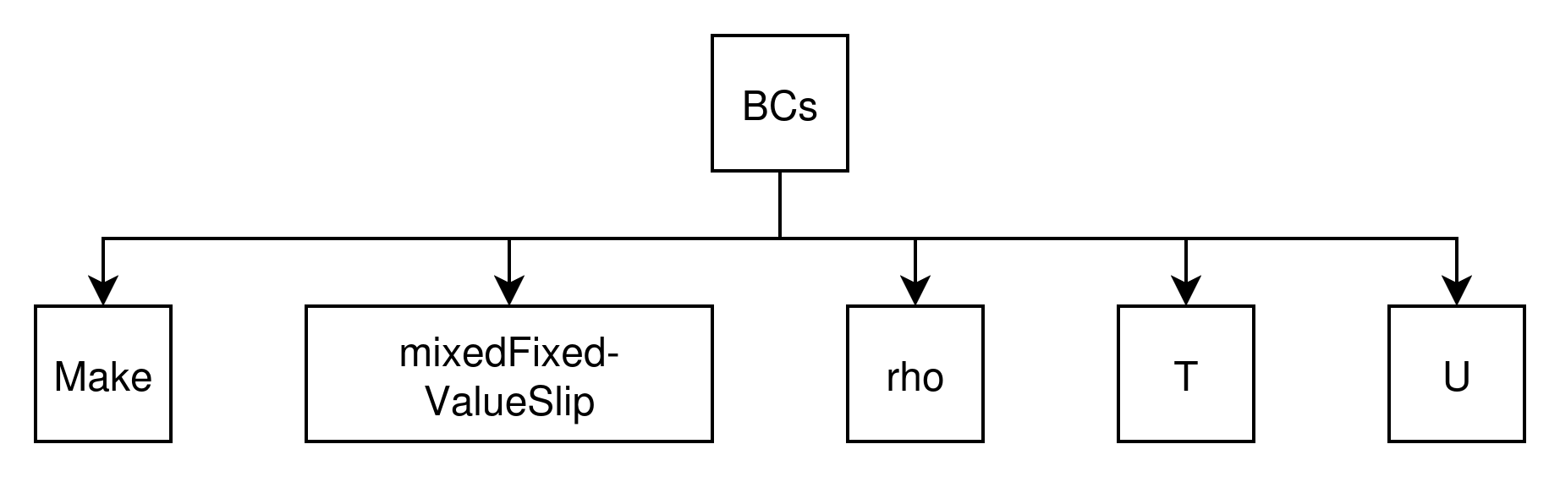
3.1.1.1. BCs/ Folder
In this folder:
Make/ contain files and options files for wmake to compile the solver.
mixedFixedValueSlip/ contain headers for blending slip and fixed boundary conditions.
rho/ contain headers for fixed value density boundary conditions.
T/ contain headers for Smoluchowski Temperature Jump boundary condition.
U/ contain headers for Maxwell Velocity Slip boundary condition.
Notes:
TASNİF DIŞI

Slide 8
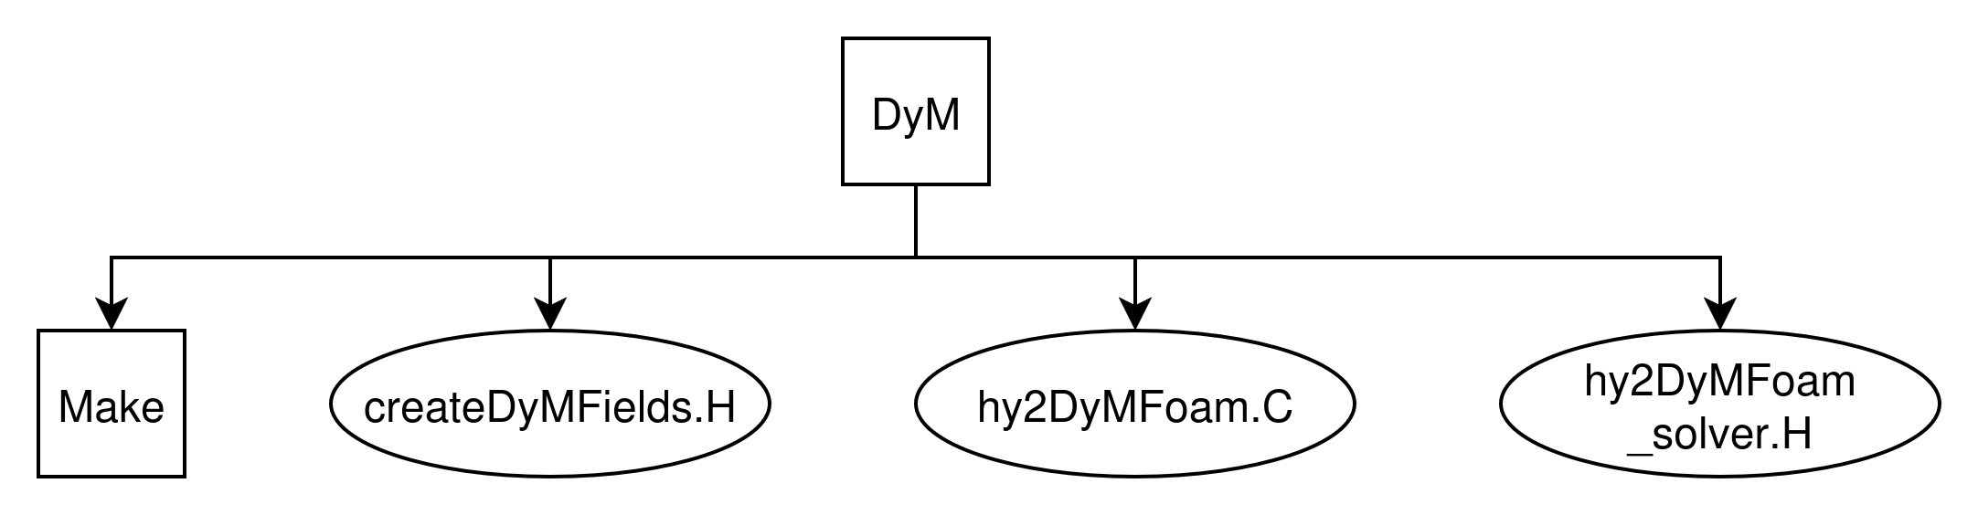
3.1.1.2. DyM/ Folder
In this folder:
Make/ contain files and options files for wmake to compile the solver.
createDyMFields.H header file for creating fields that are required.
hy2DyMFoam.C solver file for invoking commands.
hy2DyMFoam_solver.H header file for handling input/output data of the solver.
Notes:
TASNİF DIŞI

Slide 9
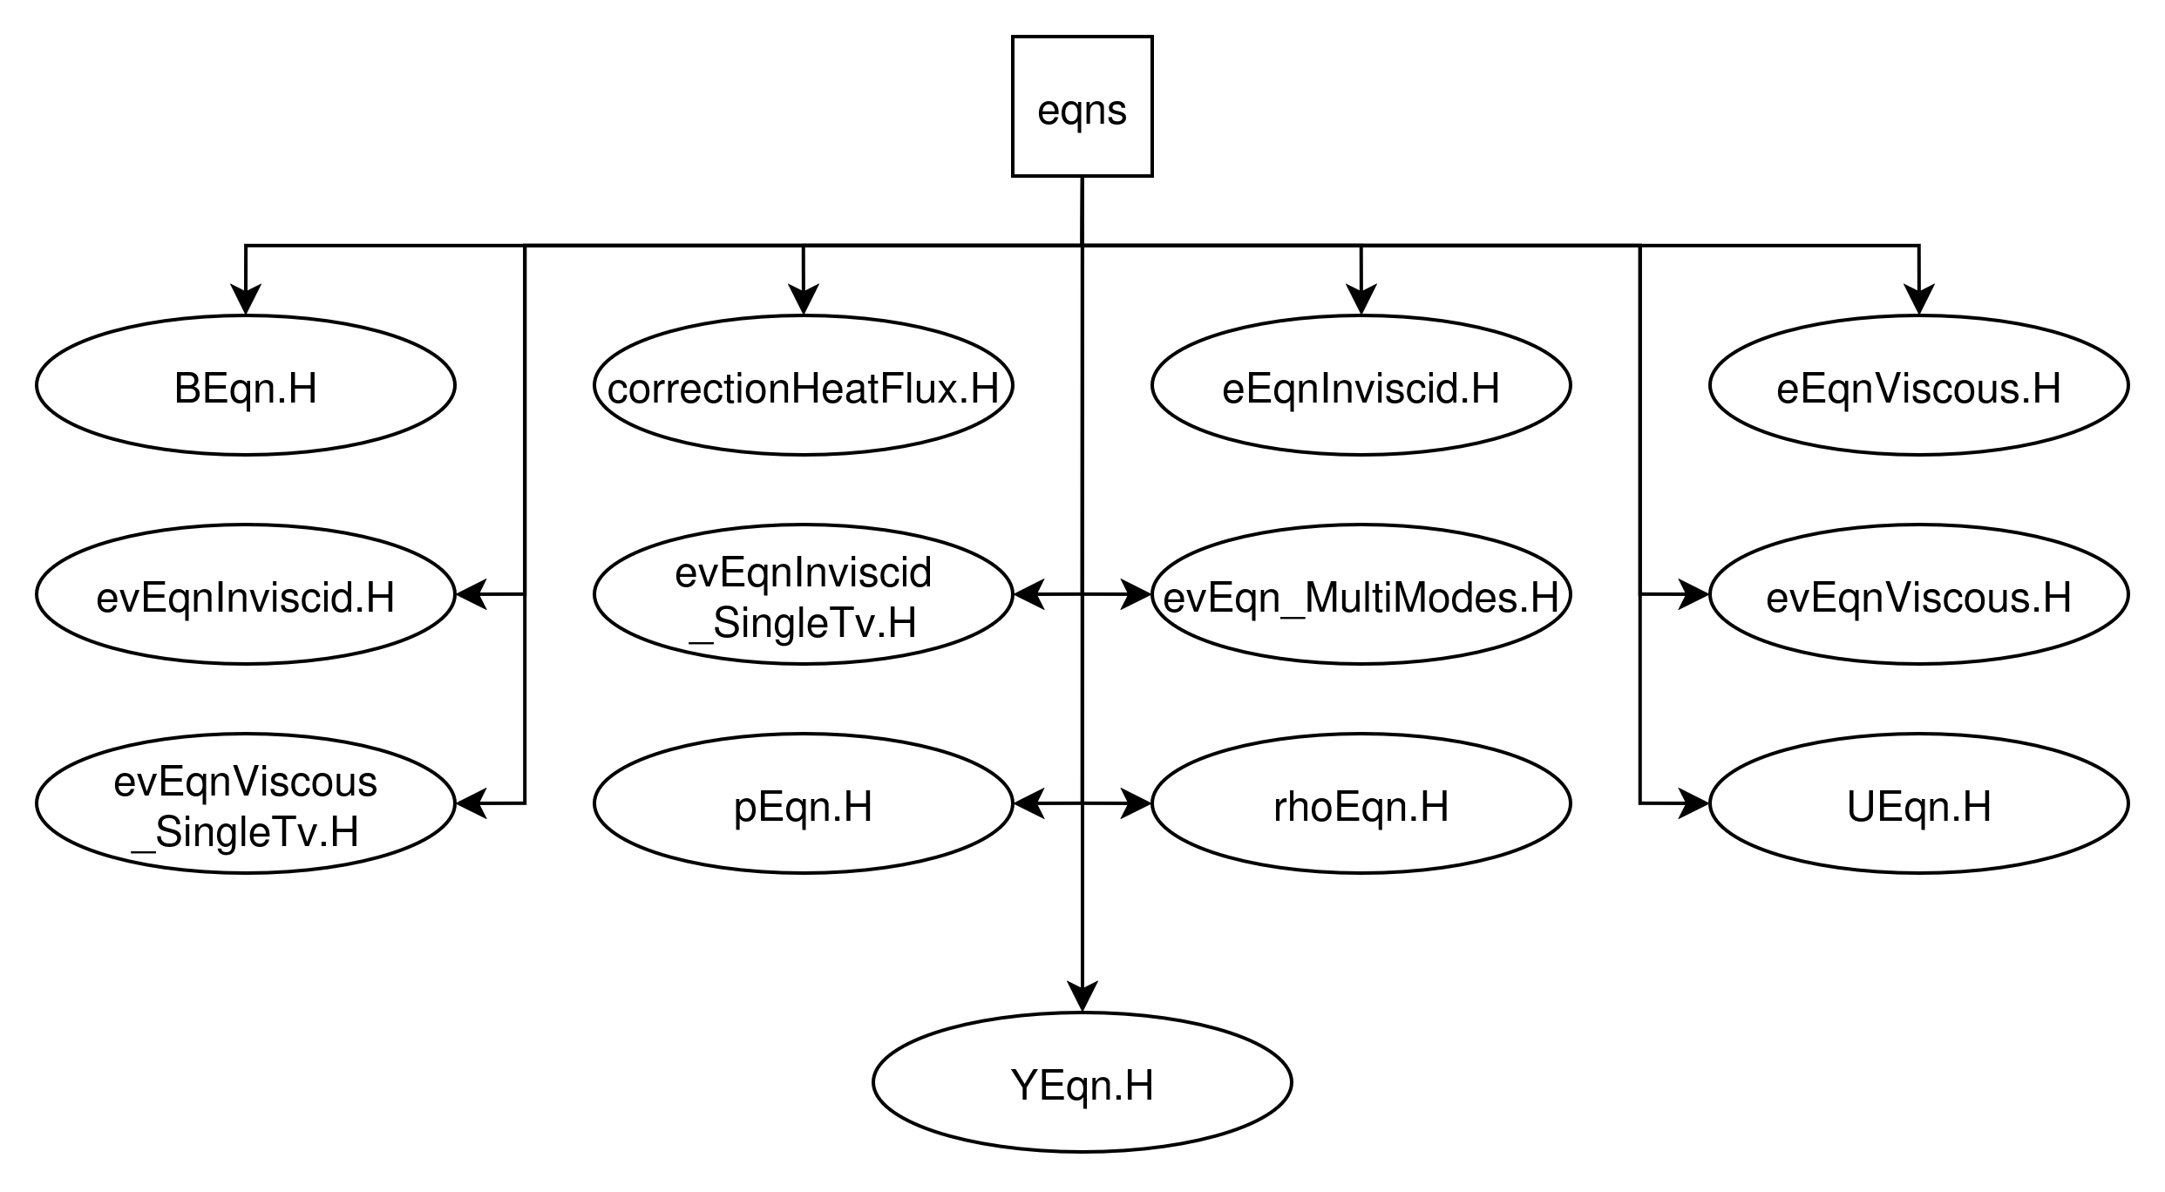
3.1.1.3. eqns/ Folder
In this folder:
BEqn.H is header file that is necessary for magnetic field solution.
correctionHeatFlux.H is header file that implements a heat correction. Only active in dev mode.
eEqnInviscid.H is header file that implements inviscid TR energy equation.
eEqnViscous.H is header file that implements viscous TR energy equation.
evEqnInviscid.H is header file that implements inviscid VE energy equations.
evEqnInviscid_SingleTv.H is header file that implements inviscid V energy equations.
evEqn_MultiModes.H is header file that implements VV, VT, HE temp. relaxations for inviscid energy equations.
evEqnViscous.H is header file that implements viscous VE energy equations.
evEqnViscous_SingleTv.H is header file that implements viscous V energy equations.
pEqn.H is header file that implements pressure calculation from density.
rhoEqn.H is header file that implements mixture continuity equation.
UEqn.H is header file that implements inviscid/viscous momentum equation.
YEqn.H is header file that implements specie transport/continuity equation.
Notes:
TASNİF DIŞI

Slide 10
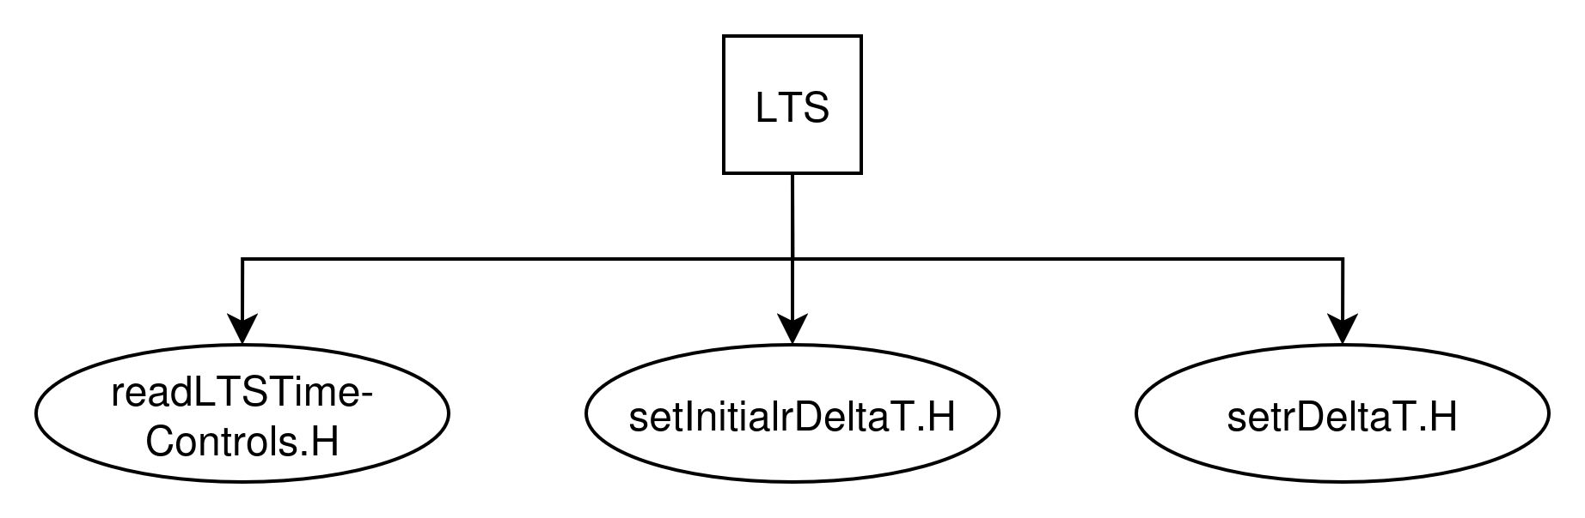
3.1.1.4. LTS/ Folder
In this folder:
readLTSTimeControls.H header file for coefficients LTS needs.
setInitialrDeltaT.H header file for local time stepping (LTS).
setrDeltaT.H header file for calculating timestep from local Courant number.
Notes:
TASNİF DIŞI

Slide 11
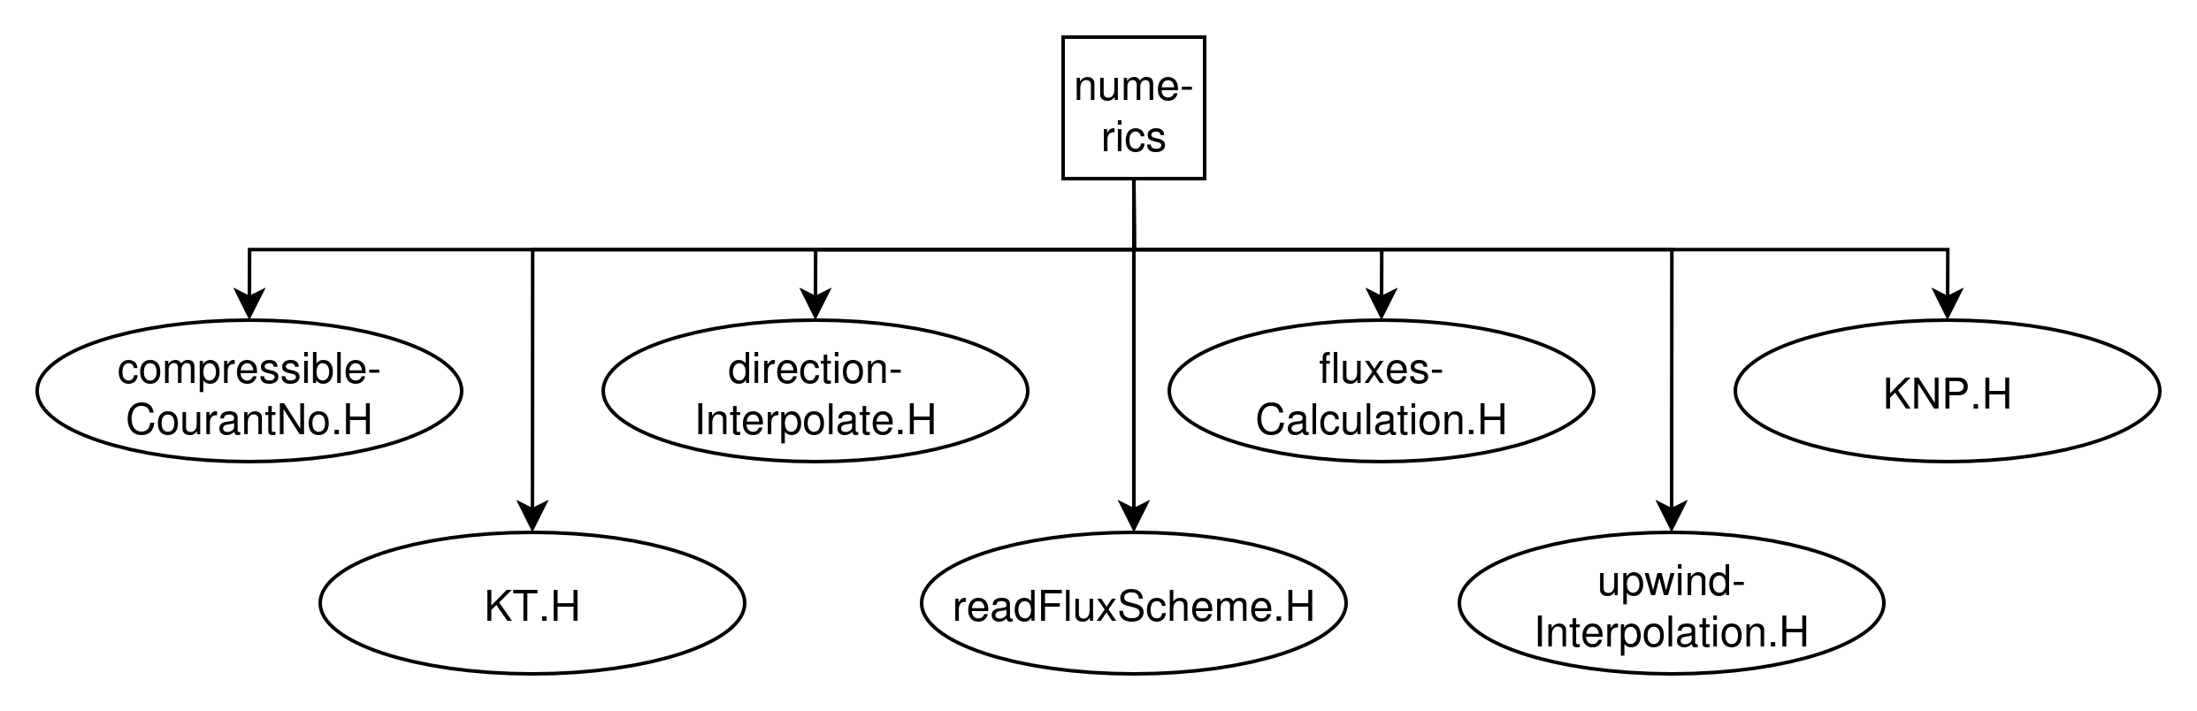
3.1.1.5. numerics/ Folder
In this folder:
compressibleCourantNo.H is header file that implements mean and max wave speed based Courant Numbers.
directionInterpolate.H is header file that implements interpolation of field according to given dir.
fluxesCalculation.H is header file that implements selection of KNP or KT flux scheme.
KNP.H is header file that implements Kurganov-Noelle-Petrova flux scheme.
KT.H is header file that implements Kurganov-Tadmor flux scheme.
readFluxScheme.H is header file that implements log outputs of flux scheme selection.
upwindInterpolation.H is header file that implements interpolation of field according to upwind dir.
Notes:
TASNİF DIŞI

Slide 12
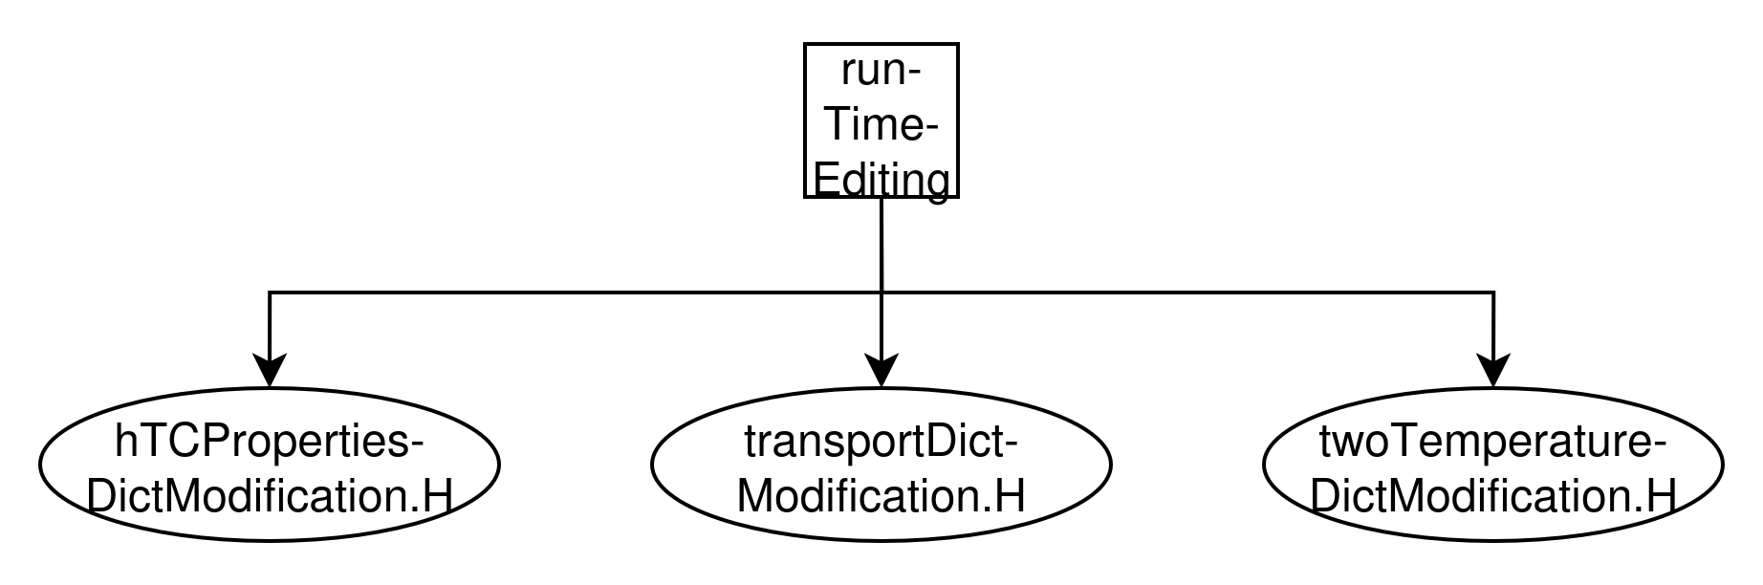
3.1.1.6. runTimeEditing/ Folder
In this folder:
hTCPropertiesDictModification.H is header file that handles run time hypersonic TC properties.
transportDictModification.H is header file that handles run time transport properties.
twoTemperatureDictModification.H is header file that handles two-temp model relaxations.
Notes:
TASNİF DIŞI

Slide 13
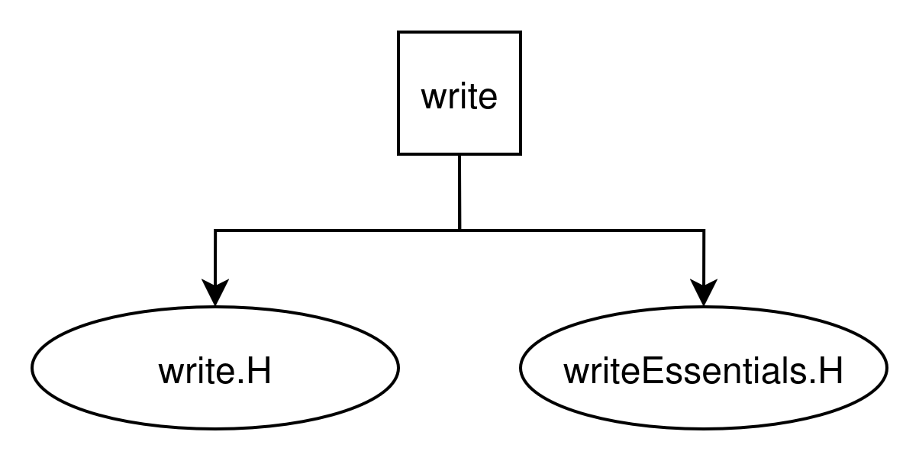
3.1.1.7. write/ Folder
In this folder:
write.H is header file that handles log outputs of reactions, transport properties etc.
writeEssentials.H is header file that handles log outputs of pressure, velocity, mass fractions etc.
Notes:
TASNİF DIŞI

Slide 14
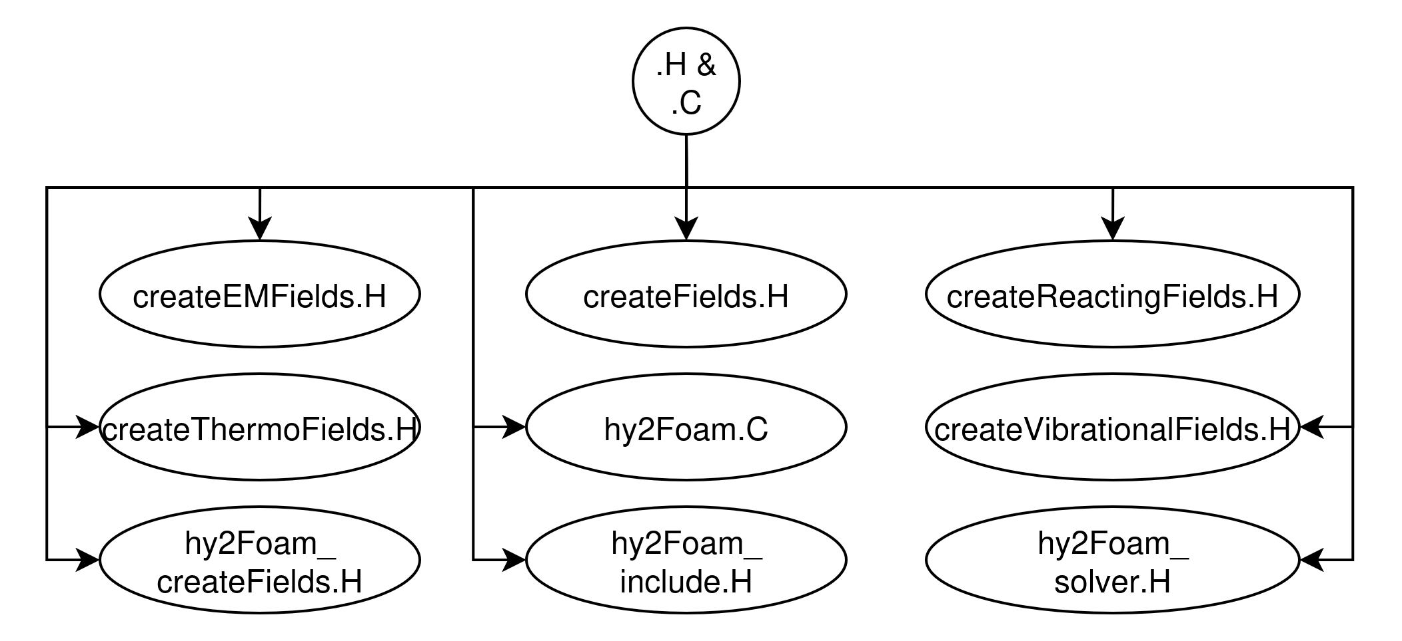
3.1.1.8. .H & .C Files
In this folder:
createEMFields.H is header file that is necessary for creating magnetic fields.
createFields.H is header file that calls createThermoFields, createReactingFields, createVibrational Fields.
createReactingFields.H is header file that creates fields related to reacting mixtures.
createThermoFields.H is header file that creates essential fields.
hy2Foam.C is solver source file that runs the simulations.
createVibrationalFields.H is header file that creates vibrational energy fields.
hy2Foam_createFields.H is header file that calls all of the headers defined above.
hy2Foam_include.H is header file that includes libraries from src/ folder.
hy2Foam_solver.H is header file that merges everything and running the actual simulation.
Notes:
TASNİF DIŞI

Slide 15
3.2. src/ Folder
This folder contains high temperature chemistry models, including reaction rates, reaction mechanisms etc.
This folder contains thermophysicalModels necessary for gas properties before starting to solve the problem.
Notes:
TASNİF DIŞI

Slide 16
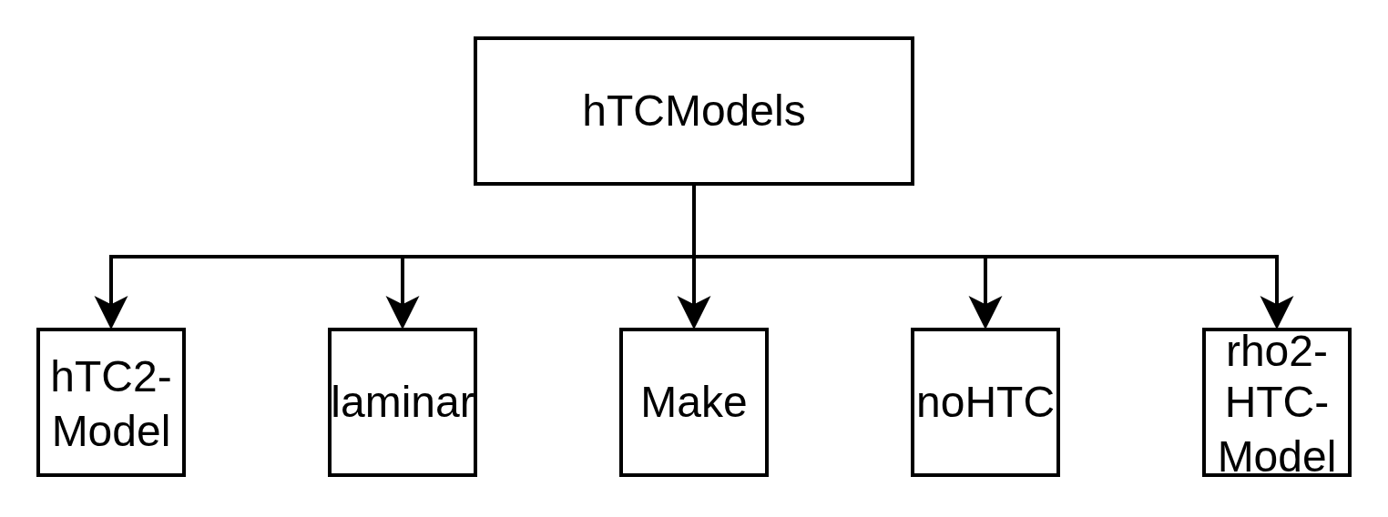
3.2.1. hTC/ Folder
This folder contains high temperature chemistry model base class and its headers.
This folder contains high temperature chemistry class when the flow is laminar.
This folder contains dummy class for high temperature chemistry when there is no reactions.
This folder contains default high temperature chemistry class for ordinary reactions.
Notes:
TASNİF DIŞI

Slide 17
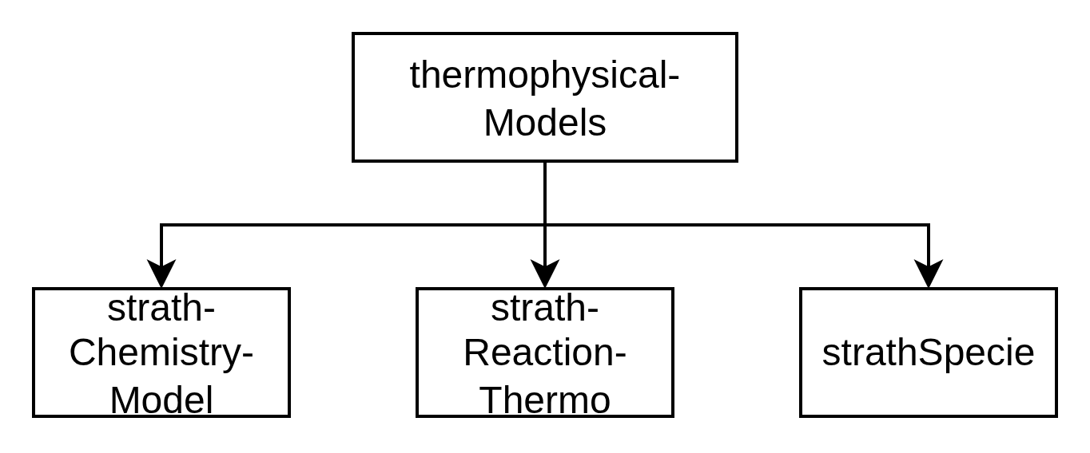
3.2.2. thermophysicalModels/ Folder
This folder contains chemistry classes that extend base chemistry classes. It will be expanded later on.
This folder contains reaction classes that handles reactions happening between species. It will be expanded later on.
This folder contains thermophysical property classes which are necessary.
Notes:
TASNİF DIŞI

Slide 18
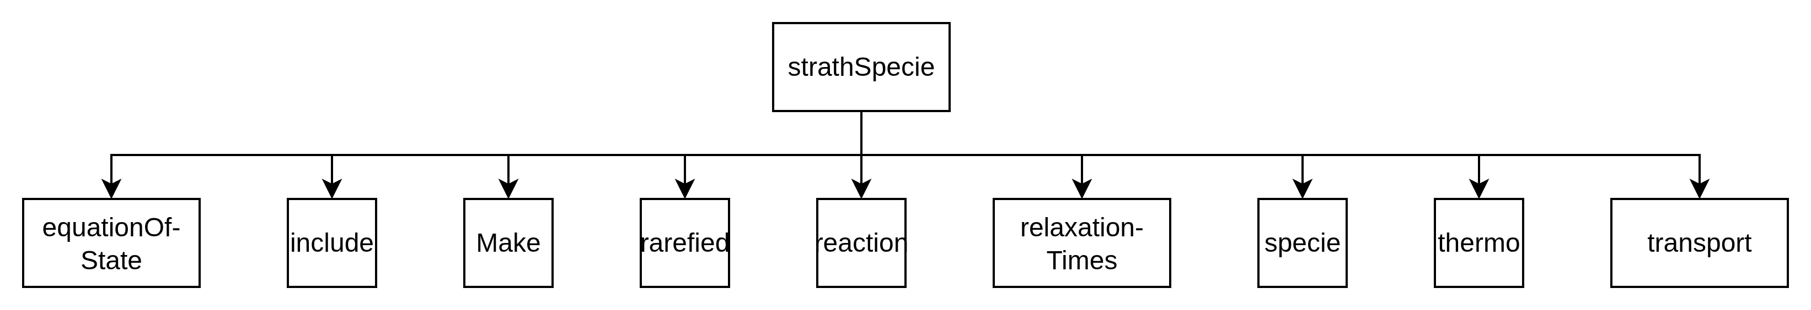
3.2.2.1. stratchSpecie/ Folder
This folder contains class that holds equation of state definition and its headers.
This folder contains classes that define acceptable specie properties in OpenFOAM.
This folder contains transport properties classes which includes mixing rules, viscosity, thermal conductivity etc.
Notes:
TASNİF DIŞI

Slide 19
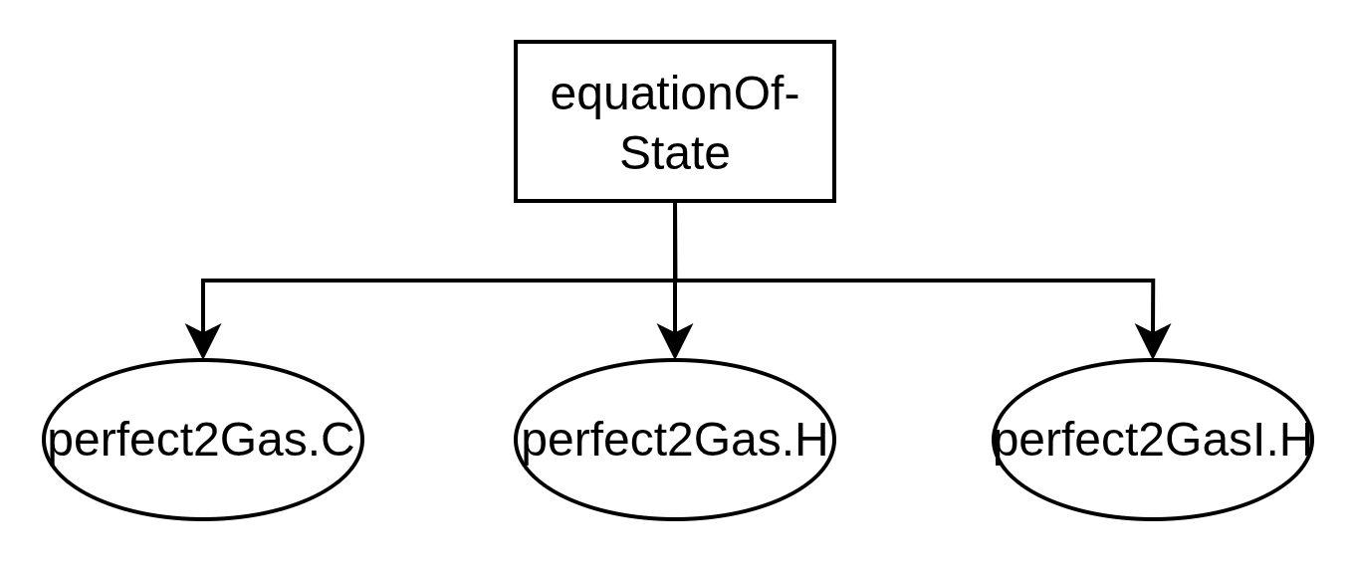
3.2.2.1.a. equationOfState/ Folder
Class definition file.
Declaration and intentions file.
Function implementation file.
Notes:
TASNİF DIŞI

