Slide 1
Week 9
Mehmet Furkan Tunç
15 April 2025
Thesis Study Report
Notes:
TASNİF DIŞI

Slide 2
Contents
1. Current Timeline
4. Governing Equations
4.1. Conventional N-S Equations
4.2. Non-eq. N-S Equations
4.2.1. Chemical Source Term
4.2.2. Mass Diffusion Term
4.2.3. Thermodynamic Properties
4.2.4. Transport Properties
4.2.5. Mixing Rule
4.2.6. Energy Source Terms
2. Introduction
3. Overall Literature Review
3.1. Flow Types
3.2. Equilibrium Term
3.3. Rarefication Degree
Notes:
TASNİF DIŞI

Slide 3
Contents
5. Selected Solvers
6. Test Cases
5.1. hy2Foam
5.1.1. Governing Equations
5.1.2. Discretization Process
5.1.3. Execution Sequence
5.1.4. Flux Reconstruction
5.2. Eilmer
5.2.1. Governing Equations
5.2.2. Discretization Process
5.2.3. Execution Sequence
5.2.4. Flux Reconstruction
5.3. SU2-NEMO
5.3.1. Governing Equations
5.3.2. Discretization Process
5.3.3. Execution Sequence
5.3.4. Flux Reconstruction
5.4. hyperReactingFoam
5.5. Solver Comparisons
6.1. Testing Timeline
6.2. Adiabatic Heat Bath
6.3. Blunted Cone
6.4. Double Wedge
7. Future Work
Notes:
TASNİF DIŞI

Slide 4
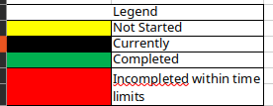
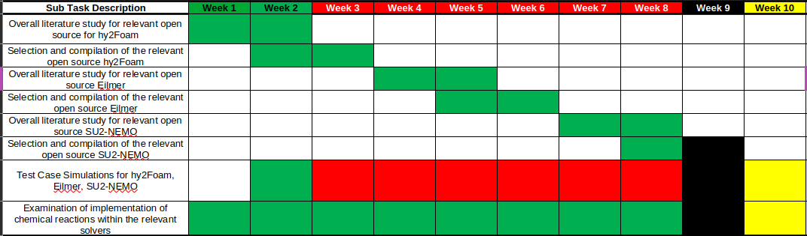
1. Current Timeline
Notes:
TASNİF DIŞI

Slide 5
2. Introduction
In the current study, main goal is:
Developing transient, compressible, two-temperature, 3D, Implicit semi-coupled, thermochemical non-equilibrium hypersonic CFD solver
Continuum assumption should hold for the flows that the developed solver can solve (Kn_max < 1).
Main goal is divided into smaller tasks. For the semester, study milestones are:
Studying literature of three selected non-equilibrium hypersonic CFD solvers
Running tutorial cases in selected CFD solvers
Examining implementation of governing equations and chemistry models in the selected CFD solvers
Notes:
TASNİF DIŞI

Slide 6

3. Overall Literature Review
Notes:
TASNİF DIŞI

Slide 7
3. Overall Literature Review
Literature review and subsequent study of the literature is limited to solvers that are capable of:
Solving compressible hypersonic flow
Solving thermochemical non-equilibrium flow
Employing two-temperature model
Main development platform is OpenFOAM, therefore two of the selected solvers are implemented within OpenFOAM framework. Also, outside of the hypersonic solvers, in order to understand and implement chemical reaction modeling, reactingFoam will be studied extensively.
Notes:
TASNİF DIŞI

Slide 8
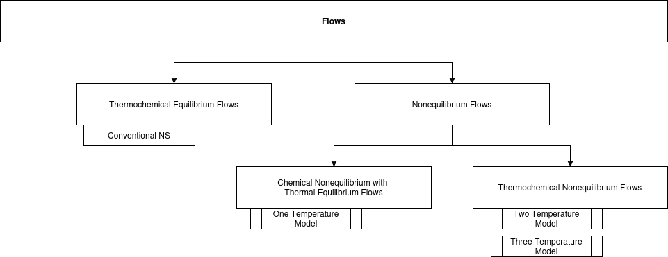
3.1. Flow Types
Reacting flows can be separated into two main camp:
  Equilibrium Flows: Internal energy modes are not considered and chemical reactions are independent of time, only depending pressure and temperature.
  Non-equilibrium Flows: Flow is rarefied enough that internal energy modes are taken into account and chemical reactions cannot happen fast enough, so they must be modeled as time-dependent.
Notes:
TASNİF DIŞI

Slide 9
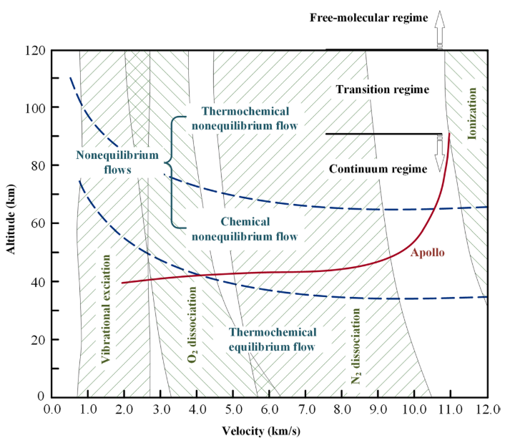

3.2. Equilibrium Term
Equilibrium: A system is in equilibrium when its macroscopic properties no longer change with time.
Relaxation: Physical relaxation refers to the process by which a system evolves toward equilibrium after being disturbed from its initial state.
Thus, a system is in non-equilibrium state if characteristic flow time is longer than relaxation times of the chemical reactions or internal energy modes.
Notes:
TASNİF DIŞI

Slide 10
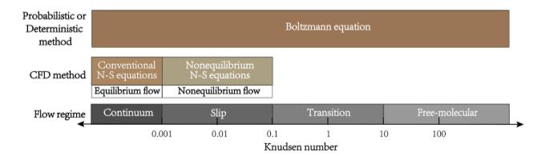
3.3. Rarefication Degree
Since rarefication of a gas influences the characteristic flow time, that is mean collision time between fluid molecules, equilibrium of the flow is directly related to the rarefication degree of the flow.
After 0.001 Kn, flow cannot be solved with conventional Navier-Stokes equations because heat transfer model of Fourier equation does not reflect the reality of the flow. According to non-equilibrium degree of the flow, chemical non-equilibrium and/or thermal non-equilibrium must be modelled with the governing equations using two- or three-temperature models which are collectively named as non-equilibrium Navier-Stokes equations.
Notes:
TASNİF DIŞI

Slide 11
4. Governing Equations
According to chemical equilibrium state of the flow, two sets of governing equations can be employed:
Conventional Navier-Stokes Equations
Non-equilibrium Navier-Stokes Equations
According to thermal equilibrium state of the flow, three different models of non-equilibrium Navier-Stokes equations can be employed:
One-temperature Model for thermal equilibrium flow
Two-temperatures Model for translational-rotational and vibrational-electronic coupling terms
Three-temperatures Model for translational-rotational, vibrational, and electronic terms
In the non-equilibrium flow models, there are several additional terms which are needed to be addressed with additional equations and emprical data. Limitations of these equations and limit conditions of the emprical data determines what are the extreme conditions that can be employed for the non-equilibrium flow models.
Notes:
TASNİF DIŞI

Slide 12
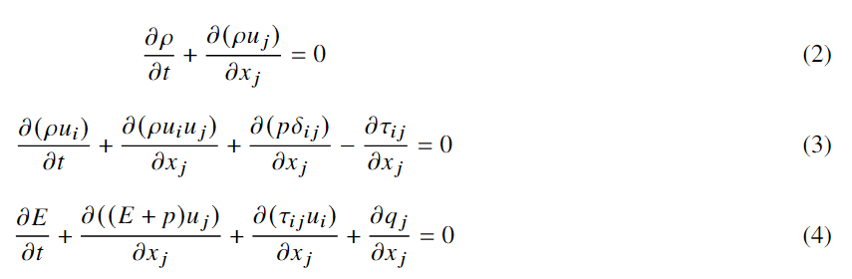
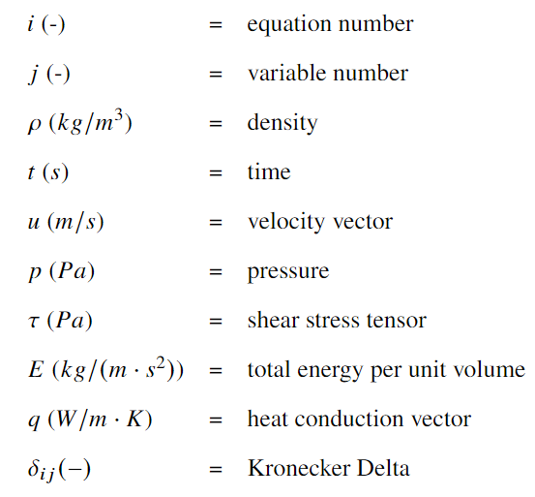
4.1. Conventional N-S Equations
Conventional Navier-Stokes Equations:
(2) Continuity Equation
(3) Momentum Transportation Equation
(4) Energy Transportation Equation
Flows that are in the thermochemical equilibrium state can be handled by conventional Navier-Stokes equations.
Notes:
TASNİF DIŞI

Slide 13
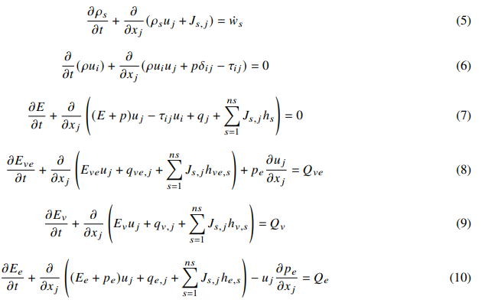
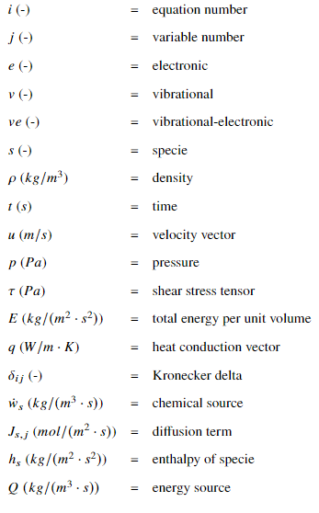
4.2. Non-eq. N-S Equations
Non-equilibrium Navier-Stokes Equations:
(5) Specie Continuity Equation
(6) Momentum Transportation Equation
(7) Energy Transportation Equation
(8) Vibrational-Electronic Energy Transportation Equation
(9) Vibrational Energy Transportation Equation
(10) Electronic Energy Transportation Equation
One Temp. Model: (5)-(6)-(7)
Two Temp. Model: (5)-(6)-(7)-(8)
Three Temp. Model: (5)-(6)-(7)-(9)-(10)
We are going to employ (5)-(6)-(7)-(9), which is three-temp. model without electronic terms and equations because we will not deal with ions and electrons.
Notes:
TASNİF DIŞI

Slide 14
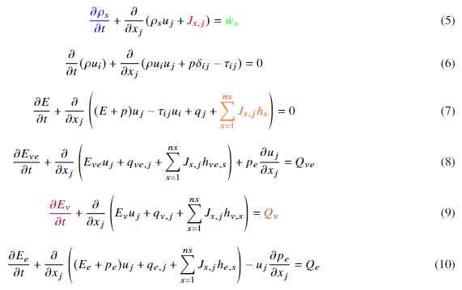
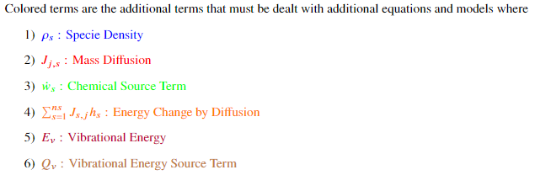
4.2. Non-eq. N-S Equations
Notes:
TASNİF DIŞI

Slide 15



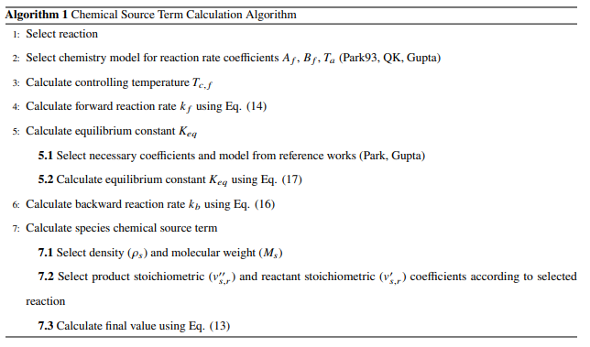

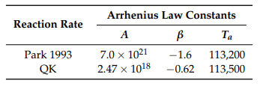
4.2.1. Chemical Source Term
where
and
For equilibrium constant calculation, Park and Gupta proposed two models:
Notes:
TASNİF DIŞI

Slide 16






4.2.2. Mass Diffusion Term
1) Fick’s Diffusion Model:
and
where
or
Lewis Number is taken as 1.4
2) Modified Fick’s Diffusion Model:
where
or
Lewis Number is taken as 1.4
3) Stefan-Maxwell Diffusion Model:
where
or
Lewis Number is taken as 1.4
Thermal conductivity and special heat coefficient under constant pressure are calculated in thermodynamical and transport properties section.
Notes:
TASNİF DIŞI

Slide 17
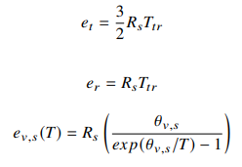
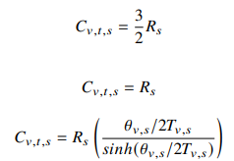
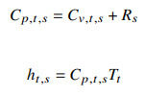

4.2.3. Thermodynamic Properties
Kinetic Energy
Trans. Energy
Rot. Energy
Vibr. Energy
Chem. Energy
Energy of a mixture can be written as the sum of the different energy modes. In order to calculate these energy types, energy of each specie is calculated and added to total.
Notes:
TASNİF DIŞI

Slide 18



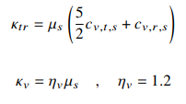

4.2.4. Transport Properties
Viscosity
Thermal Conductivity
One-temperature model Fourier Eq. :
Two-temperature model Fourier Eq. :
For the calculation of the heat conduction, Fourier equation is employed.
Thermal conductivity is calculated by Eucken’s relationship as given above. Limit of this relationship is around 6000 K, after 6000 K relationship breaks down.
Viscosity is calculated by curve-fitting formulas Blottner and Gupta gives. Reason for that approach is that curve-fitting is applied to experimental data and more accurate than theoretical models.
Notes:
TASNİF DIŞI

Slide 19


4.2.5. Mixing Rule
where
Wilke’s mixing rule is applied with the goal of determining mixture properties from the specie properties that belongs to the mixture.
It should be noted that Wilke’s mixing rule is only applicable below 10000 K and is only valid for neutral gases.
Notes:
TASNİF DIŞI

Slide 20

4.2.6. Energy Source Terms
Vibrational-Translational Energy Source Term
Millikan-White-Park Relaxation with classical/modified Landau-Teller formulation is employed for each specie.
Vibrational-Vibrational Energy Source Term
Knab’s vibrational-vibrational energy transfer formulation is employed for each specie.
Chemical-Vibrational Energy Source Term
ParkTTv model is employed for each reaction.
There are more than one model for each energy mode, however simplicity and robustness is taken into the account.
Notes:
TASNİF DIŞI

Slide 21










4.2.6. Energy Source Terms
Classical Landau-Teller
Modified Landau-Teller
Calculation
Sequence
where
Notes:
TASNİF DIŞI

Slide 22

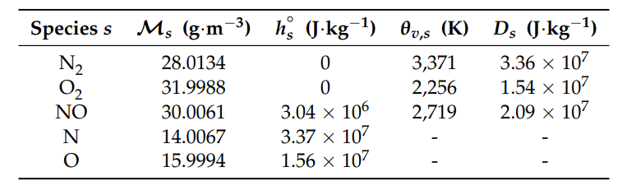


4.2.6. Energy Source Terms
Knab V-V Formula
where
Park TTv Model
where
Notes:
TASNİF DIŞI

Slide 23
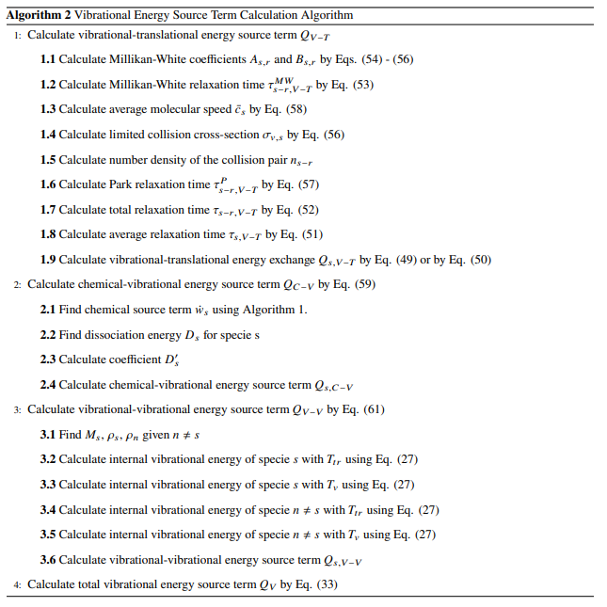
4.2.6. Energy Source Terms
Notes:
TASNİF DIŞI

Slide 24
5. Selected Solvers
01
03
SU2-
Nemo
hy2Foam
It is most commonly reviewed solver in this list. Navier-Stokes-Fourier equations are solved within OpenFOAM framework. Two-temperature model is employed.
It is the hypersonic and non-equilibrium solver of the SU2 framework. Two-temperature model is also employed.
02
04
Eilmer
hyperReactingFoam
It is selected for organized and easier to understand implementation. Navier-Stokes-Fourier equations are solved. Two-temperature model is employed.
It has extensive documentation about implementation within OpenFOAM framework. After general literature review, this solver will be main focus.
Notes:
TASNİF DIŞI

Slide 25
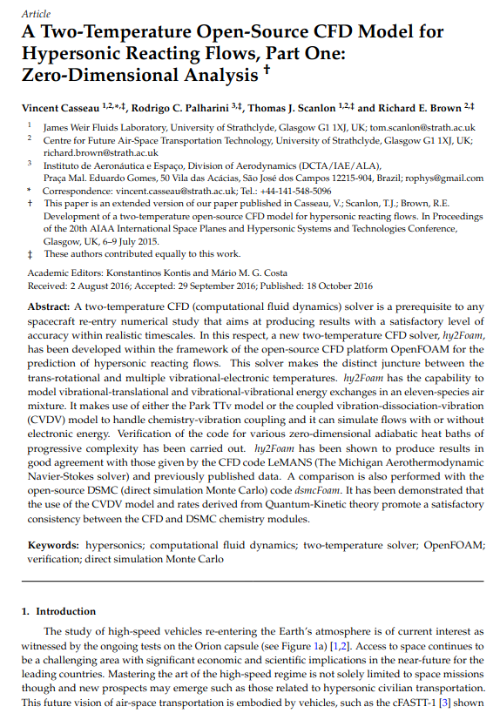
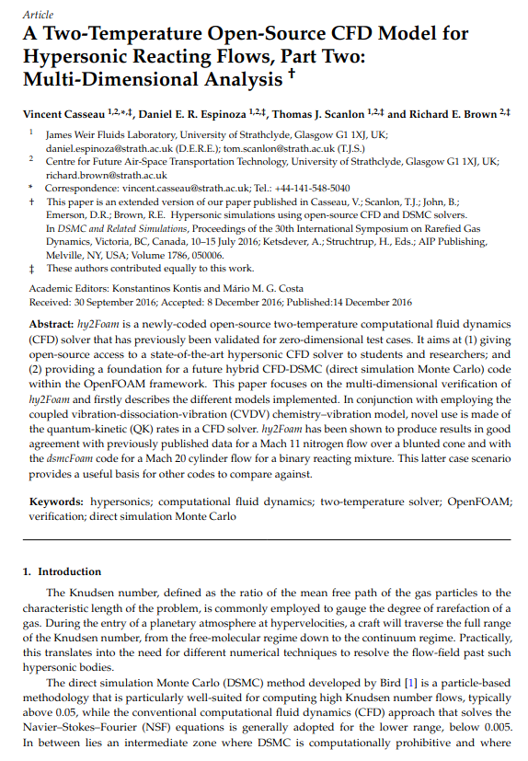
5.1. hy2Foam
hy2Foam(Hypersonic flow with 2-temperature model) is a two-temperature CFD solver which can handle 11 species air-mixture model.
Notes:
TASNİF DIŞI

Slide 26
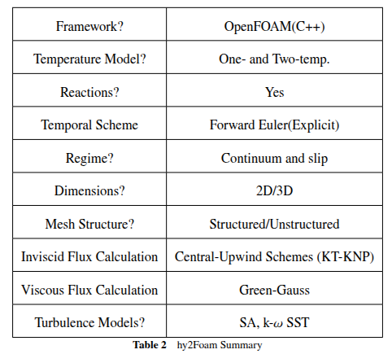
5.1. hy2Foam
hy2Foam’s general capabilities are shared below:
Notes:
TASNİF DIŞI

Slide 27

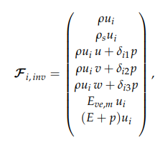
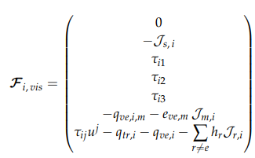

5.1.1. Governing Equations
where
Two-temperature model is given in flux-divergence form.
It should be noted that mixture continuity equation is also included.
Notes:
TASNİF DIŞI

Slide 28
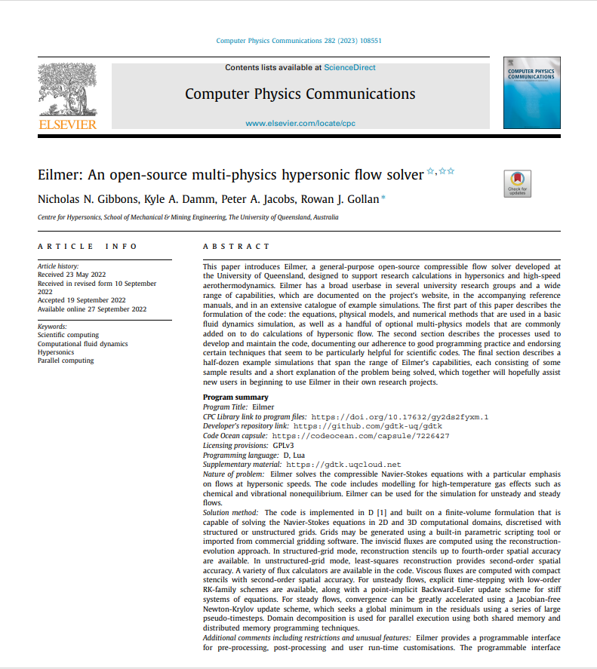
5.2. Eilmer
Eilmer is a general-purpose open-source compressible, hypersonic, non-equilibrium flow; two-temperature CFD solver.
Notes:
TASNİF DIŞI

Slide 29
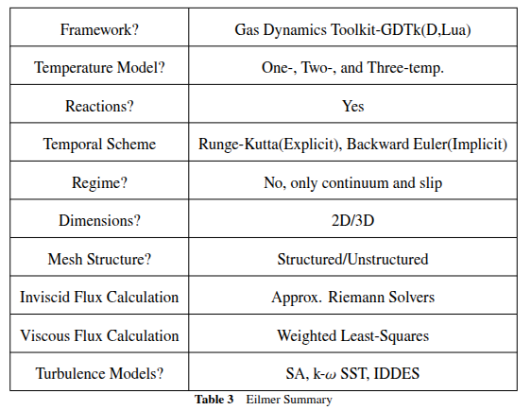
5.2. Eilmer
Eilmer’s general capabilities are shared below:
Notes:
TASNİF DIŞI

Slide 30

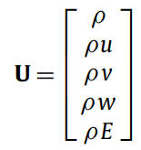
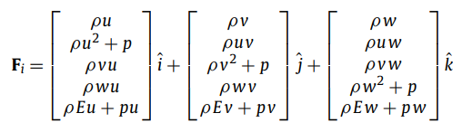
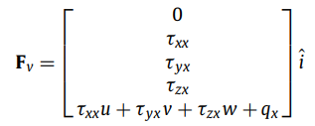
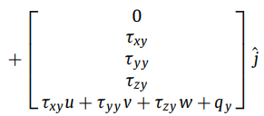
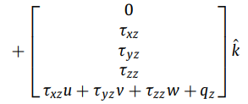
5.2.1. Governing Equations
where
For non-reacting, thermal equilibrium flow, governing equations are given as above.
Notes:
TASNİF DIŞI

Slide 31
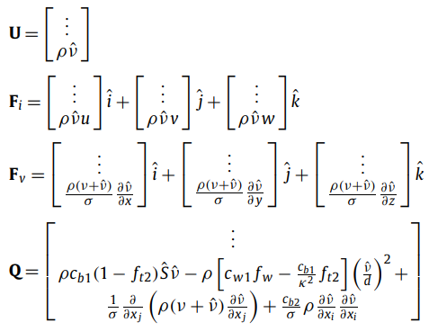
5.2.1. Governing Equations
For two-temperature and three-temperature models, extra terms are added to U.
For chemical reactions, a source term is added to continuity equation.
For mixtures, alongside mixture mass conservation equation, specie conservation equations are added.
For turbulence, RANS is employed:
  Spalart-Allmaras
  k-omega SST
  LES
Spalart-Allmaras
Notes:
TASNİF DIŞI

Slide 32

5.2.2. Discretization Process
where
Q term includes chemical reaction terms which is solved with subcycles because of numerical stiffness.
In implicit solutions, chemical reaction terms are included directly to the matrix.
Notes:
TASNİF DIŞI

Slide 33
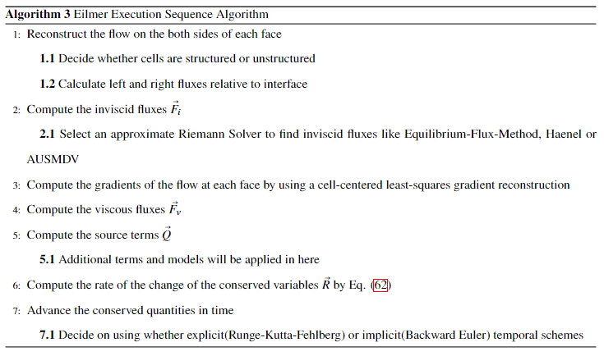
5.2.3. Execution Sequence
Notes:
TASNİF DIŞI

Slide 34

5.3. SU2-NEMO
SU2 is an open-source software suite developed to solve partial differential equations. In order to capture the complex physics of nonequilibrium flows, NonEquilibrium MOdeling (NEMO) code base is developed within SU2
framework.
Notes:
TASNİF DIŞI

Slide 35
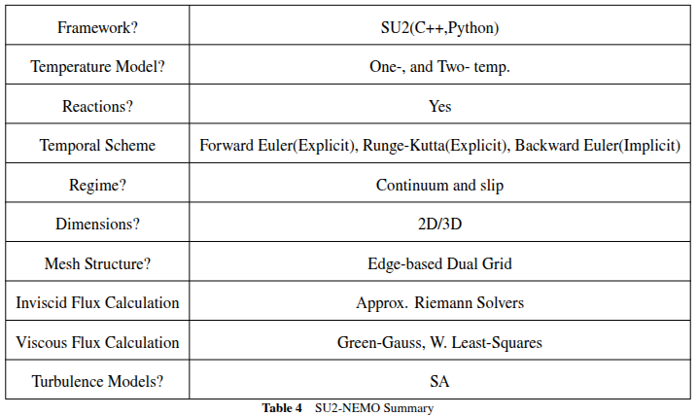
5.3. SU2-NEMO
SU2-NEMO’s general capabilities are shared below:
Notes:
TASNİF DIŞI

Slide 36
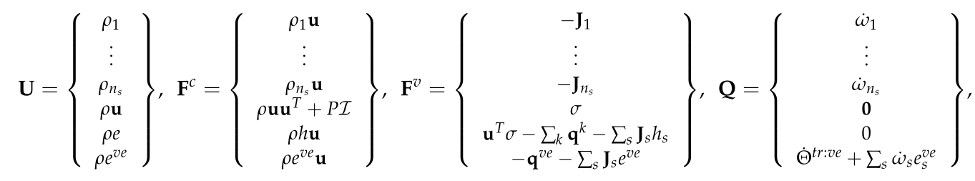
5.3.1. Governing Equations
where
For thermochemical nonequilibrium flow, governing equations are given as above.
Notes:
TASNİF DIŞI

Slide 37

5.3.1. Governing Equations
For turbulence, only Spalart-Allmaras is employed in SU2-NEMO. However, they state that turbulence in hypersonics is a work in progress.
Species are not considered individually, only mixture is considered.
Notes:
TASNİF DIŞI

Slide 38

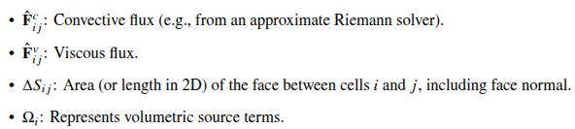
5.3.2. Discretization Process
where
Time integration can be done both implicitly and explicitly.
Implicit option is Backward Euler temporal scheme.
Explicit options are Runge-Kutta and Forward Euler temporal schemes.
Notes:
TASNİF DIŞI

Slide 39
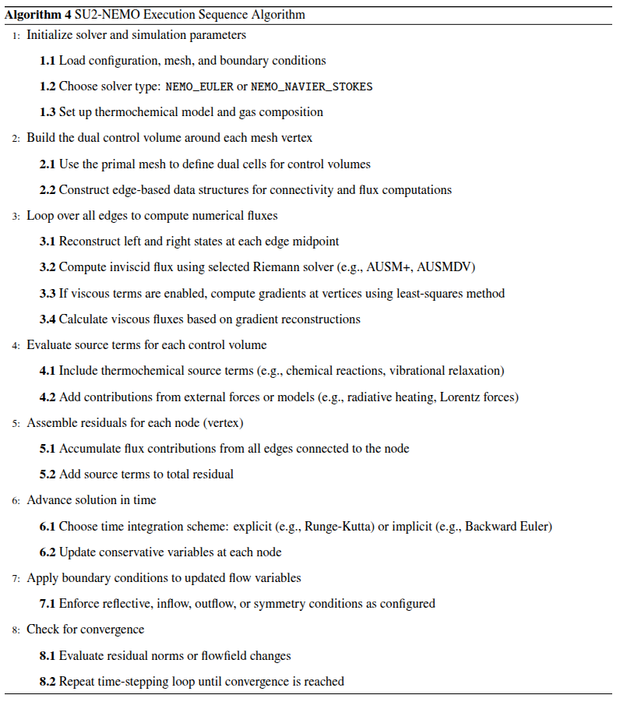
5.3.3. Execution Sequence
Notes:
TASNİF DIŞI

Slide 40
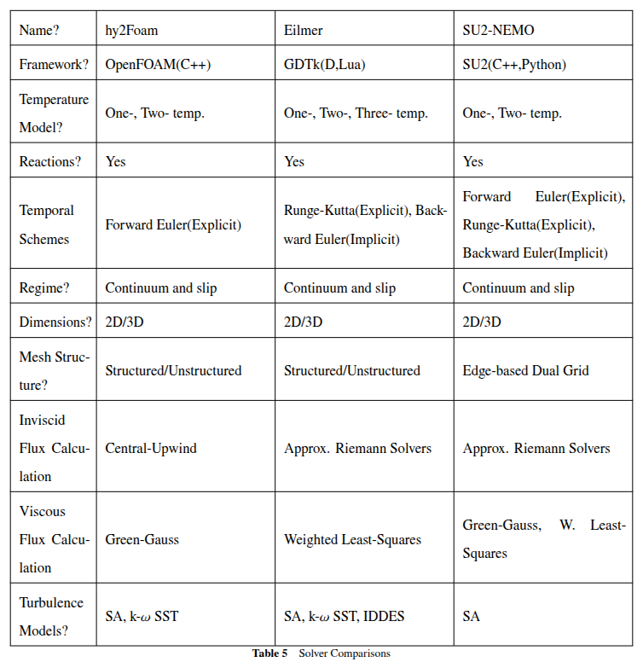
5.5. Solver Comparisons
Notes:
TASNİF DIŞI

Slide 41
6. Test Cases
Three test cases are selected from literature:
Adiabatic Heat Bath(0-D): Thermochemical non-equilibrium flow is disturbed within a single cell. Relaxation phenomenon will be observed with:
  Relaxation of Reacting H2-I2 Mixture
  Relaxation of a N2
  Relaxation of a non-Reacting and Reacting N2-N Mixture
  Relaxation of non-Reacting N₂ - O₂
  Thermal Eq. Reacting Air (N2-O2)
Blunted Cone(2-D): Hypersonic thermal non-equilibrium N2 free-stream flow is sent upon blunted cone. No reactions are taking place.
Double Wedge(2-D): Thermochemical non-equilibrium N2-O2 flow is sent upon double-wedge geometry.
Notes:
TASNİF DIŞI

Slide 42
6. Test Cases
Case Name | Geometry | Reacting? | Mesh Convergence? | Mesh (OpenFOAM) | Mesh (Eilmer) | Mesh (SU2) | Timestep Convergence?
Single Temp. Relaxation of H2-I2 | Heat Bath | Yes | No | Yes | No | No | No
V-T Relaxation of N2 | Heat Bath | No | No | Yes | No | No | No
V-T Relaxation of N2-N | Heat Bath | No | No | Yes | No | No | No
V-T and V-V Relaxation of N2-O2 | Heat Bath | No | No | Yes | No | No | No
Chemical Relaxation of Air | Heat Bath | Yes | No | Yes | No | No | No
V-T Relaxation of N2-N | Heat Bath | Yes | No | Yes | No | No | No
V-T Relaxation of N2 | Blunted Cone | No | No | Yes | No | No | No
V-T and V-V Relaxation of N2-O2 | Double Wedge | Yes | No | Yes | No | No | No
Notes:
TASNİF DIŞI

Slide 43
6.1. Testing Timeline
Notes:
TASNİF DIŞI

Slide 44
6.1. Testing Timeline
Notes:
TASNİF DIŞI

Slide 45
6.1. Testing Timeline
Notes:
TASNİF DIŞI

Slide 46
6.2. Adiabatic Heat Bath
In this case, several thermal non-equilibrium and chemical non-equilibrium mixtures are simulated.
Case Name | Geometry | Reacting? | Thermal Equilibrium?
Single Temp. Relaxation of H2-I2 | Heat Bath | Yes | Yes
V-T Relaxation of N2 | Heat Bath | No | No
V-T Relaxation of N2-N | Heat Bath | No | No
V-T and V-V Relaxation of N2-O2 | Heat Bath | No | No
Chemical Relaxation of Air | Heat Bath | Yes | Yes
V-T Relaxation of N2-N | Heat Bath | Yes | No
V-T Relaxation of N2 | Blunted Cone | No | No
V-T and V-V Relaxation of N2-O2 | Double Wedge | Yes | No
Notes:
TASNİF DIŞI

Slide 47
6.2. Adiabatic Heat Bath
Vibrational-Translational energy mode is going to be active for N2 relaxation cases. No chemical reactions are active. There are two sub-cases to consider: Vibrational Heating and Vibrational Cooling.
Physical Inputs | Vibrational Heating | Vibrational Cooling
TTr,N2 | 10000 K | 3000 K
TV,N2 | 1000 K | 10000 K
U | 0 m/s | 0 m/s
p | 101325 Pa | 101325 Pa
t | 1e-9 s | 1e-9 s
tend | 1e-5 s | 1e-4 s
XN2 | 1 | 1
Notes:
TASNİF DIŞI

Slide 48
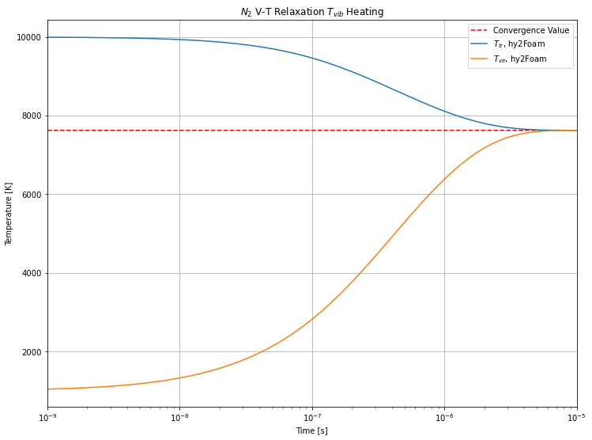
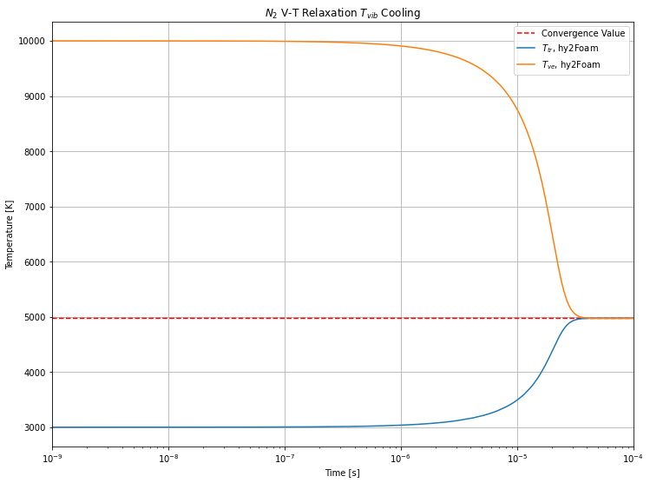
6.2. Adiabatic Heat Bath
Notes:
TASNİF DIŞI

Slide 49
6.2. Adiabatic Heat Bath
Vibrational-Translational energy mode is going to be active for N2 - N relaxation cases. No chemical reactions are active:
Physical Inputs | Vibrational Heating
TTr,N2 - TTr,N | 30000 K
TV,N2 - TV,N | 1000 K
U | 0 m/s
p | 41419.4 Pa
t | 1e-9 s
tend | 1e-5 s
XN2 | 0.5
XN | 0.5
Notes:
TASNİF DIŞI

Slide 50
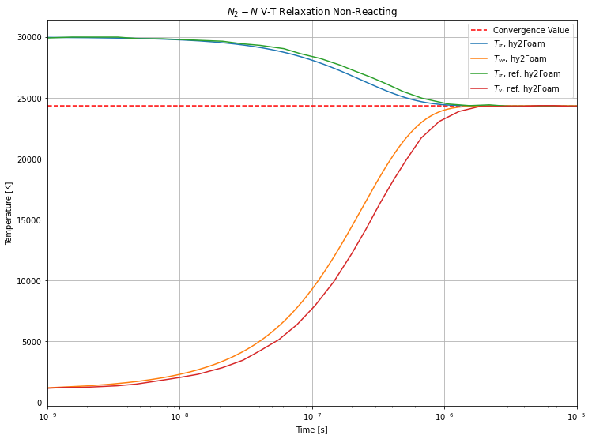
6.2. Adiabatic Heat Bath
Notes:
TASNİF DIŞI

Slide 51

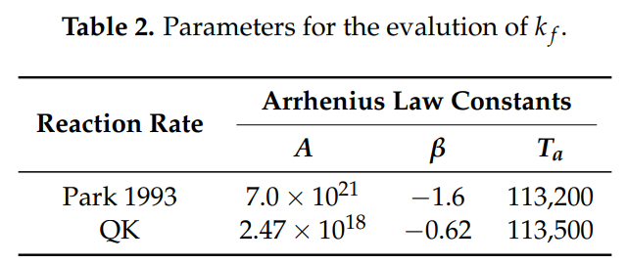
6.2. Adiabatic Heat Bath
Vibrational-Translational energy mode is going to be active for N2 - N relaxation cases. Chemical non-equilibrium is present in the flow. Only one reaction is taken into account:
Physical Inputs | Vibrational Heating
TTr,N2 - TTr,N | 30000 K
TV,N2 - TV,N | 1000 K
U | 0 m/s
p | 41419.4 Pa
t | 1e-9 s
tend | 1e-5 s
XN2 | 0.5
XN | 0.5
Notes:
TASNİF DIŞI

Slide 52
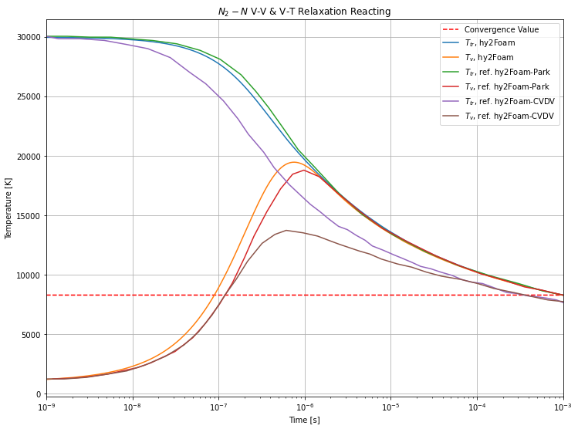
6.2. Adiabatic Heat Bath
Notes:
TASNİF DIŞI

Slide 53
6.2. Adiabatic Heat Bath
Vibrational-Translational and Vibrational-Vibrational energy modes are going to be active for N2 - O2 relaxation cases. No chemical reactions are active:
Physical Inputs | Vibrational Heating
TTr,N2 - TTr,N | 30000 K
TV,N2 - TV,N | 5000 K
U | 0 m/s
p | 101325 Pa
t | 1e-9 s
tend | 1e-5 s
XN2 | 0.5
XO2 | 0.5
Notes:
TASNİF DIŞI

Slide 54
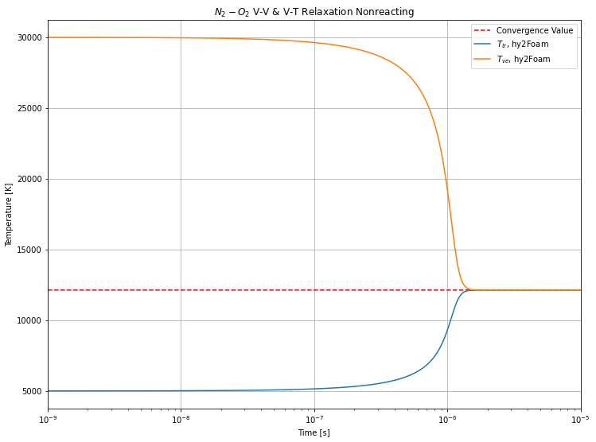
6.2. Adiabatic Heat Bath
Notes:
TASNİF DIŞI

Slide 55
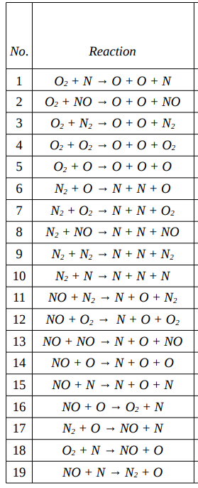
6.2. Adiabatic Heat Bath
Finally 5 species air relaxation case with thermal equilibrium is considered. Chemical non-equilibrium is present within flow field. 19 reactions are taken into account.
Physical Inputs | Vibrational Heating
T | 10000 K
U | 0 m/s
p | 6383.475 Pa
t | 1e-9 s
tend | 1e-3 s
XN2 | 0.79
XO2 | 0.21
Notes:
TASNİF DIŞI

Slide 56
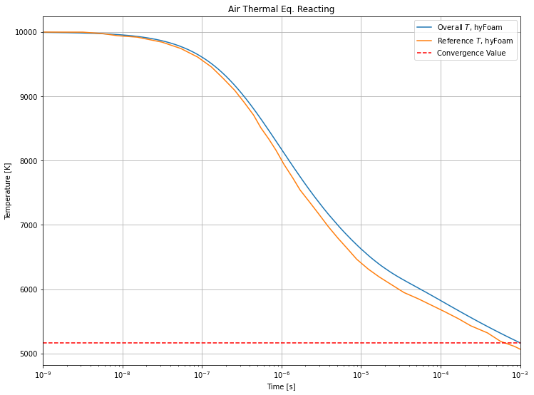
6.2. Adiabatic Heat Bath
Notes:
TASNİF DIŞI

Slide 57
7. Future Work
Additional equations and emprical data
Blunted Cone inputs, post-processing, computational cost, and literature comparison for hy2Foam
Double Wedge inputs, mesh conversion to SU2 and Eilmer frameworks
Notes:
TASNİF DIŞI

