Slide 1
Week 2
Mehmet Furkan Tunç
25 February 2025
Thesis Study Report

Slide 2
Contents
1. Current Timeline
4. Selected Solvers
4.1. hy2Foam
4.2. Eilmer
4.3. SU2-NEMO
4.4. hyperReactingFoam
4.5. Solver Comparisons
2. Introduction
5. Test Cases
5.1. Testing Timeline
5.2. Adiabatic Heat Bath
5.3. Blunted Cone
5.4. Double Wedge
3. Overall Literature Review
3.1. Flow Types
3.2. Equilibrium Term
3.3. Rarefication Degree
6. Future Work

Slide 3
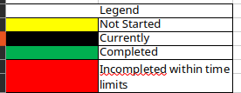
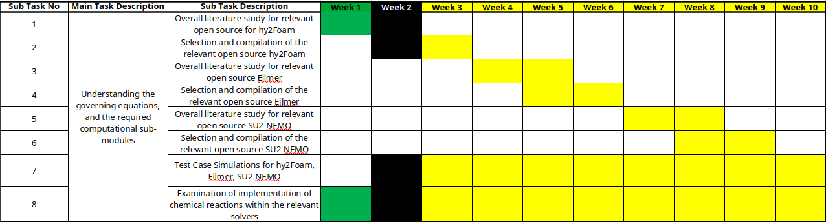
1. Current Timeline

Slide 4
2. Introduction
In the current study, main goal is:
Developing transient, compressible, two-temperature, 3D, Implicit semi-coupled, thermochemical non-equilibrium hypersonic CFD solver
Continuum assumption should hold for the flows that the developed solver can solve (Kn_max < 1).
Main goal is divided into smaller tasks. For the semester, study milestones are:
Studying literature of three selected non-equilibrium hypersonic CFD solvers
Running tutorial cases in selected CFD solvers
Examining implementation of governing equations and chemistry models in the selected CFD solvers

Slide 5

3. Overall Literature Review

Slide 6
3. Overall Literature Review
Literature review and subsequent study of the literature is limited to solvers that are capable of:
Solving compressible hypersonic flow
Solving thermochemical non-equilibrium flow
Employing two-temperature model
Main development platform is OpenFOAM, therefore two of the selected solvers are implemented within OpenFOAM framework. Also, outside of the hypersonic solvers, in order to understand and implement chemical reaction modeling, reactingFoam will be studied extensively.

Slide 7
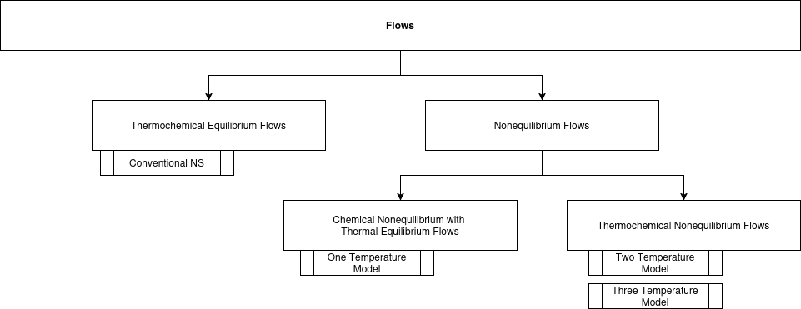
3.1. Flow Types
Reacting flows can be separated into two main camp:
  Equilibrium Flows: Internal energy modes are not considered and chemical reactions are independent of time, only depending pressure and temperature.
  Non-equilibrium Flows: Flow is rarefied enough that internal energy modes are taken into account and chemical reactions cannot happen fast enough, so they must be modeled as time-dependent.

Slide 8
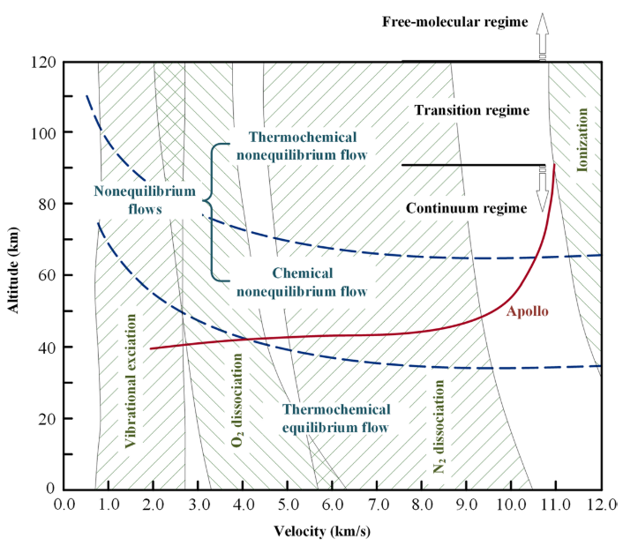

3.2. Equilibrium Term
Equilibrium: A system is in equilibrium when its macroscopic properties no longer change with time.
Relaxation: Physical relaxation refers to the process by which a system evolves toward equilibrium after being disturbed from its initial state.
Thus, a system is in non-equilibrium state if characteristic flow time is longer than relaxation times of the chemical reactions or internal energy modes.

Slide 9
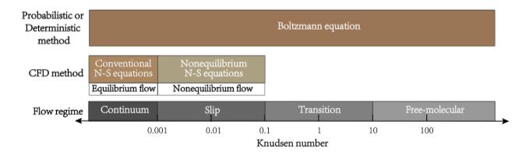
3.3. Rarefication Degree
Since rarefication of a gas influences the characteristic flow time, that is mean collision time between fluid molecules, equilibrium of the flow is directly related to the rarefication degree of the flow.
After 0.001 Kn, flow cannot be solved with conventional Navier-Stokes equations because heat transfer model of Fourier equation does not reflect the reality of the flow. According to non-equilibrium degree of the flow, chemical non-equilibrium and/or thermal non-equilibrium must be modelled with the governing equations using two- or three-temperature models which are collectively named as non-equilibrium Navier-Stokes equations.

Slide 10
4. Selected Solvers
01
03
SU2-
Nemo
hy2Foam
It is most commonly reviewed solver in this list. Navier-Stokes-Fourier equations are solved within OpenFOAM framework. Two-temperature model is employed.
It is the hypersonic and non-equilibrium solver of the SU2 framework. Two-temperature model is also employed.
02
04
Eilmer
hyperReactingFoam
It is selected for organized and easier to understand implementation. Navier-Stokes-Fourier equations are solved. Two-temperature model is employed.
It has extensive documentation about implementation within OpenFOAM framework. After general literature review, this solver will be main focus.

Slide 11
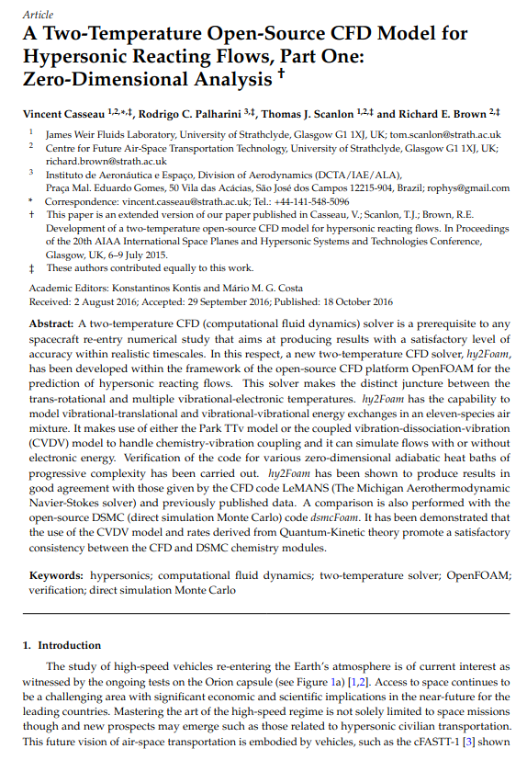
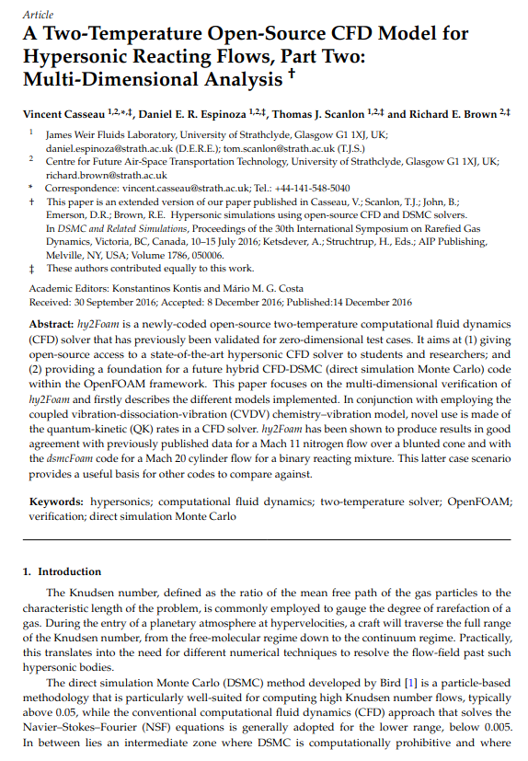
4.1. hy2Foam
hy2Foam(Hypersonic flow with 2-temperature model) is a two-temperature CFD solver which can handle 11 species air-mixture model.

Slide 12
4.1. hy2Foam
hy2Foam’s general capabilities are shared below:
Language (Framework) | C++, OpenFoam
Temperature Model | One and Two-Temperature Model
Temporal Scheme | Explicit (because of rhoCentralFoam)
Based On | Density (compressible solver)
Continuum Assumption? | Yes
2D/3D? | 2D/3D
Mesh Capabilities? | Structured/Unstructured
Flux Calculation Scheme? | Kurganov Central-Upwind Scheme

Slide 13
5. Test Cases
Three test cases are selected from literature:
Adiabatic Heat Bath(0-D): Thermochemical non-equilibrium flow is disturbed within a single cell. Relaxation phenomenon will be observed with:
  Relaxation of Reacting H2-I2 Mixture
  Relaxation of a N2
  Relaxation of a non-Reacting and Reacting N2-N Mixture
  Relaxation of non-Reacting and Reacting Air (N2-O2)
Blunted Cone(2-D): Hypersonic thermal non-equilibrium N2 free-stream flow is sent upon blunted cone. No reactions are taking place.
Double Wedge(2-D): Thermochemical non-equilibrium N2-O2 flow is sent upon double-wedge geometry.

Slide 14
5. Test Cases
Case Name | Geometry | Reacting? | Mesh Convergence? | Mesh (OpenFOAM) | Mesh (Eilmer) | Mesh (SU2) | Timestep Convergence?
Single Temp. Relaxation of H2-I2 | Heat Bath | Yes | No | Yes | No | No | No
V-T Relaxation of N2 | Heat Bath | No | No | Yes | No | No | No
V-T Relaxation of N2-N | Heat Bath | No | No | Yes | No | No | No
V-T and V-V Relaxation of N2-O2 | Heat Bath | No | No | Yes | No | No | No
V-T and V-V Relaxation of N2-O2 | Heat Bath | Yes | No | Yes | No | No | No
V-T Relaxation of N2-N | Heat Bath | Yes | No | Yes | No | No | No
V-T Relaxation of N2 | Blunted Cone | No | No | Yes | No | No | No
V-T and V-V Relaxation of N2-O2 | Double Wedge | Yes | No | Yes | No | No | No

Slide 15
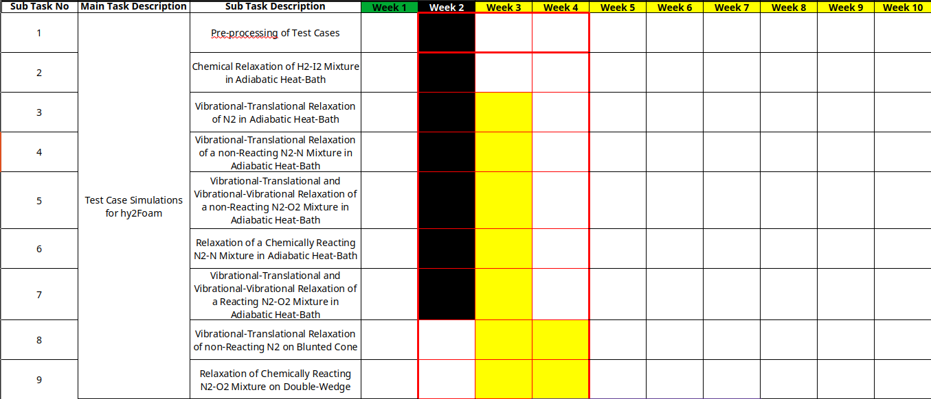
5.1. Testing Timeline

Slide 16
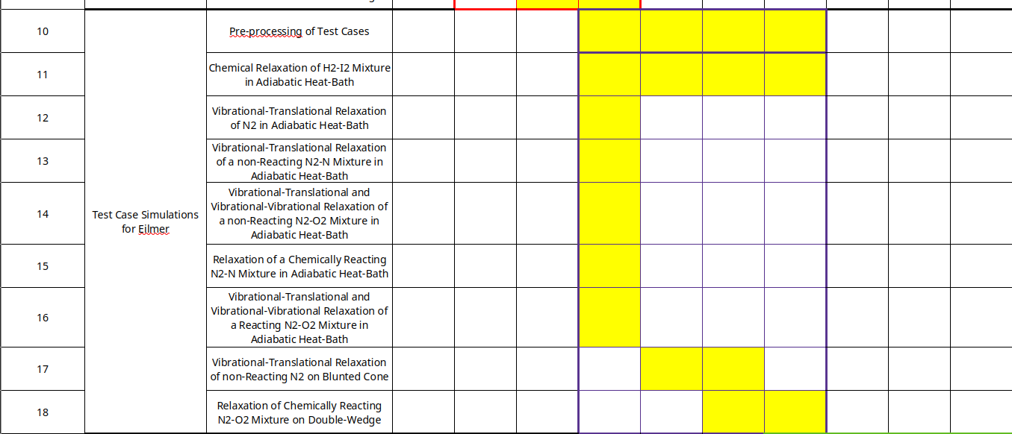
5.1. Testing Timeline

Slide 17
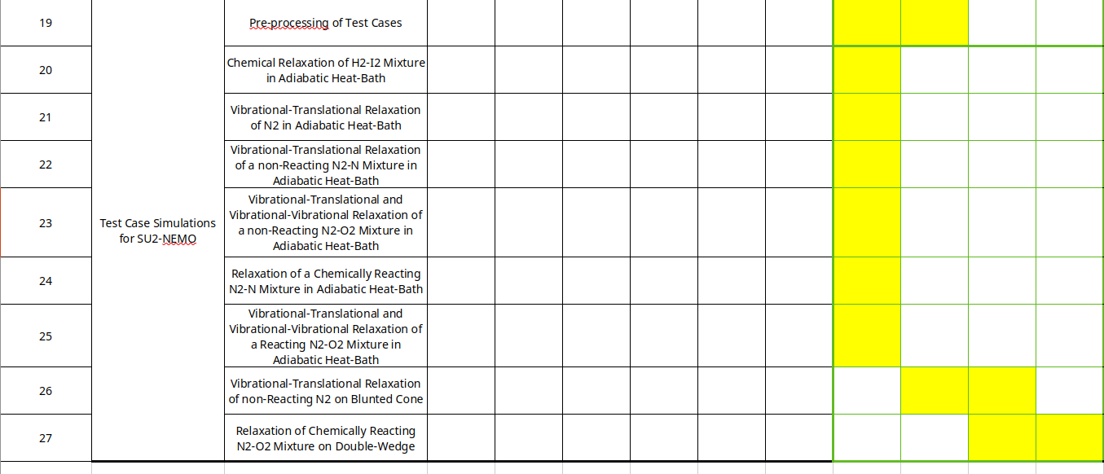
5.1. Testing Timeline

Slide 18
6. Future Work
Thermochemical non-equilibrium flow’s governing equations and main models which are used for determining necessary terms on the modeling
Adiabatic Heat Bath inputs, post-processing, computational cost, and literature comparison for hy2Foam
Blunted Cone inputs, mesh conversion to SU2 and Eilmer frameworks

