Slide 1
Side-Jet Project
Mehmet Furkan Tunç
06 December 2025
Side-Jet Interactions over a Hypersonic Cone Flow
Notes:
TASNİF DIŞI

Slide 2
1. Introduction
Karpuzcu and Levin [1] studied side-jet interactions over a hypersonic cone flow using DSMC method.
In this report,
How they conducted their studies,
What are the results,
How we can conduct our study from their results
are presented.
[1] Karpuzcu, I. T., & Levin, D. A. (2023). Study of side-jet interactions over a hypersonic cone flow using kinetic methods. AIAA Journal, 61(11). https://doi.org/10.2514/1.J063020
Notes:
TASNİF DIŞI

Slide 3
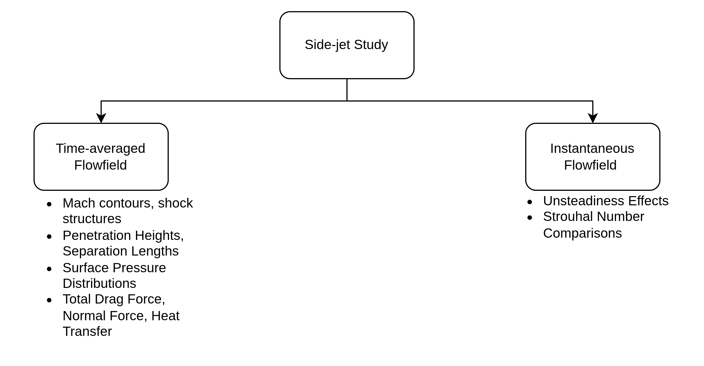
2. Study Inputs
There are two pillars to this study as given below:
Notes:
TASNİF DIŞI

Slide 4
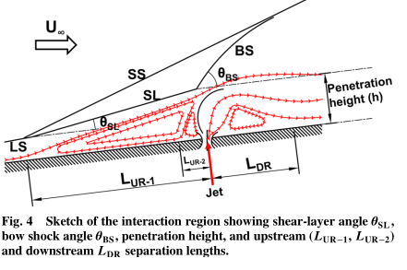
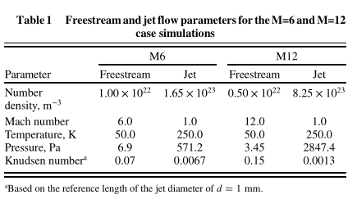
2. Study Inputs
Numerical Setup
Physical Setup
Cone Diameter : 0.1 m
Cone Lenght : 0.4 m
Jet Diameter : 0.001 m
Freestream Re : 100000 m⁻¹
Normalizations are done with Cone Lenght
Jet’s Center x/L : 0.5
Jet’s Center y/L : 0.0625
Timestep : 5 * 10⁻⁹ s
Sampling Time: 5 * 10⁻⁴ s
Flow Establish Time : 2.5 * 10⁻³ s
Final Time : 5 * 10⁻³ s
Total Cost : 460000 CPU*hours
Molecular Model : VHS
N2 Molecule Dia. : 4.467 * 10⁻¹⁰ m
Viscosity Index : 0.26
Isothermal Twall : 300 K
No Reactions
Axisymmetric Case
Both jet and freestream is N2
Notes:
TASNİF DIŞI

Slide 5
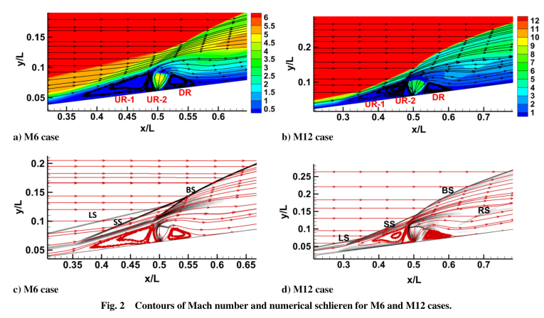
3. Steady Study Outputs
There are two upstream separations and one downstream separation.
Macroscopic scale has Mach contours and numerical Schlieren contours as given below:
Notes:
TASNİF DIŞI

Slide 6
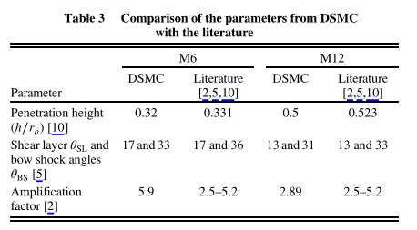


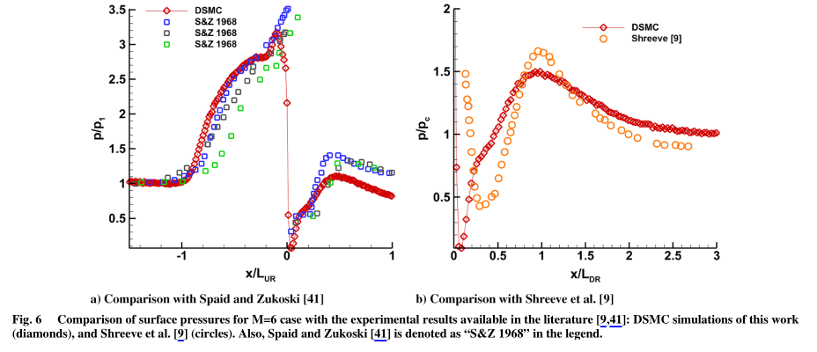
3. Steady Study Outputs
Penetration heights, bow shock angles and amplification factors are necessary flow properties for accurately representing physics:
Scaled Mass Flow Rate
Theoretical Penetration Height
Amplification Factor
Pressure distribution on the surface with different jet strengths*(60,100,200) are given on right side.
*Jet Strength: It is defined as the
ratio of the jet total pressure to the static pressure of the incoming flow
just upstream of separation
Notes:
TASNİF DIŞI

Slide 7
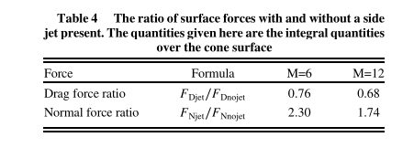
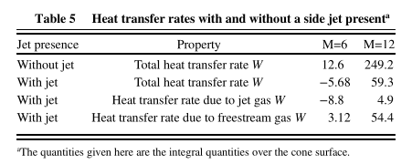
3. Steady Study Outputs
At last, they compared results of integrated values of total drag force, normal force, and heat transfer:
Notes:
TASNİF DIŞI

Slide 8
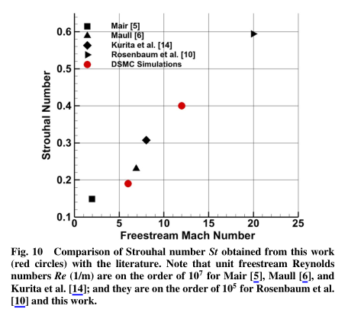
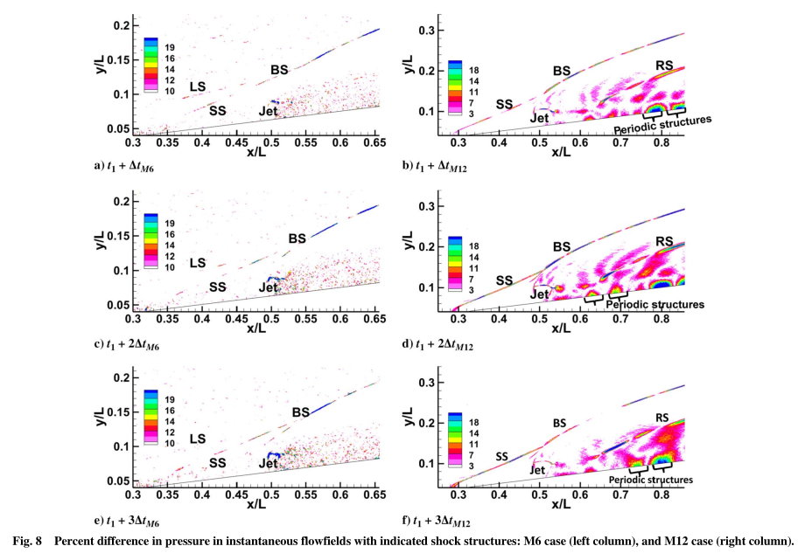
4. Unsteadiness Study Outputs
They checked out flowfields at different instants and compared result differences to steady results:
They plotted flow velocity to flow oscillations using Ma and St numbers:
Notes:
TASNİF DIŞI

Slide 9
5. Discussion
Important points from that study:
For cold side-jet flows, DSMC results more or less agree with experiments
In downstream, jet and freestream flows do not mix; as a result heat transfer happens from surface to flow. In other words, surface “cools off”.
Total drag decreases; normal force increases with the effect of side-jet.
If the incoming boundary layer is laminar, frequency of unsteadiness increases with Mach number but does not strongly depend to Reynolds number.
What is the limitations of the study?
Only one type of geometry (axisymmetric cone)
Only two Ma numbers, 6 and 12
Only cold jet is studied, there is no hot-jet case
No chemical reactions, no thermal non-equilibrium (too cold for vibrational excitation)
Only one jet position condition
Only one jet strength condition
Notes:
TASNİF DIŞI

Slide 10
6. Possible Future Work
How this study can be improved:
Same study with CFD to show accuracy/cost scale,
Thermal non-equilibrium/chemical equilibrium N2 with same setup,
Thermal and chemical non-equilibrium N2 with same setup,
Cold-jet with air, thermal and chemical equilibrium,
Cold-jet with air, thermal and chemical non-equilibrium,
Different jet locations with cold-jet,
Different cone half-angles with same cold-jet and setup,
Ma 6-7-8-9-10-11-12 to develop a curve fit for amplification factors
What is not worth investigating:
Different geometries like flat plate, cone, wedge [1],
Flat plate unsteadiness effects [2],
Different jet-strengths [3]
[1] Min, B.-Y., Lee, J.-W., & Byun, Y.-H. (2006). Numerical investigation of the shock interaction effect on the lateral jet controlled missile. Aerospace Science and Technology, 10, 385–393.
[2] Miller, W. A., Medwell, P. R., Doolan, C. J., & Kim, M. (2018). Numerical investigation of a pulsed reaction control jet in hypersonic crossflow. Physics of Fluids, 30, 106108. https://doi.org/10.1063/1.5049391
[3] Karpuzcu, I. T., Levin, D. A., Mamrol, D. V., Wagner, L. N., Noftz, M. E., Jewell, J. S., and Smith, S. T., “Jet Flow – Shockwave Interactions in a Hypersonic Flow Using Experimental and Kinetic Methods,” AIAA SciTech Forum, San Diego, CA & Virtual, Jan. 3–7, 2022.
Notes:
TASNİF DIŞI

Slide 11
Thanks for Listening
Notes:
TASNİF DIŞI

