Slide 1

SQL Cursors

Slide 2
What is SQL Cursor
Process data one row at a time
Comparable to While loop
Must be declare (DECLARE [Name] CURSOR FOR...)
Uses SQL memory rather than RAM

Slide 3
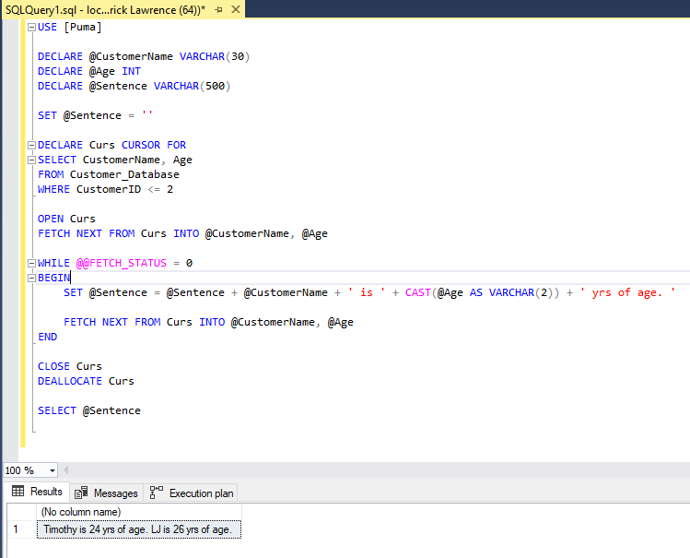
SQL Cursor Example
1. Creation of cursor
2. Select query to be traversed
3. Allows cursor data to be accessed
4. Getting of data per row
5. Processing of fetched data
6. Closing of cursor and deallocation of SQL resources
1
2
3
4
5
6

