Slide 1
The Battle of the Neighborhoods New York City and Toronto

Slide 2
Introduction: Business Problem
In this project we will compare the top 5 drinking locations in New York City (NYC) to Toronto. Specifically, this report will be targeted to stakeholders interested in drinking places in NYC versus Toronto to determine which city has better drinks.
Only the top 5 drinking places will be considered for each city. The data will be scraped from Foursquare and will be sort by popularity. Data to consider assessing will include price, rating and number of likes. Additional unique features may also be taken into consideration.

Slide 3
Data
Based on our defined business problem, factors that will influence our decisions are:
Price
Rating
Number of Likes
Unique features if any

Slide 4
Methodology
Foursquare web scrape
No statistical analysis were performed due to the limited sample size and information.

Slide 5
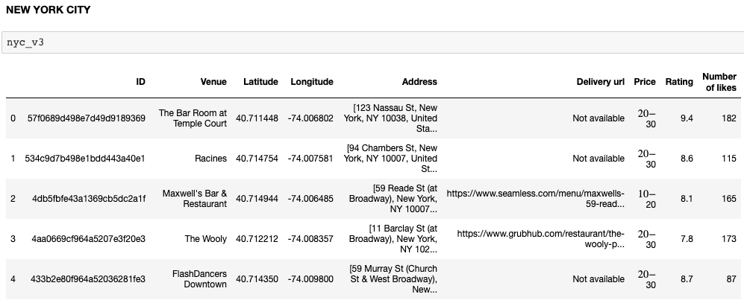
Analysis

Slide 6
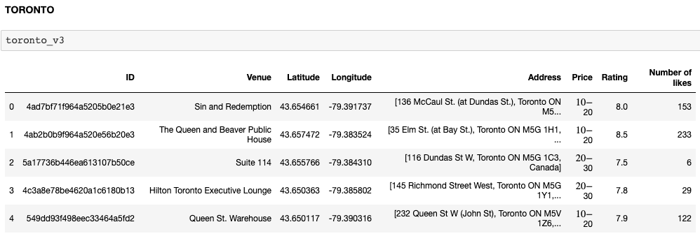

Slide 7
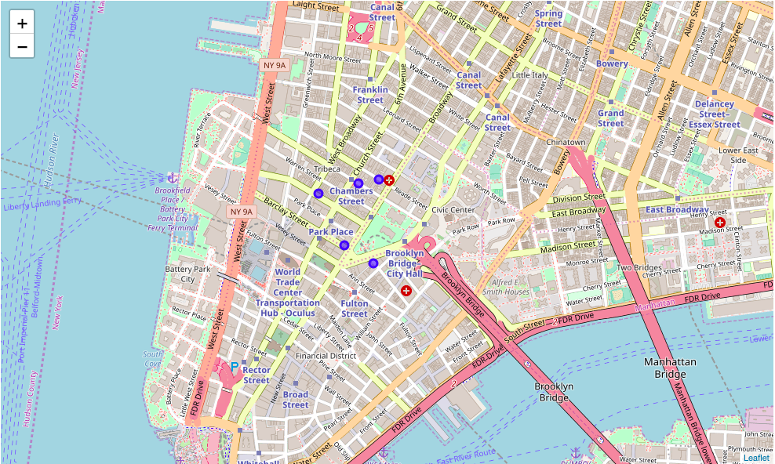
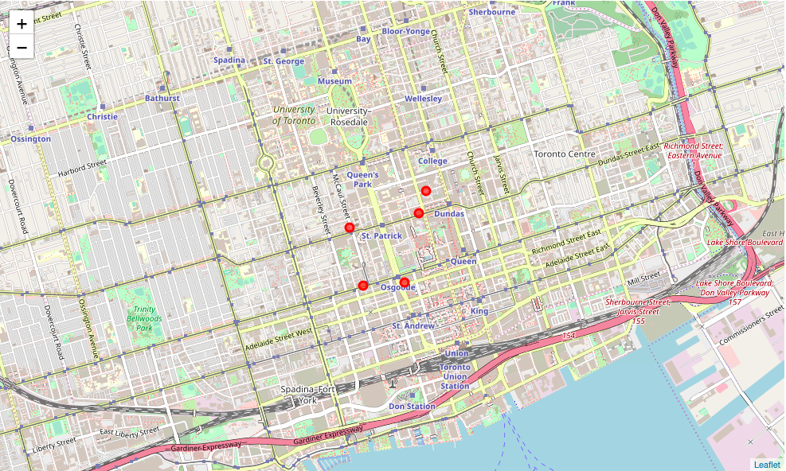
New York City
Toronto

Slide 8
Our data shows that NYC has higher ratings and also pricier.
The rating for NYC range from 7.8 to 9.4. Only one of the five venue is tier price 2 ($10 - $20) and the rest are tier price 3 ($20 - $30). Although Flash Dancers Downtown has the second highest rating of 8.7, note that there are only 87 likes. Interestingly, two of the venues have delivery, however it is most likely related to food and not drinks.
The rating for Toronto range from 7.5 to 8.0. Three of the venues are tier price 2 and the other two are tier price 3. Interestingly, Suite 114 and Hilton Toronto Executive Lounge only has 6 and 29 likes respectively. The other three venues have more likes, indicating a better data population.
Analysis Overall, it is difficult to make the comparison between drinking venues in NYC and Toronto just based on price, ratings and likes. The reasons include the following:
The number of customers is different, therefore the data population may be skewed.
Some venues seem to offer both drinks and food - which makes it difficult to understand if it is the food that was rated high or the drinks.
Different venue offer different menu, a deeper look into the menu may offer more valuable insights
Further scraping on the comments/reviews per venue may offer more insights into customer taste
In addition, I find it interesting how Foursquare have sorted the venues popularity. While the url was set to 'sortByPopularity=0', the data generated did not sort the ratings from high to low. The sort by popularity could also be set to 1, which I tried as an experiment and it yielded lower number of likes therefore I decided to keep it at zero. Understanding how Foursquare sorted the venues would be crucial to have better confidence if the venues generated were indeed the top venues.

Slide 9
Conclusion
While the data was inconclusive, we can agree that NYC is more popular due to more number of likes. More data scraping would be required to further determine the differences for customers to determine which city would be a better fit for them.

