Slide 1
An Enhancement of Eigenface Algorithm Applied in Missing People Tracer

Slide 2
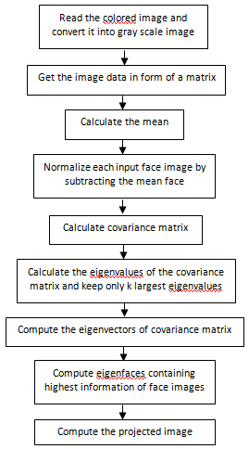
Eigenface Algorithm
An algorithm used for facial recognition
Gets the facial features in mathematical sense as an alternative to physical face feature

Slide 3
Problems
Sensitivity to illumination cause inaccurate or inability to recognize a person

Slide 4
Problems
The existing algorithm is susceptible in producing inaccurate recognition results compared to the input image

Slide 5
Problems
Inefficiency of PCA’s Dimension Reduction when total number of training face (M) is larger to the squared of training face dimension (N²)

Slide 6
Problem 1 Objectives
The proposed algorithm should be able to adapt to various lighting environment settings that will help the recognition to be more accurate and assures the identification of faces

Slide 7
Problem 1 Objectives
The algorithm will check the image data’s lowest and highest value (0 – 255 where 0 is brightest) and determine whether the lighting is normal, too bright, or too dark.
If the image is too bright, it will undergo a procedure where the values will be increased accordingly.

Slide 8
Problem 1 Objectives
If the image is too dark, it will undergo a procedure where the values will be decreased accordingly.
However, if the image is determined to be of normal lighting, it will continue to the next step of the algorithm immediately.

Slide 9
Problem 2 Objectives
Generation of a more reliable output and provide the best matches of the inputted image

Slide 10
Problem 2 Objectives
Before comparing eigenface containing with highest information of face images it will first undergo a procedure where a common threshold will be applied to find if the person in the
image is the same with the
the compared image.

Slide 11
Problem 3 Objectives
Offers a simple yet flexible integration in the face recognition system and sustain a low-level processing that will keep its efficiency

Slide 12
Problem 3 Objectives
The proposed algorithm should determine what procedure would be the most efficient in calculating the covariance matrix because the Dimension Reduction’s efficiency can only be maintained under a specific case.

Slide 13
Problem 3 Objectives
Such case is where the squared of training face dimension N² is larger than the value of the total number of training face M. Otherwise, the Dimension Reduction’s purpose of improving efficiency would be defeated

Slide 14

Problem 3 Objectives
Thus, if N² is less than M, the proposed algorithm will take on a different procedure where the covariance matrix will be computed as follows:
or
C = AA^{T} (N² x N² matrix)

