Slide 1
Introducing Android
From history to useful libraries in ±20mn
https://plnech.fr/files/Android.{pdf,pptx}
Notes:
Hello World
This is gonna be information-heavy.

Slide 2
History
2003: Android, Inc. founded by Andy Rubin, Rich Miner, Nick Sears and Chris White
2005: Acquisition by Google
2007: Open Handset Alliance
2008: Android 1.0
2009, 2010, 2011,…, 2015 : new versions of Android
Further Reading
The history of Android
OHA Press Release
Android Version History
2/19
Notes:
1: Android Inc: Andy Rubin/Rich Miner, Nick Sears, Chris White
initial idea: OS for digital cameras
"smarter mobile devices that are more aware of its owner's location and preferences"
Problem : "the market for the devices was not large enough"
2: -> Acquired by Google in 2005 for 50m€
3: OHA: Effort to develop Android with industry leaders
"As part of its efforts to promote a unified Android platform,
OHA members are contractually forbidden from producing devices
that are based on incompatible forks of Android“
4: Versions

Slide 3
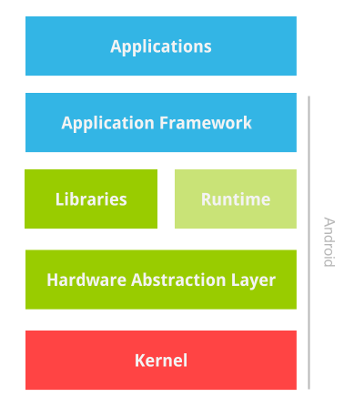
Operating System
Further Reading
Android Architecture
Understanding the Android System Server
3/19
Notes:
Applications
App framework
Libraries: BioNic (libc, libdl, libm…), openssl, webkit, etc...
Android Libraries: android.os, android.opengl, android.view...
Runtime: virtual machine (Dalvik/ART)
Kernel

Slide 4
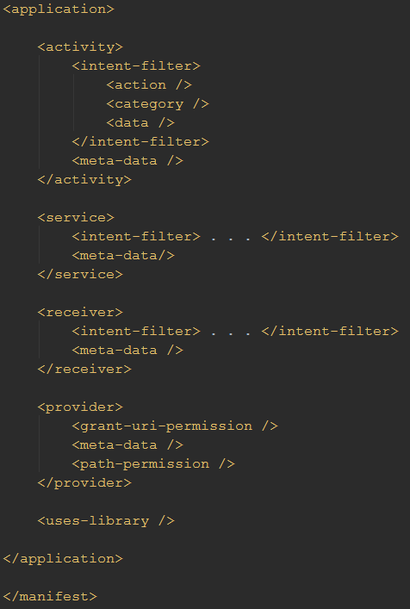
Project Structure | Manifest
"The manifest file presents essential information
about your app to the Android system.”
Further Reading
App Manifest Intro
4/19
Notes:
"The manifest file presents essential information about your app to the Android system"
- Names the package
- Describes the app components
- Lists permissions of the app
- Declares minimul level of the Android API
- Libraries linked against <uses-library>

Slide 5
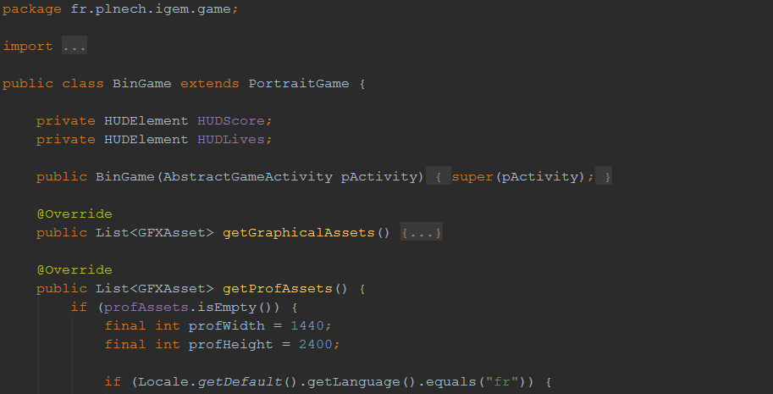
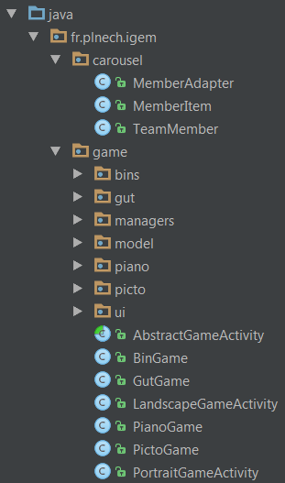





Project Structure | Source Code
Further Reading
Scala on Android
Clojure on Android
Getting Started with Kotlin on Android
5/19
Notes:
1 Structured by java package
2 Classical Java code
3 Also open to other JVM-based languages (Kotlin♥, Clojure, Scala...)

Slide 6
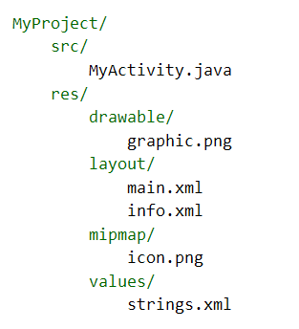
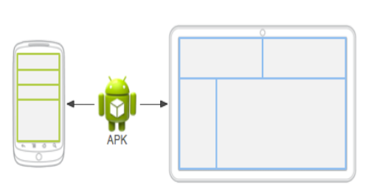
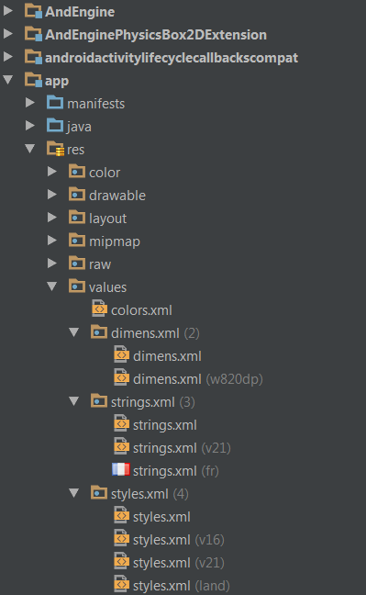
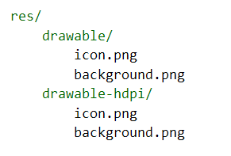
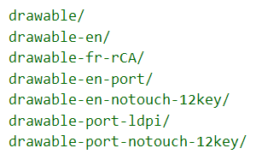
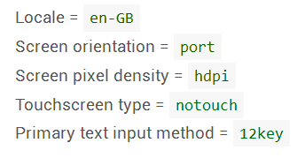
Project Structure | Resources
Further Reading
Providing Resources
Supporting Multiple Screens
Localizing with Resources
6/19
Notes:
1 Structure: Basic example
2 But what if you want a different layout on mobile and tablet? Or different images ?
3 Introducing automated resource selection
4 Exemple of folder hierarchy
5 Exemple of selector categories
6 Real-world example
- L10n/I18n made easy

Slide 7
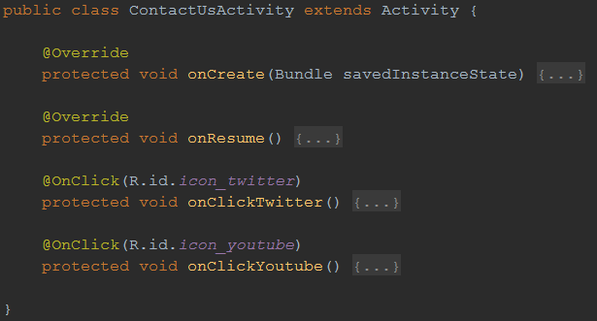
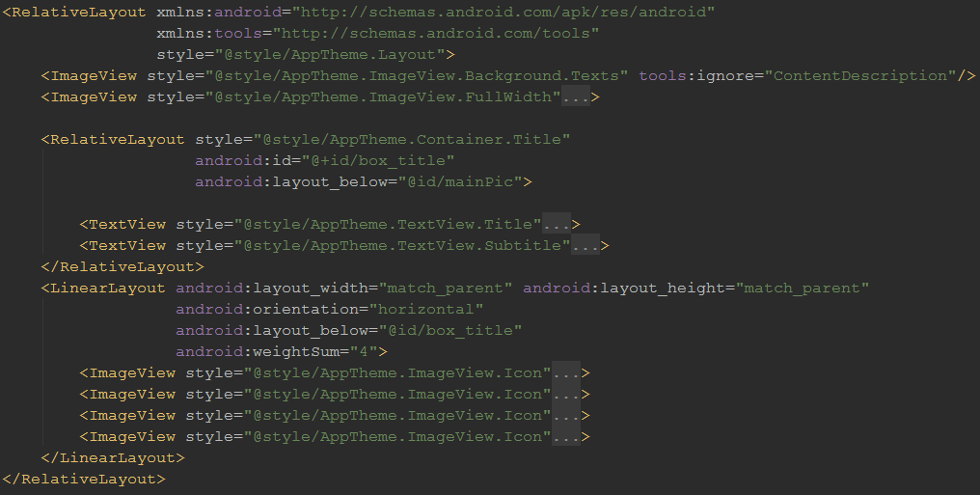
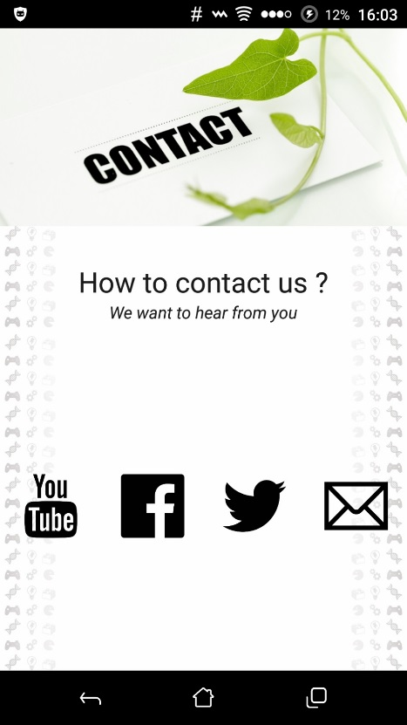
Essential Notions | Activities
"a component that provides a screen
with which users can interact
in order to do something"
Further Reading
Activities Guide
Activity Reference
Managing the Activity Lifecycle
7/19
Notes:
1 XML
2 Java
3 Result
4 Lifecycle

Slide 8
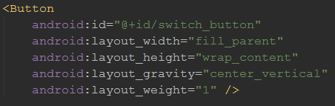
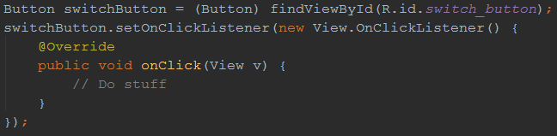
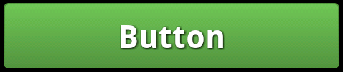
Essential Notions | Views
"A View occupies a rectangular area on the screen .and is responsible for drawing and event handling“
Further Reading
UI Overview
View Reference
8/19
Notes:
"the basic building block for user interface components.“
1 XML : ID, attributes
2 Code: findById, manipulation (onclicklistener)
3 Rendered

Slide 9
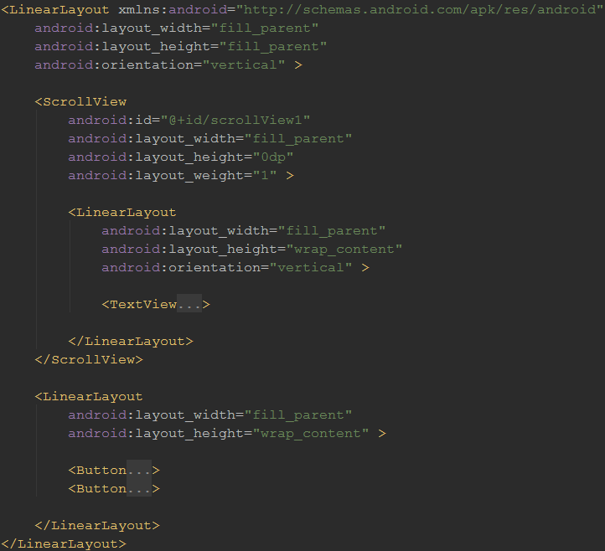
Essential Notions | ViewGroups
"A ViewGroup is a special view
that can contain other views"
Further Reading
UI Overview
ViewGroup Reference
9/19
Notes:
"A ViewGroup is a special view that can contain other views (called children.)"
Layouts: predefined ViewGroups

Slide 10
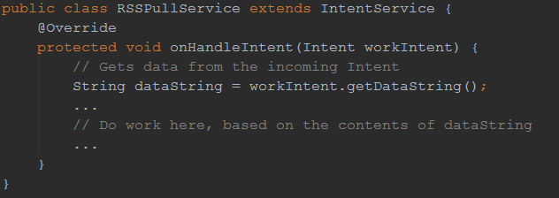
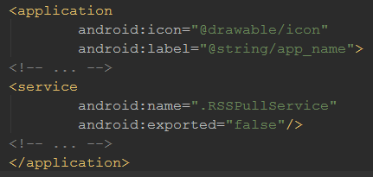
Essential Notions | Services
, "A Service is an application component
, that can perform long-running operations in the background
and does not provide a user interface. "
Further Reading
Services Guide
Create a Background Service
Service Reference
10/19
Notes:
"A Service is an application component
that can perform long-running operations in the background
and does not provide a user interface."
Background task / Scheduled task
1 Code: RSSPull example
2 Manifest: declaration
Interaction with other apps

Slide 11


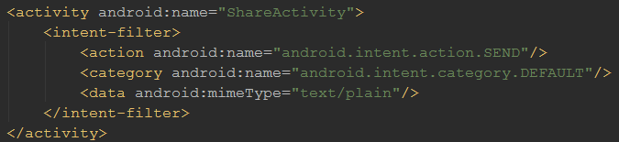
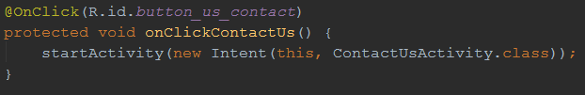
Essential Notions | Intents
"An Intent is an abstract description
of an operation to be performed."
Further Reading
Intents and Intents Filter Guide
Intent Reference
Common Intents
11/19
Notes:
Action + data (URI) + extras
1: Example opening a link with capable apps
2: Declaring intent filters on activities
3: Starting a service Service: action + extras
4: Starting another activitry through intent
examples:
ACTION_VIEW tel:123
ACTION_EDIT content://contacts/people/1
ACTION_SEND + putExtra(Intent.EXTRA_TEXT, “The Game”)

Slide 12
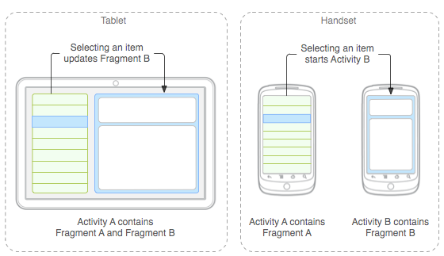
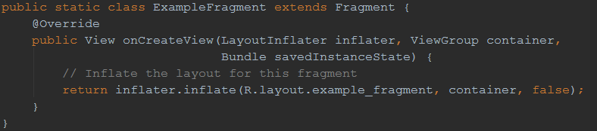
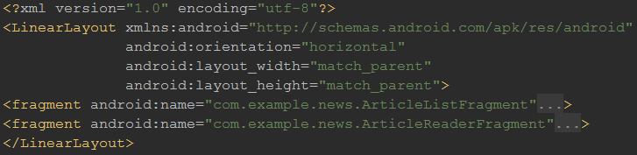
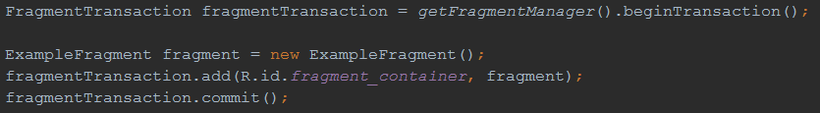
Essential Notions | Fragments
"A Fragment represents a behavior
or a portion of user interface in an Activity”
Further Reading
Building a Dynamic UI with Fragments
Fragments Guide
Fragment Reference
12/19
Notes:
You can see fragments as the building blocks of your application's visual organization
1: Imagine a contact app: You would like list and detail in tablet as Act A, but in phone as Act A and Act B… use fragments!
2: Structured as an activity
3: Can be included in activity’s xml…
4: …or dynamically loaded in code
Reusable: use a fragment in multiple activities
Modular: allows an activity to behave differently in different contexts (screen size, etc)
Independant: own lifecycle, receives its own input events, can be added or removed while the activity is running

Slide 13
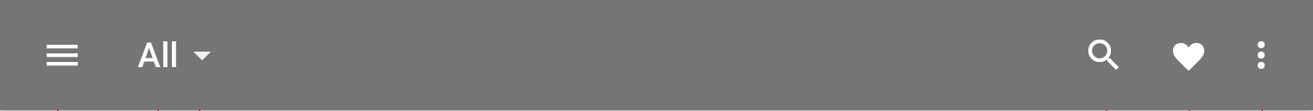
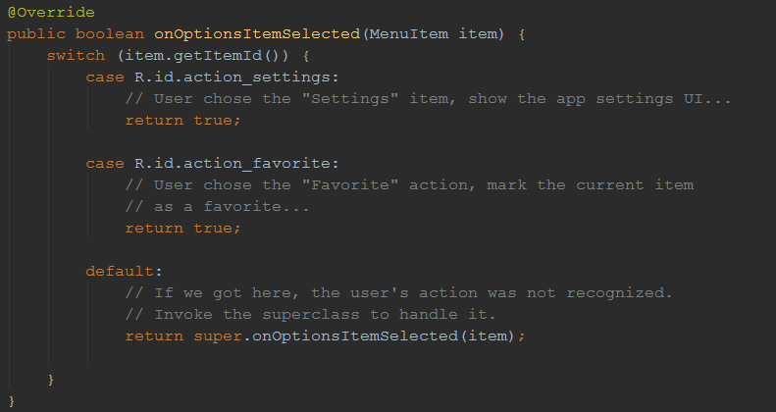
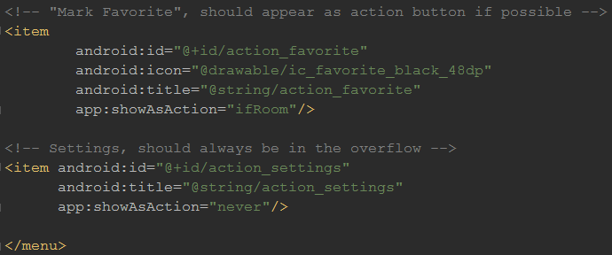
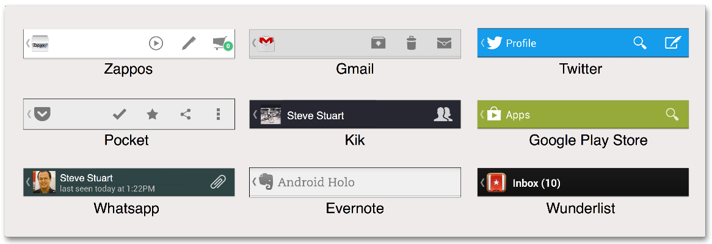
Essential Notions | App Bar and navigation
"A special kind of toolbar
used for branding, navigation, search, and actions.”
Further Reading
Adding the App Bar
Implementing Effective Navigation
Material Design | App Bar
13/19
Notes:
1: Nav icon (Hamburger) | Title/Filter icon | Action icons | Menu icon
Used for Navigation, Branding, and some actions.
Navigation : mail app, detail, next -> back/top?
2: XML Declaration
3: onOptionsSelected implementation
4: Branding: see examples

Slide 14
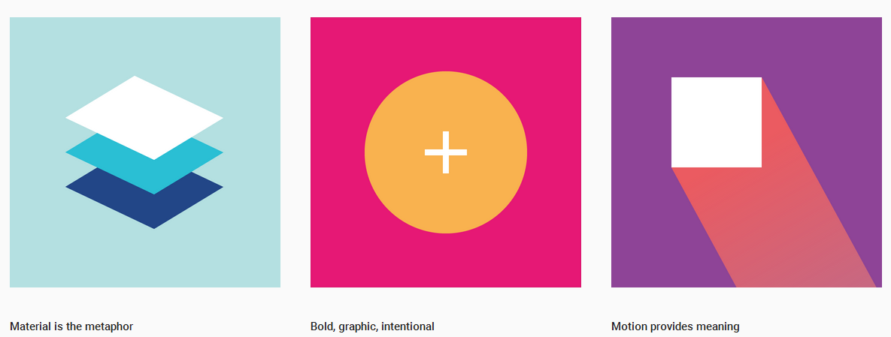
A few words on Material Design
Further Reading
Material Design Introduction
The Transitions Framework
lgvalle/Material-Animations
14/19
Notes:
1
Material metaphor
Intentional design, graphical and colourful
Meaning-driven design
2 Animations
Transitions Framework
Lgvalle’s Material Animations

Slide 15
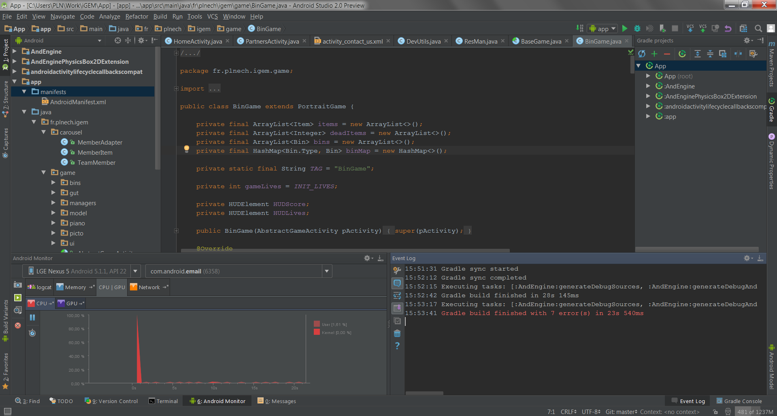
Tools | Android Studio
Further Reading
Android Studio Overview
Developer Workflow
15/19
Notes:
- IntelliJ IDEA: A solid basis (code analysis, powerful template engine,
numerous features like database access, deploy, or complex run configurations)
- Android Lint code analysis
- ProGuard and App signing capabilities
- Built-in access to Google Services

Slide 16
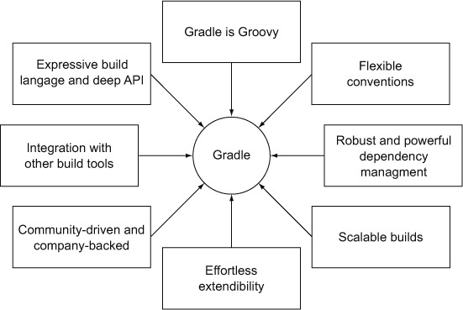

Tools | Gradle
Further Reading
Introduction to Android Development with Gradle
Getting Started with Gradle for Android
16/19
Notes:
Mostly for dependency management and build
Groovy-based build system
Large API yet easy to extend
Easy to integrate with other build tools/systems (Ivy, Jenkins…)

Slide 17
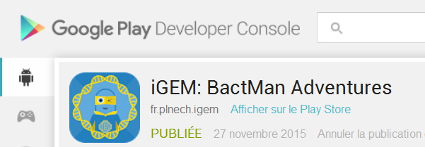
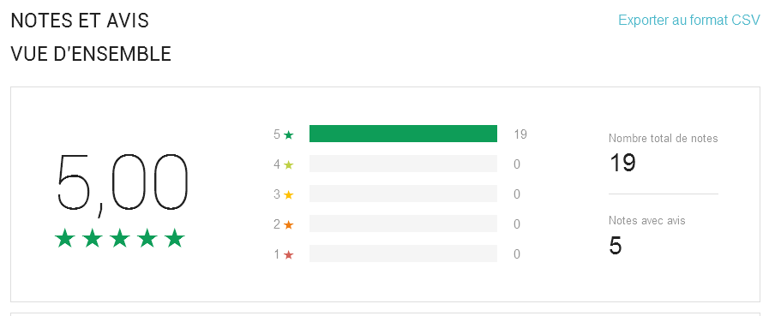
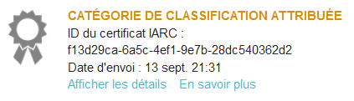
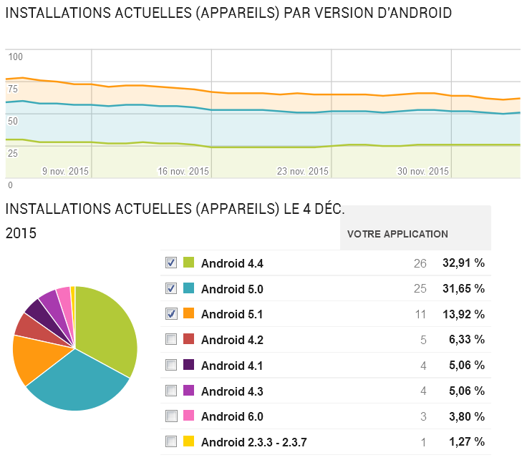
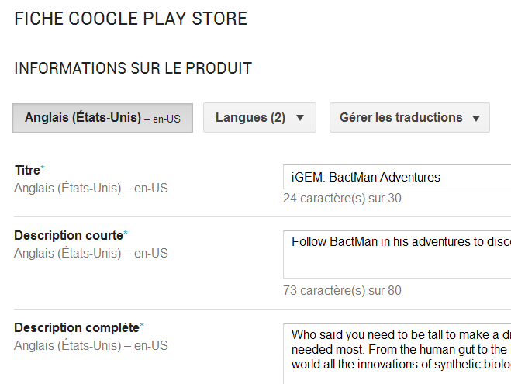
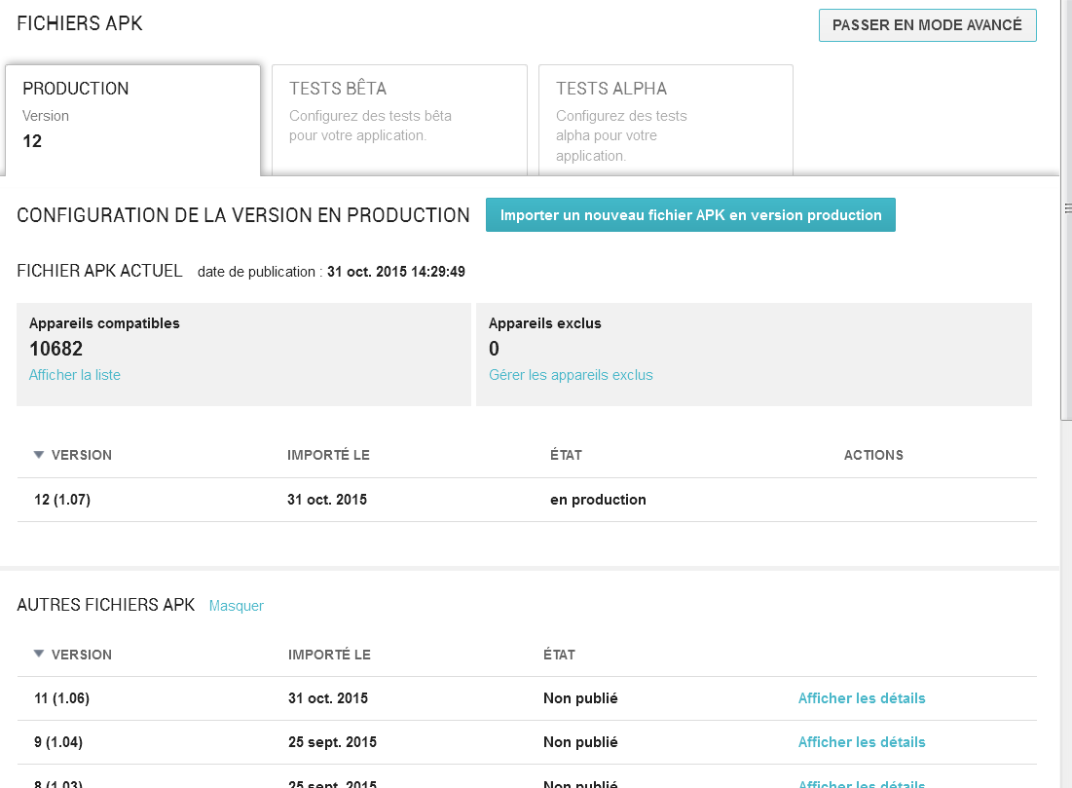




Tools | Play Store
Further Reading
Developer Console
Get Started with Publishing
17/19
Notes:
1 Main platform to distribute apps
Needs an account (25$ for life)
2 Tools for store management/customisation : ratings…
3 API version statistics
4 play store listing editing
5 Certification program (PEGI, etc)
6 Beta deployment / elementary crash reporting
7 Not the only platform: -
F-Droid for Free Software
Decentralised repos: Aptoide
Centralised marketplaces: Amazon apps, Samsung apps, GetJar/Slide me/...

Slide 18

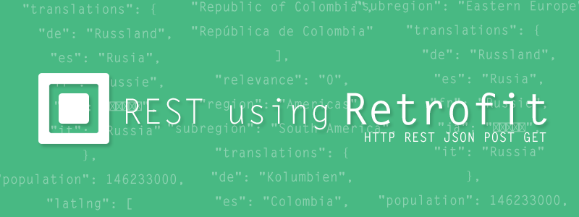


Useful Libraries
Further Reading
Development Library Statistics
18/19
Notes:
RetroFit: Enjoy the REST of your life
GSON: Used by RetroFit, json <> java made easy
Support: Use new features on old phones
Glide: Image loading and manipulation with ease
Crouton: smarter notifications that Toasts

Slide 19
Thank you
Questions?
https://plnech.fr/files/Android.{pdf,pptx}
Notes:
Bye World
Easy, wasn’t it?

