Slide 1



WELCOME TO MWANGAZA
Lighting the path to a better life, one skill at a time.

Slide 2



Problem Statement
Many adults in Africa missed formal education and struggle with basic communication and life skills.
House helps, security guards, and domestic workers lack access to educational resources tailored to their needs.
Existing educational platforms don't address practical skills like cooking, home management, and first aid.
Psychological support and trauma healing resources are rarely accessible to underserved populations.

Slide 3



Solution
Mwangaza is a groundbreaking mobile application designed to empower adults who missed out on basic education.
Provides essential life, communication, and emotional wellness skills through an accessible mobile platform.
Transforms learning into a simple, practical, and enjoyable experience with audio and visual tools.
Bridges the gap between potential and opportunity for underserved populations.

Slide 4
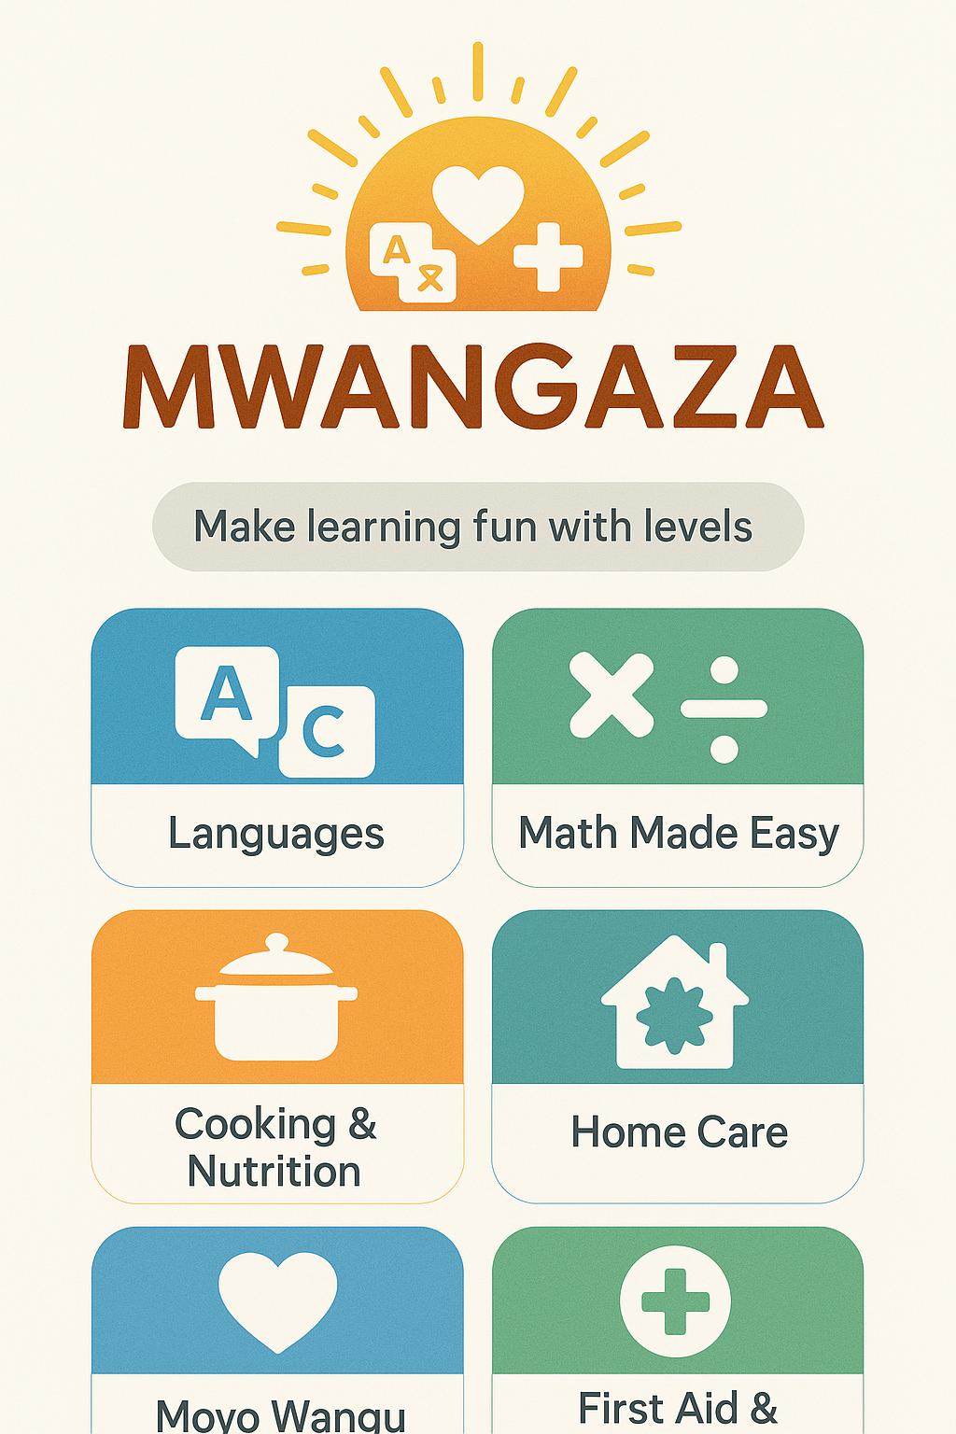






What Mwangaza Offers
Language Learning
English and Kiswahili lessons with audio and visual tools for everyday conversations.
Basic Math
Foundational math skills for budgeting, shopping, and everyday tasks.
Cooking & Home Management
Easy-to-follow recipes, cleaning, and household efficiency tips.
Psychological Support
Guidance for managing trauma, stress, and access to professional help.
First Aid Training
Step-by-step instructions for handling common emergencies.

Slide 5

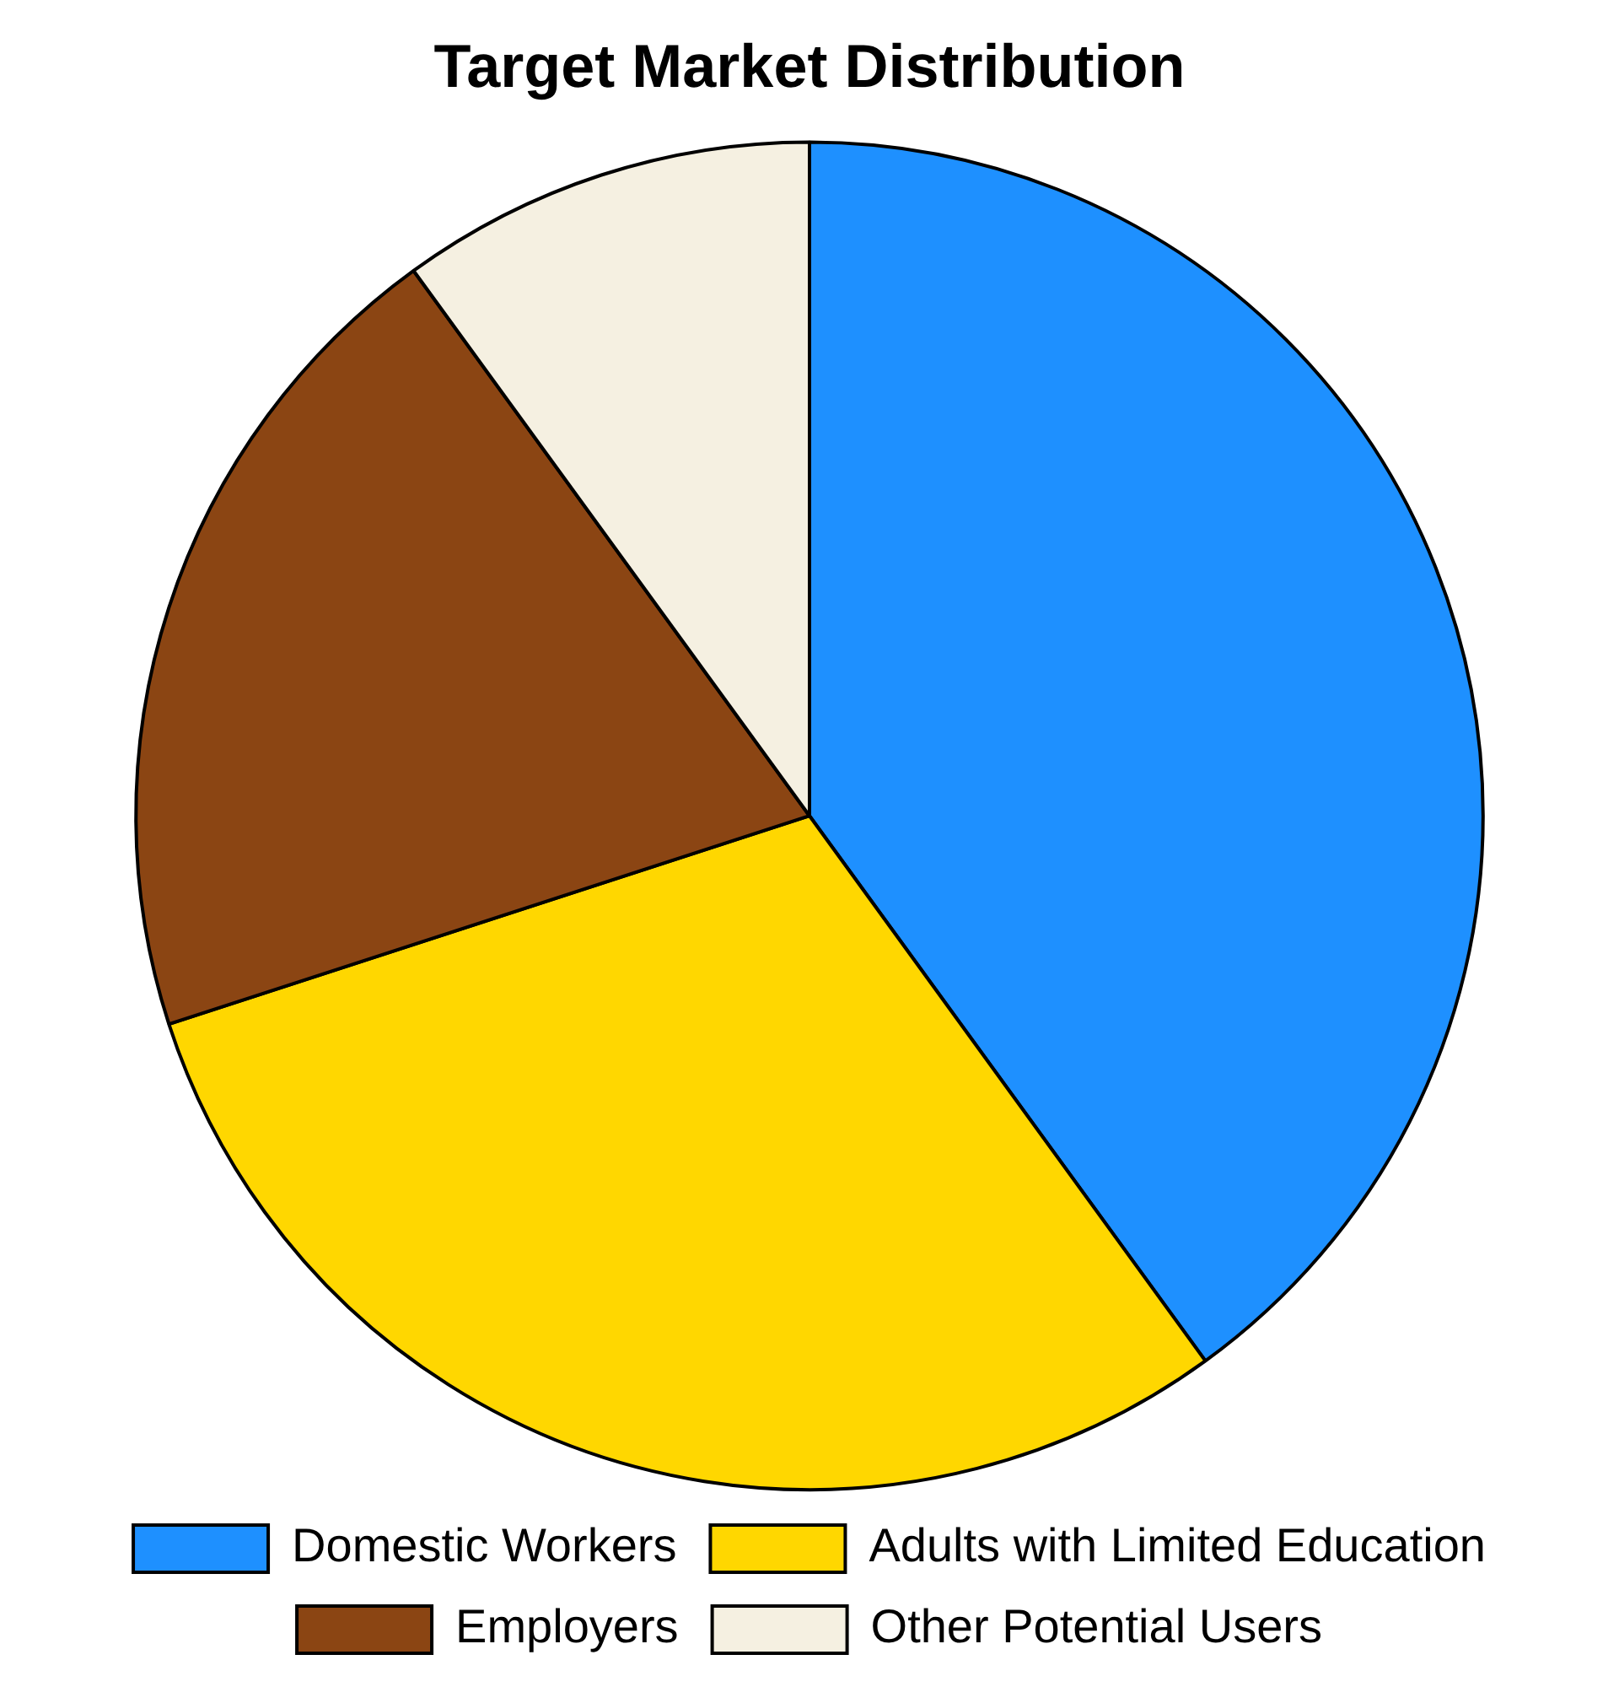



Target Market
For Employees:
House helps, security guards, and domestic workers seeking personal development and better communication
Adults over 20 who missed formal education and aspire for better job opportunities
For Employers:
Families and organizations hiring domestic workers who want trustworthy, well-trained staff
Employers seeking a structured way to train and develop their workers

Slide 6


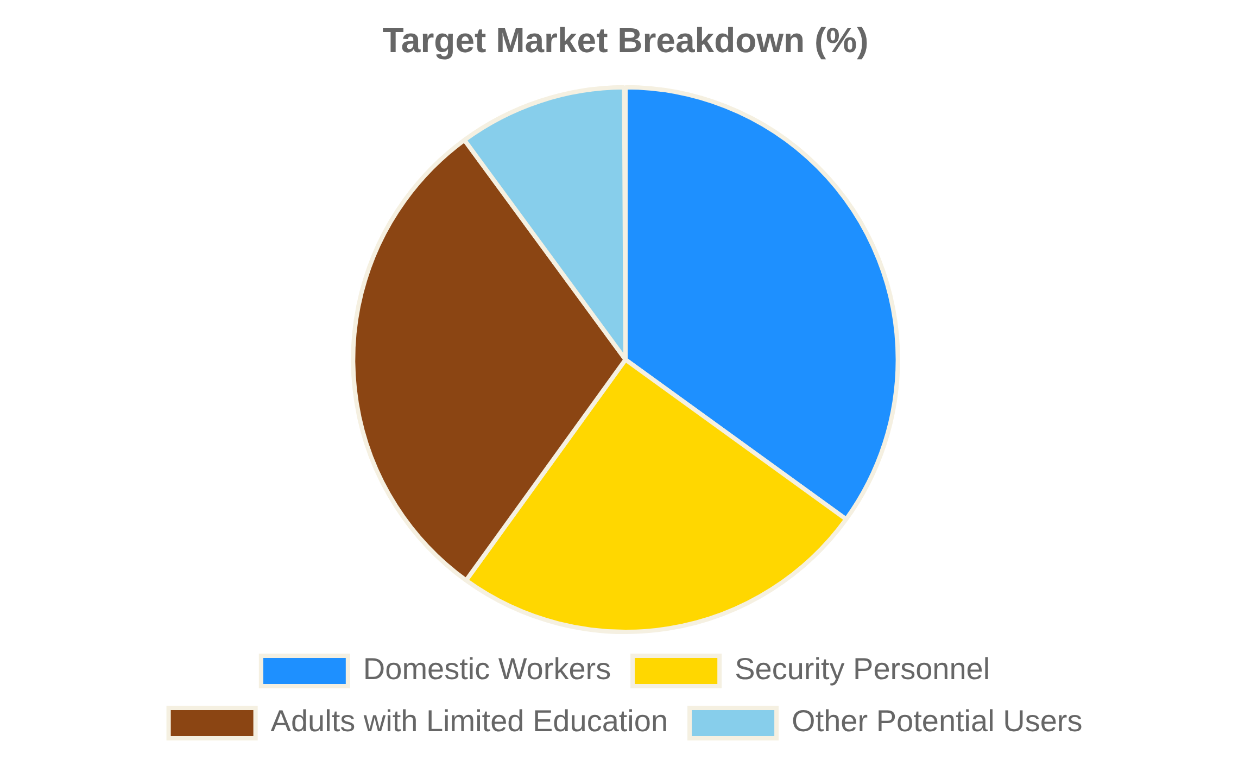
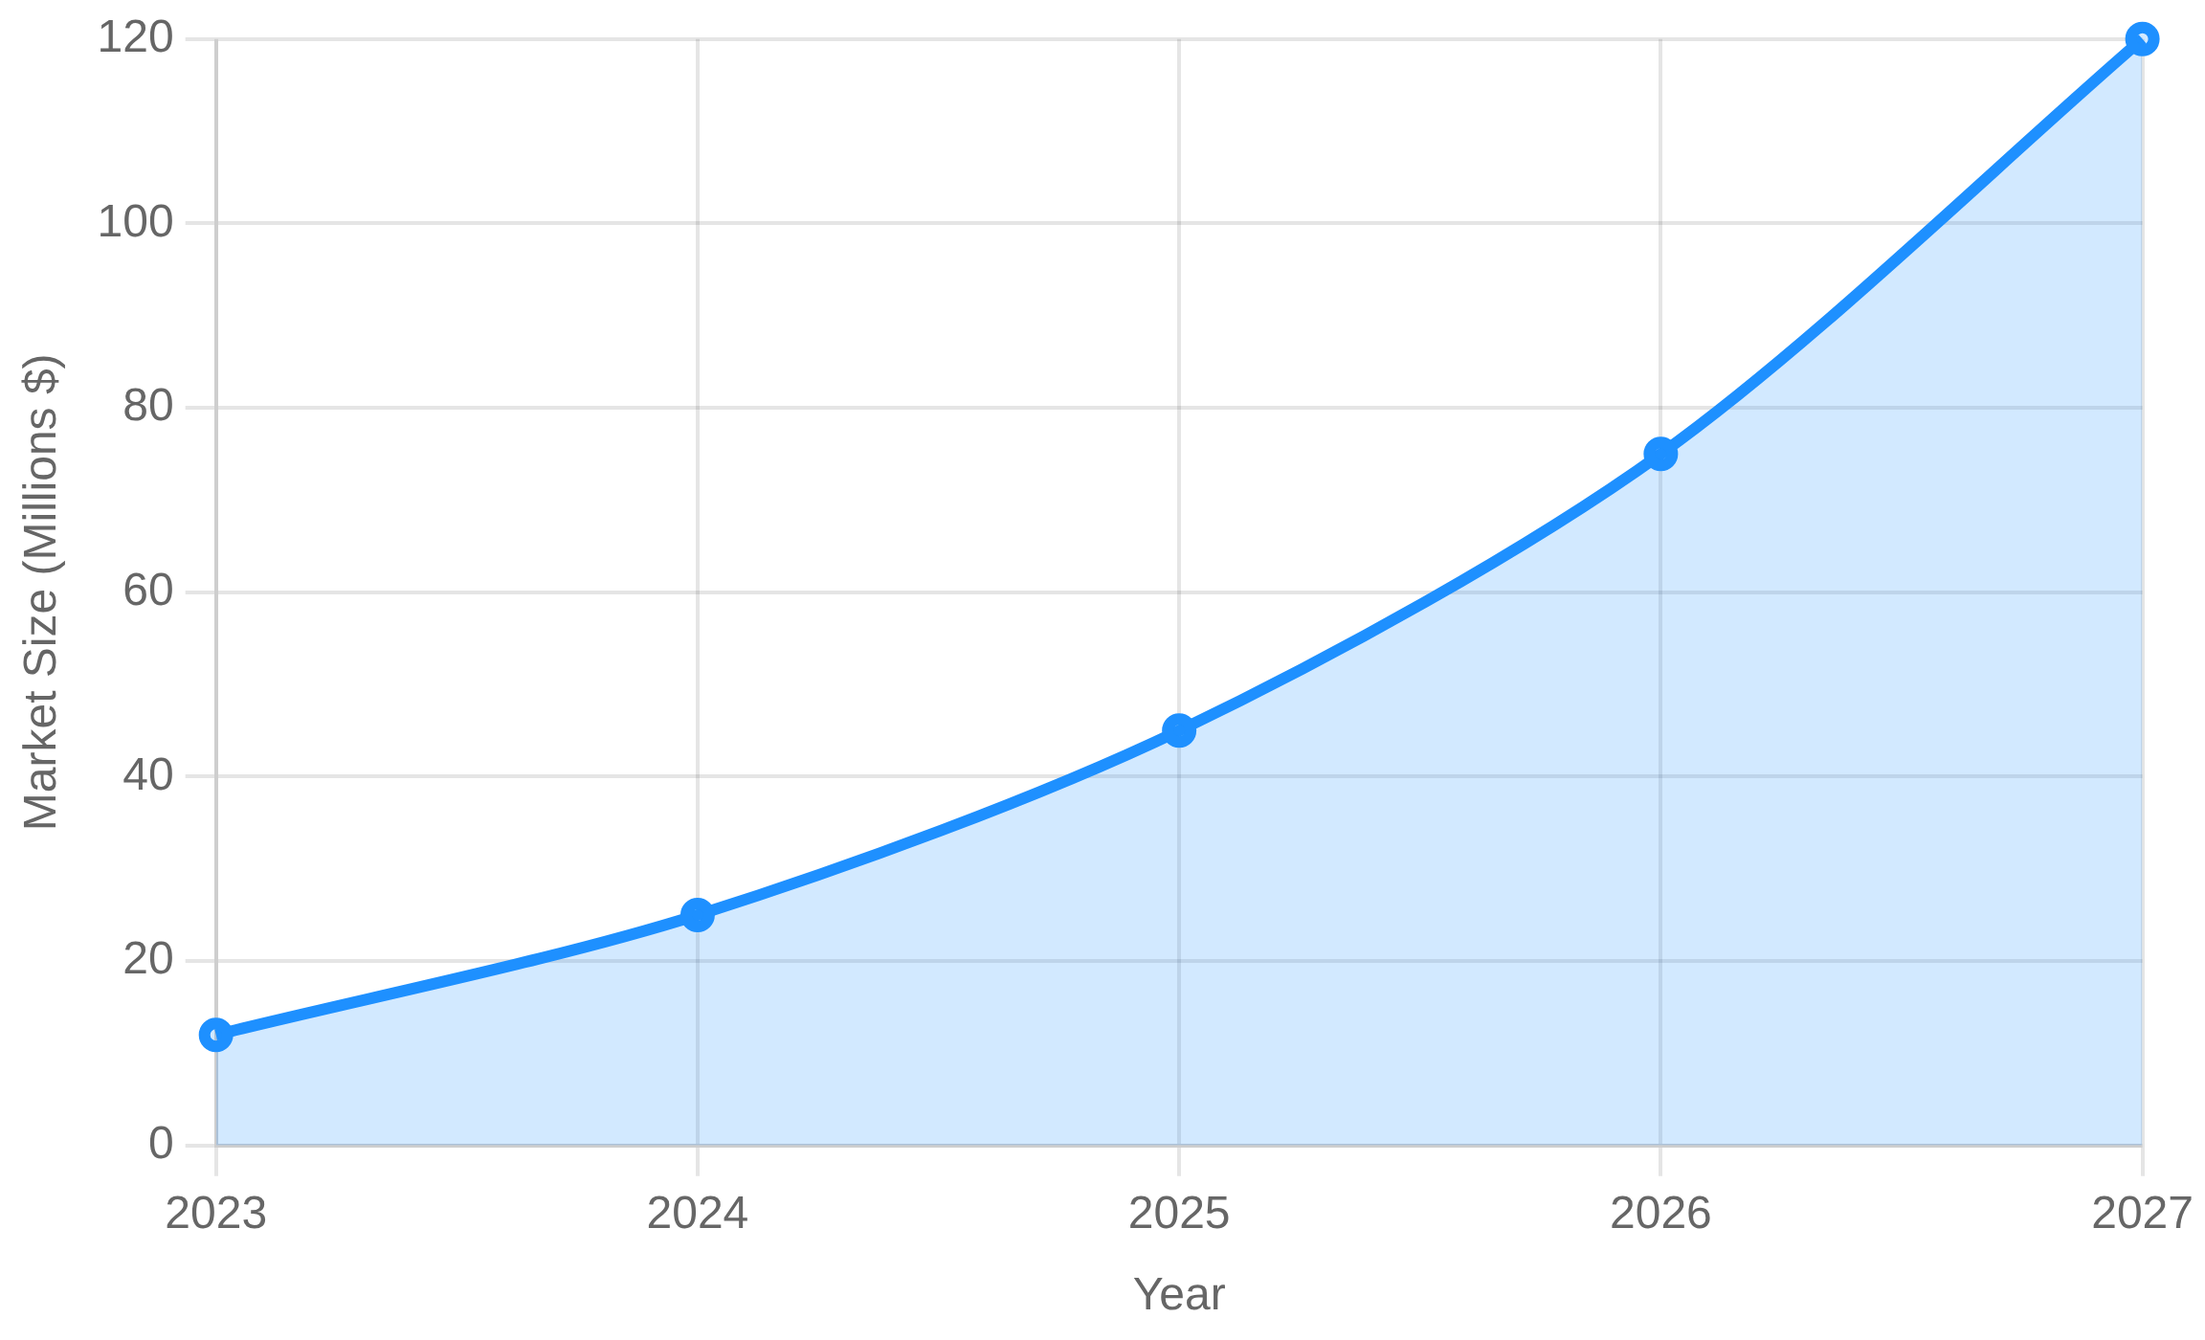
Market Size
The adult education app market in Africa represents a significant opportunity with over 300 million adults who could benefit from accessible educational resources.
Target Demographics
Market Growth Potential

Slide 7

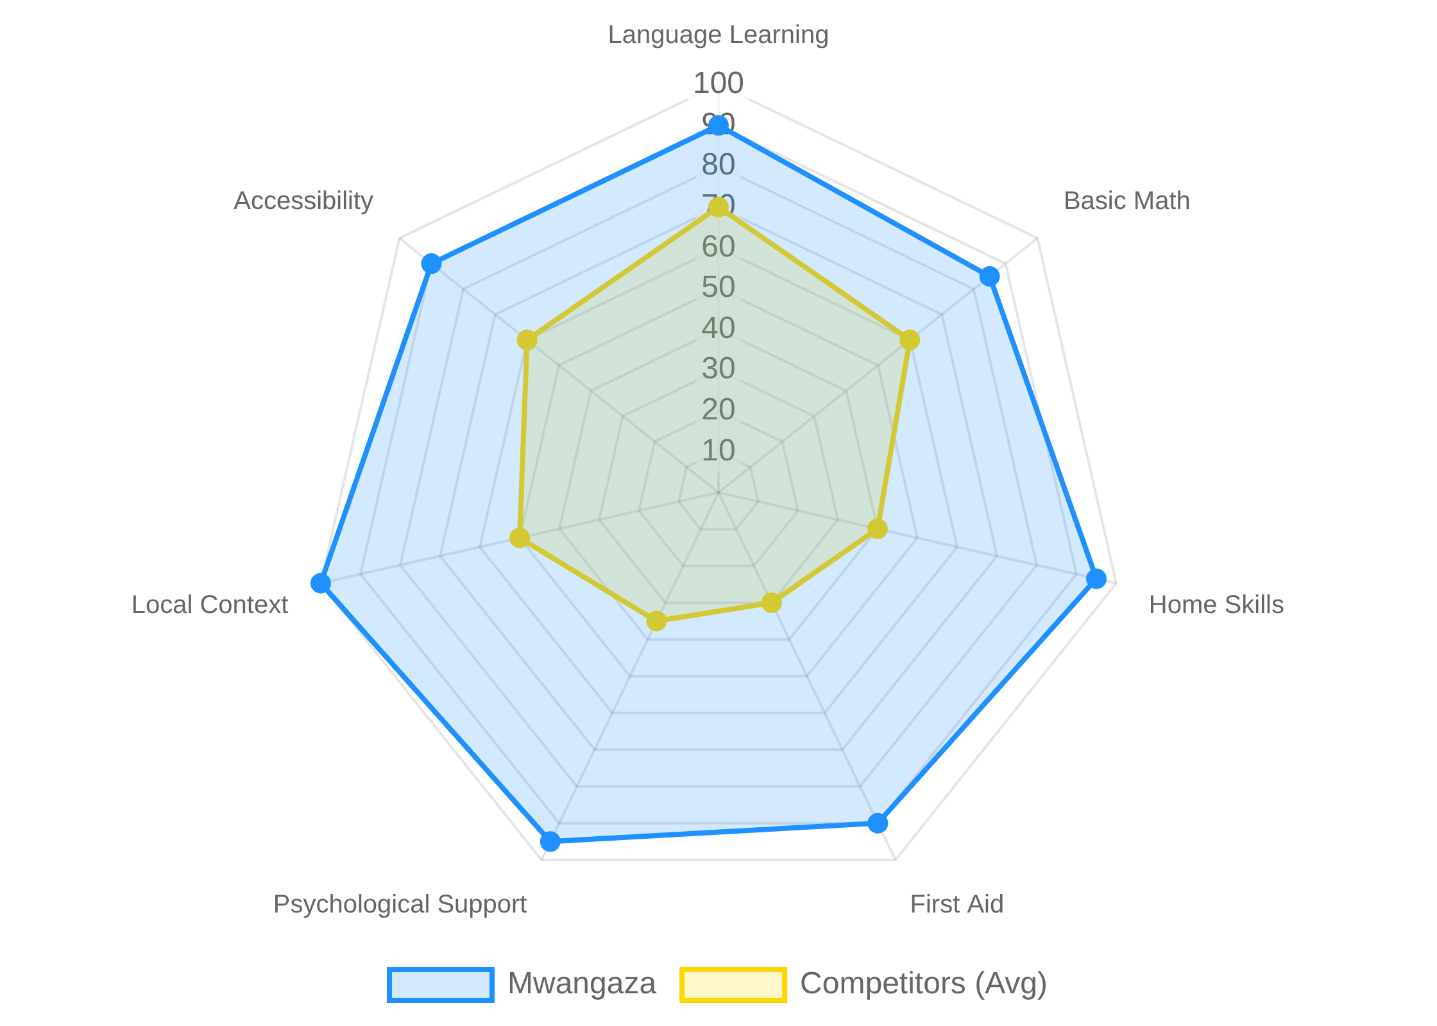

Competitors
Feature Comparison
Key Competitors
General Learning Apps (Duolingo, Khan Academy)
Regional Education Platforms
Vocational Training Apps
Mental Health Support Apps
Unlike competitors, Mwangaza offers a comprehensive solution specifically designed for underserved adult populations in Africa, combining practical skills with emotional support.

Slide 8
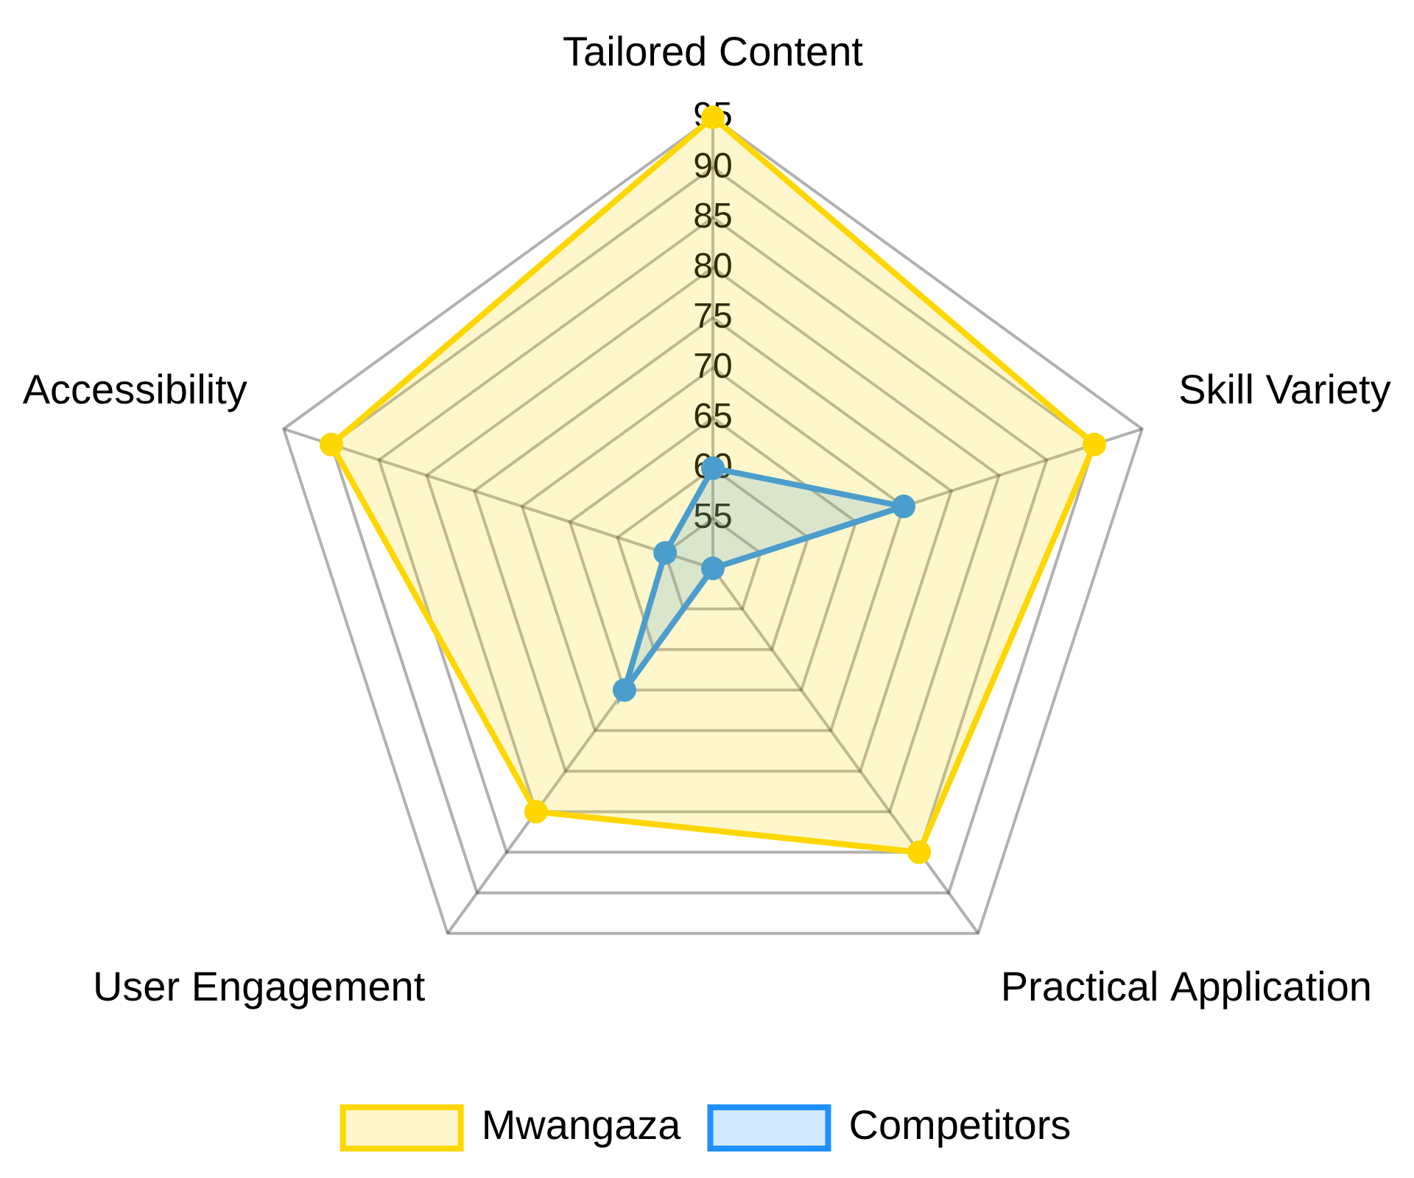


Competitive Advantage
Tailored specifically for underserved adult populations in Africa
Comprehensive skill set including language, math, home skills, and psychological support
Engaging gamified learning experience with levels and rewards
Dual value proposition for both employees and employers
Focus on practical, real-world applications rather than just theory

Slide 9

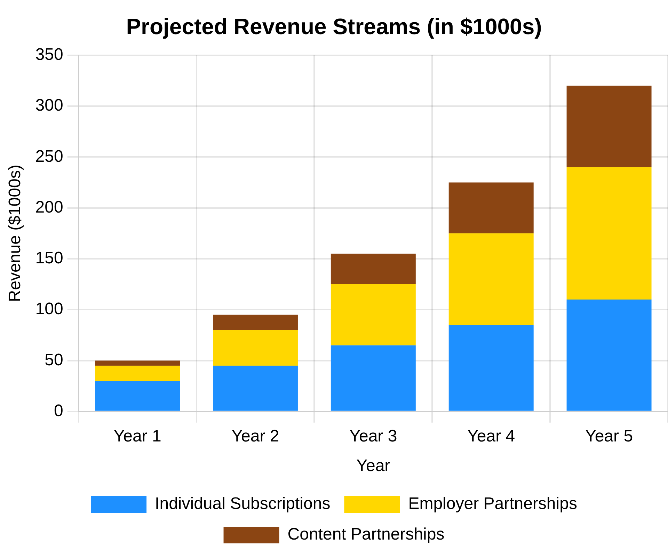



Business Model
Subscription Model
Monthly or annual subscription fees for premium content
Tiered pricing based on access level and features
Employer Partnerships
Bulk subscriptions for organizations to train their staff
Custom content development for specific employer needs
Content Partnerships
Revenue sharing with expert content creators
Sponsored educational content from relevant organizations

Slide 10

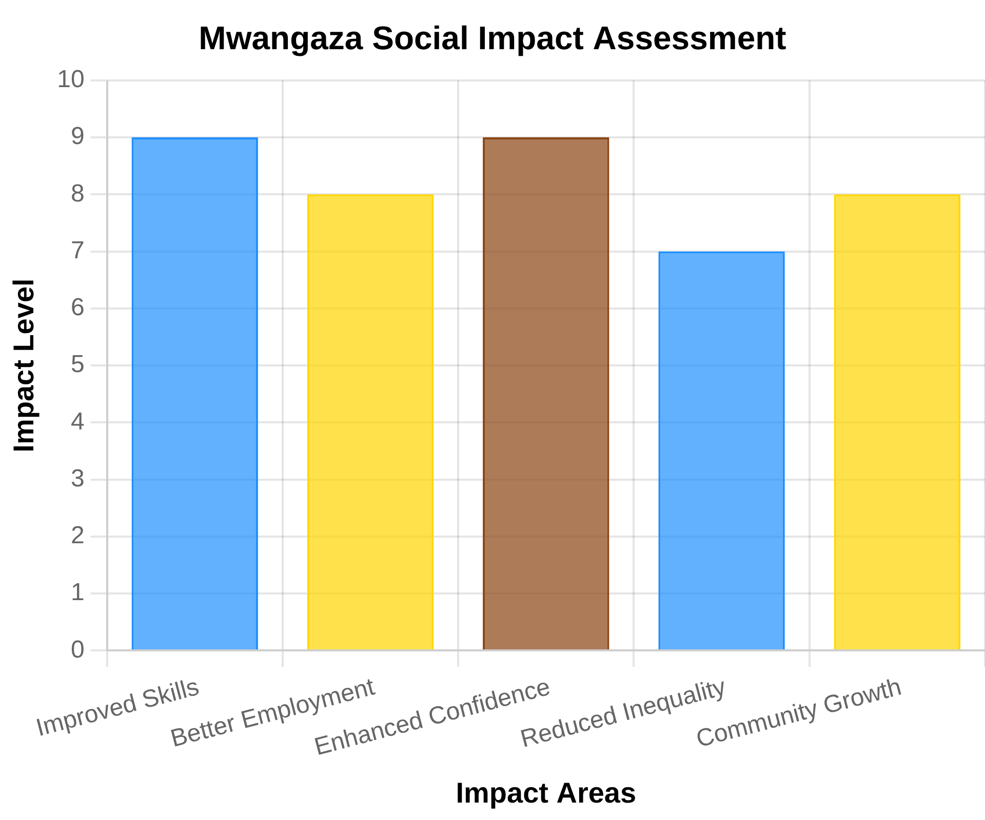




Social Impact
SDG 4: Quality Education
Providing accessible education to adults who missed formal schooling, promoting lifelong learning opportunities.
SDG 8: Decent Work
Creating economic opportunities by enhancing employability and job skills for domestic workers.
SDG 10: Reduced Inequalities
Reducing educational inequalities by removing geographical and financial barriers to learning.
SDG 17: Partnerships
Collaborating with local organizations and employers to create sustainable educational ecosystems.

Slide 11

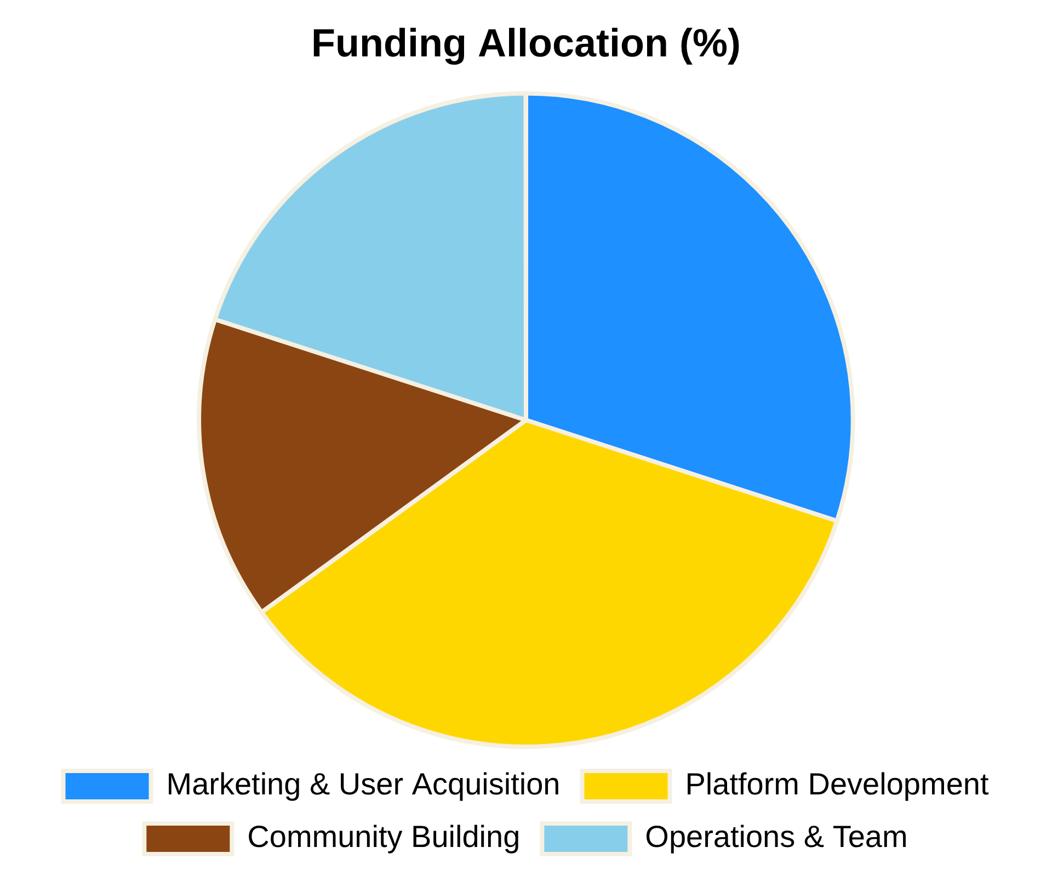


Our Ask
We are seeking
Ksh 500,000
in funding to scale our educational platform
and expand our reach across Africa. The funds will be allocated to:
Marketing & User Acquisition
Targeted campaigns to reach domestic workers, security personnel, and employers
Platform Development
Enhancing features and expanding content in multiple languages
Community Building
Creating support networks and engagement programs
Operations & Team
Growing our team of developers, content creators, and support staff

Slide 12




Thank You!
Join the Mwangaza Movement
Empower your staff. Empower yourself. With Mwangaza, education is no longer a privilege—it's a right at your fingertips.
info@mwangaza.com
+254 700 123 456
www.mwangaza.com
Mwangaza – Lighting the path to a better life, one skill at a time.

