Slide 1
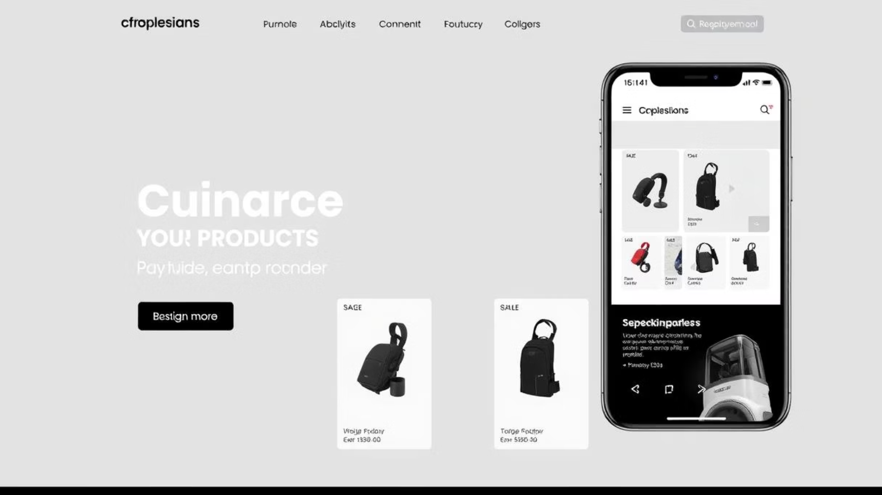
ShopEase – Modern E-commerce Frontend Website
This document provides a comprehensive overview of ShopEase, a modern and responsive e-commerce frontend web project. It covers the project's architecture, technologies used, key features, page descriptions, folder structure, and future enhancement plans. Intended for developers and technical project managers, this guide serves as both an introduction and a reference for implementation and continued development.

Slide 2
Project Overview and Description
ShopEase is designed as a modern, responsive e-commerce frontend built with web standards HTML5, CSS3, and JavaScript. It offers users a clean and intuitive interface where they can browse product categories, view featured product listings, explore discounts and deals, and access brand and contact information.
The user experience centers on simplicity and usability, leveraging Bootstrap 5 for a fluid grid system and responsive design, and Font Awesome for consistent iconography. The frontend is developed independently of backend services, enabling seamless integration with any backend technology or API.
The static nature of the frontend removes the need for server setup, allowing quick deployment or testing in any modern web browser. This architectural choice also emphasizes frontend agility and rapid prototyping with future plans for backend connectivity.

Slide 3
Technology Stack and Folder Structure
The project employs the following technologies:
HTML5: Provides the structural foundation of the web pages and semantic markup
CSS3: Manages styling and adaptations for responsive design
Bootstrap 5.3.3: Utilized for its grid system, pre-built components, and ensuring responsiveness across devices
Font Awesome: Supplies a rich collection of icons used throughout the UI
JavaScript: Enables interactivity, including navigation toggles and dynamic content behaviors
The project directory is well-organized to separate concerns:
/ShopEase: Root folder containing all files
index.html, products.html, deals.html, contact.html, cart.html, account.html: Main HTML pages each serving a distinct purpose
/css: Contains stylesheet files like styles.css and product.css
/js: Hosts JavaScript files such as main.js
/images: Stores product imagery e.g., wireless earbuds, smart watch, bluetooth speaker, wallet

Slide 4
Page Descriptions and User Interaction
The project contains multiple pages, each designed to meet standard e-commerce frontend requirements:
index.html: Serves as the homepage featuring a hero banner, curated featured products, and a newsletter signup form to encourage user engagement
products.html: Displays product categories or a detailed product grid to facilitate product discovery and browsing
deals.html: Lists current discounts and special offers to highlight promotions and boost sales
contact.html: Provides a contact form along with business information for customer support and inquiries
cart.html: Presents the shopping cart user interface listing selected products ready for checkout
account.html: Contains login and signup user interface components for user authentication and profile management
Each page incorporates key UI elements such as dropdown menus for navigation, product cards with "Add to Cart" buttons, and Font Awesome icons for visual cues. The design adheres to a clean, modern aesthetic that supports user-friendly browsing and conversion.

Slide 5
Key Features and User Experience Highlights
ShopEase implements several important frontend features that enhance both usability and aesthetics:
Responsive Design: Utilizing Bootstrap 5 ensures the website layout fully adapts to any screen size from desktop monitors to mobile devices, preserving usability and aesthetics.
Interactive Product Cards: Each product card includes an "Add to Cart" button with JavaScript-driven interaction allowing immediate user actions without page reloads.
Dropdown Navigation Menu: The navigation bar supports dropdown menus for streamlined access to multiple categories or pages, facilitating efficient navigation.
Newsletter Subscription: A simple subscription form embedded on the homepage encourages users to sign up for updates and promotions.
Iconography: Font Awesome icons add intuitive visual accents to buttons, form elements, and navigation menus, boosting accessibility and clarity.
Modern Layout: Clean typography, ample whitespace, and a consistent color palette contribute to a professional and inviting user interface.

Slide 6
Setup Instructions and Deployment
Setting up ShopEase for local development or testing is straightforward due to its static nature:
Clone or download the complete project folder from the provided GitHub repositories.
Open the index.html file with any modern web browser such as Chrome, Firefox, Safari, or Edge.
No backend server or additional configuration is required to view and interact with the frontend components.
This simplicity makes ShopEase highly accessible for rapid prototyping or integration testing with backend APIs. However, future versions may require backend setup for full e-commerce functionality including cart persistence and user accounts.

Slide 7
Future Enhancements and Roadmap
The current static frontend provides a solid foundation for an e-commerce site, but several planned enhancements aim to expand functionality and improve user experience:
Backend Integration: Connecting with backend technologies such as Node.js, PHP, or Firebase to enable dynamic data handling, user authentication, and inventory management.
Search and Filter Features: Adding advanced search filters on products pages will allow users to find items quickly based on categories, price ranges, and ratings.
Shopping Cart Functionality: Implementing persistent shopping cart data using local storage or databases to maintain user selections across sessions.
Animations and Transitions: Leveraging animation libraries like GSAP or AOS for enhanced visual feedback and smoother user interactions.
Accessibility Improvements: Enhancing ARIA labels, enabling keyboard navigation, and improving contrast ratios to make the frontend more inclusive for all users.
These improvements will bring ShopEase closer to a production-ready state, providing a comprehensive shopping experience that meets modern web standards.

Slide 8
Credits and Contact Information
This project is built upon reputable open-source frameworks and libraries:
Bootstrap for responsive grid system and UI components
Font Awesome for scalable and accessible iconography
For further questions, collaboration, or access to source code, please contact the author:
Name: Silas HAKUZWIMANA
Email: hakuzwisilas@gmail.com
GitHub Repositories:
feb-2025-final-project-and-deployment-Silas-Hakuzwimana
https://github.com/Silas-Hakuzwimana/final-project.git
Live link: https://taupe-sopapillas-48e4a5.netlify.app/

