Slide 1

Emotional Health
Group-5
Shivangi Verma
Prashant Chaudhary
Ankeit Taksh
Anirban Kar Chodhuri

Slide 2
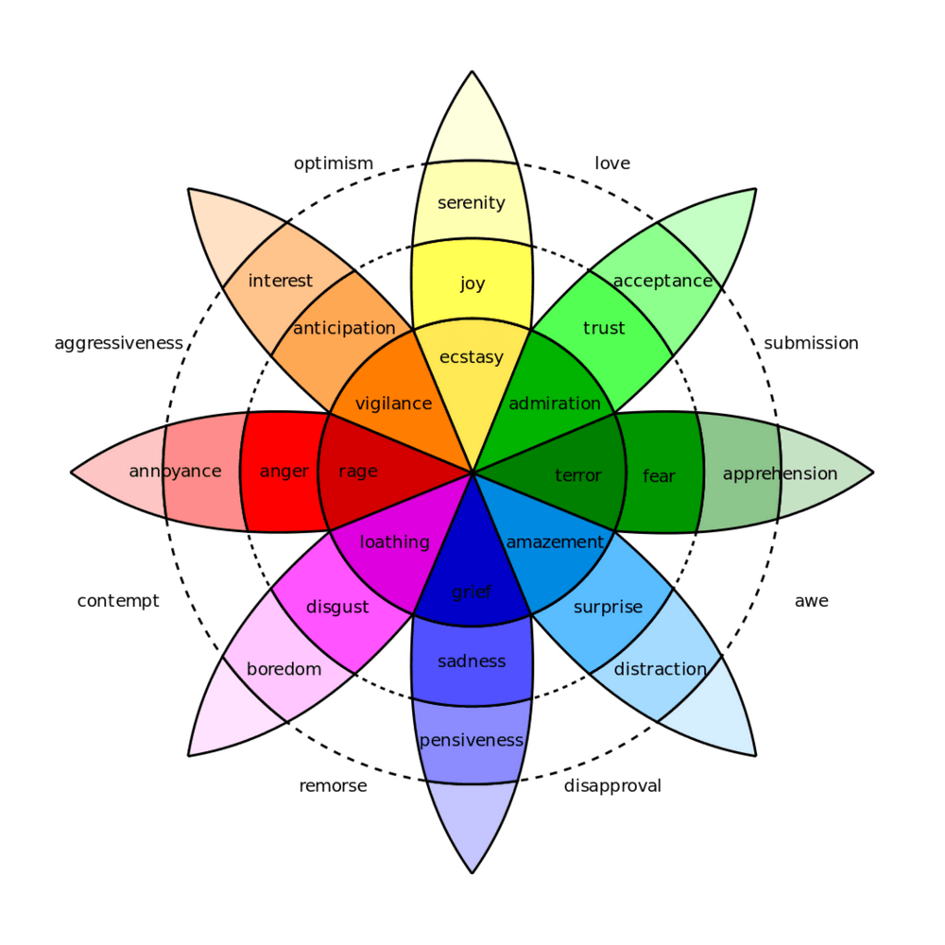
Background
- Depression is a serious health condition causing -
Constant thoughts of traumatic memories
Insomnia
Anxiety
Suicidal tendencies (worst case)
Worldwide affecting more than 264 million people of all age groups (WHO)
- With the growth of Social Media Platforms,
- People tend to express their opinions, emotions
- Share activities updates online that reflects their mood and mental health
This can be good for analysis and recommendation by applying AI techniques
- Finding these indicators will help in early diagnosis and help potential victims
Emotions Considered in our case -
Stress
Depression
Anxiety
Fear
Loneliness

Slide 3


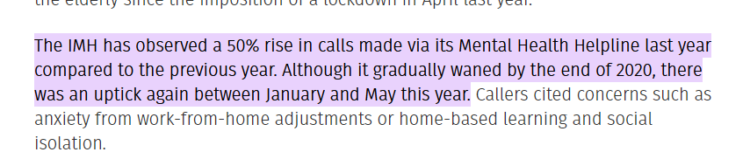
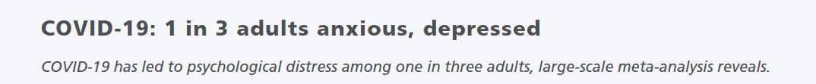

Slide 4
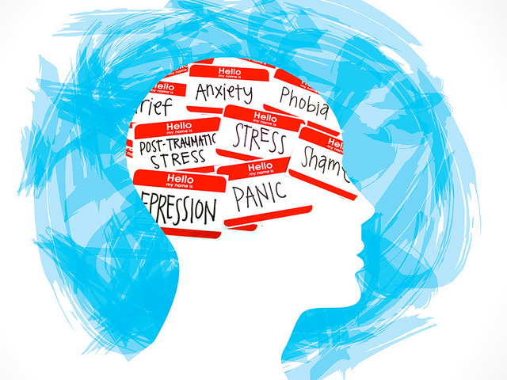
Business Problem
How Social Media Can help?
Platform – to outlet individual’s thoughts and emotions,
Anonymity - Offers level of anonymity, to make people uninhibited in their expressions.
Opportunity - it provides a good opportunity to identify potential depression in the users and from there offer suitable support
Shortcomings of Human experts ?
Expensive
Need to solicit
Victims need to be aware of personal situation or help available
Stigma associated with mental health treatment

Slide 5
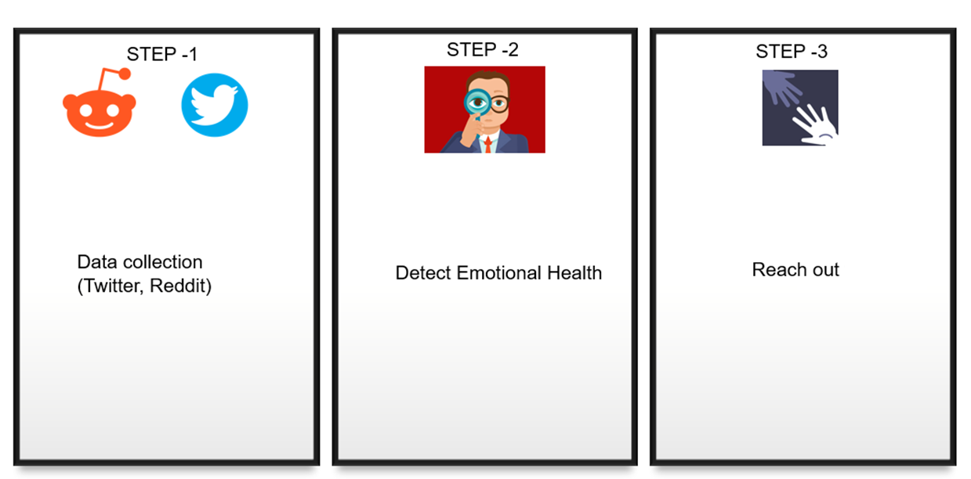
Introducing Emotional Health Bot

Slide 6





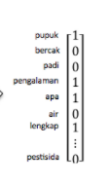


Complete Workflow Design
Deep Analysis Pipeline
P
R
E
P
R
O
C
E
S
S
I
N
G
L
A
Y
E
R
RESPONSE
GENERATION
D
A
T
A
C
O
L
L
E
C
T
O
R
Track Loneliness, Stress and Anxiety score
Classic NLP Based
Anxious
Reach out with chatbot link
OUT
PUT
C
H
A
N
N
E
L
S
Classify
Depressed
Deep Learning Based
Lonely
Reference Document using
Document
Similarity
#Millenial
#SUICIDE
Suicidal
#LONELY
Intent pipeline – Simple / Counsel / Survey
r/depression
r/Anxiety
r/Stress
Counsel Intent
Cosine similarity with Question from Q/A Counsel dataset
Word Embedding
Pull the respective answer for response
Simple Intent
Survey Intent
Generate appropriate response
based on intent
Msg, Document Store

Slide 7
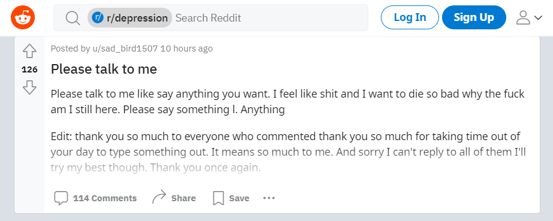
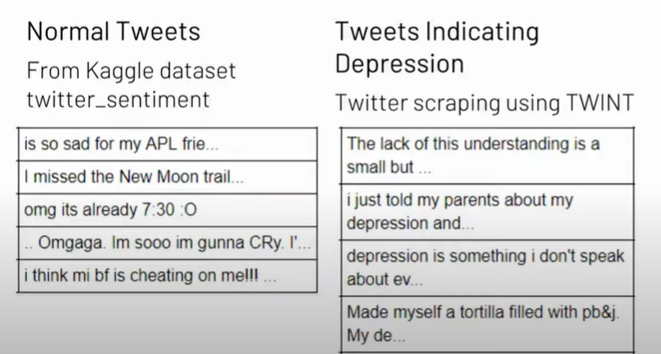

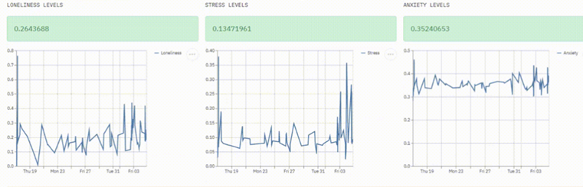
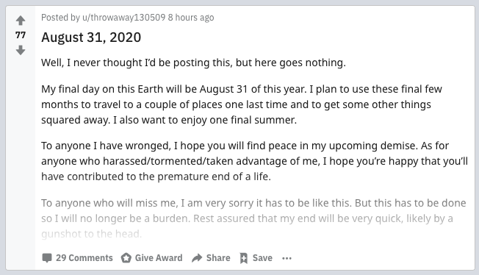
Sample Tweets & Posts for Classification

Slide 8
Datasets - Available & Self Annotated
Public
Distress analysis Interview Corpus(DAIC-WOZ) database
(This database is part of a larger corpus, the Distress Analysis Interview Corpus (DAIC) (Gratch et al.,2014), that contains clinical interviews designed to support the diagnosis of psychological distress conditions such as anxiety, depression, and post-traumatic stress disorder)
Sentiment 140
(This is the sentiment140 dataset. It contains 1,600,000 tweets extracted using the twitter api . The tweets have been annotated (0 = negative, 4 = positive)
Transcripts found online that are interviews between a counsellor and a patient
Self Annotated
We have used Twint, Tweepy and Reddit APIs to scrape data online and then manual tagging them using keywords and other methods
ANXIETY TWEET
day 41 365 got7 nobody knows dont know anything lonely im alone dont want show side ive hide dont need see face expression anymore enough
want say dm always open need gladly listen rant need please need someone dont hesitate reach even weve never speak youre alone feeling valid love
hey yall want let know u ever need vent talk arm open u never want u go something alone pls dont hesitant dm literally love sm
want say dm always open need gladly listen rant need please need someone dont hesitate reach even weve never speak youre alone feeling valid love
sherlock come pretty boy cant think one thing like louis like youre sad sherlock
listen vocaloid cover icam derange tired draw
rain sad music
life unfair im big sad
tonight 1 night im tire foot hurt im feed cry name
dont tire vote bts cheer work hard vote dynamite favorite song kca
say sweet dream girl eye make happy sad equal measure
STRESS

Slide 9




Data Cleaning and Pre-Processing
Example : Original tweet
Step 1: Remove #@
Natural Language processing
Step 2: Remove emojis and images
Cleaned tweet
This does not feel good #lonely .Lyf is not feeling good !! What have I done #depressed G2G RN @DDj do you feel so
this does note feel good lonely.lyf is not feeling good what have I done depressed got to go right now ddj do you feel so
Text tokenization
Step 3: Remove punctuations and numbers
Remove stopwords
Annotate Text
POS Tagging
Step 4: Expand Abbreviations, Acronyms, Initialisms, and Slangs-(using urban dictionary)
Model

Slide 10
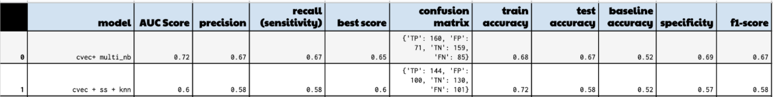
Deep Analysis flow - Classic NLP Pipeline
Pre-processing
Feature engineering
Train model :
Baseline models
Logistic regression
SVM
Naïve Bayes
Ensemble methods
Random forest etc
Annotated data for each label collected from online sources
Bag of Word
Model evaluation
Predict class
Remove stop-words
TF-IDF
Training
Stemming and Lemmatization
Word Embedding
Testing
Test data
Pre-processing
Fit model
Predict class
Evaluation

Slide 11
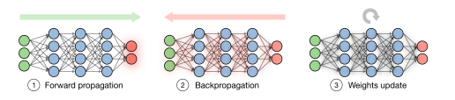
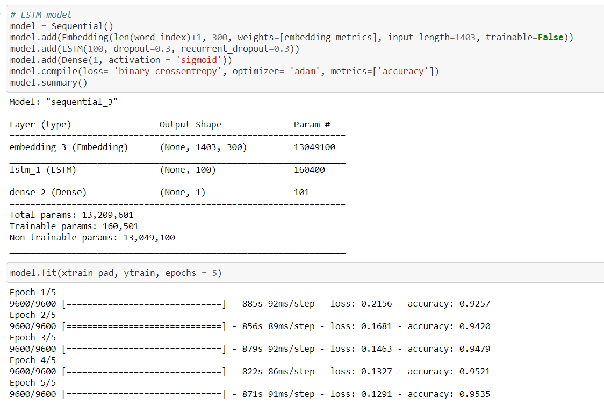
Training
Deep Analysis flow – DL Pipeline
Annotated data for each label collected from online sources
Pre-processing
Embedding training
Weight initialization
Initialize epoch ,batch and step
Calculate forward pass
Compare calculated output to expected output
Word 2Vec(CBOW and Skip-Gram)
Glove
Adjust weights
Calculate scores
Combination of various models of RNN ,CNN combined with hyperparameter tuning methods
Dense Layer
Predict class
Testing
Word 2Vec(CBOW and Skip-Gram)
Glove
Test data
Pre-processing
Embedding training
Fit model
Predict class

Slide 12
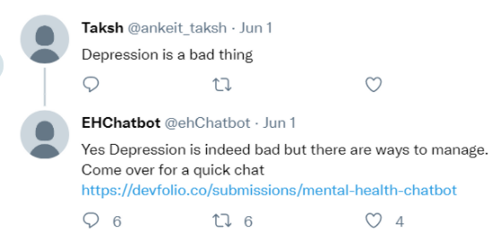
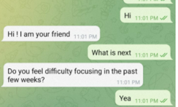
Intent flow – Simple Intent Response
Intents | Sample queries | Action/Response
Greeting | "Hi","Hello","Is there someone I can talk" | "Hi ! I am your friend"
Counsel | "Can I speak to a counselor","Speak to a doctor" | "Please enter your query"
Goodbye | "Thanks","Bye" | "Thanks for having this conversation"
SOS | "Helpline numbers","Helpcenters" | Call immediately or inform regional help centers
Survey | "SURVEY","survey","I would like to take a survey" | "Would you like to take answer some questions which will help us understand you better"
Fig : User posts a message ,Our chatbot reaches out
Fig : Intent and associated action
Fig : Sample screen of how chatbot medium might look

Slide 13

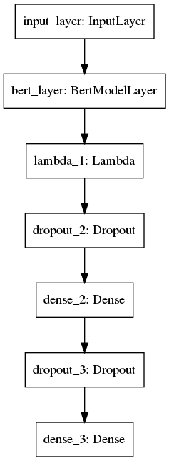
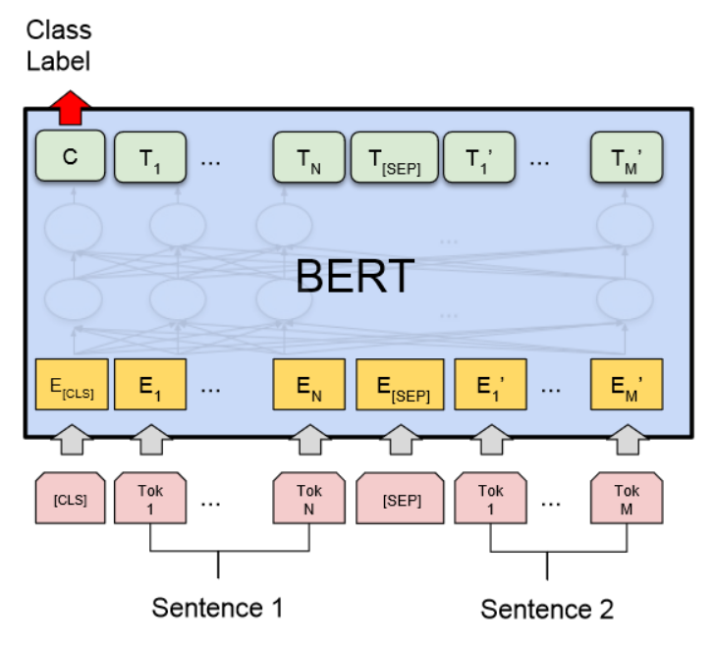

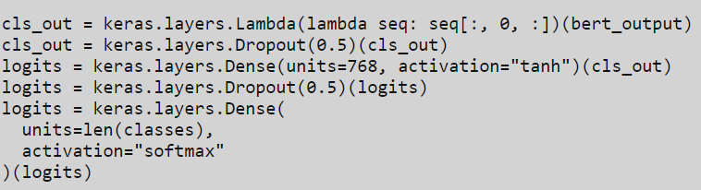
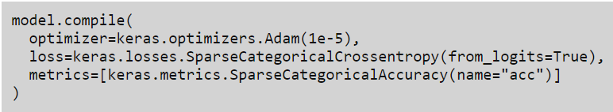
Intent flow – Simple Intent Training
Data preparation
1.Load modules
2.Load intents
Load BERT model
Tokenize using BERT Tokenizer
1.Text normalisation
2.Punctuation splitting
3.WordPiece tokenisation
Pre-process input data
["[CLS]"] + tokens + ["[SEP]"]
Add padding to the sequence
Train and Finetune model
Predict intent
BERT For Sequence Classification

Slide 14
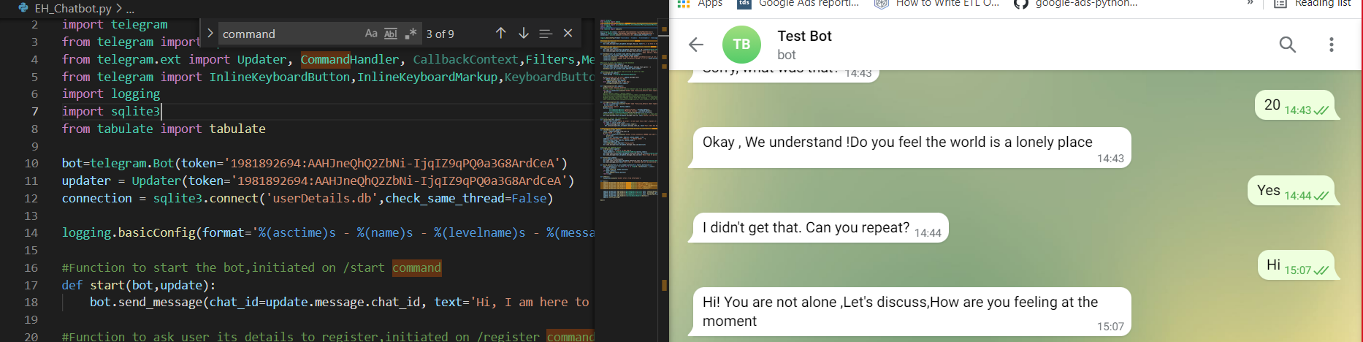
Intent flow – Counsel Intent Example
Fig: Chatbot Interface where the user will Counsel specific question for example”How many types of depressions are there “etc

Slide 15

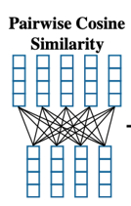
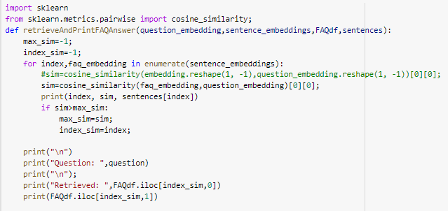
Intent flow – Counsel Intent Backend
Appropriate response pulled from database and response created
Since our ultimate goal is that the machine understands the context of user query we are targeting semantic similarity for which we will be using BERT Embeddings
Answer from counselor:
If everyone thinks you're worthless, then maybe you need to find new people to hang out with.Seriously, the social context in which a person lives is a big influence in self-esteem.Otherwise, you can go round and round trying to understand why you're not worthless, then go back to the same crowd and be knocked down again.There are many inspirational messages you can find in social media.
User Query: Everyone thinks I am worthless
User query embedding
Question in transcripts: Can I change my feeling of being worthless to everyone?
Answer from counselor:
If everyone thinks you're worthless, then maybe you need to find new people to hang out with.Seriously, the social context in which a person lives is a big influence in self-esteem.Otherwise, you can go round and round trying to understand why you're not worthless, then go back to the same crowd and be knocked down again.There are many inspirational messages you can find in social media. Â Maybe read some of the ones which state that no person is worthless, and that everyone has a good purpose to their life.
Question embeddings

Slide 16
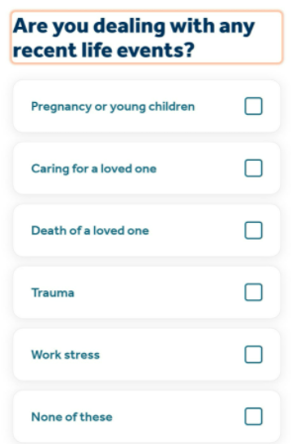
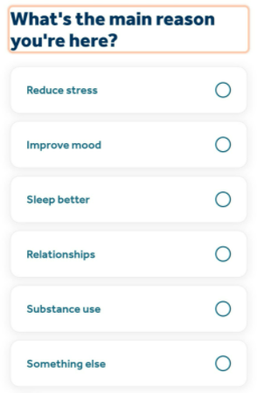
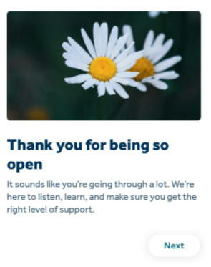
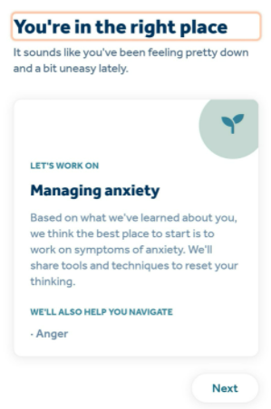
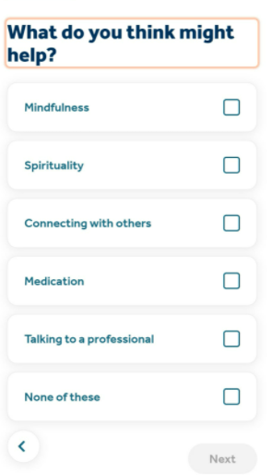
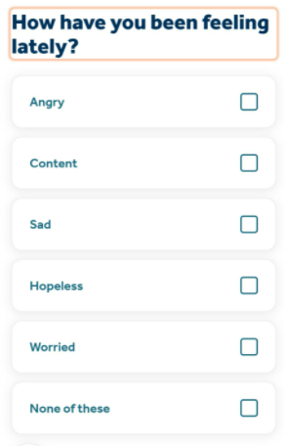
Intent flow – Survey

Slide 17
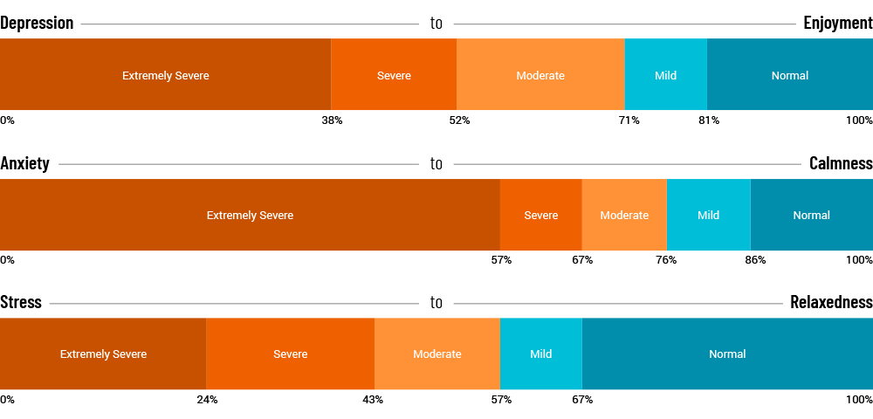
Response Generation – Document similarity & relevance
Approaches
Keyword based search
Vector based search
Index – the document (& store)
Vectorize – text data
Retrieve - its most similar documents + distance
Find - numerical representation of text queries / chats
Measure - similarity b/w query vector & docs
Retrieve - its most similar documents + distance
Relevance | Topic | Document
85% | Stress | Document1,Document2
50% | Lonely | Document1,Document3
30% | Depressed | Document1,Document4
22% | Anxeity | Document1,Document5

Slide 18

Challenges
Lot of junk tweets and posts to filter out .
Multimedia tweets are ignored because focus is on text.
Difficult to scrape without using depression related keywords.
Class imbalance between actually depressed tweets and suggestive help material .
Difficult to classify between various emotions under depression quadrant and lack of training dataset .

Slide 19
Current status and future scope
Current status
Data collection
Future scope
We aim to add an audio medium as data collection as well ,which will then classify sounds on our decided labels.
We can collaborate with real counsellors or health centers which canbe more helpful in the long run.

Slide 20


