Slide 1
PLS 120 Text Images

Slide 2
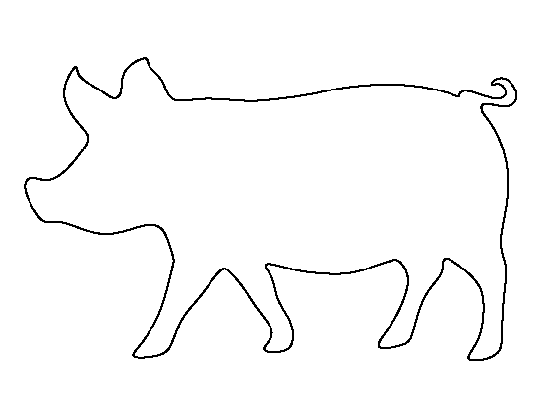

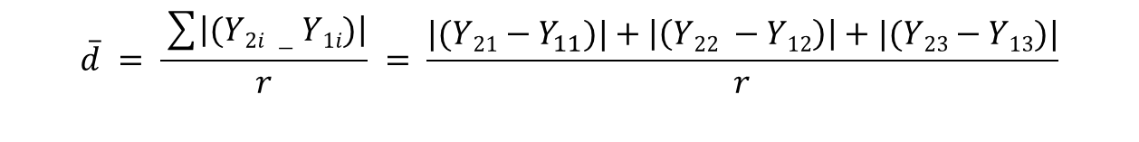




Pen 1
Pen 2
Pen 3
$${Y_{11} Y}_{21}$$
$${Y_{12} Y}_{22}$$
$${Y_{1r} Y}_{2r}$$
Treatment 1
Treatment 2
$${Y_{11} Y}_{12} Y_{13}$$
$${Y_{21} Y}_{22} Y_{23}$$
$$\overline{d} = \frac{\sum{\left|(Y2i −Y1i)\right|}}{r} = \frac{|(Y21−Y_{11})|+\left|\left(Y22 −Y12\right)\right|+|(Y23−Y13)|}{r}$$

Slide 3
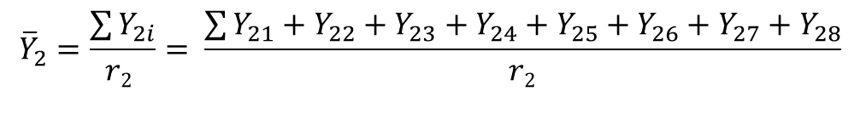

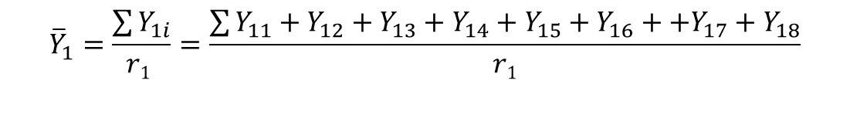
Treatment 1
${Y_{11} Y}_{12} Y_{13} Y_{14}$ $Y_{15} Y_{16} Y_{17}$ $Y_{18}$
Treatment 2
${Y_{21} Y}_{22} Y_{23} Y_{24}$ $Y_{25} Y_{26} Y_{27}$ $Y_{28}$
$${\overline{Y}}_{1}=\frac{\sum{Y_{1i}}}{r1 }=\frac{\sum{Y_{11}}+Y_{12}+Y_{13}+Y_{14}+Y_{15}+Y_{16}++Y_{17}+Y_{18}}{r1}$$
$${\overline{Y}}_{2}=\frac{\sum{Y_{2i}}}{r2 }= \frac{\sum{Y_{21}}+Y_{22}+Y_{23}+Y_{24}+Y_{25}+Y_{26}+Y_{27}+Y_{28}}{r2}$$
$$\overline{d}=\overline{Y_{1}}−{\overline{Y}}_{2}$$

Slide 4
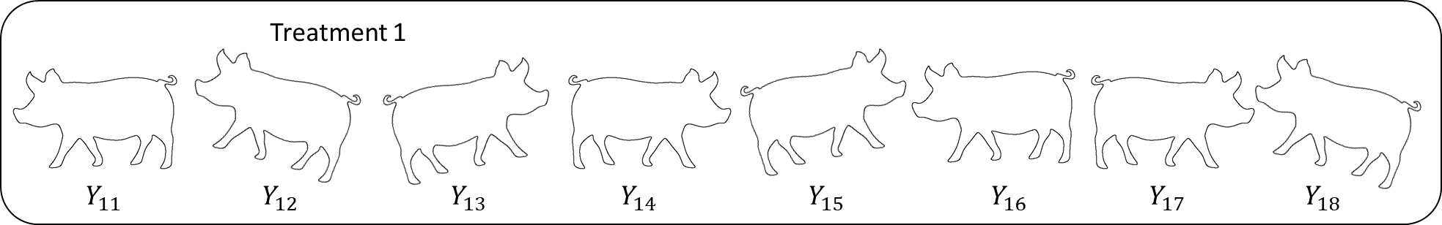
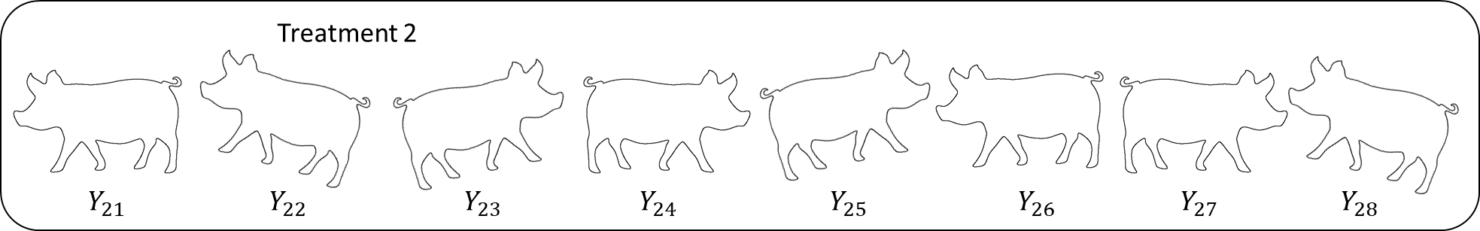
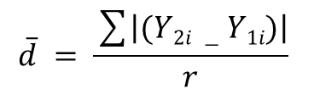
$$\overline{d} = \frac{\sum{\left|(Y2i −Y1i)\right|}}{r}$$
$$\overline{d} = \frac{\sum{\left|(Y2i −Y1i)\right|}}{r} = \frac{|(Y21−Y_{11})|+\left|\left(Y22 −Y12\right)\right|+|(Y23−Y13)|+…+\left|\left(Y27 −Y17\right)\right|+|(Y28−Y18)|}{r}$$

Slide 5
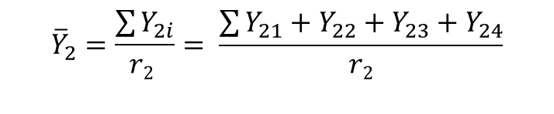

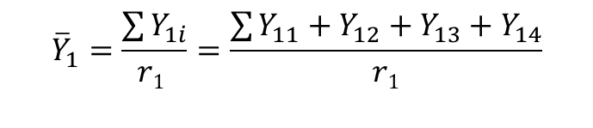
Treatment 1
Treatment 2
$${Y_{11} Y}_{12} Y_{13} Y_{14}$$
$${Y_{21} Y}_{22} Y_{23} Y_{24}$$
$${\overline{Y}}_{1}=\frac{\sum{Y_{1i}}}{r1 }=\frac{\sum{Y_{11}}+Y_{12}+Y_{13}+Y_{14}}{r1}$$
$${\overline{Y}}_{2}=\frac{\sum{Y_{2i}}}{r2 }= \frac{\sum{Y_{21}}+Y_{22}+Y_{23}+Y_{24}}{r2}$$
$$\overline{d}=\overline{Y_{1}}−{\overline{Y}}_{2}$$

Slide 6
Steps to test two population means
Collect samples for each population
Calculate the average and the sample variance for each sample
Identify which equation(s) to use depending on
If the samples are paired or independent
If the population variances are equal
If the sample sizes are the same
Calculate the difference of the averages and difference of the sample variances between the two samples
Calculate the calculated t-statistic (using your dbar and sbar)
Compare your calculated t-statistic to the critical t-value to determine if the null hypothesis will be rejected or not.

Slide 7
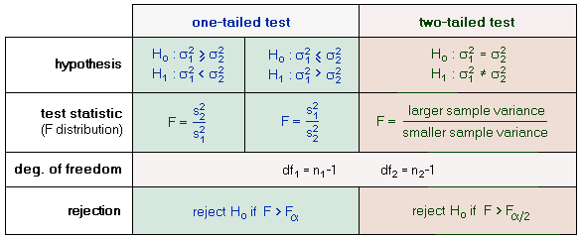

Slide 8
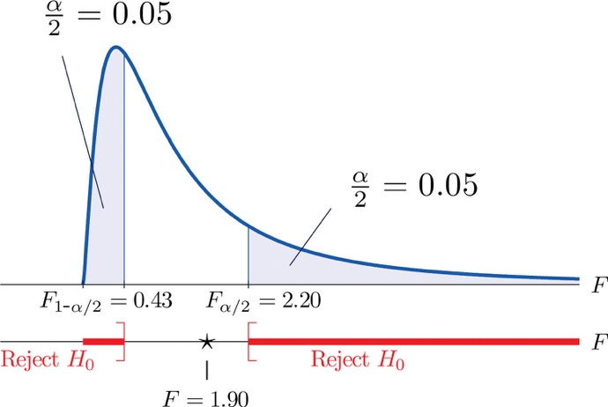

Slide 9
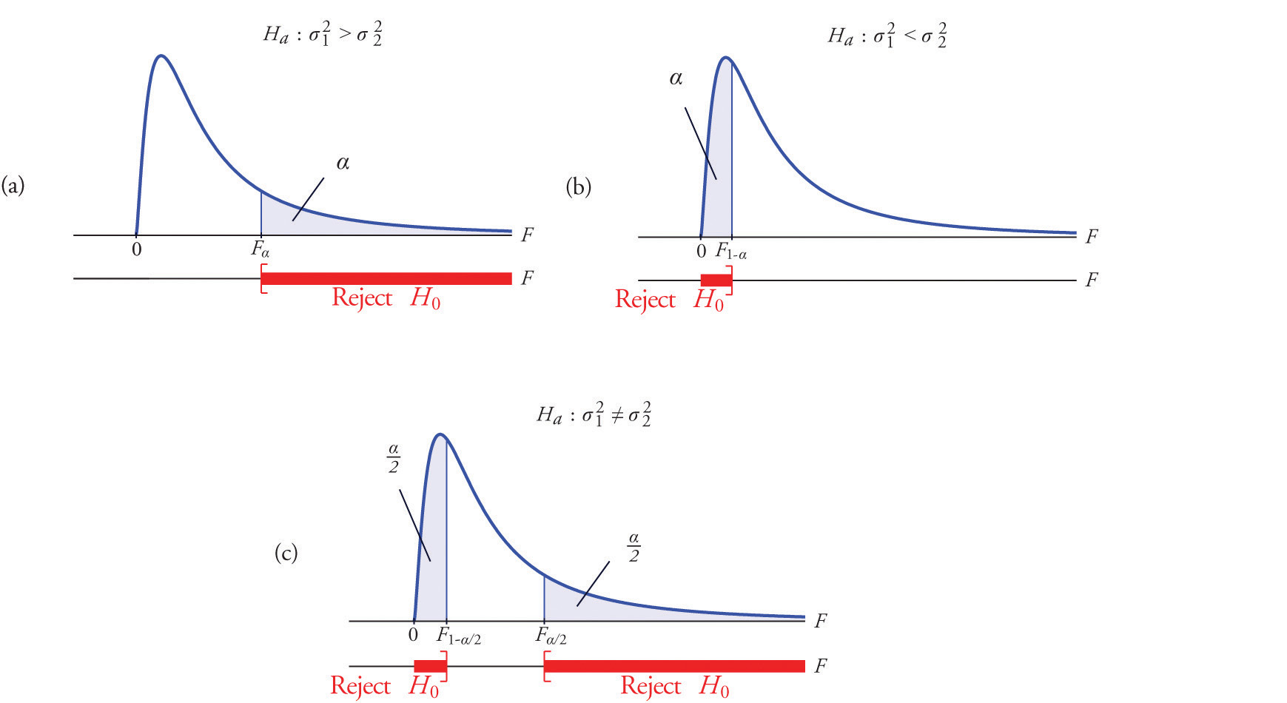

Slide 10


Slide 11
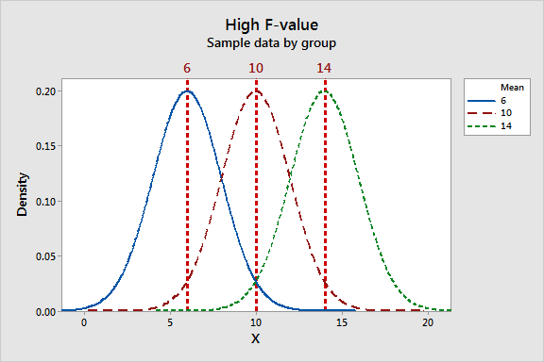

Slide 12
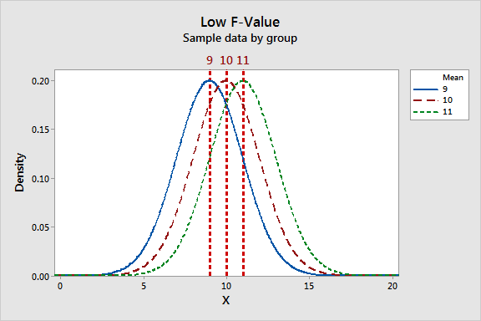

Slide 13
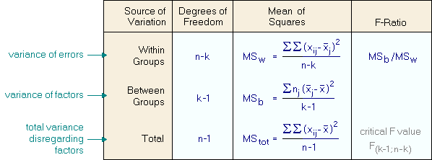

Slide 14
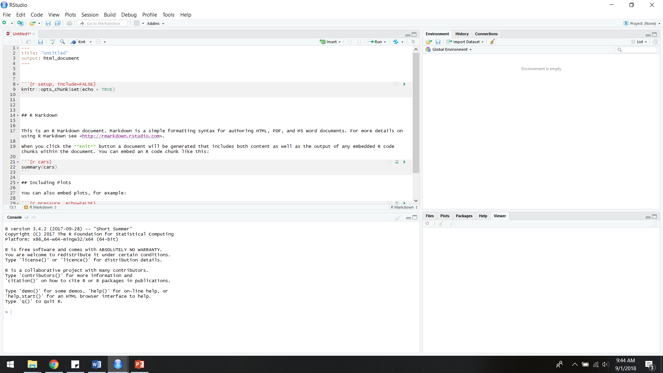
Markdown Document
where to edit and save lines of code;
can send code to console from here
Environment and History
where datasets and objects are listed
Console
where to enter code for R to calculate
File / Plots / Packages / Help
where to view files in working directory, view plots, install and load packages, and find help on functions

Slide 15
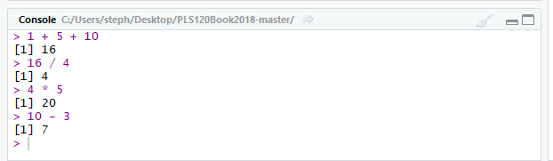

Slide 16
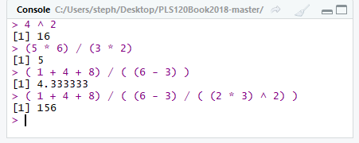

Slide 17
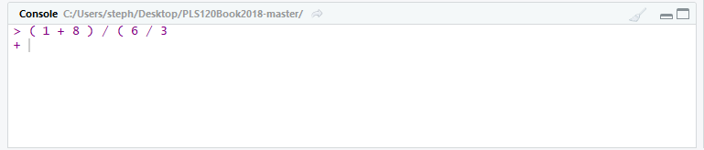
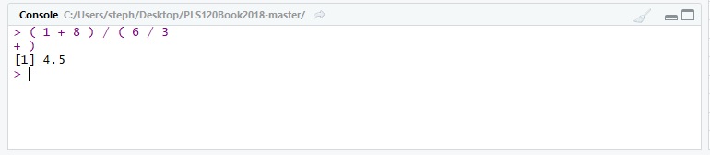

Slide 18
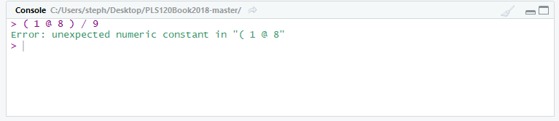

Slide 19
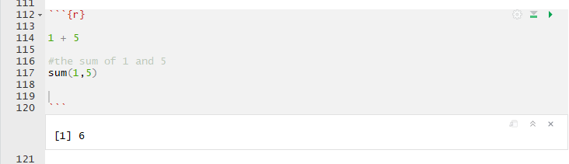

Slide 20
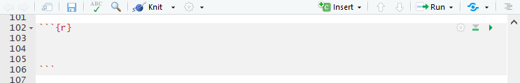

Slide 21
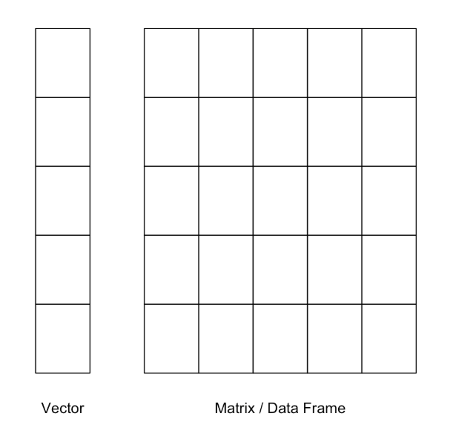

Slide 22
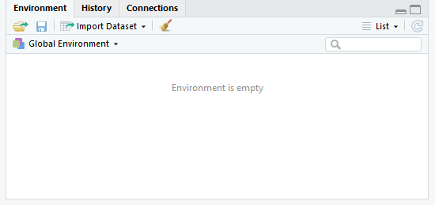
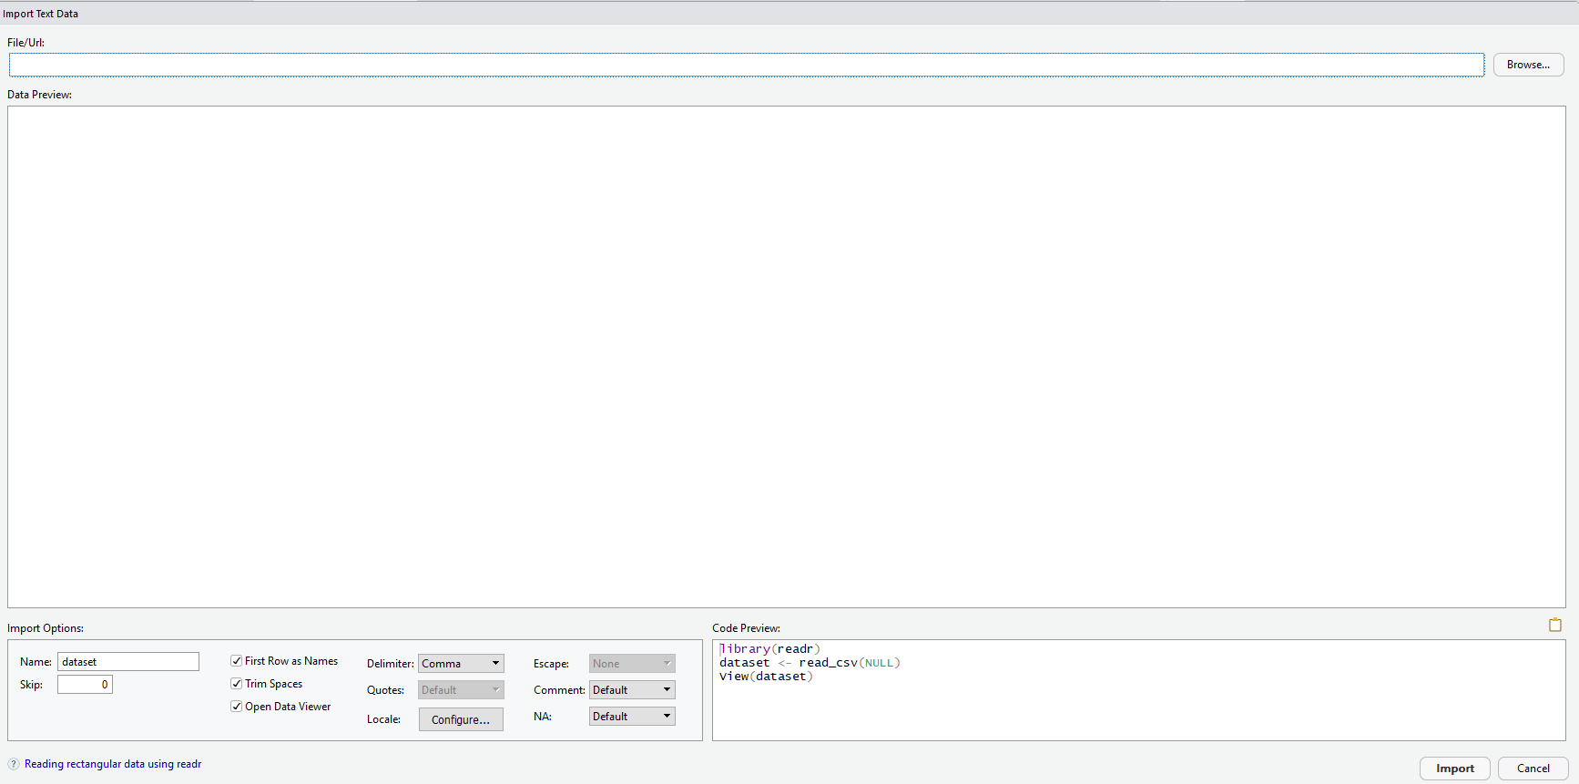

Slide 23
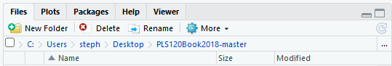

Slide 24
