Slide 1
IFC Inside: A General Approach to Retrofitting Languages with Dynamic Information Flow Control
Stefan Heule, Deian Stefan, Edward Z. Yang, John C. Mitchell, Alejandro Russo
Stanford University, Chalmers University

Slide 2
What is IFC?
Not all information in a program is equal
Some might be more sensitive
Information flow control …
… tracks where information flows
… allows policies to restrict flows of information

Slide 3
Example: security on the web
Modern web pages involve many components
Javascript of the website
Javascript of some (untrusted) library
Advertising code
Browser addons
Web content can be very sensitive
Online banking, passwords, personal information, etc.

Slide 4
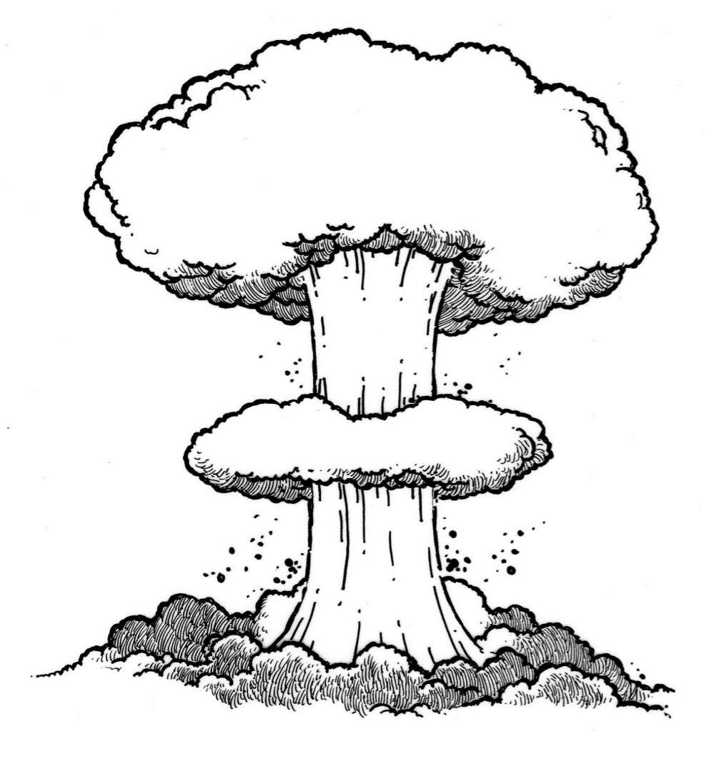
Current situation
Code written by many different parties
Potentially mutually distrusting parties
Computing over sensitive data
IFC to the rescue
Label sensitive data as such
Prevent flow of sensitive data to undesired places (like arbitrary web servers)

Slide 5
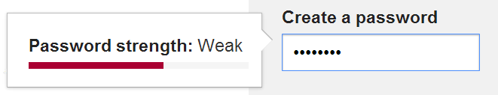
Concrete Example
Password strength checking
Website uses check_strength(pw) from a (not fully trusted) library
The library could send the password to bad.com
With IFC, we can precisely decide what the library can do with the password

Slide 6
Why isn’t everyone using IFC?
We are interested in a dynamic IFC system
A key challenge is performance
Tracking information at a fine-grained level is expensive

Slide 7



Coarse-grained IFC
The program is split into computational units (tasks)
All data within one task has a single label
Different computational units can communicate
$$l$$
$$l$$
$$l$$

Slide 8
Advantages of coarse-grained IFC
Efficiency
Checks only at isolation boundaries
Minimal changes to language
If added to a language retroactively
Reuse existing programs
Simple
to understand and reason about

Slide 9
Goals
Formally define a core calculus for a coarse-grained dynamic IFC system
Combine IFC language with any programming language
Prove security guarantees of IFC (known as non-interference)

Slide 10
Approach Overview
Given a target language (any programming language)
Define an IFC language
Minimal calculus, only IFC features
Combine target and IFC language
Allow target language to call into IFC, and vice-versa
Careful definition of the IFC language allows the overall system to provide isolation, regardless of what the target language does

Slide 11
IFC language
Tag data with security labels
Labels form a lattice, and determine how data can flow inside an application
Example lattice
Two labels H (high) and L (low)
Flow from H to L is not allowed
H
L

Slide 12

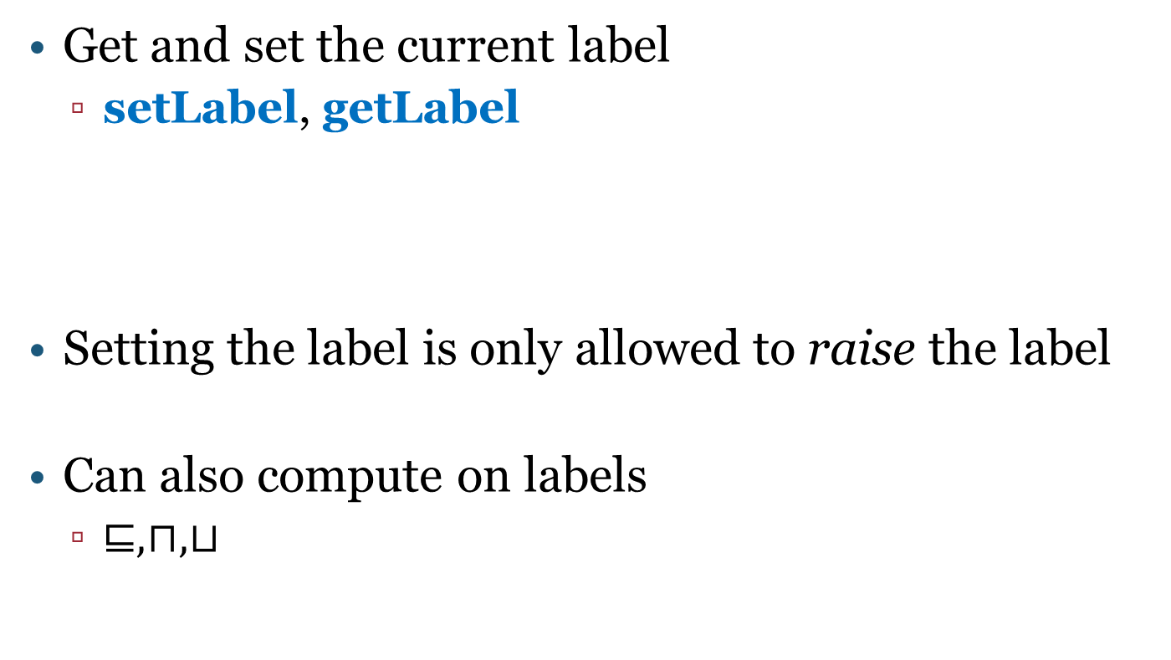


IFC language: labels
Get and set the current label
setLabel, getLabel
Setting the label is only allowed to raise the label
Can also compute on labels
$⊑, ⊓, ⊔$
$$l_{1}$$
setLabel $l_{2}$
$$l_{2}$$

Slide 13



IFC language: sandboxing
Isolate an expression as a new task
sandbox e
$$l$$
sandbox e
$$l$$
$$l$$
e
1
1
2

Slide 14







Inter-task communication
Tasks can send and receive messages
Send message v to task i, protected by label $l^{′}$
send i $l^{′}$ v
Can only send messages at or above current label
$$l_{1}$$
$$l_{2}$$
$$l_{1}$$
$$l_{2}$$
send 2 $l^{′}$ v
1
2
1
2
$$\left(1,l^{′},v\right)$$

Slide 15




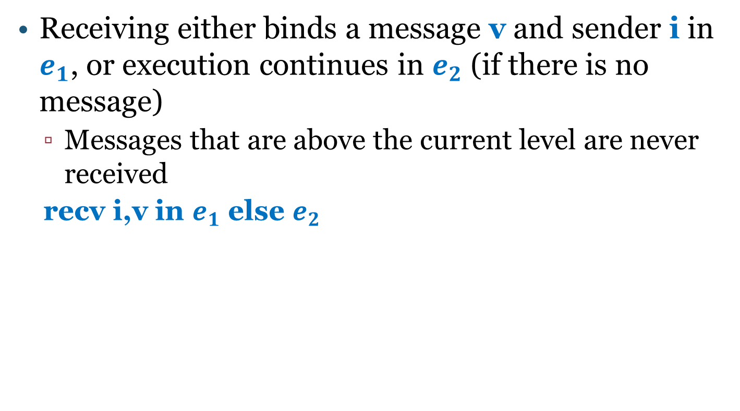






Inter-task communication
Receiving either binds a message v and sender i in $e_{1}$, or execution continues in $e_{2}$ (if there is no message)
Messages that are above the current level are never received
recv i,v in $e_{1}$ else $e_{2}$
$$H$$
$$H$$
$$L$$
$$L$$
$$recv$$
$e_{1}$ [v,i]
$$recv$$
$$e_{2}$$
2
2
2
2
$$\left(1,H,v\right)$$
$$\left(1,H,v\right)$$

Slide 16
Formal treatment

Slide 17
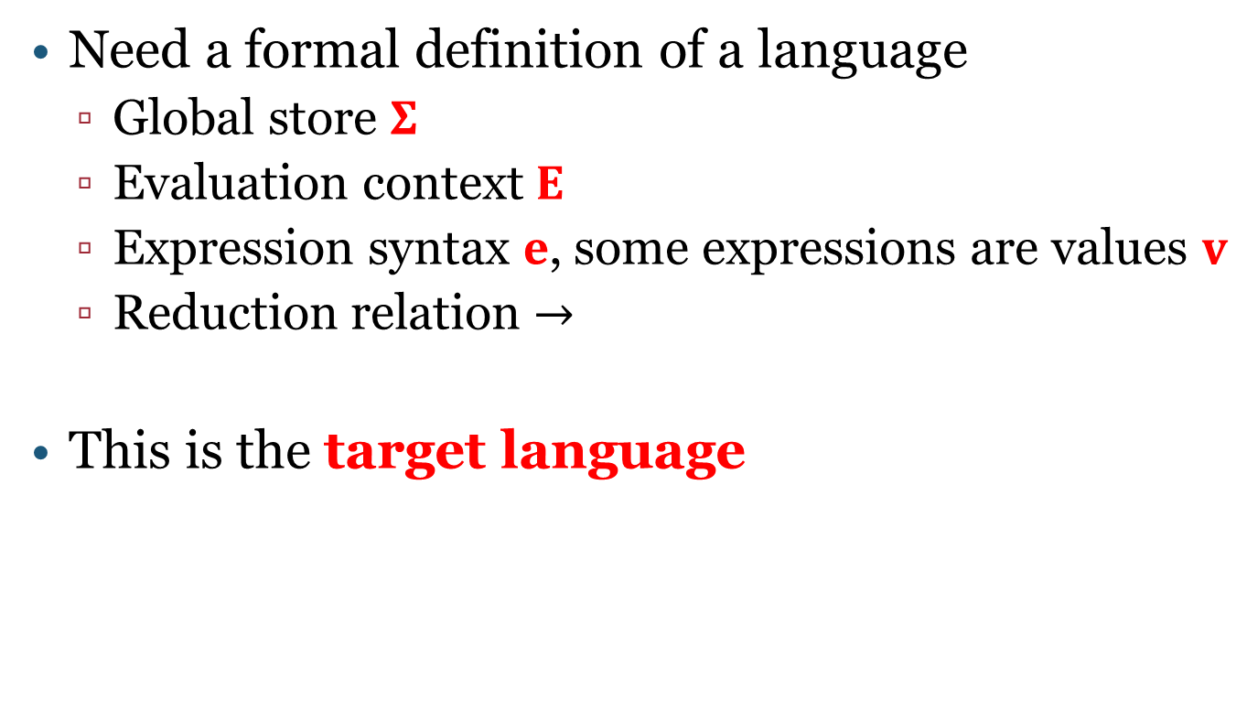
What is a programming language?
Need a formal definition of a language
Global store $Σ$
Evaluation context $E$
Expression syntax $e$, some expressions are values $v$
Reduction relation $→$
This is the target language

Slide 18
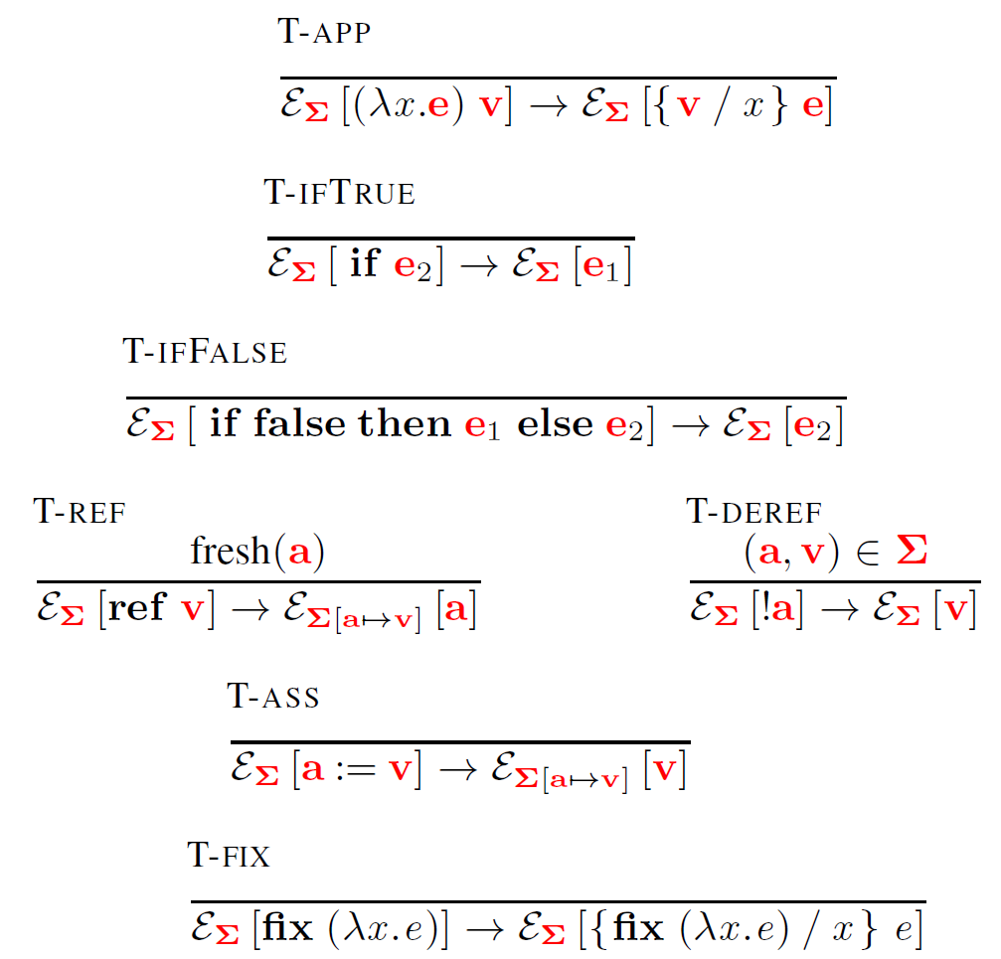
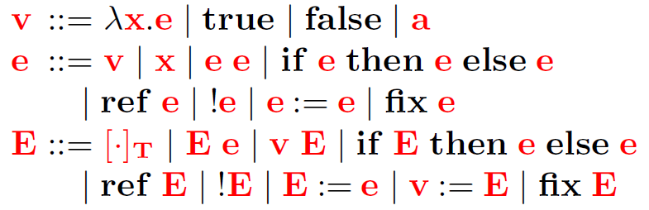
Example: Mini-ECMAScript

Slide 19

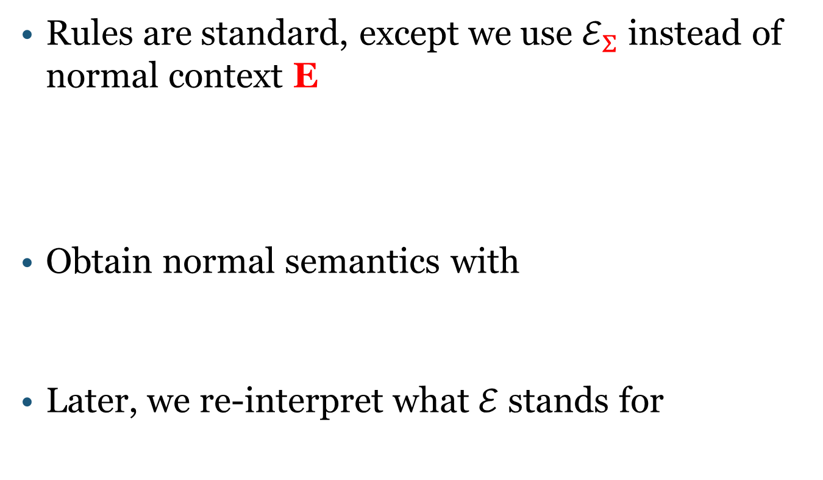
Notation
Rules are standard, except we use $ℰ_{Σ}$ instead of normal context E
Obtain normal semantics with
Later, we re-interpret what $ℰ$ stands for

Slide 20
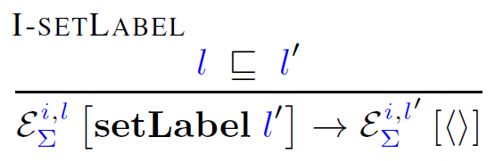






IFC language
Also defined in terms of an special $ℰ$
$$l_{1}$$
setLabel $l_{2}$
$$l_{2}$$
$$i$$
$$i$$

Slide 21
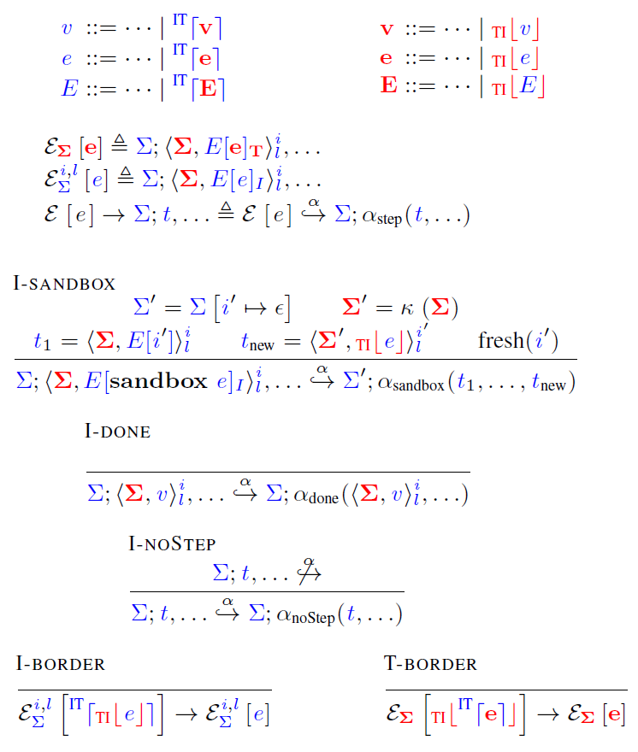
Embedding [Matthews and Findler, POPL’07]
Extend IFC and target language syntax
Re-interpret context and reduction relation

Slide 22
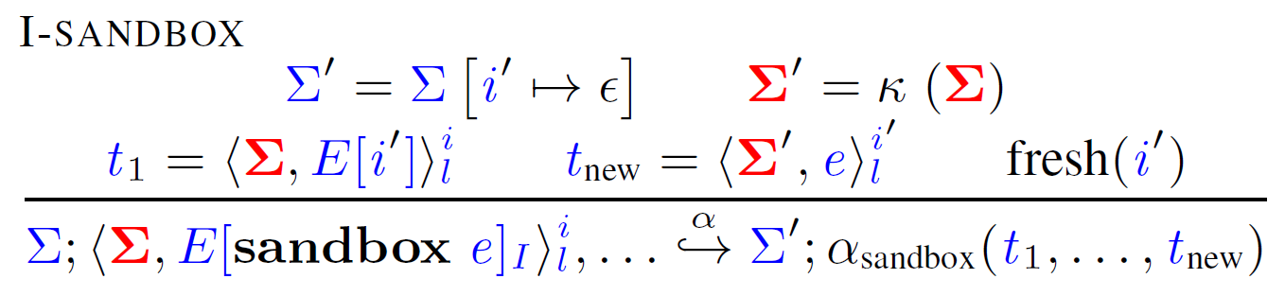
Sandboxing
sandbox e does
Create new task for e
Schedule e according to scheduling policy

Slide 23








Security Guarantees
Non-interference:
Intuitively: An attacker that can only see values up to level $l$ should not see a difference in behavior if values at level $l′$ > $l$ are changed
$$L$$
$$H$$
$$H$$
$$L$$
$$H$$
1
2
3
1
4
$$\left(1,H,33\right)$$
$$\left(1,H,−1\right)$$

Slide 24
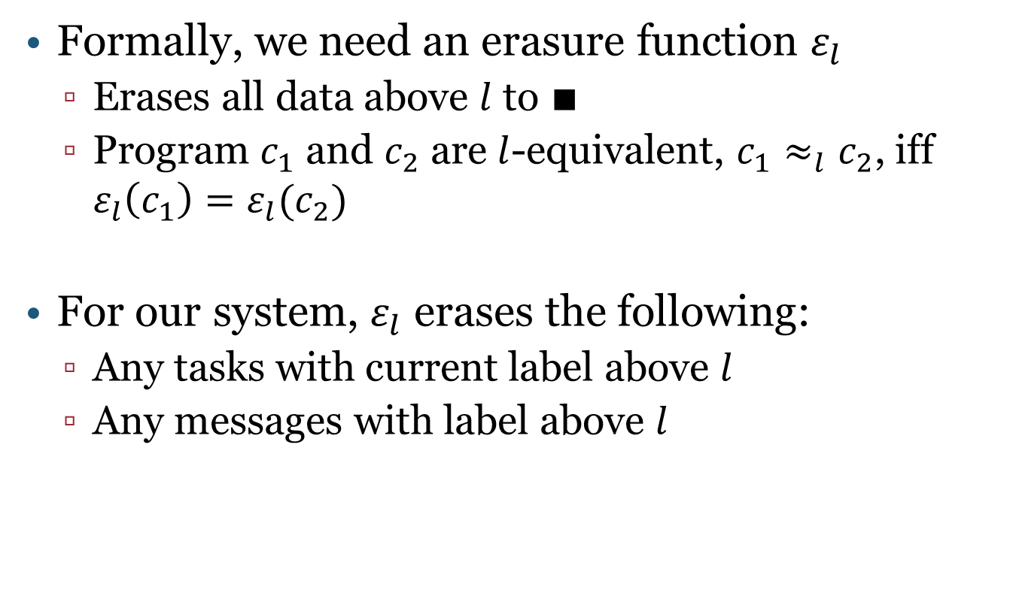
Erasure function
Formally, we need an erasure function $ε_{l}$
Erases all data above $l$ to $∎$
Program $c_{1}$ and $c_{2}$ are $l$-equivalent, $c_{1}≈_{l}c_{2}$, iff $ε_{l}\left(c_{1}\right)=ε_{l}(c_{2})$
For our system, $ε_{l}$ erases the following:
Any tasks with current label above $l$
Any messages with label above $l$

Slide 25


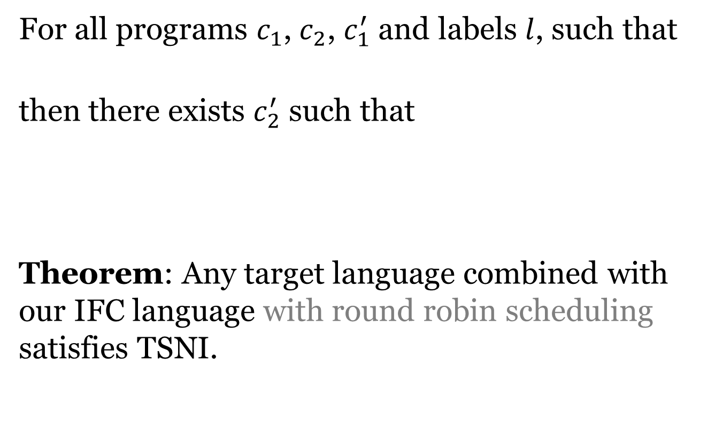
Termination sensitive non-interference (TSNI)
For all programs $c_{1}$, $c_{2}$, $c_{1}^{′}$ and labels $l$, such that
then there exists $c_{2}^{′}$ such that
Theorem: Any target language combined with our IFC language with round robin scheduling satisfies TSNI.

Slide 26
Real world examples
Is this actually practical?
One challenge are external effects
File system, internet connection, etc.
Possible solutions
Make external effects inaccessible
Internalize them into the IFC language
Labeled file system

Slide 27
SWAPI
Implementation of coarse-grained dynamic IFC system for Javascript
Websites have access to XHR constructor
XHR requests need to be modeled at the IFC language level
SWAPI chooses origins (example.com) as labels

Slide 28
Password strength checker in SWAPI
Even if check_strength(pw)is completely untrusted, it cannot send the password to bad.com
Execute check_strength in a sandboxed task

Slide 29
Conclusions
Coarse-grained IFC is great
Allows for language-independent IFC system
Efficient, yet flexible
Combining operational semantics of two languages as key mechanism to formalize our system

Slide 30

Thank you.
Questions?

Slide 31
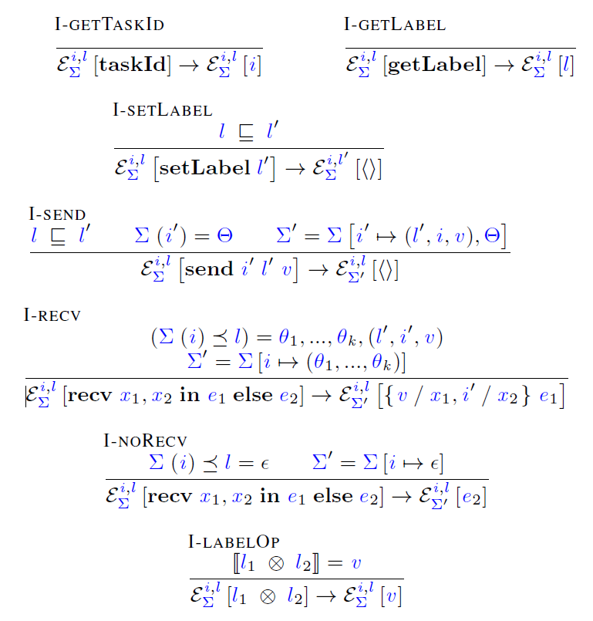
Basic rules

Slide 32
Inter-task communication
Sending places message on global queue
Receiving either receives the message, or drops it (based on label)

Slide 33
Embedding
Extend IFC and target language syntax
Re-interpret context and reduction relation

Slide 34
Sandboxing
sandbox e does
Create new task for e
Schedule e according to scheduling policy

Slide 35
Remaining rules

Slide 36
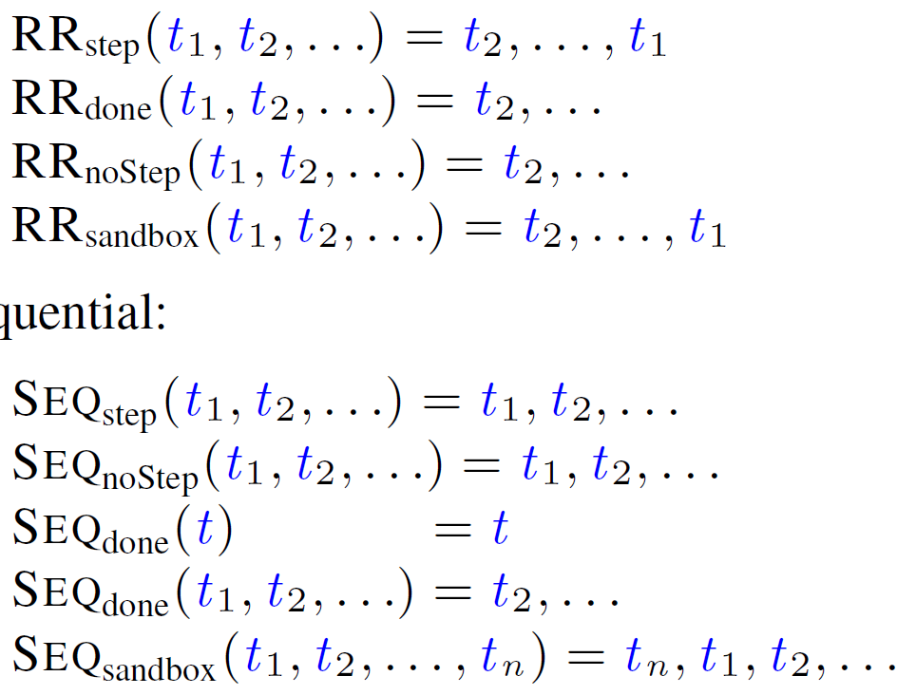
Scheduling policies
Concurrent, round robin
Sequential

Slide 37
Why IFC?
Solves many existing security problems
Example web client side
Combination of scripts on a site
Not full isolation, want flexibility (password strength checker)
Browser addons
Other plugin systems

Slide 38
Intro
Define IFC
Motivation why IFC is useful
Motivation why coarse-grained IFC is cool
Others have already done IFC!
Not generally for any language
Not coarse-grained dynamicly

Slide 39
Motivation
Given a piece of code (e.g. a library), under what conditions is it correct to invoke it?
What are the conditions on a, fromIndex, etc?
void sort(int[] a, int fromIndex, int toIndex);

Slide 40
Backwards analysis
Sequential composition
push_back (s1;s2) fg =
push_back s1 (push_back s2 fg)
Assignment
push_back (e1=e2) fg =
remove anything from fg that might get invalidated by the assignment
but keep everything that matches e1 exactly, and replace it with e2

Slide 41
Example Assignment
// FG: 3 == c
a[j] = 3;
// FG: a[i] < b || a[j] == c

