Slide 1
IFC Inside: Retrofitting Languages with Dynamic Information Flow Control
Stefan Heule, Deian Stefan, Edward Z. Yang, John C. Mitchell, Alejandro Russo
Stanford University, Chalmers University

Slide 2
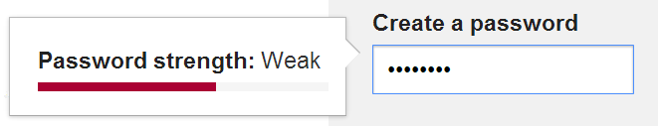
Motivating Example: Web Security
Website uses check_strength(pw) from some library
Danger: the library could send the password to bad.com
Website author has little control over this
[Van Acker et al., CODASPY’15]

Slide 3
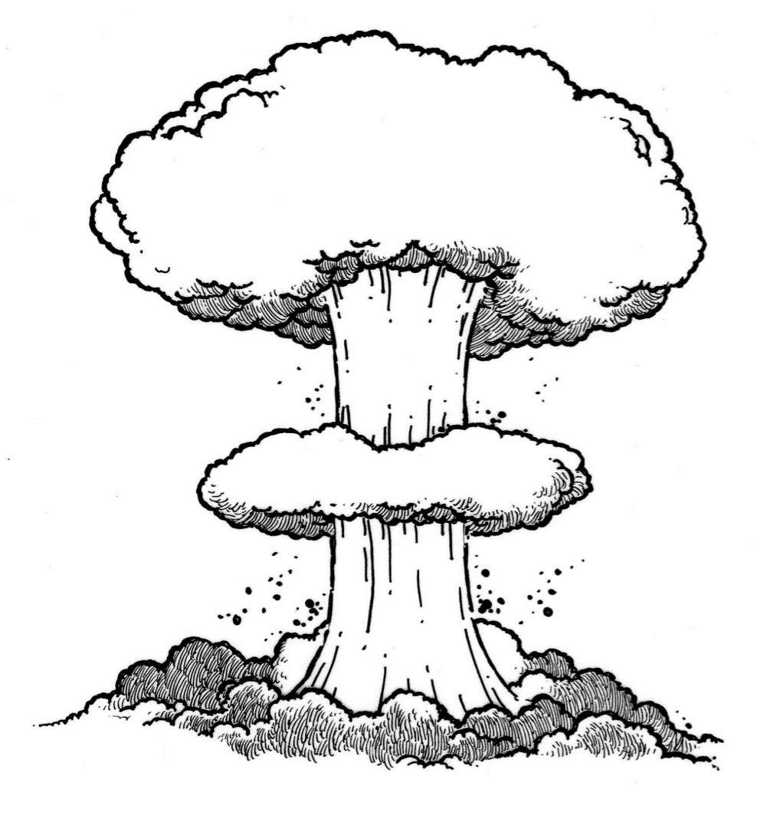
Web Security Today
Code written by many different parties
Potentially mutually distrusting parties (website code, utility/framework libraries, advertising code, …)
Computing over sensitive data (passwords, healthcare information, banking data)

Slide 4
Possible Solution: IFC
Information flow control …
… tracks where information flows
… allows policies to restrict flows of information
In the example
Label password as sensitive
Restrict its dissemination (e.g. to arbitrary webservers)

Slide 5
What kind of IFC?
Various trade-offs in IFC systems
Dynamic vs static
What kind of labels
Granularity at with information is tracked
Sweetspot: dynamic, coarse-grained IFC

Slide 6



Coarse-grained IFC
The program is split into computational units (tasks)
All data within one task has a single label
Different computational units can communicate
$$l_{1}$$
$$l_{2}$$
$$l_{3}$$

Slide 7
This Talk
Given an existing programming language, how can we add dynamic IFC?
Minimal changes to language
Simplifies implementation
Formal security guarantees

Slide 8
Approach Overview
Given a target language
Any programming language for which we can control external effects
Define an IFC language
Minimal calculus, only IFC features
Combine target and IFC language
Allow target language to call into IFC, and vice-versa
Careful definition of the IFC language allows the overall system to provide isolation, regardless of what the target language does

Slide 9
IFC language
Tag tasks with security labels
Labels form a lattice, and determine how data can flow inside an application
Example lattice
Two labels H (high) and L (low)
Flow from H to L is not allowed
H
L

Slide 10

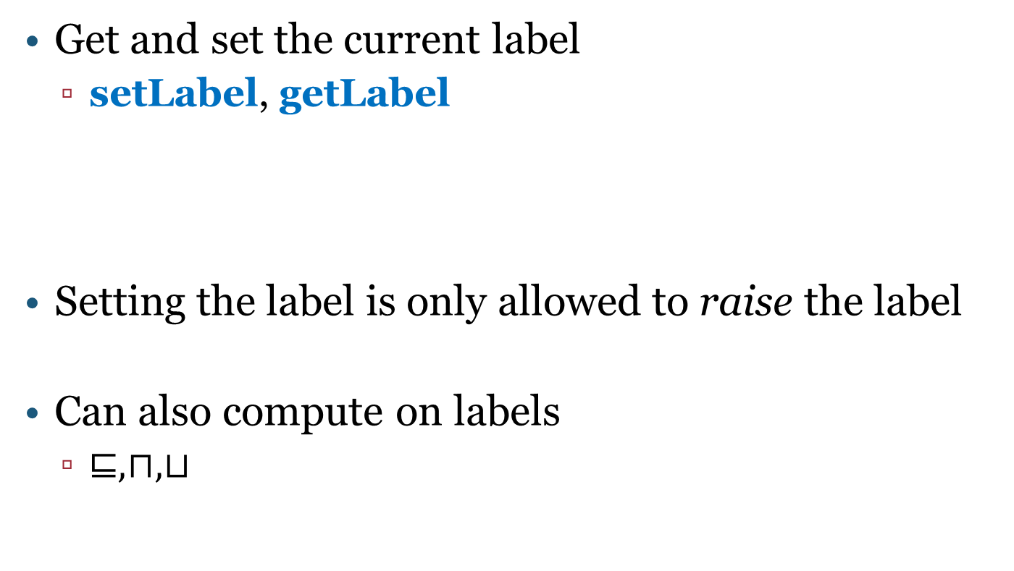


IFC language: labels
Get and set the current label
setLabel, getLabel
Setting the label is only allowed to raise the label
Can also compute on labels
$⊑, ⊓, ⊔$
$$L$$
setLabel $H$
$$H$$

Slide 11



IFC language: sandboxing
Isolate an expression as a new task
sandbox e
New task has separate state
$$l$$
sandbox e
$$l$$
$$l$$
e
1
1
2

Slide 12







Inter-task communication
Tasks can send and receive messages
Send message v to task i, protected by label $l$
send i $l$ v
Can only send messages at or above current label
$$L$$
$$H$$
$$L$$
$$H$$
send 2 $H$ v
1
2
1
2
$$\left(1,H,v\right)$$

Slide 13




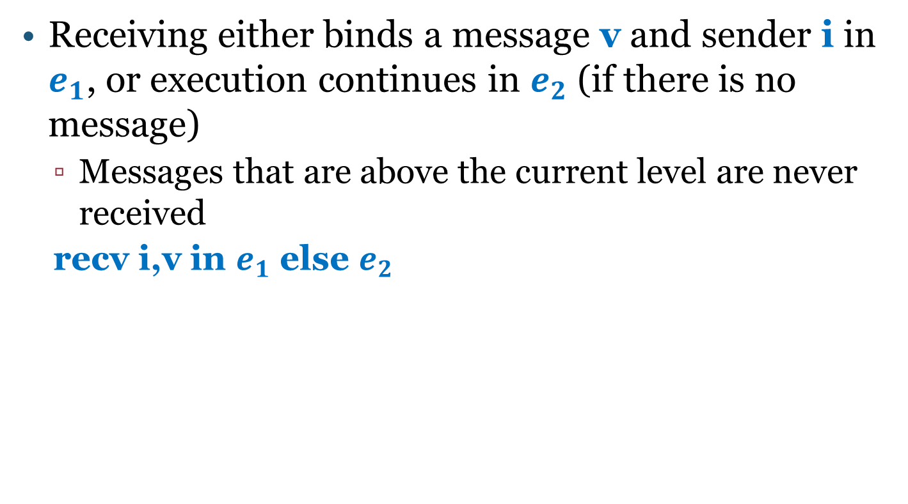






Inter-task communication
Receiving either binds a message v and sender i in $e_{1}$, or execution continues in $e_{2}$ (if there is no message)
Messages that are above the current level are never received
recv i,v in $e_{1}$ else $e_{2}$
$$H$$
$$H$$
$$L$$
$$L$$
$$recv$$
$e_{1}$ [v,i]
$$recv$$
$$e_{2}$$
2
2
2
2
$$\left(1,H,v\right)$$
$$\left(1,H,v\right)$$

Slide 14
Formal treatment

Slide 15
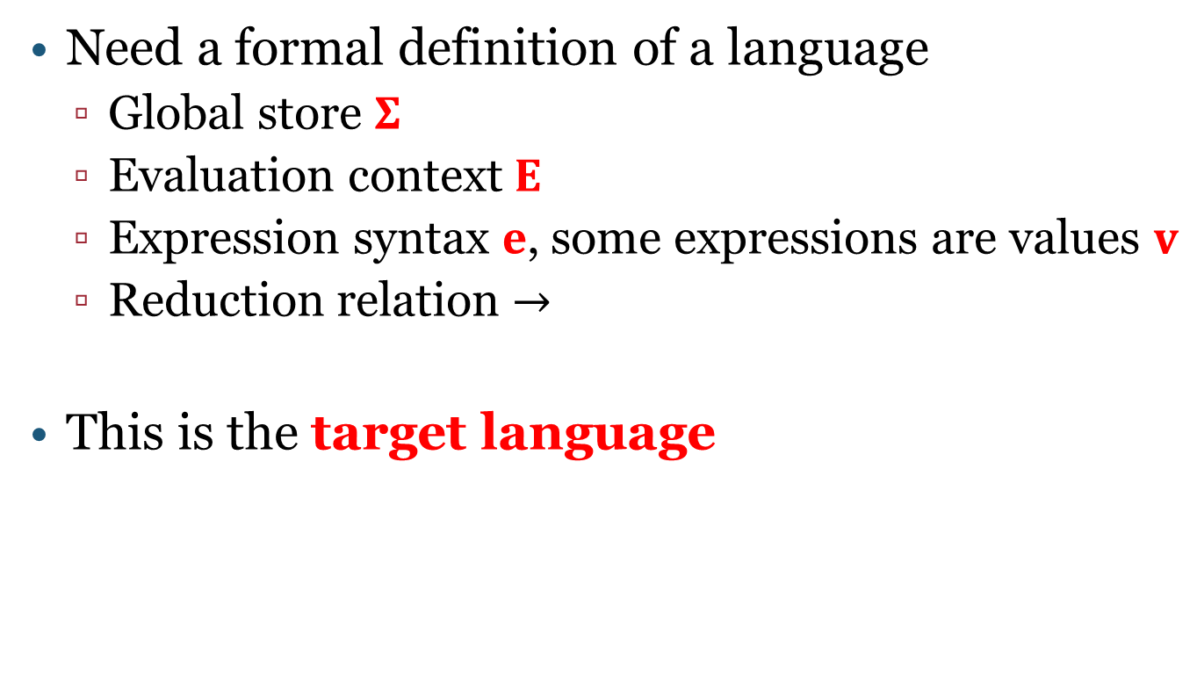
What is a programming language?
Need a formal definition of a language
Global store $Σ$
Evaluation context $E$
Expression syntax $e$, some expressions are values $v$
Reduction relation $→$
This is the target language

Slide 16
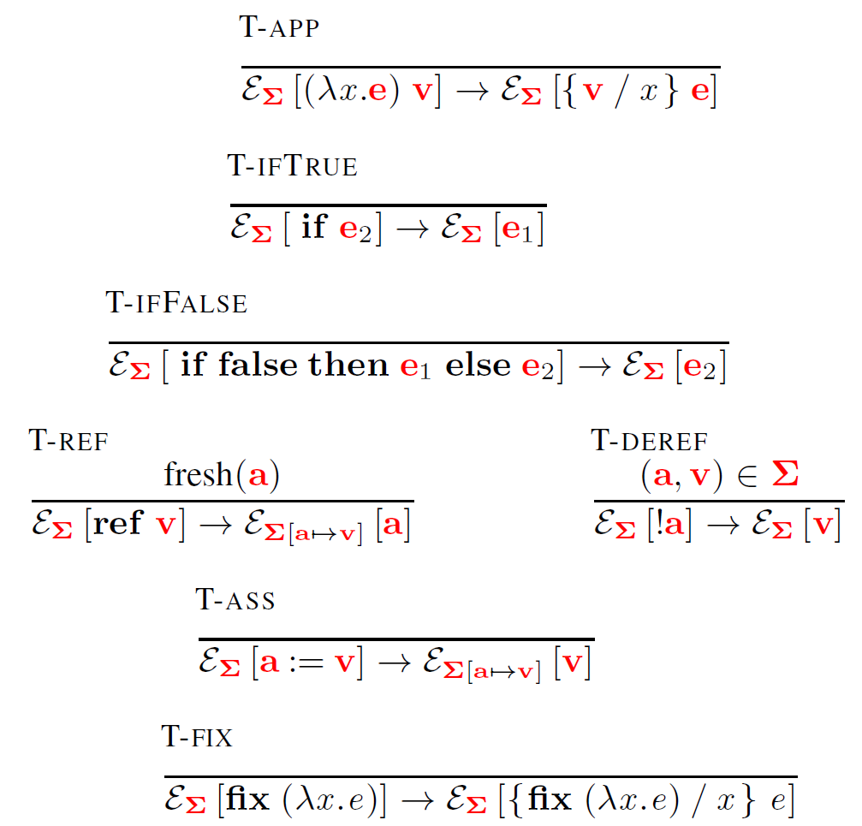
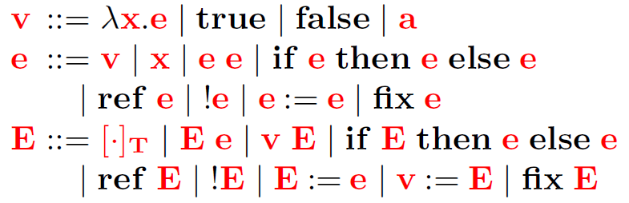
Example: Mini-ECMAScript

Slide 17

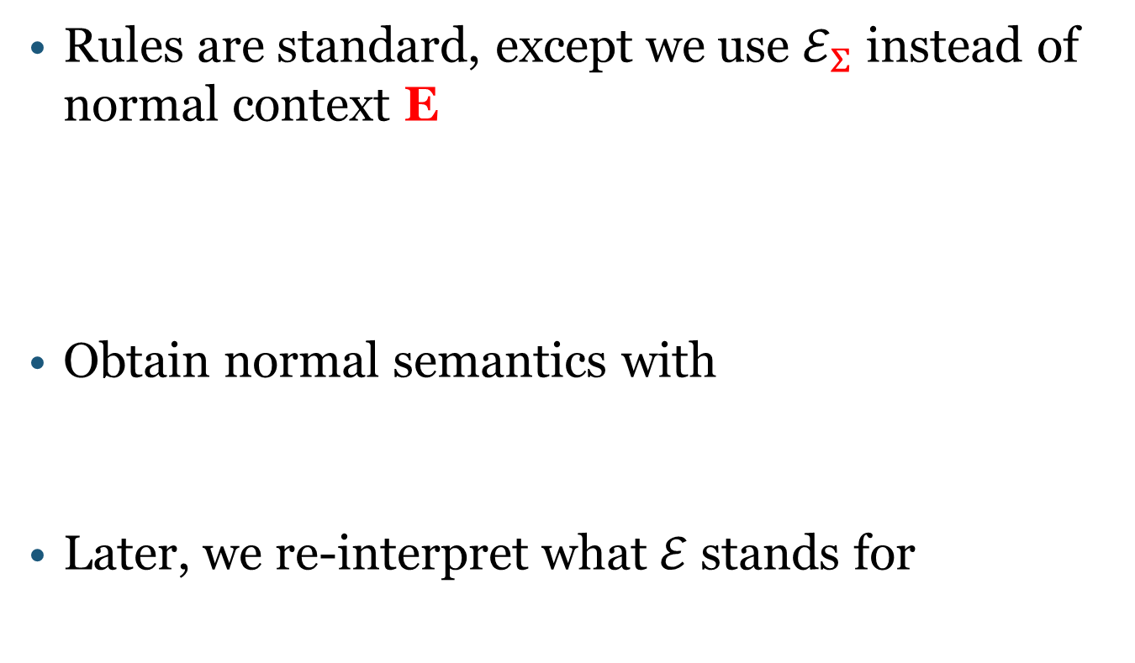
Notation
Rules are standard, except we use $ℰ_{Σ}$ instead of normal context E
Obtain normal semantics with
Later, we re-interpret what $ℰ$ stands for

Slide 18
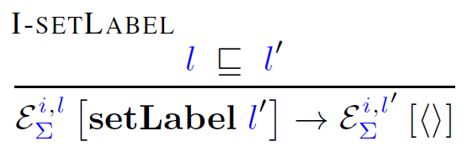

IFC language
Also defined in terms of a special $ℰ$

Slide 19
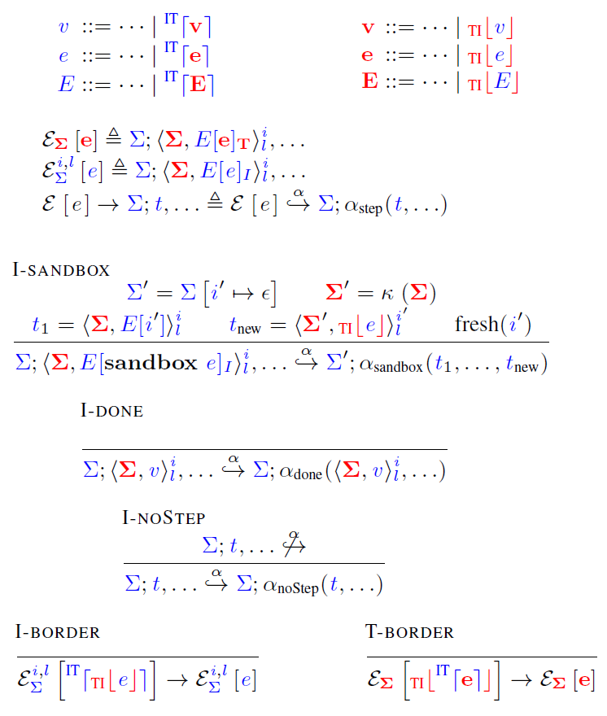
Embedding [Matthews and Findler, POPL’07]
Extend IFC and target language syntax
Re-interpret context and reduction relation

Slide 20
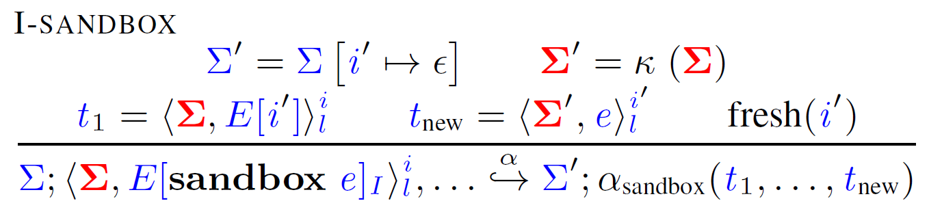
Sandboxing
sandbox e does
Create new task for e
Separate state for new task
Schedule e according to scheduling policy

Slide 21









Security Guarantees
Non-interference:
Intuitively: An attacker that can only see values up to level $l$ should not see a difference in behavior if values at level $l′$ > $l$ are changed
$$L$$
$$H$$
$$H$$
$$L$$
$$H$$
$$≈_{L}$$
1
2
3
1
4
$$\left(1,H,33\right)$$
$$\left(1,H,−1\right)$$

Slide 22





Security Guarantees
Non-interference:
Intuitively: An attacker that can only see values up to level $l$ should not see a difference in behavior if values at level $l′$ > $l$ are changed
$$L$$
$$H$$
$$H$$
$$L$$
$$H$$
$$≈_{L}$$
1
2
3
1
4
$$\left(1,H,33\right)$$
$$\left(1,H,−1\right)$$

Slide 23
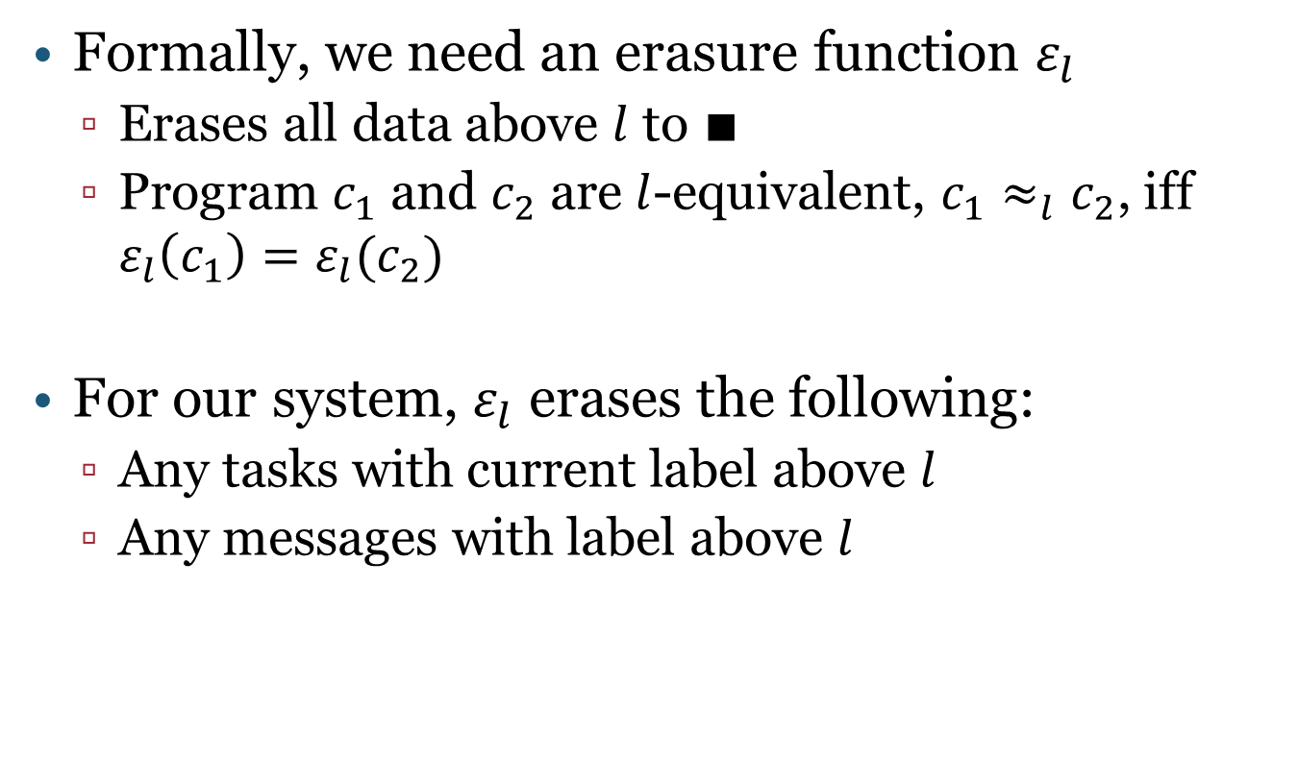
Erasure function
Formally, we need an erasure function $ε_{l}$
Erases all data above $l$ to $∎$
Program $c_{1}$ and $c_{2}$ are $l$-equivalent, $c_{1}≈_{l}c_{2}$, iff $ε_{l}\left(c_{1}\right)=ε_{l}(c_{2})$
For our system, $ε_{l}$ erases the following:
Any tasks with current label above $l$
Any messages with label above $l$

Slide 24


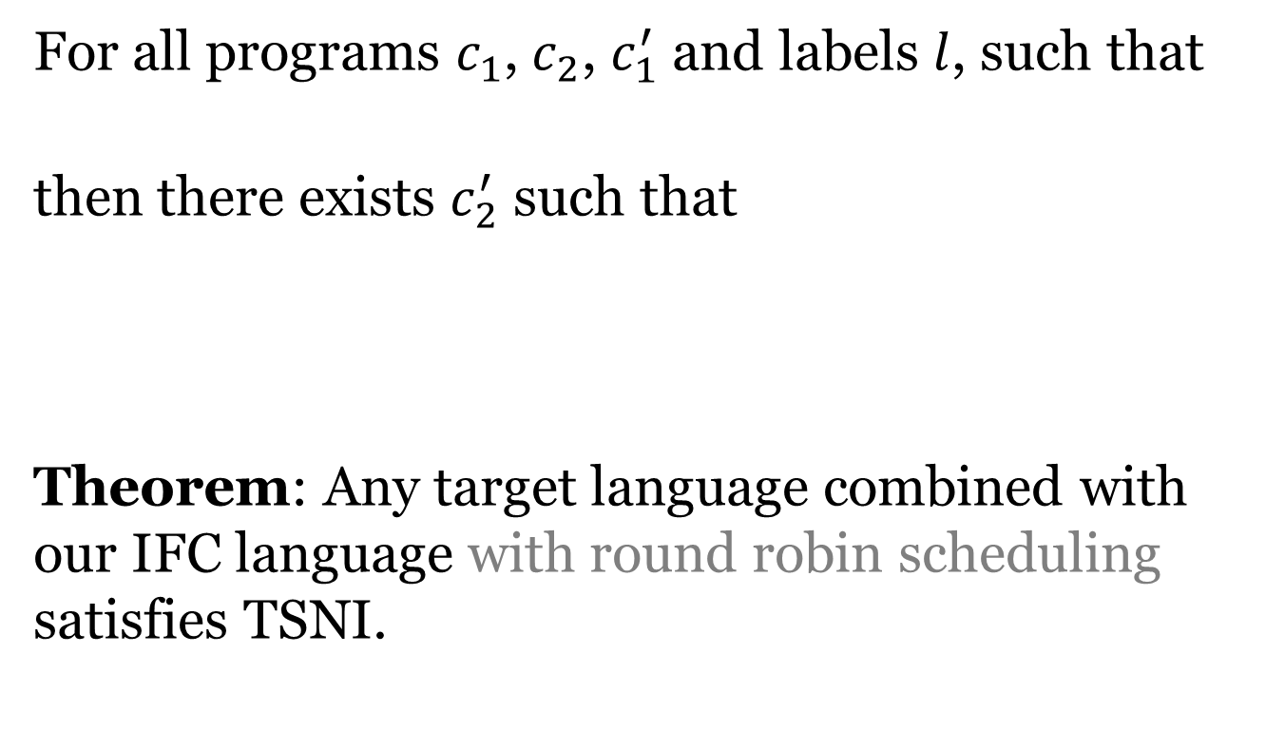
Termination sensitive non-interference (TSNI)
For all programs $c_{1}$, $c_{2}$, $c_{1}^{′}$ and labels $l$, such that
then there exists $c_{2}^{′}$ such that
Theorem: Any target language combined with our IFC language with round robin scheduling satisfies TSNI.

Slide 25






Practicality
Formalism requires separate heaps
An implementation might want to have one heap
Naïve implementation is insecure
Shared references, need additional checks
$$L$$
$$H$$
1
2
$$L$$
$$H$$
1
2

Slide 26
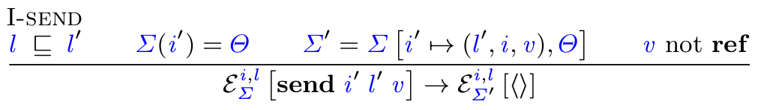
Modifying the Combined Language
Single heap only requires restricting transition rules
Intuitively appears OK
In general, not safe
We give a class of restrictions that is safe
In a nutshell: restriction cannot depend on secret data

Slide 27
Summary So Far
Clean separation of IFC and target language
Allows reasoning without knowledge of target
Implementation doesn’t need to change existing language much
Example: Implementation for NodeJS
No changes to Javascript runtime
Worker threads implement tasks
Trusted main worker implements IFC checks

Slide 28



Implementation
IFC for Node.js
No changes to Javascript runtime or Node.js
Worker threads implement tasks
Trusted main worker implements IFC checks
Also in the paper:
Connect formalism to Haskell IFC system
Sketch a C implementation using our system
$$L$$
$$H$$
$$L$$
1
1
2
$$\left(1,H,33\right)$$
$$H$$
2
$$\left(1,H,33\right)$$
Trusted IFC Worker
Task Workers

Slide 29
Separation Facilitates Safe Design
Clean separation of IFC and target
Simplifies reasoning about safe extensions
Example: Exceptions
If target language has exceptions, they stop propagation on task boundary
LIO (Haskell library for IFC), exceptions were labeled
Complicated design
One rule was wrong

Slide 30
Conclusions
Formalism for dynamic coarse-grained IFC for many programming languages
Little reliance on language details
Combining operational semantics of two languages as key mechanism to formalize our system
Allows security proofs to be once and for all

Slide 31

Thank you.
Questions?

Slide 34
Example: security on the web
Modern web pages involve many components
Javascript of the website
Javascript of some (untrusted) library
Advertising code
Browser addons
Web content can be very sensitive
Online banking, passwords, personal information, etc.

Slide 35
Current situation
Code written by many different parties
Potentially mutually distrusting parties
Computing over sensitive data
IFC to the rescue
Label sensitive data as such
Prevent flow of sensitive data to undesired places (like arbitrary web servers)

Slide 36
Concrete Example
Password strength checking
Website uses check_strength(pw) from a (not fully trusted) library
The library could send the password to bad.com
With IFC, we can precisely decide what the library can do with the password

Slide 37
Why isn’t everyone using IFC?
We are interested in a dynamic IFC system
A key challenge is performance
Tracking information at a fine-grained level is expensive

Slide 38



Coarse-grained IFC
The program is split into computational units (tasks)
All data within one task has a single label
Different computational units can communicate
$$l$$
$$l$$
$$l$$

Slide 39
Advantages of coarse-grained IFC
Efficiency
Checks only at isolation boundaries
Minimal changes to language
If added to a language retroactively
Reuse existing programs
Simple
to understand and reason about

Slide 40
Goals
Formally define a core calculus for a coarse-grained dynamic IFC system
Combine IFC language with any programming language
Prove security guarantees of IFC (known as non-interference)

Slide 41
Approach Overview
Given a target language (any programming language)
Define an IFC language
Minimal calculus, only IFC features
Combine target and IFC language
Allow target language to call into IFC, and vice-versa
Careful definition of the IFC language allows the overall system to provide isolation, regardless of what the target language does

Slide 42
IFC language
Tag data with security labels
Labels form a lattice, and determine how data can flow inside an application
Example lattice
Two labels H (high) and L (low)
Flow from H to L is not allowed
H
L

Slide 43



IFC language: labels
Get and set the current label
setLabel, getLabel
Setting the label is only allowed to raise the label
Can also compute on labels
$⊑, ⊓, ⊔$
$$l_{1}$$
setLabel $l_{2}$
$$l_{2}$$

Slide 44
IFC language: sandboxing
Isolate an expression as a new task
sandbox e
$$l$$
sandbox e
$$l$$
$$l$$
e
1
1
2

Slide 45







Inter-task communication
Tasks can send and receive messages
Send message v to task i, protected by label $l^{′}$
send i $l^{′}$ v
Can only send messages at or above current label
$$l_{1}$$
$$l_{2}$$
$$l_{1}$$
$$l_{2}$$
send 2 $l^{′}$ v
1
2
1
2
$$\left(1,l^{′},v\right)$$

Slide 46
Inter-task communication
Receiving either binds a message v and sender i in $e_{1}$, or execution continues in $e_{2}$ (if there is no message)
Messages that are above the current level are never received
recv i,v in $e_{1}$ else $e_{2}$
$$H$$
$$H$$
$$L$$
$$L$$
$$recv$$
$e_{1}$ [v,i]
$$recv$$
$$e_{2}$$
2
2
2
2
$$\left(1,H,v\right)$$
$$\left(1,H,v\right)$$

Slide 47
Formal treatment

Slide 48
What is a programming language?
Need a formal definition of a language
Global store $Σ$
Evaluation context $E$
Expression syntax $e$, some expressions are values $v$
Reduction relation $→$
This is the target language

Slide 49
Example: Mini-ECMAScript

Slide 50
Notation
Rules are standard, except we use $ℰ_{Σ}$ instead of normal context E
Obtain normal semantics with
Later, we re-interpret what $ℰ$ stands for

Slide 51






IFC language
Also defined in terms of an special $ℰ$
$$l_{1}$$
setLabel $l_{2}$
$$l_{2}$$
$$i$$
$$i$$

Slide 52
Embedding [Matthews and Findler, POPL’07]
Extend IFC and target language syntax
Re-interpret context and reduction relation

Slide 53
Sandboxing
sandbox e does
Create new task for e
Schedule e according to scheduling policy

Slide 54
Security Guarantees
Non-interference:
Intuitively: An attacker that can only see values up to level $l$ should not see a difference in behavior if values at level $l′$ > $l$ are changed
$$L$$
$$H$$
$$H$$
$$L$$
$$H$$
1
2
3
1
4
$$\left(1,H,33\right)$$
$$\left(1,H,−1\right)$$

Slide 55
Erasure function
Formally, we need an erasure function $ε_{l}$
Erases all data above $l$ to $∎$
Program $c_{1}$ and $c_{2}$ are $l$-equivalent, $c_{1}≈_{l}c_{2}$, iff $ε_{l}\left(c_{1}\right)=ε_{l}(c_{2})$
For our system, $ε_{l}$ erases the following:
Any tasks with current label above $l$
Any messages with label above $l$

Slide 56
Termination sensitive non-interference (TSNI)
For all programs $c_{1}$, $c_{2}$, $c_{1}^{′}$ and labels $l$, such that
then there exists $c_{2}^{′}$ such that
Theorem: Any target language combined with our IFC language with round robin scheduling satisfies TSNI.

Slide 57
Real world examples
Is this actually practical?
One challenge are external effects
File system, internet connection, etc.
Possible solutions
Make external effects inaccessible
Internalize them into the IFC language
Labeled file system

Slide 58
COWL [OSDI’14]
Implementation of coarse-grained dynamic IFC system for Javascript
Websites have access to XHR constructor
XHR requests need to be modeled at the IFC language level
COWL chooses origins (example.com) as labels

Slide 59
Password strength checker in COWL
Even if check_strength(pw)is completely untrusted, it cannot send the password to bad.com
Execute check_strength in a sandboxed task

Slide 60
Conclusions
Coarse-grained IFC is great
Allows for language-independent IFC system
Efficient, yet flexible
Combining operational semantics of two languages as key mechanism to formalize our system

Slide 61
Thank you.
Questions?

Slide 62
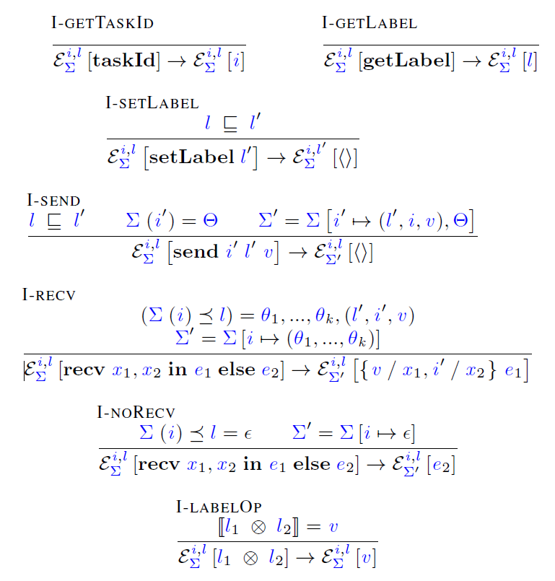
Basic rules

Slide 63
Inter-task communication
Sending places message on global queue
Receiving either receives the message, or drops it (based on label)

Slide 64
Embedding
Extend IFC and target language syntax
Re-interpret context and reduction relation

Slide 65
Sandboxing
sandbox e does
Create new task for e
Schedule e according to scheduling policy

Slide 66
Remaining rules

Slide 67
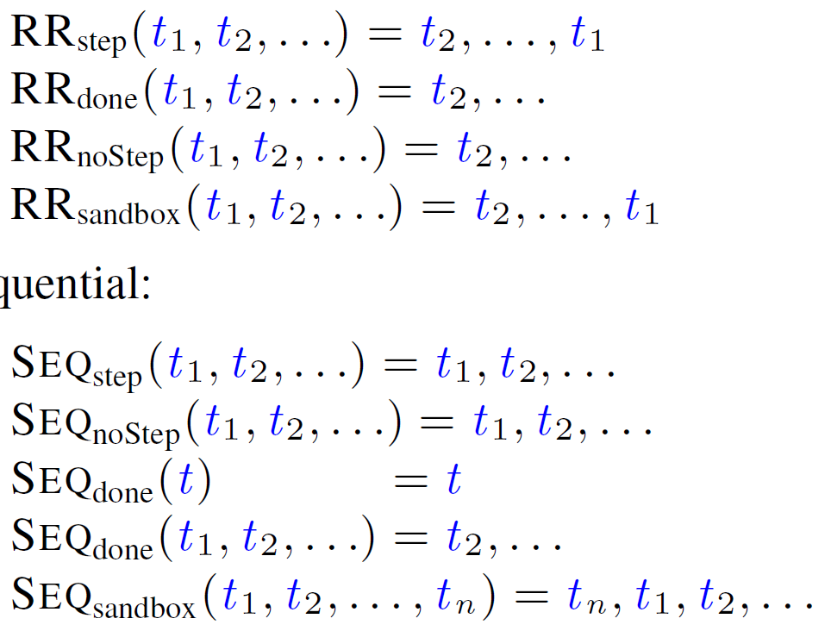
Scheduling policies
Concurrent, round robin
Sequential

Slide 68
Why IFC?
Solves many existing security problems
Example web client side
Combination of scripts on a site
Not full isolation, want flexibility (password strength checker)
Browser addons
Other plugin systems

Slide 69
Intro
Define IFC
Motivation why IFC is useful
Motivation why coarse-grained IFC is cool
Others have already done IFC!
Not generally for any language
Not coarse-grained dynamicly

Slide 70
Motivation
Given a piece of code (e.g. a library), under what conditions is it correct to invoke it?
What are the conditions on a, fromIndex, etc?
void sort(int[] a, int fromIndex, int toIndex);

Slide 71
Backwards analysis
Sequential composition
push_back (s1;s2) fg =
push_back s1 (push_back s2 fg)
Assignment
push_back (e1=e2) fg =
remove anything from fg that might get invalidated by the assignment
but keep everything that matches e1 exactly, and replace it with e2

Slide 72
Example Assignment
// FG: 3 == c
a[j] = 3;
// FG: a[i] < b || a[j] == c

