Slide 1
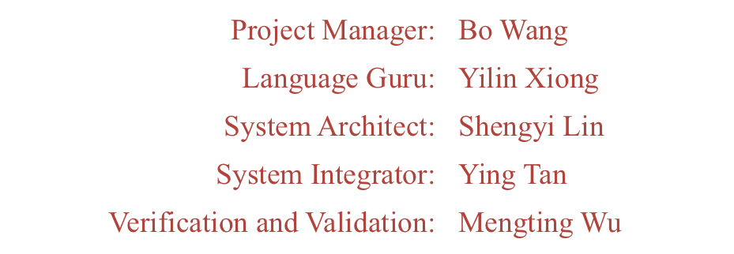
MPL
Music Processing Language

Slide 2
Why MPL?
Break the traditional way to compose note by note
Make the composition process programmable, efficient and interesting.
Target Users
  Professional musicians and music amateurs
  People love both music and programming
Sparking Features
  Simple data structure
  Convenient Operations
  Rich Functions

Slide 3
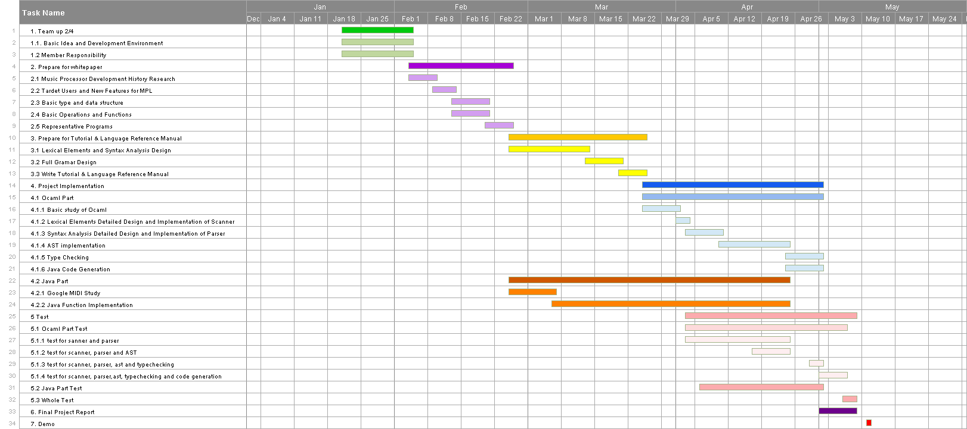
Time Plan

Slide 4
MPL in One Slide
Melody addChords(Melody melody) {
Melody newMelody = Melody();
for(int i = 0; i < melody.getLength(); i++) {
Note note = melody.getNote(i);
Note chord = note - 12;
newMelody.addNote(chord);
}
return newMelody;
}
void main(string arg[]) {
Music music = read("twinkle_twinkle0.mid");
Melody melody = music.getTrack(0).getMelody();
Melody newMelody = addChords(melody);
Track tracks[] = {music.getTrack(0), Track(newMelody, PIANO)};
Music newMusic = Music(tracks);
write(newMusic, "new_twinkle_twinkle.mid");
// Finished
}
Variable Definition Use Type Construction
Function Definition
Calculation of music
For Loop
Built-in function for music type
Built-in function for general purpose
Array Initialization
Comments
Call user defined function

Slide 5
Key Features Demo

Slide 6
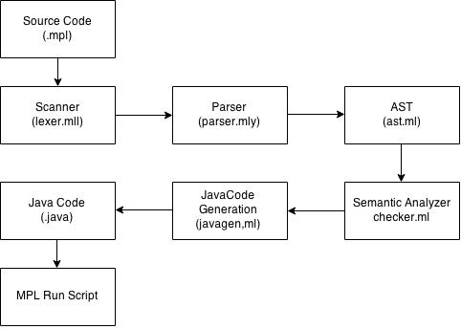
How it works

Slide 7
Role & Responsibility
Module | Responsible Members
Scanner | Mengting Wu, Bo Wang
Parser | Yilin Xiong
AST | Bo Wang, Mengting Wu
Checker | Yilin Xiong, Ying Tan
Code Generation | Yilin Xiong, Bo Wang, Mengting Wu
Java Implementation | Shengyi Lin, Ying Tan
Test | Shengyi Lin

Slide 8
Symbol Table
Environment Stack
Keep Scope: Number each blocks.
Push the number of the current block when go into the block, and pop out after go out.
Symbol Table
Name each variable with name “scopeNumber_name” and store its type with name into HashMap.
Type is stored as string.
Function type: void_argType_returnType

Slide 9
Symbol Table
//Push: block 0 Stack: 0
void main(string arg[]) {
// Push: block 1 Stack: 1 0
Music music = read("twinkle_twinkle2.mid");
int i;
for(i = 0; i < music.getNumberOfTracks(); i++) {
// Push: block 2 Stack: 2 1 0
Track track = music.getTrack(i);
track.setTimbre(PIANO);
// Pop: block 2 Stack: 1 0
}
write(music, "twinkle_twinkle3.mid");
// Pop: block 1 Stack: 0
}
Symbol Table:
Variable | Type
1_arg | array_string
1_music | Music
1_i | int
2_track | Track
main | void_array_string_void

Slide 10
Run Time Environment
Ocaml (Frontend for translator)
JDK 1.6 (JVM)
MPL.jar: (Java backend with midi API)
users can download from https://github.com/PLT-MPL/MPL/tree/master/ShellScript to generate midi file.
MPL.sh
Help user to test MPL code more conveniently.

Slide 11
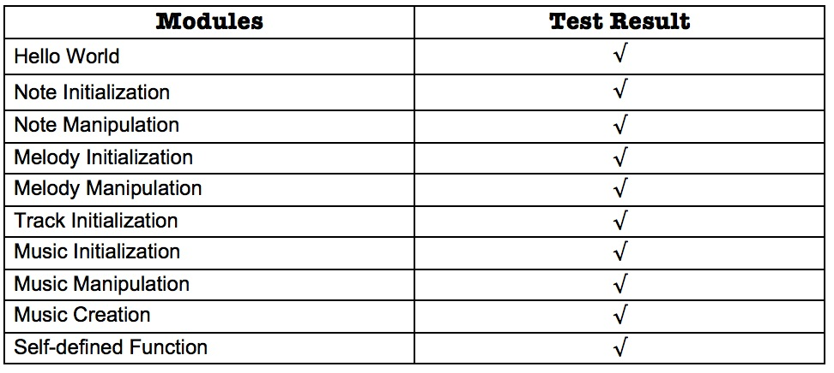
Script and Test Plan
Command:
MPL.sh <Path/To/ShellScript/Folder> <Input/MPL/Filename> <Output/Executable/Filename>
Test Plan:

Slide 12
DEMO

Slide 13
Lessons Learnt
Flexible timeline are vital important.
Start work before considering too much.
Functional languages are sooo interesting.
We should have taken Computer Science Theory class before it.

Slide 14
Thanks!

