Slide 1
Viruses Simulation

Slide 2
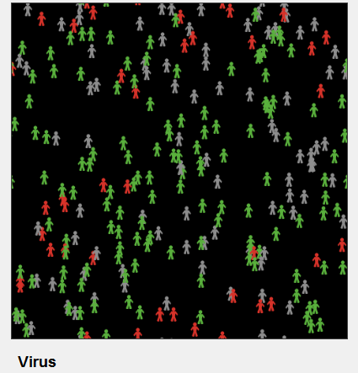
Explanation
This model simulates the transmission and perpetuation of a virus on a population

Slide 3
Changes
Parameters
Number of people Static - 150
Infectiousness 8% , 92%
Chance-recover 23% , 74%
Duration Static – 20%

Slide 4
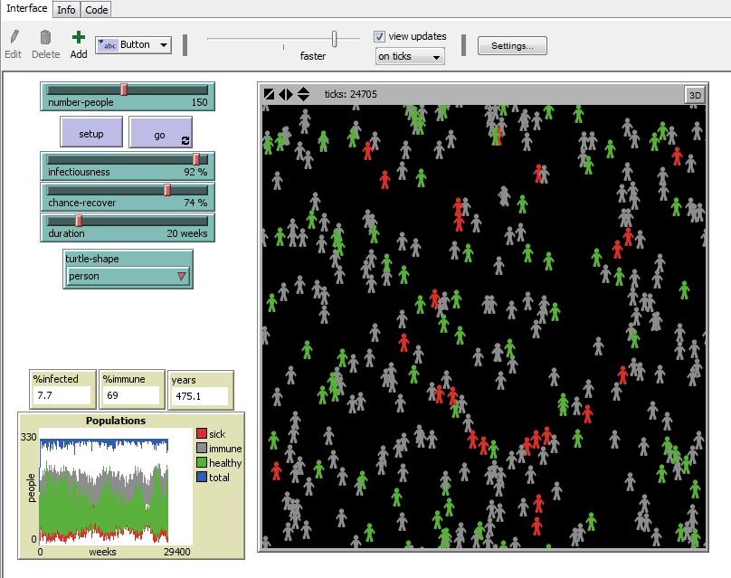
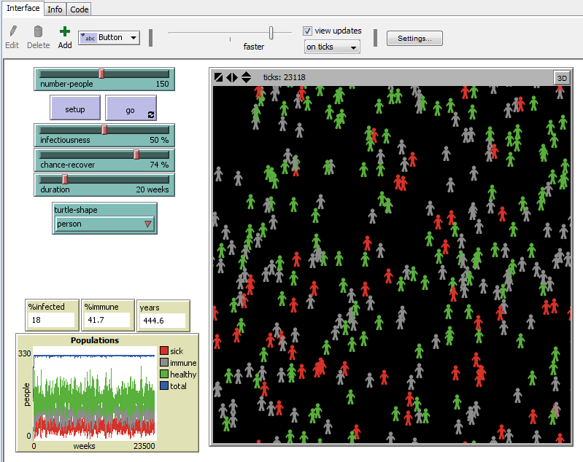
Results
> Infectiousness (92%)
> Immunity rate (69%)
< Infected population (7.7%)
> Infectiousness (50%)
> Immunity rate (41.7%)
< Infected population (18.0%)

