Slide 1
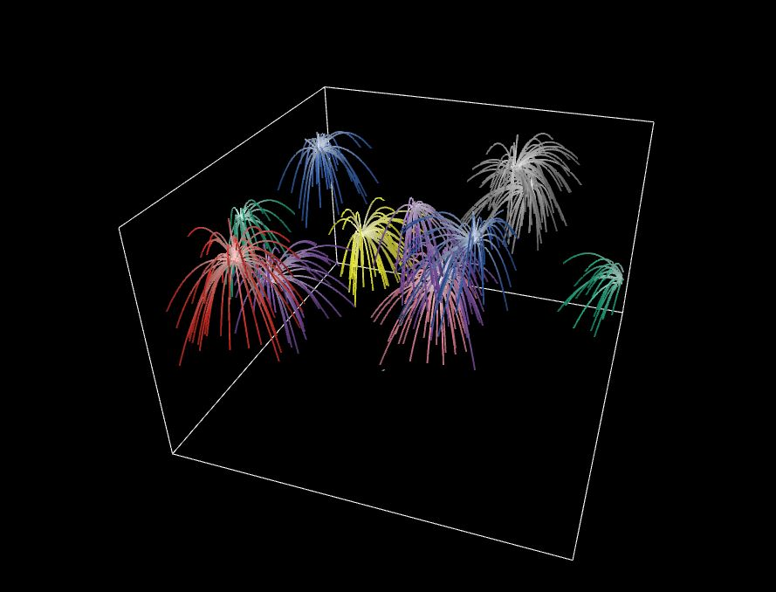
FIREWORKS 3D
A Netlogo Sample Simulation

Slide 2
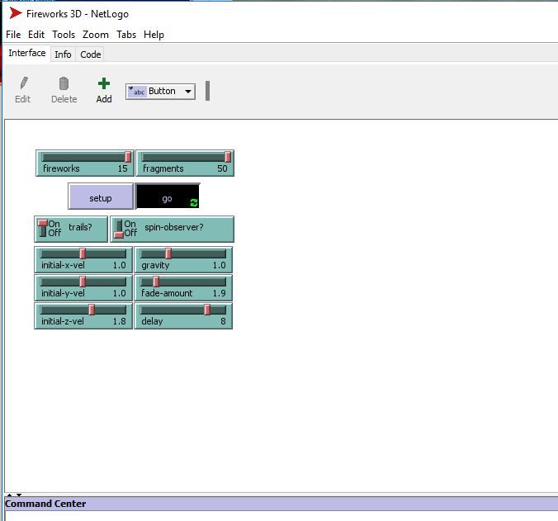
INTERFACE:
Allows you to customize your own fireworks display in an interactive 3D environment
Input Variables include:
  Initial X/Y Velocity- Impacts the arc and general direction of fireworks
  Initial Z Velocity- Impacts height of fireworks
  Gravity- Impacts the speed at which bursts fall back to earth
  Fade- Impacts the length of the firework trails before they go away
  Burst Delay- Impacts time from the peak of the firework trajectory, to burst.

Slide 3
OBSERVATIONS/RESULTS:
After experimenting with several different iterations of settings, I was able to arrive at what I thought was the best looking fireworks display with a combination of all adjustments noted.
Interesting notes:
  It is entirely possible to launch the fireworks out of the environment. This can be done by running a high initial z velo, or taking away some gravity.
  The appearance of the fireworks was most strongly dominated by the fade amount, number of fireworks, and fragment amounts. I found the best results by maxing out the firework/fragments, and minimal fade.

