Slide 1

Traffic – Basic Sample Model

Slide 2

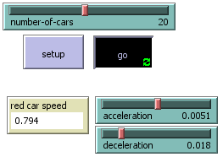
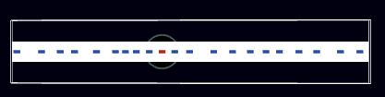
Traffic – Basic:
This simulates highway travel. Cars slow down if they sense a car ahead or the can speed up if the highway is clear. The number of cars on the road also affects travel progress. This simulation demonstrates how traffic jams form, even when there is no accident.

Slide 3

I didn’t go too crazy here, as this was a pretty simple simulation (“Traffic-Basic”). I thought about how I perceive traffic in real life. Clearly the number of cars on the road affect traffic speed. More cars creates congestions, which slows progress. When there are less cars on the road, there are less instances that will require a speed change by the cars. Because of this, I didn’t do too much with this slider.
I focused more on acceleration and deceleration. From my experiences of driving, I thought acceleration would have a greater negative effect on traffic flow (I also drive like a 90 year old man). I cranked acceleration up to observe the effect. Then I bumped it back down and played with the deceleration. Here is where I was surprised.

Slide 4

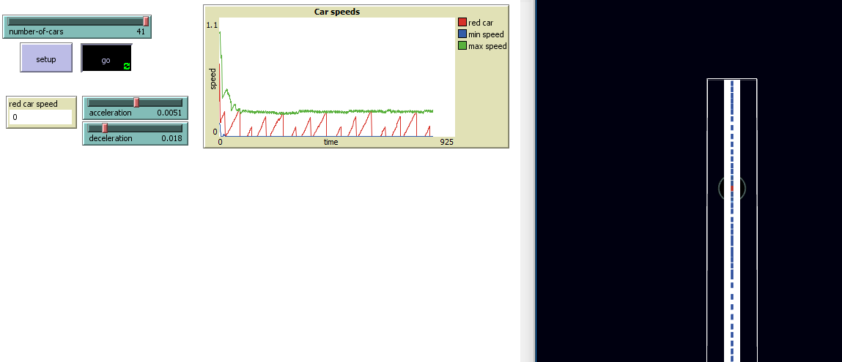
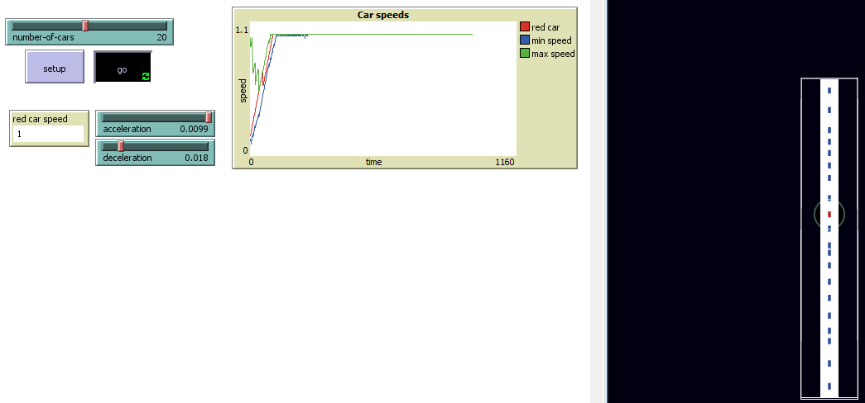
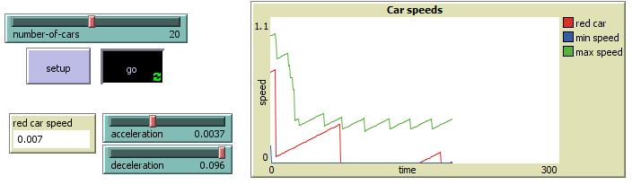
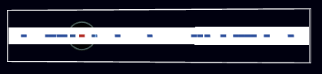
Number of car: More cars created slower traffic, less cars allowed traffic to flow freely
Acceleration: Had less effect on traffic than I thought. Higher acceleration yielded higher speeds and lower acceleration still eventually reached higher speeds.
Deceleration: This had the biggest surprise effect. I didn’t think about how when the car in front of you slows down, the person behind them has to slow down more. It was said in the info for the simulation that traffic patters move in a reverse direction (backwards) from where the problem begins. This is different that many other situations.

