Slide 1
NetLogo Virus Simulation
Simulates how infectious diseases spread.
Assumptions:
  User decides how many individuals are in the same population as the infected
  User determines how contagious the disease is
  User determines the mortality rate
  User determines how long an infected individual will be contagious
The simulation starts with 10 infected individuals in the population
Colors change depending on the state of the person
  Red – infected Green – healthy Grey – immune Blue - total

Slide 2
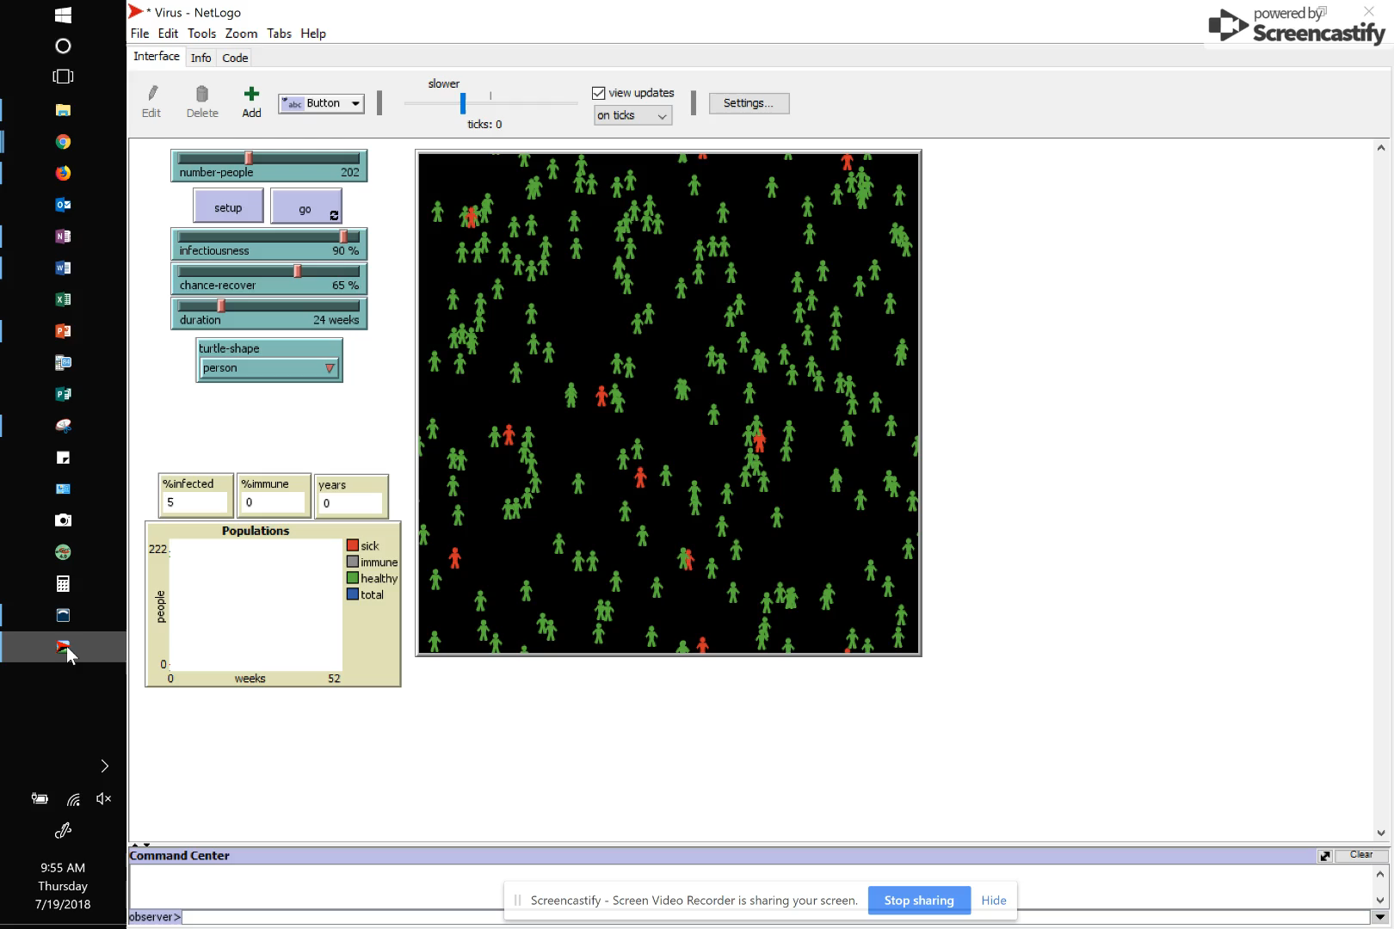
In this first simulation, the idea was represent a small population of mammals living in the wild.
I assumed that after being sick, they would maintain an immunity to the disease for a full year before being susceptible to the illness again.
Because of their shorter lifespans and less frequent rates of reproduction the rate of illness cycled.
What’s interesting in the graph is that with each cycle of infection, the illness rate got higher. Gone unchecked, this illness could over years wipe out the population.

Slide 3
NetLogo Virus Simulation
Changes made to the code
  Wanted to simulate the spread of disease in humans
  Changed the average lifespan (from CDC statistics)
  Changed the reproduction rate (from Our World In Data
  Also worked in a random variable that would model death by other causes independent of the disease

Slide 4
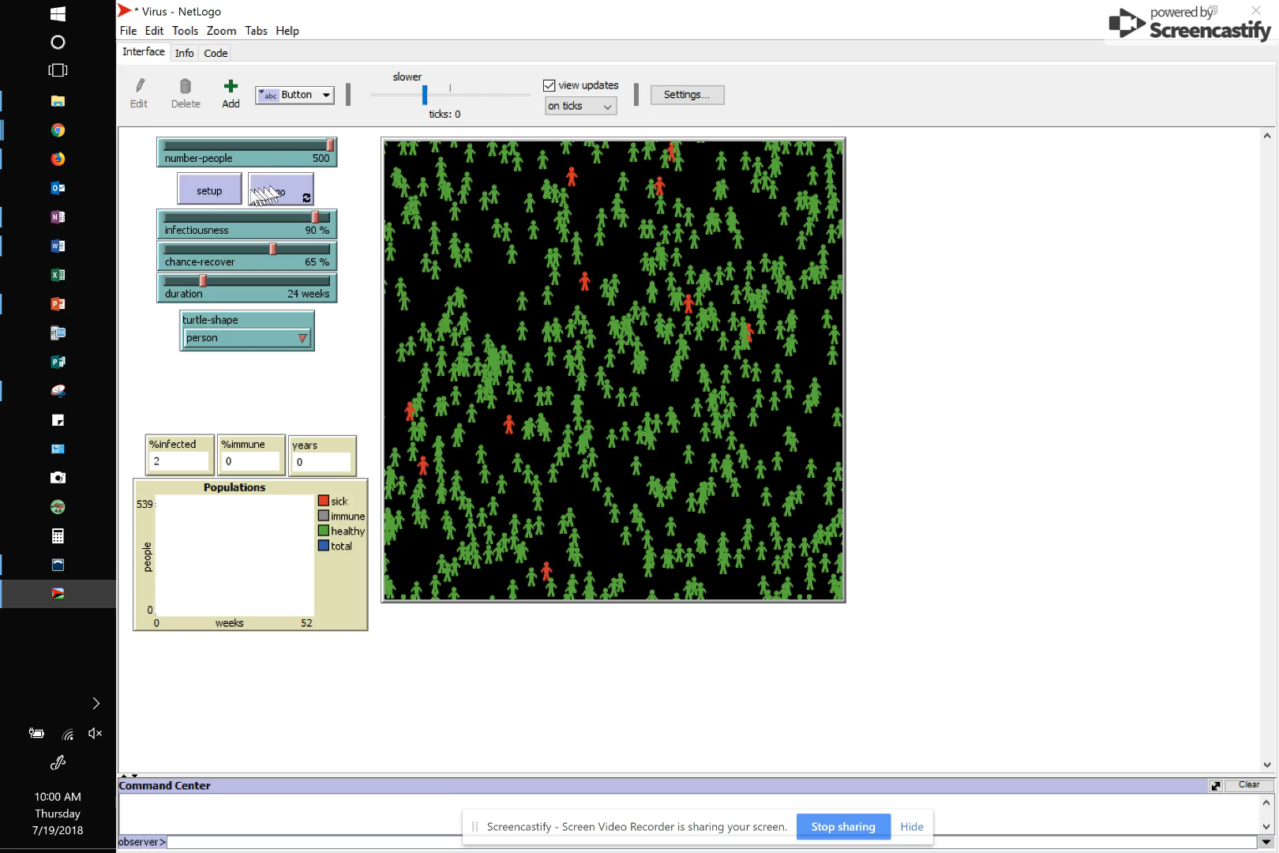
With humans, I also assumed a greater starting population. Between school, work and other activities people come in contact with more people.
I maintained all other variables (i.e. contagion, mortality, and the length of time that a person maintains immunity from the disease after recovering from it.
What’s interesting in the graph is that with each cycle of infection, the illness rate got lower. This indicates that the disease would eventually become extinct on its own..
Even with longer lifespans and greater rate of reproduction, the disease rate cycled.

