Slide 1
NETLOGO - FIREWORKS
Presentation by:
Mary Lynne Bridger

Slide 2
WHAT IS IT?:
This program models the action of fireworks. Rockets begin at the bottom of the view, shoot upwards into the sky and then explode, emitting showers of falling sparks.
HOW IT WORKS
Each rocket, represented by a turtle, is launched upward with an initial x and y velocity. At a certain point in the sky, an explosion occurs, which is represented by a series of turtle hatches. Each hatched turtle inherits the velocity from the original rocket in addition to velocity from the explosion itself. The result is a simulation of a fireworks display

Slide 3
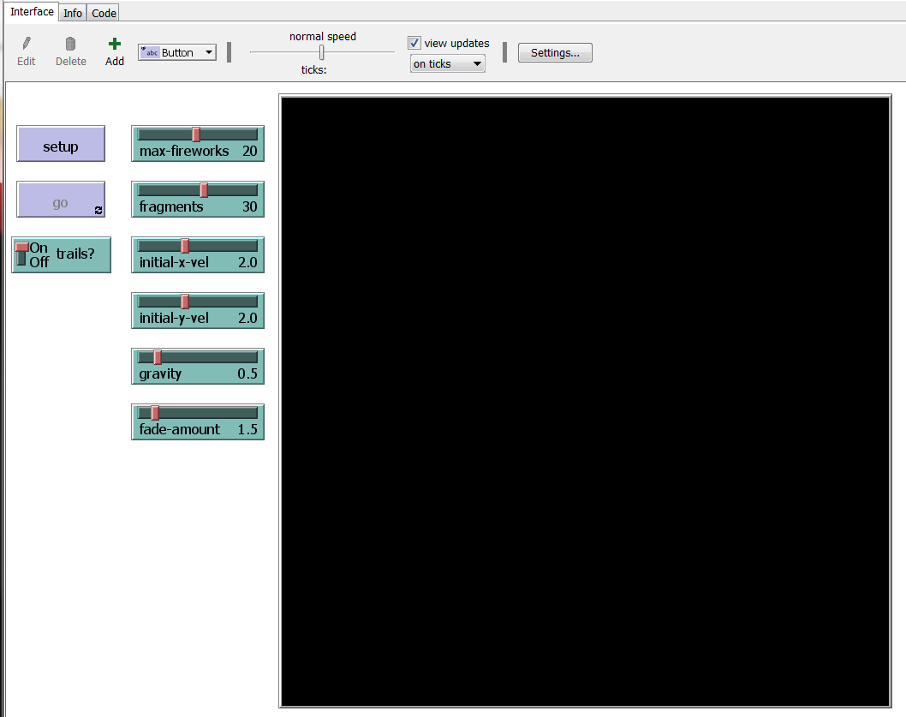
STARTING THE SIMULATION
Defaults start with:
Max-fireworks = 20
Fragments = 30
Initial-x-vel = 2.0
Initial-y-vel = 2.0
Gravity = 0.5
Fade-amount = 1.5
Click setup to start the simulation with the defaults settings and then click go to begin.

Slide 4


Slide 5
CHANGING THE VARIABLES
Experiment with the INIT-X-VEL and INIT-Y-VEL sliders. Observe that at an initial x-velocity of zero, the rockets launch straight upwards. When the initial x-velocity is increased, notice that some rockets make an arc to the left or right in the sky depending on whether the initial x-velocity is negative or positive.
With the initial y-velocity, observe that, on a fixed GRAVITY value, the heights of the fireworks are lower on smaller initial y-velocities and higher on larger ones. Also observe that each rocket explodes at a height equal to or a little less than its apex.

Slide 6
CHANGING THE VARIABLES
Changing the INIT-Y-VEL and INIT-X-VEL

Slide 7
CHANGING THE VARIABLES
Changing Gravity

Slide 8
CHANGING OTHER VARIABLES

