Slide 1
Rabbits Grass Weeds NetLogo Sim
THE ORIGINAL
This project explores a simple ecosystem made up of rabbits, grass, and weeds. The rabbits wander around randomly, and the grass and weeds grow randomly. When a rabbit bumps into some grass or weeds, it eats the grass and gains energy. If the rabbit gains enough energy, it reproduces. If it doesn’t gain enough energy, it dies.

Slide 2
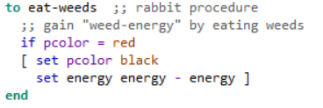
Rabbits Grass Death NetLogo Sim
THE REMIX
I modified the code by changing the color of the weeds to red to indicate a dangerous plant and changed the energy gain from the weeds so that the weeds killed the rabbit instantly. I also removed the weed energy slider from the GUI.

Slide 3
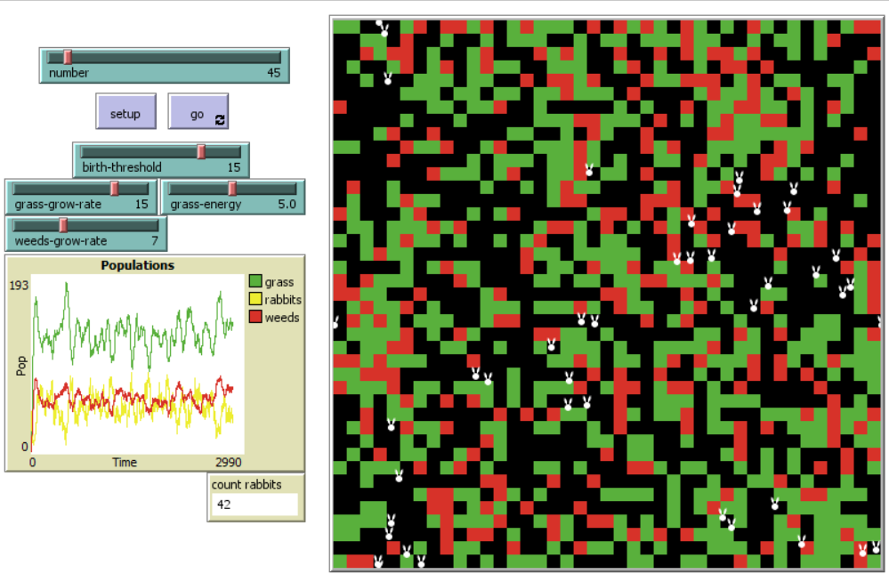
EQUILIBRIUM?
THE RESULTS
If the growth rate of the death weeds is kept low relative to the grass rate then everyone reaches an equilibrium. However, if the death weeds have a similar or higher growth rate relative to the grass the rabbits die out quickly.

