Slide 1


GitHub Workflow Basics

Slide 2



Teacher Account
Organization
A
B
Repositories

Slide 3

Teacher Account
A1
Organization
FORK
A1
A
B
Repositories

Slide 4
Teacher Account
A1
Organization
FORK
A1
A
B

Slide 5
Teacher Account
A1
Organization
CLONE
FORK
A1
A
B

Slide 6
Teacher Account
Sync
A1
Organization
CLONE
FORK
A1
A
B

Slide 7
Teacher Account
Pull Request
Sync
A1
Organization
CLONE
FORK
A1
A
B

Slide 8
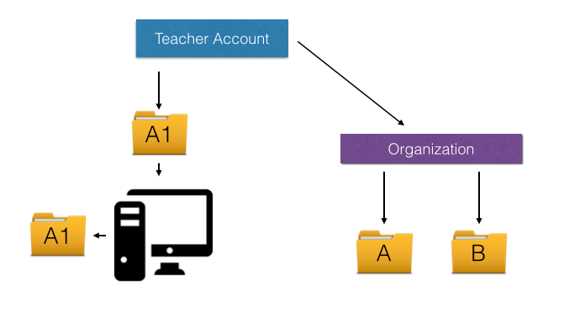
FORK
Student Account
A2
CLONE
A2

