Slide 1

AI-Powered Energy Consumption Optimization Assistant
Hybrid retrieval, multi-agent analysis and cost/carbon estimates for energy analysts
Lavenia Energy Optimization | Project Presentation
Notes:
Introduce the project: a local decision-support prototype that lets analysts search historical energy cases and get recommendations.

Slide 2




Problem Statement
Analysts need to explore historical consumption records, spot high-consumption and peak-period cases, and act on evidence. Doing that manually is slow and inconsistent.
19,735
Finding comparable cases
Similar scenarios are buried in timestamped records.
processed energy cases an analyst would otherwise search by hand
Reading time patterns
Peak hours, seasons and anomalies need context to interpret.
Turning data into action
UCI Appliances Energy Prediction dataset
Guidance should be tied to evidence, not generic tips.
Notes:
Analysts face thousands of timestamped records. The dataset is UCI Appliances Energy Prediction; the pipeline produced 19,735 processed cases.

Slide 3



Business Need
Find relevant cases
Investigate peaks
Recommend actions
Make similar historical energy cases easy to retrieve.
Support analysis of high-consumption and peak-period scenarios.
Rule-based and optional LLM-assisted optimization advice.
Scope
A decision-support prototype. Cost, carbon and reduction values are estimates, not verified savings.
Estimate impact
Review quality
Scenario-based cost and carbon estimates from supplied inputs.
Feedback and evaluation help judge output quality.
Notes:
Five objectives from the README, plus the scope caveat: this is a decision-support prototype and impact values are estimates.

Slide 4

Solution Overview
A natural-language interface over processed energy cases and a recommendation workflow
Prepare the data
Retrieve evidence
Analyze and recommend
Preprocess timestamps and consumption fields
Derive time, deviation and anomaly features
Build 19,735 searchable cases
Embed cases with all-MiniLM-L6-v2
Store vectors in ChromaDB
Blend semantic and keyword search
Coordinator routes query and context
Rule-based paths, optional LLM analysis
Cost and carbon estimates
Delivered through a FastAPI backend and a Streamlit interface, with feedback and evaluation endpoints
Notes:
Three stages: prepare data, retrieve evidence, analyze and recommend. Everything is served through FastAPI and Streamlit.

Slide 5
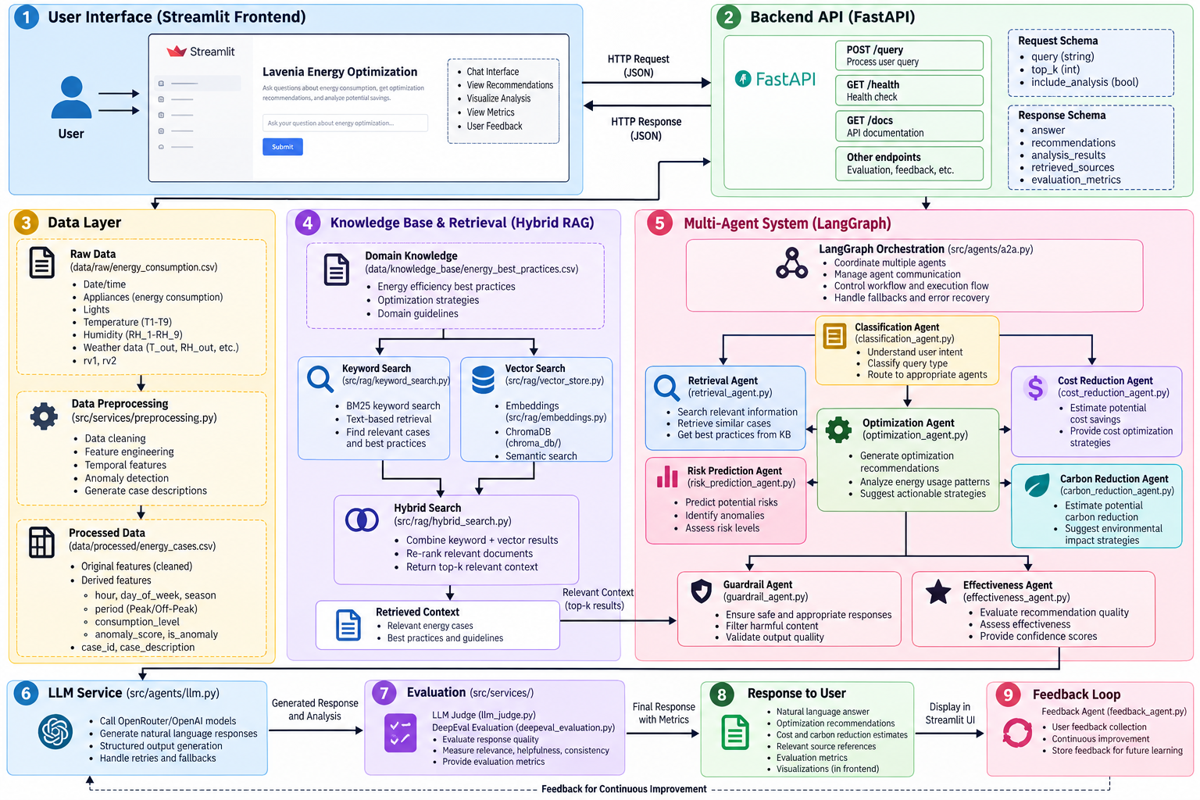
Architecture
1
Interface layer
Streamlit sends queries to a FastAPI backend.
2
Knowledge and retrieval
ChromaDB vectors plus keyword search, merged by hybrid ranking.
3
Coordinator and agents
src/agents/a2a.py routes each query through specialist agents.
4
LLM, evaluation, feedback
Optional LLM analysis, judge scoring and a user feedback loop.
Notes:
Walk through the figure left to right: UI and API, data layer, hybrid RAG, multi-agent coordinator, LLM service, response and feedback loop.

Slide 6
Data Flow
1
Raw data
2
Preprocess
3
Embed and index
UCI Appliances Energy Prediction: timestamped consumption and environment readings.
Derive time, rolling-average, deviation and anomaly features into processed cases.
all-MiniLM-L6-v2 embeddings stored in ChromaDB with the knowledge base.
4
Hybrid retrieve
5
Analyze
6
Respond and learn
Semantic and keyword search, weighted about 70/30, returns top-k context.
Coordinator and specialist agents, with rule-based paths or optional LLM analysis.
FastAPI returns results to Streamlit; feedback routes capture user input.
data/ raw/energy_consumption.csv > processed/energy_cases.csv + knowledge_base/energy_best_practices.csv
Notes:
Follow a record from the raw CSV to the Streamlit response. Hybrid weighting is a project-specific 70/30 semantic/keyword setting.

Slide 7







Technology Stack
LANGUAGE AND DATA
BACKEND
FRONTEND
Python + Pandas
FastAPI
Streamlit
CSV datasets, preprocessing
Pydantic request validation
Interactive analysis interface
EMBEDDINGS
VECTOR STORE
RETRIEVAL
all-MiniLM-L6-v2
ChromaDB
Hybrid search
sentence-transformers model
Similarity-based retrieval
Semantic + keyword, about 70/30
LLM
ORCHESTRATION
EVALUATION
openai/gpt-4.1
LangGraph
DeepEval
Via OpenRouter, optional
Coordinator workflow (a2a.py)
LLM-as-judge and Pytest suite
Notes:
The LLM and judge evaluation are optional and controlled by configuration; rule-based paths work without them.

Slide 8
Agent Workflow
1 Guardrail Agent
2 Classification Agent
3 Retrieval Agent
Checks query suitability
Classifies intent to guide the path
Fetches cases and knowledge context
Coordinator (src/agents/a2a.py): invokes the relevant analysis agents as needed
Risk Prediction
Optimization
Cost Reduction
Carbon Reduction
Effectiveness
Feedback
Flags risk and anomaly signals
Drafts actionable recommendations
Estimates cost impact from tariffs
Estimates emissions impact
Scores recommendation quality
Collects and summarizes user feedback
LLM generation is used when enabled; rule-based paths cover supported workflows. The diagram does not mean every agent executes for every query.
Notes:
Nine named specialist agents. The coordinator is not counted as a tenth agent, and not every agent runs for every query.

Slide 9

Demo
Sample queries
Run it locally
1
How can I reduce high energy consumption during peak hours?
TERMINAL 1 BACKEND
/api/analyze
uvicorn src.main:app --reload
2
Find historical cases with high energy consumption.
TERMINAL 2 FRONTEND
streamlit run frontend/frontend.py
/api/search
3
What patterns are visible during winter energy consumption?
SWAGGER UI
127.0.0.1:8000/docs
/api/analyze
STREAMLIT UI
4
Suggest practical ways to reduce energy use without disrupting essential activities.
localhost:8501
/api/recommend
Notes:
Start the backend and frontend in two terminals, then walk through the sample queries. Swagger UI shows exact request schemas.

Slide 10
Evaluation Results
DeepEval (recorded run)
0.825
Overall
0.75
Answer Relevancy
0.90
Energy Recommendation Quality
Run-specific results, not guaranteed for every query. Retrieval labels are rule-derived proxies, and cost/carbon outputs are estimates.
Notes:
These are scores from specific recorded runs, not guarantees for every query. Evidence support at 0.50 is the weakest dimension.

Slide 11
Challenges and Learnings
Challenges
Learnings and next steps
Tuning hybrid retrieval
Hybrid search balances both
The 70/30 semantic/keyword balance needs testing on representative queries.
Semantic search captures concepts; keywords catch exact terms.
Single-home dataset
Fallbacks add resilience
Household data cannot validate commercial or industrial settings.
Rule-based paths keep the app usable without an LLM.
Estimates, not savings
Grounding is the gap
Cost and carbon results depend on tariff, emission-factor and reduction assumptions.
Evidence support scored lowest (0.50) in the judge run.
LLM reliability and cost
Next: broader data
Provider limits and credentials affect generation and judge runs.
Add facility datasets, human-annotated tests and measured outcomes.
Notes:
Challenges on the left, learnings and next steps on the right. Evidence grounding is the clearest area to improve.

