Slide 1
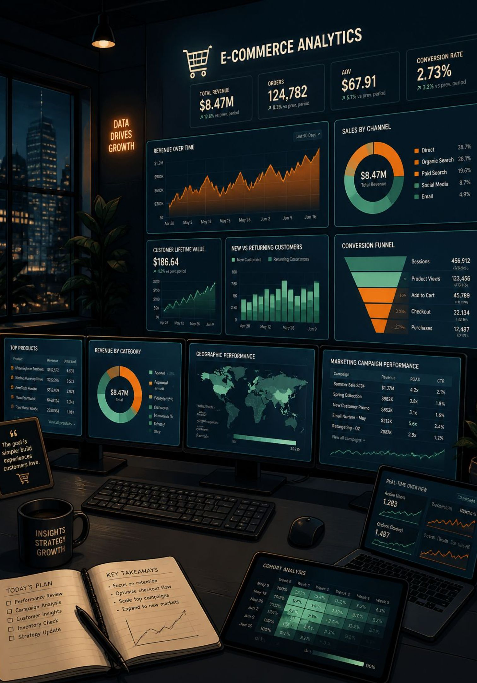
Customer Shopping Behavior Analysis
End-to-End Data Analytics Project
PYTHON
MYSQL
POWER BI

Slide 2





Project Overview
Raw Dataset
Python
MySQL
Power BI
3,900 rows
Data cleaning & EDA
SQL business analysis
Interactive dashboard
Business Insights
Recommendations

Slide 3

Data Preparation — Python
Key Preprocessing Steps
Inspection: Loaded dataset, checked dimensions, data types, and descriptive statistics
Quality: Found 37 missing values in Review Rating; no duplicates
Cleaning: Filled missing values by category median; standardized column names to snake_case
Feature Engineering: Created Age Group segments; converted purchase frequency to numeric
Integration: Connected cleaned dataset to MySQL for SQL-based analysis

Slide 4






SQL Business Analysis
Six key business questions answered through structured SQL queries.
Revenue by Gender
Customer Segmentation
Subscription Analysis
Male $157,890 vs. Female $75,191
Loyal 3,116 · Returning 701 · New 83
27% subscribers; 73% non-subscribers
Product Performance
Revenue by Age Group
Shipping Analysis
Top 5 products by average review rating
Young Adults led at $62,143
Express avg $60.48 vs. Standard $58.46

Slide 5
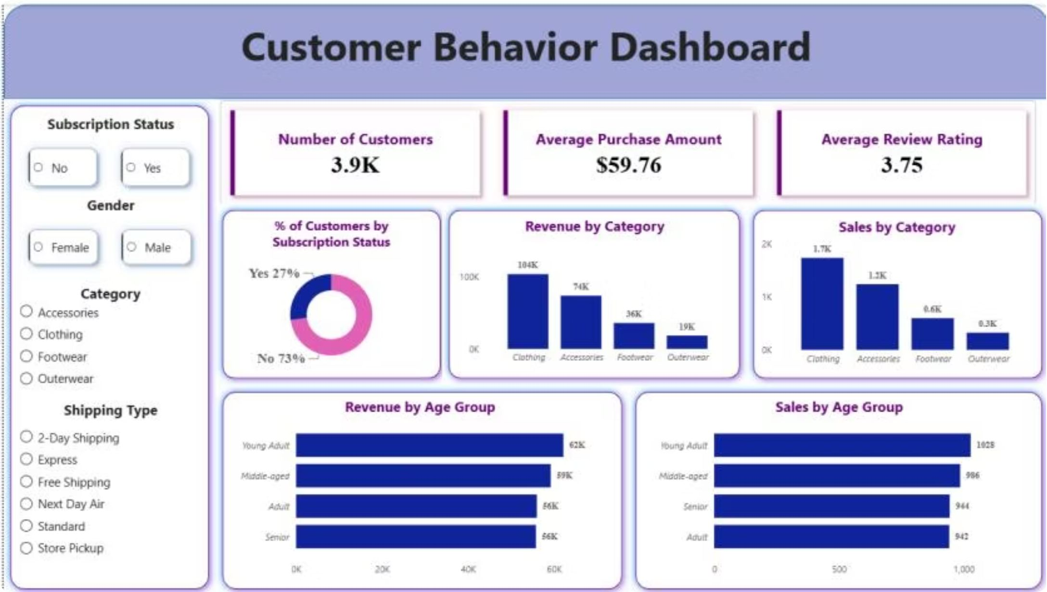
Interactive Power BI Dashboard
Dashboard Features
KPI Cards: 3.9K customers · $59.76 avg purchase · 3.75 avg rating
Interactive Filters: Subscription, Gender, Category, Shipping Type
Revenue Analysis: Breakdown by category and age group
Customer Segmentation: New, Returning, and Loyal visualizations
Product Insights: Sales and revenue by product category

Slide 6
Key Business Insights
Clothing Dominates Revenue
Young Adults Lead Spending
Highest revenue and sales across all categories
Top revenue-contributing age group at $62,143
Subscription Gap
Loyal Customer Base
Only 27% subscribed — significant growth opportunity
80% of customers classified as loyal
Express Shipping Premium
Top-Rated Products
Slightly higher average spend ($60.48 vs. $58.46)
Gloves, Sandals, and Boots rated highest — strong marketing potential

Slide 7

Business Recommendations
Increase Customer Subscriptions
Strengthen Customer Loyalty
Optimize Discount Strategy
Promote exclusive discounts and loyalty benefits to boost subscriber conversion.
Reward repeat customers with personalized offers to increase lifetime value.
Review campaigns regularly to drive sales while maintaining healthy margins.
Promote Top-Performing Products
Focus on High-Value Segments
Highlight best-selling, highly rated products to maximize engagement and conversions.
Target marketing toward highest-revenue age groups and loyal customers.

Slide 8
Project Summary
Tools Used
Transforming raw customer data into actionable business insights through analytics.
Python (Pandas)
MySQL
Power BI
Skills Demonstrated
Data Cleaning & EDA
SQL Querying
Dashboard Development
Business Analysis & Data Storytelling

