Slide 1
Search for Exoplanets
(project proposal)

Slide 2
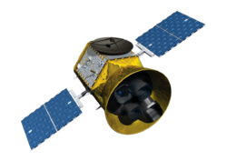
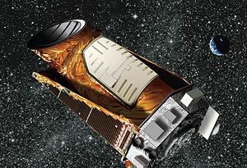
Current State
Transitin Exoplanet Survey Satellite (launched in March, 2018)
3,758 confirmed exoplanets in 2,808 systems, with 627 systems having more than one planet.
expecting 20,000 new exoplanets in the next 2 years
Kepler space observatory (launched in 2009)

Slide 3
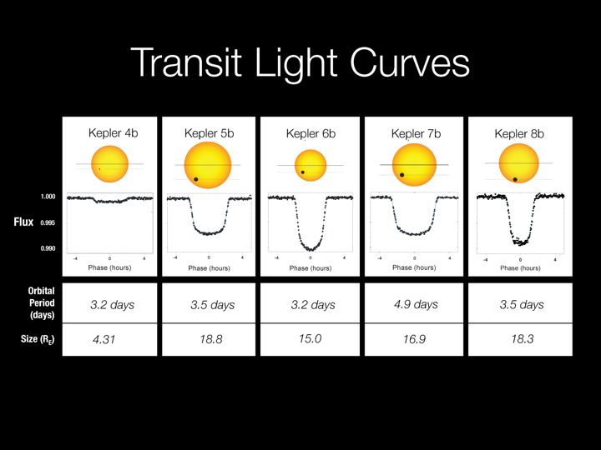
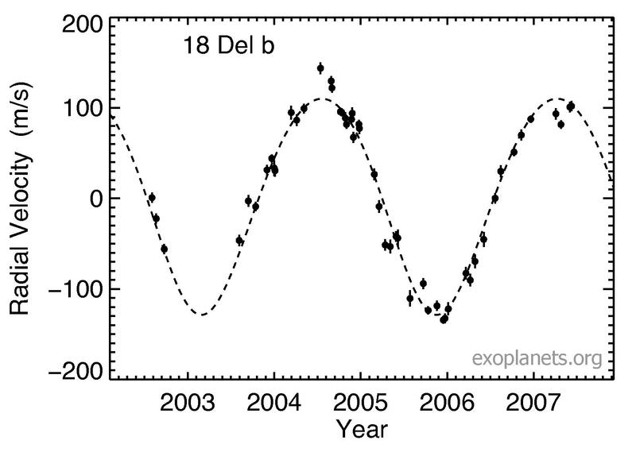
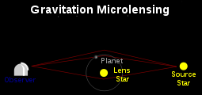
Methods
Transit photometry
Gravitational microlensing
Radial velocity

Slide 4
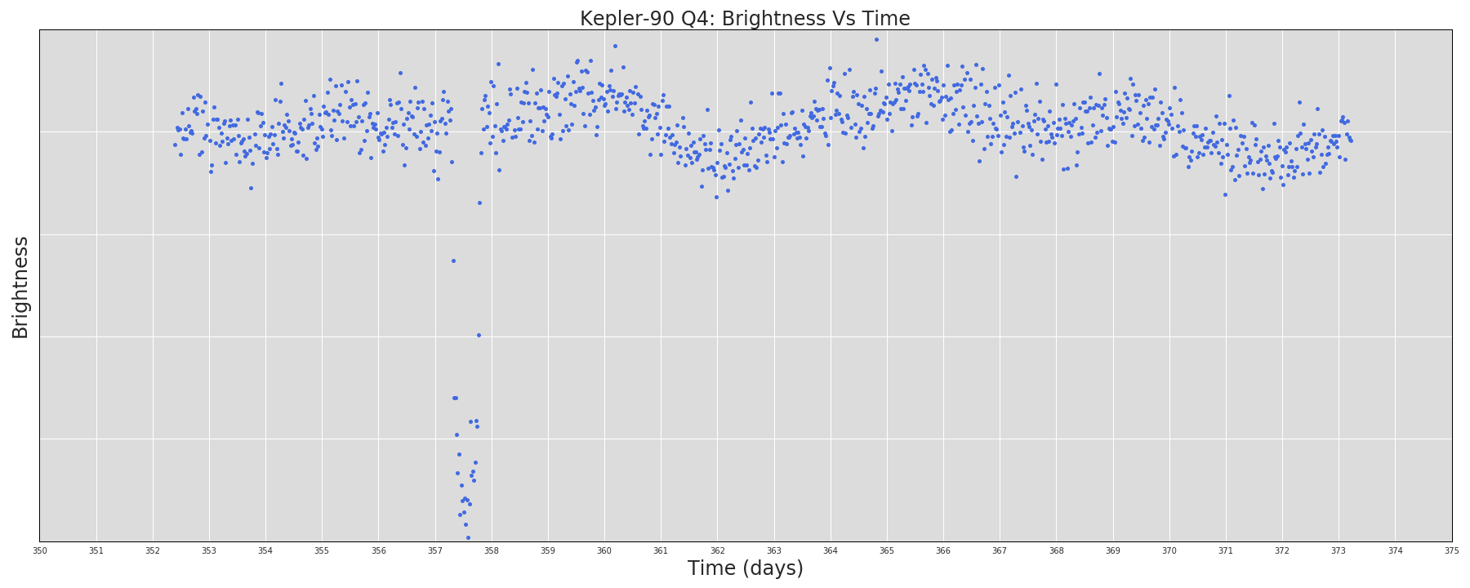
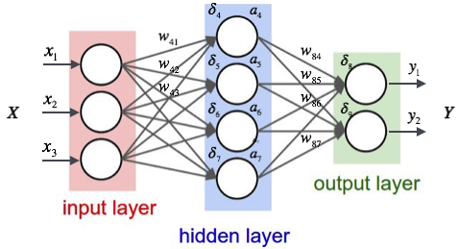


Model
raw light-curve data

