Slide 1

PROJECT REPORT (RFID ATTENDANCE SYSTEM)
MADE BY : NISHANT SINGHAL (UE215065)
PRATEEK MEENA (UE215069)
PRATEEM GIRI (UE215070)
. PRIYANSHU KASHYAP (UE215072)

Slide 2
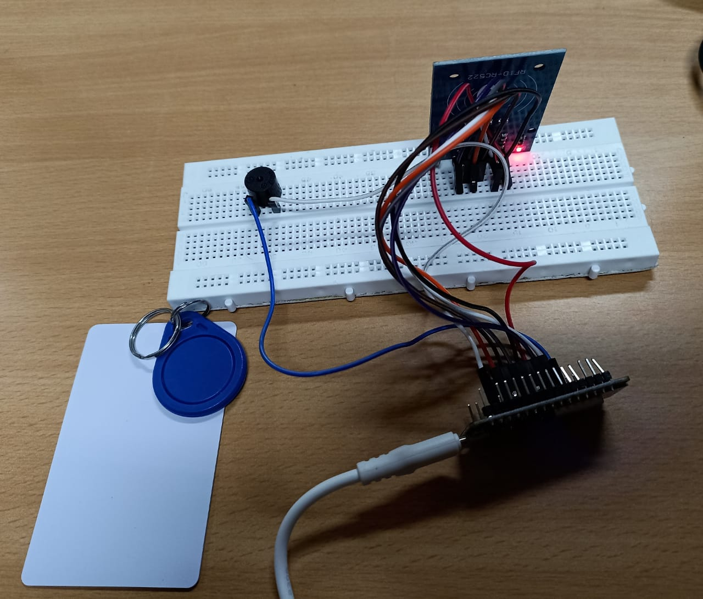

Slide 3
INTRODUCTION
Before getting started with the project, one must understand the concept of radio frequency identification (RFID) as well as a substantial amount of knowledge of IoT(Internet of things) and how these two concepts are tied together in this project.
RFID basically is a wireless system of communication or information exchange between two components – a tag and a reader. It uses the principle of electromagnetic coupling in the radio frequency portion of the electromagnetic spectrum. The reader is a device that has two or more antennas which emit radio waves and receive signals back from the RFID tag. The RFID tag uses these radio waves to communicate it’s identity and other information. There are various types of RFID systems broadly classified on the basis of two categories :
On the basis of frequency band at which they operate
On the basis of their energy source

Slide 4
On the basis of frequency band :
RFID systems are classified into three categories on the basis of frequency band at which they operate :
Low frequency (LF) RFID : This band generally covers a frequency range of 30 KHz to 300 KHz. Typical LF RFID systems work with 125 KHz or 134 KHz. This frequency range provides a short reading range of about 10 cm. The reading speed is slow but the resistance to external interference is very high. Therefore it is prone to interference from nearby metals or liquids and can be used in complex environments.
High frequency (HF) RFID : The ranges of the HF frequencies go from 3 to 30 MHz. Most RFID HF systems work with 13.56 MHz, with reading ranges between 10cm and 1m. Interferences moderately affect HF systems.
Ultra high frequency (UHF) RFID : UHF systems cover frequency ranges from 300Mhz to 3Ghz. Most of them operate between 900 and 915 Mhz. UHF RFID reading systems can reach more than 12 meters, have very fast data transmission and are very sensitive to interference.

Slide 5
On the basis of energy source of the RFID tag
There are two types of RFID systems based on energy source of the RFID tag :
Passive RFID tags : Passive RFID systems use tags with no internal power source and instead are powered by the electromagnetic energy transmitted from an RFID reader. The lower price point per tag makes employing passive RFID systems economical for many industries.
Active RFID tags : Active RFID systems use battery-powered RFID tags that continuously broadcast their own signal. Active tags provide a much longer read range than passive tags, but they are also much more expensive.

Slide 6
The Internet of things (IoT) :
The internet of things refers to a network of hardware devices (“things”) which are embedded with specific software, sensors or other technologies to connect with each other over the internet and communicate or exchange data. In simple words, we can transmit and receive data between multiple physical devices via internet. In context with our project, Iot refers to the network of the RFID attendance circuit and the system (PC, laptop or smartphone).Here the attendance circuit is embedded with a code which enables the microcontroller(nodeMCU Amica) in the attendance circuit to connect with a Wifi network . Any system connected to the same Wifi network will display the information transmitted from the microcontroller(Name) on a google spreadsheet.

Slide 7
COMPONENTS USED
Amica Node MCU ESP8266 DEVELOPMENT BOARD.
RC522 RFID Card Reader Module 13.56MHz along with RFID tags.
DC 5V HNDZ Active Buzzer.
Jumper Wires.
Breadboard.

Slide 8
THEORY :
In this project, a predefined RFID tag (Card or key) is scanned by the RFID reader RC522 reader module and the information contained in the RFID tag i.e the name of an individual is displayed on a google spreadsheet along with the current date and time. Every time there is a successful identification, it is indicated by the beeping of buzzer. This project is composed of three different parts with an individual code for each part.

Slide 9
Making the google spreadsheet
This part involves configuring the spreadsheet for displaying the information sent by the microcontroller (nodeMCU) on the spreadsheet along with the present date and time. It decides the format in which the information is to be displayed i.e in which cell the particular information for example name of the individual is to be shown. It also decides the order in which the information is to be stored for eg in case of date, the order of date , month and year can be changed as per the code. The code is written in the app script extension of the google spreadsheet. The code written is enclosed in the link given below.
RFID - Project Editor - Apps Script (google.com)

Slide 10
Writing the information (Name of an individual) from the microcontroller to the RFID tag
In this part, we write the code in the Arduino IDE for writing the desired information to the RFID tag. For this, first we have to install the esp8266 library and all the subsequent libraries used in the code. Then by uploading this code and scanning the RFID tag with the use of RC522 reader module, the required information (name) present in the code is stored in the RFID tag. The code is enclosed in the object file given below :

Slide 11
Displaying the information on the spreadsheet
In this part, with all the required libraries installed, the code written in the Arduino IDE displays the information stored on the RFID tag on the google spreadsheet when the RFID tag is scanned by the reader module. The code is given in the object file given below :

Slide 12
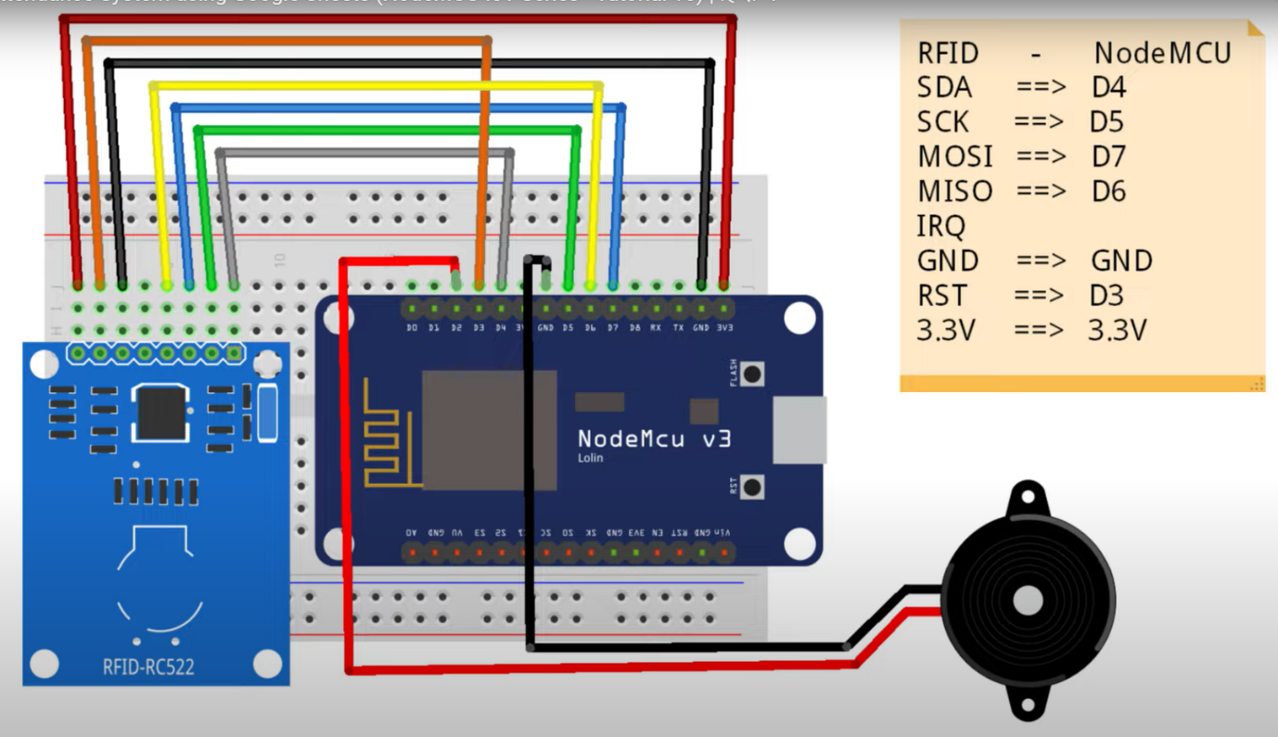
CIRCUIT DIAGRAM :

Slide 13
The V_{cc} ( +3.3V) pin of the nodeMCU is connected to the V_{cc} pin of the RC522 and the GND (ground) pins of the nodeMCU are connected to the GND pin of the RC522 and the cathode of the buzzer.
The digital pins D3-D7 of the nodeMCU are connected to the remaining pins of the RC522 RFID module. The digital pin D2 is connected to the anode of the buzzer.

Slide 14
APPLICATIONS :
This project can be used as a smart attendance system for offices, libraries etc where an attendance record needs to be maintained reducing manual efforts and human errors and discrepancies which arise due to the old conventional pen & paper way of recording attendance.
Currently, RFID technology is finding multiple applications in a wide variety of fields depending on the type of RFID system.
Low frequency RFID systems can be used for access control such as RFID door lock, RFID attendance system, RFID safe lock etc. They can also be used for animal tracking since they are resistant to interference from complex environment conditions.
High frequency RFID systems can be used for payments, ticketing and data transfer applications.
Ultra high frequency RFID has a large reading range with active UHF RFID systems having a range extending upto even 100m. So they are usually used on wagons, products or containers that have to be controlled in large spaces.

Slide 15
CONCLUSION :
In conclusion, we can say that RFID attendance system is a much faster,accurate and efficient way of marking attendance than the traditional paper based system. RFID technology is a promising new technology. It’s use as an alternative to bar codes is increasing day by day. However, like all other technologies, RFID also has it’s own set of limitations. It is prone to two main issues – reader collision which occurs when a signal from one RFID reader interferes with a second reader. It can be prevented by using an anti-collision protocol to make RFID tags take turns transmitting to their appropriate reader. Tag collision - Tag collision occurs when too many tags confuse an RFID reader by transmitting data at the same time. Choosing a reader that gathers tag info one at a time will prevent this issue. Despite all of the abovementioned challenges, it’s use is increasing day by day as new ways and methods are being implemented in improving this technology.

Slide 16
FUTURE SCOPE :
The future scope of this project is to extend it to an even more compact design with more capabilities and functionalities.
The whole circuit used for demonstration purpose can be soldered on a general purpose PCB board to make it compact and appealing.
It can have more functionalities by integrating various other sensors, actuators and displays in the circuit. Actuators can be used to incorporate an RFID based door lock and various other sensors can be used for different measurements as per the need of the system for eg specific temperature sensors can be incorporated to display the body temperature of medical patients along with their attendance record.
It can be used for displaying the exit time and other fields such as card number, roll number etc as well by modifying the spreadsheet code.

Slide 17
REFERENCES :
https://github.com/shubhamkumar27/WIFI_based_RFID_attendance-system_using_NodeMcu_and_Django
Types of RFID Systems | UHF, HF, NFC, LF | Dipole (dipolerfid.com)
Low Frequency RFID vs. High Frequency RFID: The Top 8 Differences - atlasRFIDstore
Radio Frequency Identification (RFID) | FDA

