Slide 1
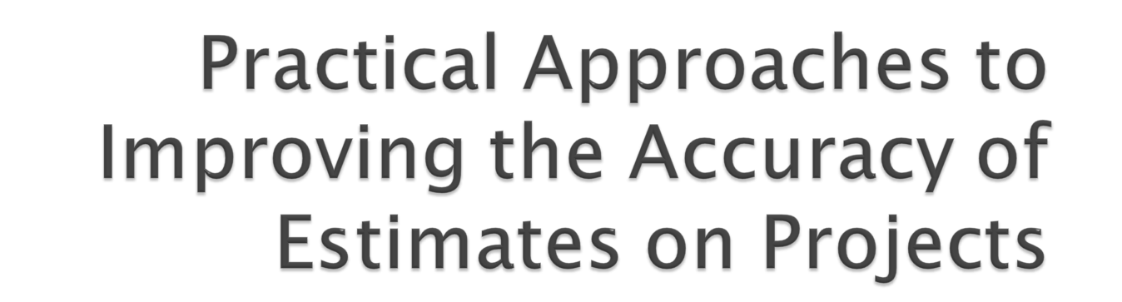
Ayaz Somjee, PMP
PMI-KPC Session 80
October 4, 2011

Slide 2

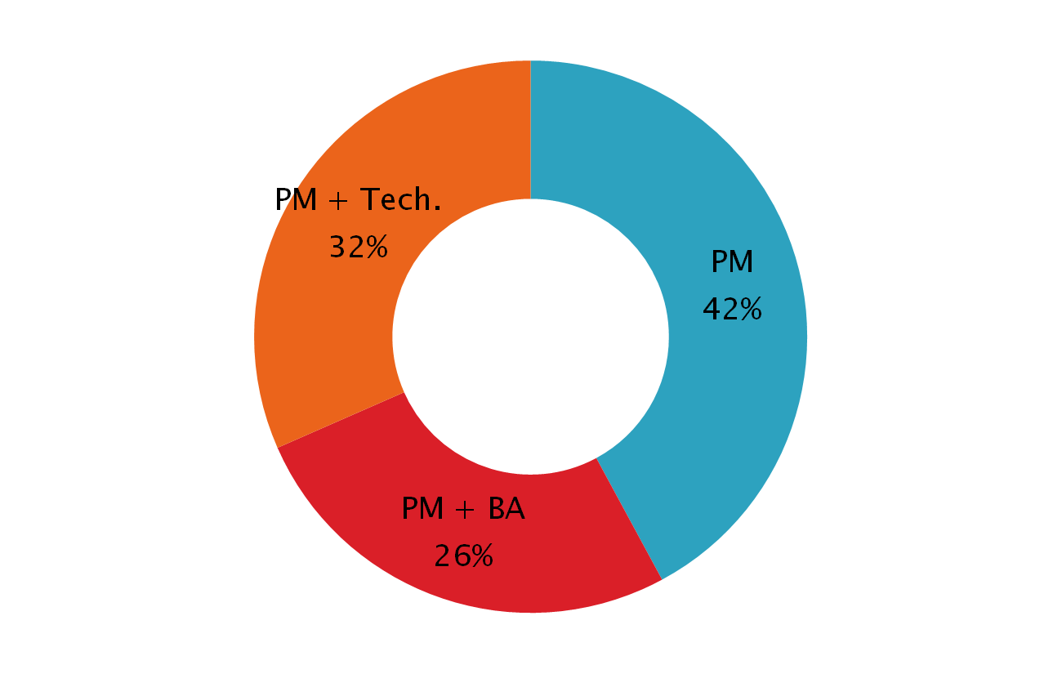
Notes:
I’ll get the numbers from the audience

Slide 3

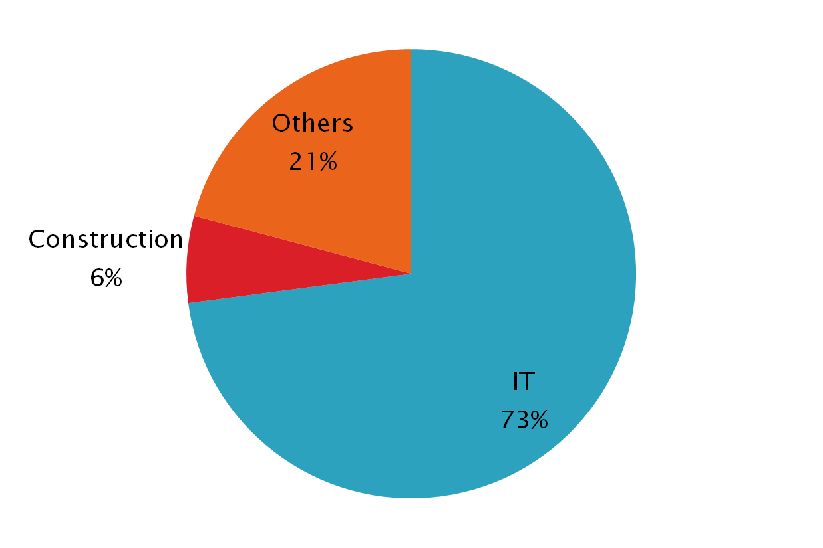
Notes:
I’ll take the data live and feed in here

Slide 4

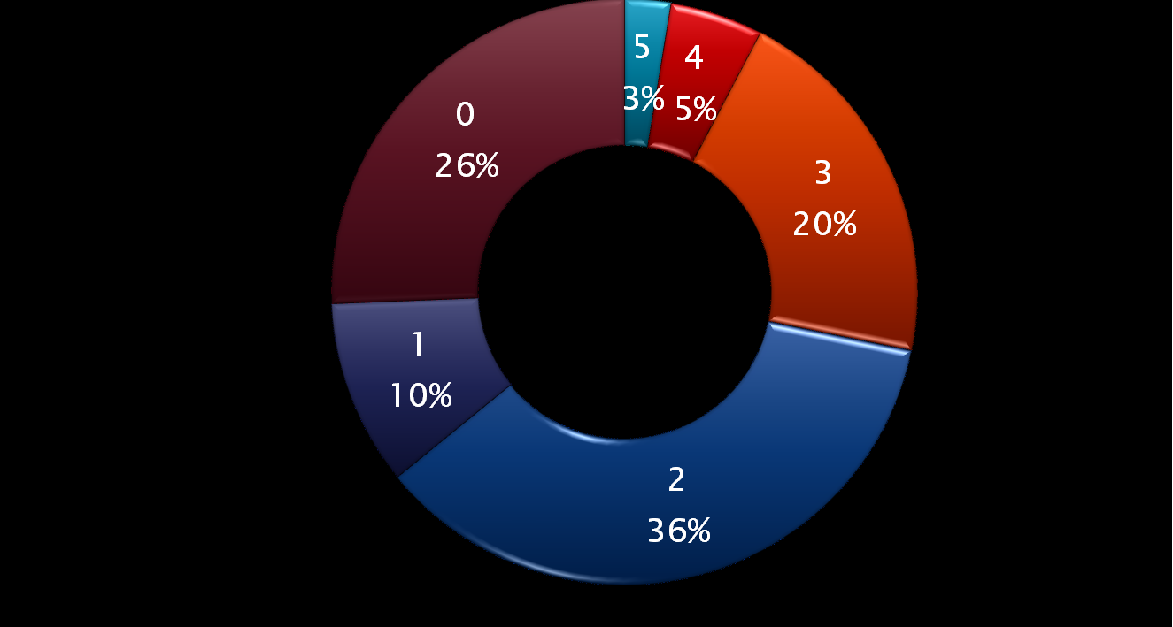
Number of successful projects from Last 5 Projects?
Notes:
I’ll take the data live and feed in here

Slide 5
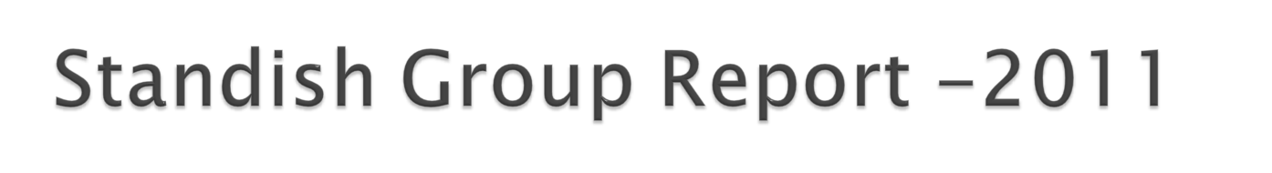
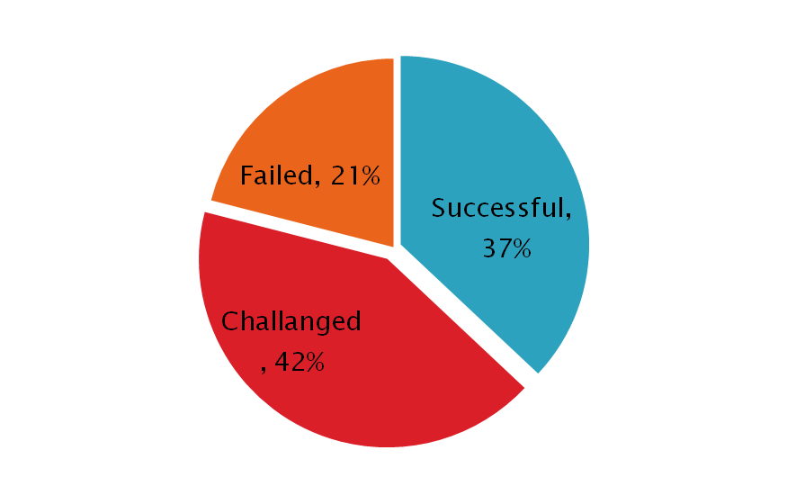
Reasons:
  Failure to control scope,
  Poor architecture,
  Requirements volatility,
  Unsystematic development process,
  Unreliable estimates.
9 out of 10 Projects have cost over runs (Oxford Review of Economic Policy - PMI Network October 2011 – Estimating Errors)

Slide 6

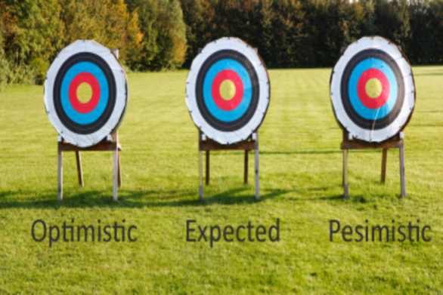
Estimate. An estimate is an informed assessment of an uncertain event.
Guess. A guess is a special kind of estimate—one where we do not have enough information to make an informed assessment.

Slide 7


Pre-Requisites
Human Aspect
Data
Tools & Techniques

Slide 8

Scope
  Requirements
  WBS
Risk
  Risk Management
Change
  Change Management
Notes:
How many of us feel we do not have proper scope defined for our projects?
Sales makes a deal with client for the product that is not even developed

Slide 9


Project Manager
  The maverick
  The star in making
Resource
  Been there, done that
  The new comer
Dictionary ⬅➔ Glossary
Notes:
How many of you have been guilty of estimating on your project?
How many of us have been asking for estimates from the wrong person?
Do your questions make the resources uncomfortable?
You’ll have the system live by <October 2011>

Slide 10


Industry Specific
  Construction
  IT
Mature[d] Organization (Process wise)
  Lessons Learned
  Knowledge Base
Notes:
Programmers don’t document
How many of us have lessons learned processes that we follow?
Do we have a KB? If yes, Are we following it?

Slide 11

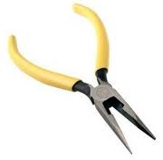
Three Point Estimates
Delphi
COCOMO
PERT
Notes:
Which techniques you usually use? Do you customize the techniques?
Templates / Historical Data
How long is the estimation session?
Who is involved in estimation?

Slide 12


Notes:
There is no silver bullet – we need to Keep it Simple and Follow it.

Slide 13
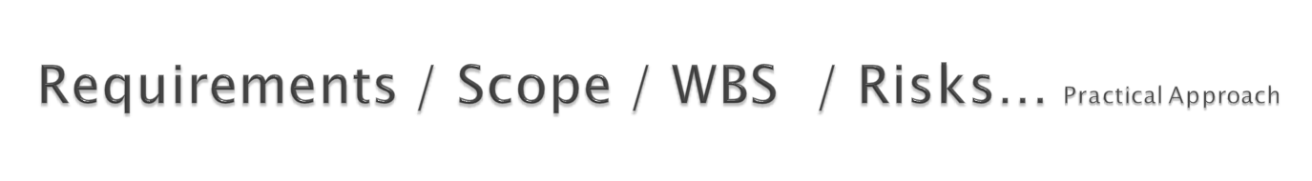

  Document
    Assumptions & Constraints
    Known Unknowns
    Detailed / clear requirements
  Language / Terminologies –
    (work vs. duration)
    (Deployed vs. Implemented)
  Change Mechanism
  It has been observed by the Standish Group a lack of user engagement and changing specifications were two of the primarily reasons that software projects fail (The Standish Group, 1994).
  Share Information

Slide 14
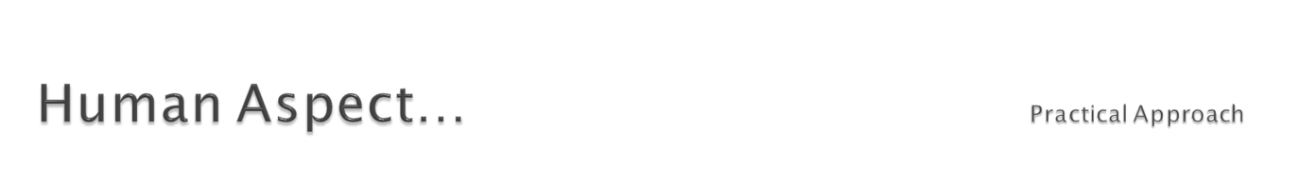
Organizational Culture / Team Dynamics
  Experience
  Domain Expertise
  The Optimist
  The Pessimist
Facilitate rather than dominate
  Management vs. Team
  Trust Factor
Play the disagreements
  Document the assumptions
  Refer to documents
Do your job – Ask questions
Notes:
The role of Project Manager as a Facilitator

Slide 15

  Lessons Learned → KB
    Process
  Quality of data
    Control points
Notes:
How good is your Lessons Learnt Process
How good is your KB
Concentrate to refine the process

Slide 16
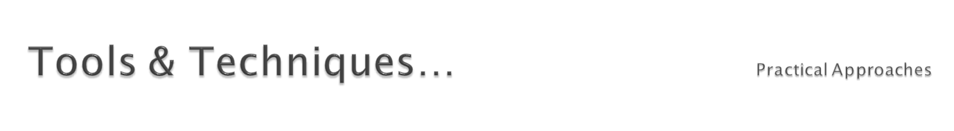
Involve the expert.
Provide information and then give them time and space
Short (multiple) sessions – no 6 hr. sessions
If you do not have answers, go get’em !!!
Share the risks
Get ranges rather than absolute numbers
Don’t blame the person – concentrate on the process

Slide 17

Planning Poker?

Slide 18

Pre-Requisites
Document Assumptions, Document Requirements, Break’em down, Document Constraints, Change Mechanism, Information is for all
Human Aspect
Involve them all, Facilitate rather than dominate, Do your job – Ask questions, Don’t lose the big-picture
Data
  KB, Process Improvements
Tools & Techniques
  Planning Poker, 3 Point Estimates etc.

