Slide 1
Practical Approaches to Improving the Accuracy of Estimates on Projects
Ayaz Somjee, PMP
PMI-KPC Session 80
October 4, 2011

Slide 2
Role that we play
Notes:
I’ll get the numbers from the audience

Slide 3
Sectors that we belong to…
Notes:
I’ll take the data live and feed in here

Slide 4
Projects We Manage
Number of successful projects from Last 5 Projects?
Notes:
I’ll take the data live and feed in here

Slide 5
Standish Group Report -2011
Reasons:
Failure to control scope,
Poor architecture,
Requirements volatility,
Unsystematic development process,
Unreliable estimates.
9 out of 10 Projects have cost over runs (Oxford Review of Economic Policy - PMI Network October 2011 – Estimating Errors)

Slide 6
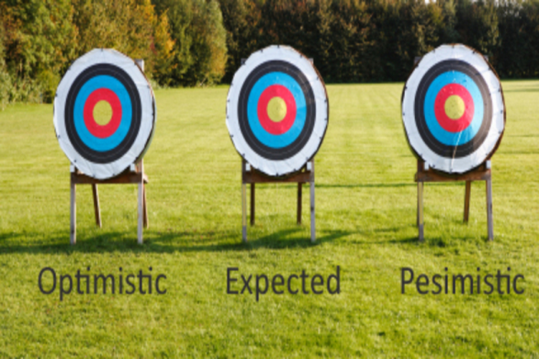
Estimate
Estimate. An estimate is an informed assessment of an uncertain event.
Guess. A guess is a special kind of estimate—one where we do not have enough information to make an informed assessment.

Slide 7

The Foundation
Pre-Requisites
Human Aspect
Data
Tools & Techniques

Slide 8
Pre Requisites
Scope
Requirements
WBS
Risk
Risk Management
Change
Change Management
Notes:
How many of us feel we do not have proper scope defined for our projects?
Sales makes a deal with client for the product that is not even developed

Slide 9

Human Aspect
Project Manager
The maverick
The star in making
Resource
Been there, done that
The new comer
Dictionary ⬅➔ Glossary
Notes:
How many of you have been guilty of estimating on your project?
How many of us have been asking for estimates from the wrong person?
Do your questions make the resources uncomfortable?
You’ll have the system live by <October 2011>

Slide 10

Data
Industry Specific
Construction
IT
Mature[d] Organization (Process wise)
Lessons Learned
Knowledge Base
Notes:
Programmers don’t document
How many of us have lessons learned processes that we follow?
Do we have a KB? If yes, Are we following it?

Slide 11
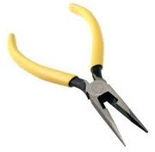
Tools & Techniques
Three Point Estimates
Delphi
COCOMO
PERT
Notes:
Which techniques you usually use? Do you customize the techniques?
Templates / Historical Data
How long is the estimation session?
Who is involved in estimation?

Slide 12

Practical Approaches
Notes:
There is no silver bullet – we need to Keep it Simple and Follow it.

Slide 13

Requirements / Scope / WBS / Risks… Practical Approach
Document
Assumptions & Constraints
Known Unknowns
Detailed / clear requirements
Language / Terminologies –
(work vs. duration)
(Deployed vs. Implemented)
Change Mechanism
It has been observed by the Standish Group a lack of user engagement and changing specifications were two of the primarily reasons that software projects fail (The Standish Group, 1994).
Share Information

Slide 14
Human Aspect… Practical Approach
Organizational Culture / Team Dynamics
Experience
Domain Expertise
The Optimist
The Pessimist
Facilitate rather than dominate
Management vs. Team
Trust Factor
Play the disagreements
Document the assumptions
Refer to documents
Do your job – Ask questions
Notes:
The role of Project Manager as a Facilitator

Slide 15
Data… Practical Approaches
Lessons Learned → KB
Process
Quality of data
Control points
Notes:
How good is your Lessons Learnt Process
How good is your KB
Concentrate to refine the process

Slide 16
Tools & Techniques… Practical Approaches
Involve the expert.
Provide information and then give them time and space
Short (multiple) sessions – no 6 hr. sessions
If you do not have answers, go get’em !!!
Share the risks
Get ranges rather than absolute numbers
Don’t blame the person – concentrate on the process

Slide 17
Tools & Techniques …
Planning Poker?

Slide 18
The Foundation (revisited)
Pre-Requisites
Document Assumptions, Document Requirements, Break’em down, Document Constraints, Change Mechanism, Information is for all
Human Aspect
Involve them all, Facilitate rather than dominate, Do your job – Ask questions, Don’t lose the big-picture
Data
KB, Process Improvements
Tools & Techniques
Planning Poker, 3 Point Estimates etc.

