Slide 1
Introducing PowerPoint 2007
A tour of new features

Slide 2
PowerPoint 2007
This presentation demonstrates the new capabilities of PowerPoint through examples. You can view it in Slide Show or by browsing through the slides in Normal View. These slides are designed to give you great ideas for the presentations you’ll create in PowerPoint 2007!
Text, Graphics & Pictures
SmartArt
Themes & Quick Styles
New Layouts

Slide 3
Text, Graphics & Pictures

Slide 4
Superior Text
Soft Shadow
Text in PowerPoint 2007 has learned new tricks. There are handy features like strikethrough and advanced features like character spacing control. And you’ll look your best with soft shadows and the ability to put “WordArt” styles right onto your slide text.
Effects
Kerning
Character Spacing
Styled Underline
Strikethrough

Slide 5
The Power of OfficeArt Graphics
Make a statement with great looking graphics. PowerPoint makes it easy to produce visuals that used to require multiple applications to accomplish. Easily apply soft shadows, reflections, glows, bevels, 3D and more!
Soft Shadow
Reflection
Bevel
3D

Slide 6


Picture This…
You can do a lot more with pictures in PowerPoint 2007. Easily recolor pictures or change the shape of their frame. And all of OfficeArt’s effects can be applied to a picture – even 3D!

Slide 7
SmartArt

Slide 8
Visualize It!
Business Process
Operate
Support
Optimize
Change
SmartArt turns your bullet points into graphics in a single click. You can even change your graphic layout to find just the right way to express your idea.

Slide 9
Business Process
Operate
Support
Optimize
Change

Slide 10
Business Process
Operate
Support
Optimize
Change

Slide 11
Themes & Quick Styles

Slide 12
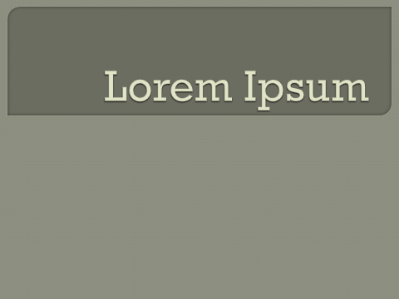
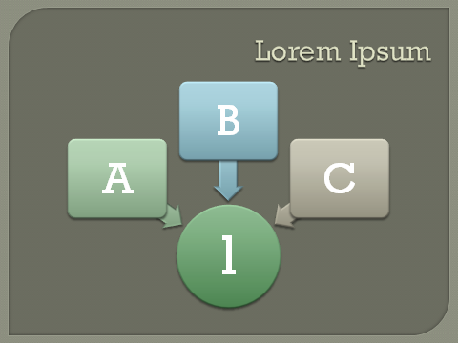
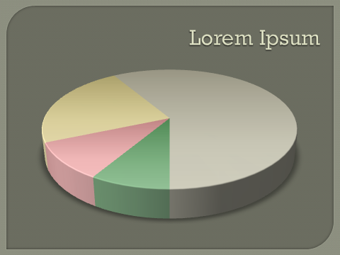
Get Coordinated with Themes!
Office Themes give you effortless coordination of the colors, fonts and graphic effects applied to your presentation. Everything you insert into your presentation will be automatically styled to match.

Slide 13
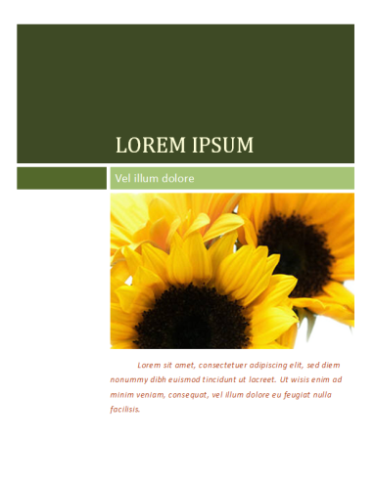
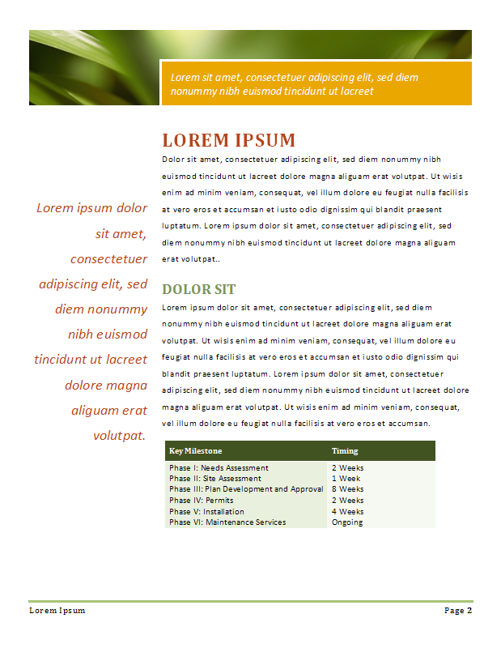
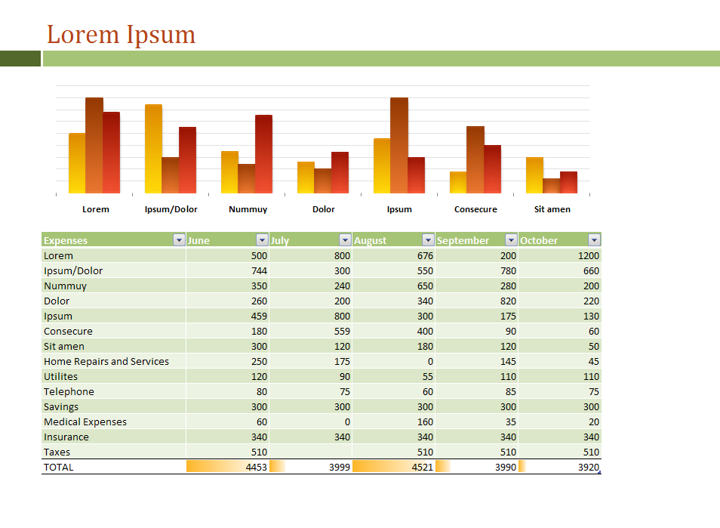
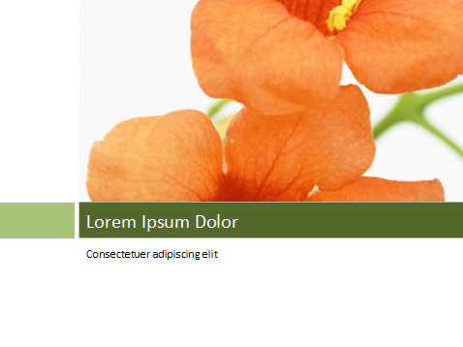
Word and Excel, too!
PowerPoint now shares a common set of “Office Themes” with Word and Excel so you can create documents and spreadsheets that match your presentation for a “branded” look.

Slide 14
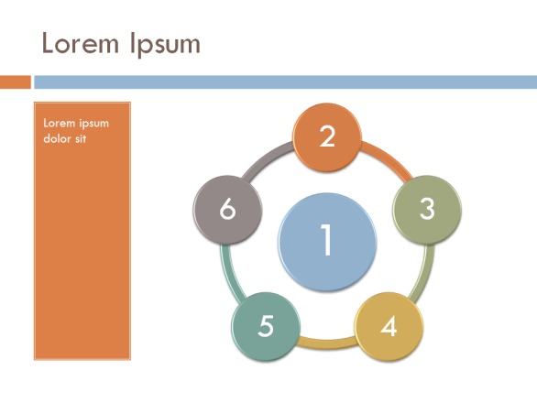
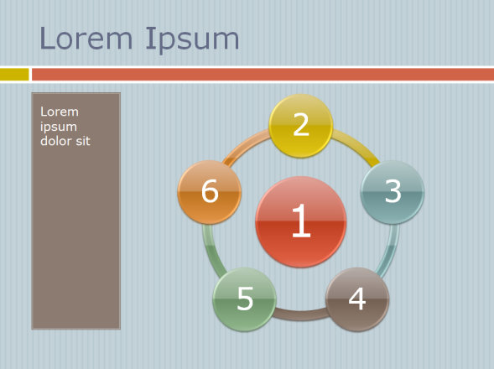
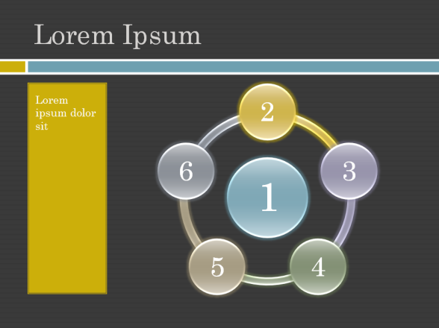
Mix It Up!
Office Themes are infinitely customizable. You can mix and match the colors, fonts and effects from different themes.

Slide 15
Quick Styles
1
2
3
4
5
There is a spectrum of designer styles for every chart, diagram, table or picture you add to your presentation. In a single click you can go from understated to wow or anywhere in between.
1 | 2 | 3
1 | 2 | 3
1 | 2 | 3
1
2
3
4
5
1 | 2 | 3
1 | 2 | 3
1 | 2 | 3
1
2
3
4
5
1 | 2 | 3
1 | 2 | 3
1 | 2 | 3

Slide 16
New Layouts

Slide 17
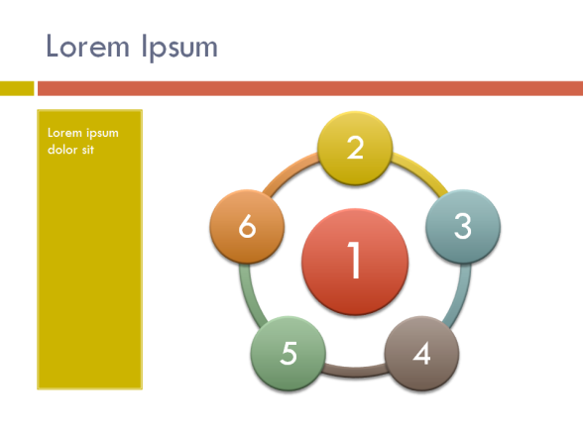
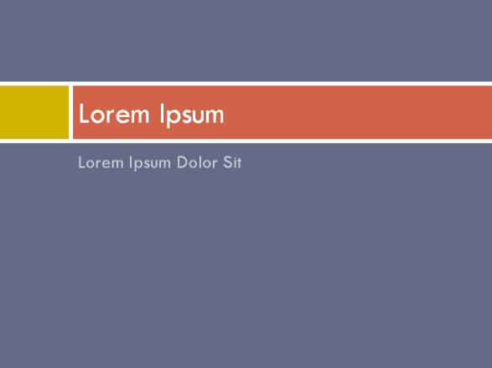
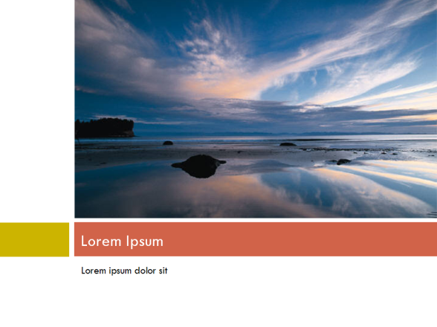
Slide Perfect!
PowerPoint has new layouts that give you more ways to present your words, images and media.
Everything you add into the layout placeholders is arranged perfectly for you.

Slide 18
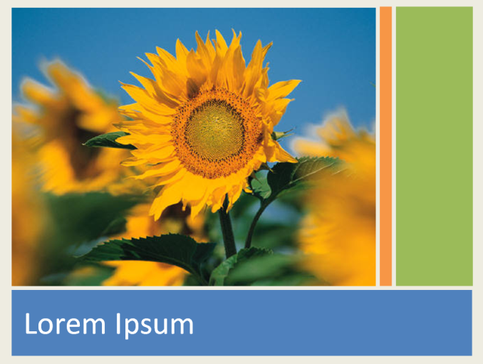
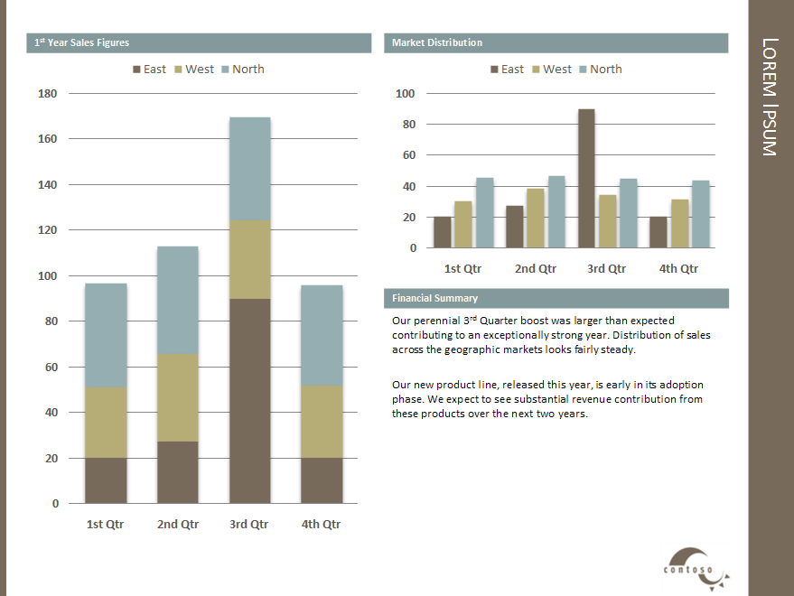
Arrange it Your Way
With custom layouts you design your own slide arrangements. You can create new kinds of documents with PowerPoint. Easily create everything from business pitchbooks to family photo albums.

