Slide 1
Create a Research Dataset

Slide 2
What Are We Exploring?
Our objective is to compare health inequalities in different states of the United States utilizing public data sources.
Listening to other students focus on how COVID-19 has affected different communities; hospital availability; and health insurance.

Slide 3
Datasets We’re Using
COVID-19 Case Surveillance Public Use Data with Geography (CDC)
COVID-19 Reported Patient Impact and Hospital Capacity by Facility (HealthData.gov)
Health Insurance Coverage of the Total Population dataset
County Health Rankings dataset
COVID-19 Vaccination Data
Behavioral Risk Factor Surveillance System (BRFSS) dataset

Slide 4
Merging the Data
Step 1: In FIPS codes and state mappings, we have performed the mapping of states and counties present in each dataset.
Step 2: Combined health insurance data with COVID-19 case data through state identifiers.
Step 3: Combined variables of hospital capacity with COVID-19 value.
Step 4: Used Combined County Health Rankings to enhance the database with health outcome rankings.
Step 5: Combined the BRFSS dataset into the analysis using variables including smoking, obesity, and physical inactivity for health behavior to understand which populations with risky factors are associated with COVID-19 outcomes.
Step 6: Integrated the COVID-19 Vaccination dataset of vaccination rates by the manufacturer and age group on COVID-19 cases and outcomes.

Slide 5
The Final Dataset
Merges health care data, patient and deaths, coronavirus, shortages, and insurance information, health behaviors, vaccination rates.
Present-day findings on the effect of various factors at the state and county level on the health status of individuals.
Research value: The given dataset can be used to make decisions in the healthcare sector, allocate funds, and provide targeted healthcare options at the community level.

Slide 6
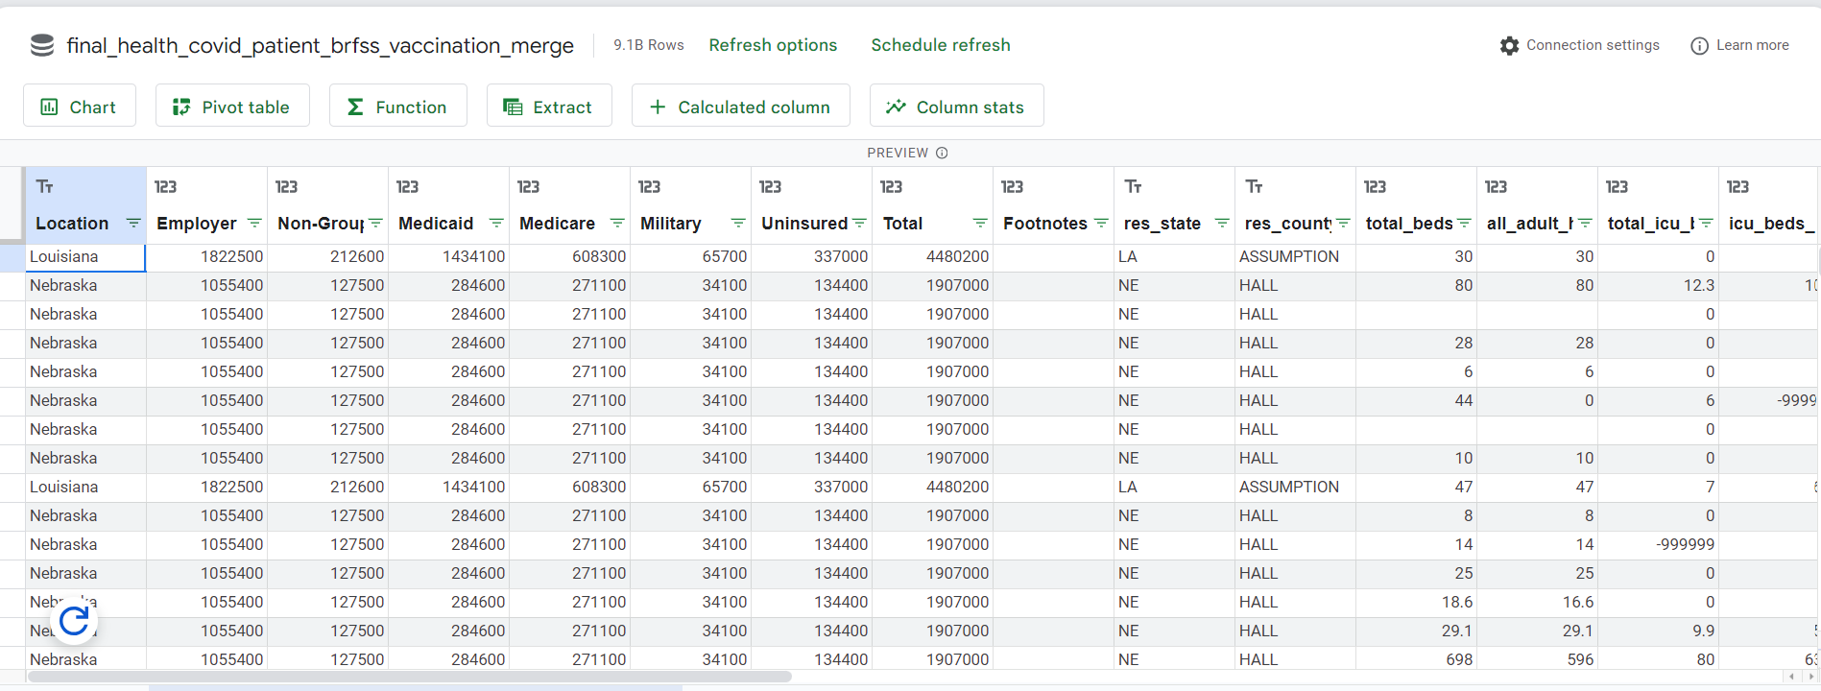

Slide 7
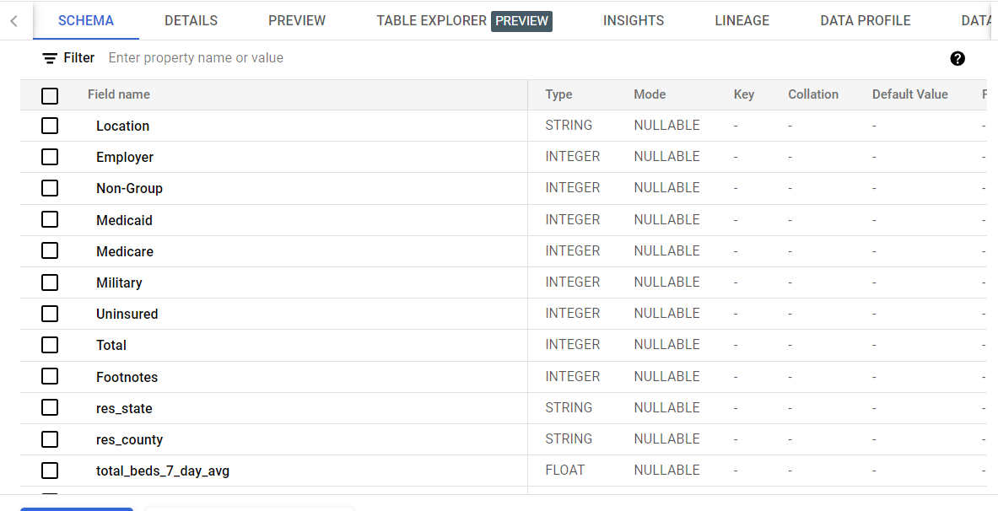
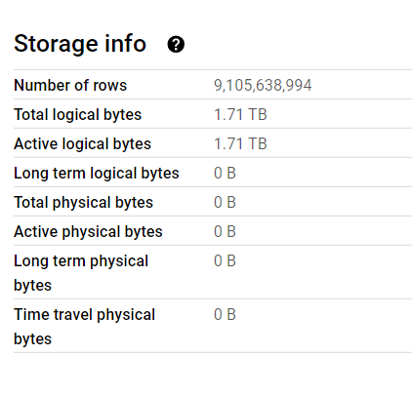
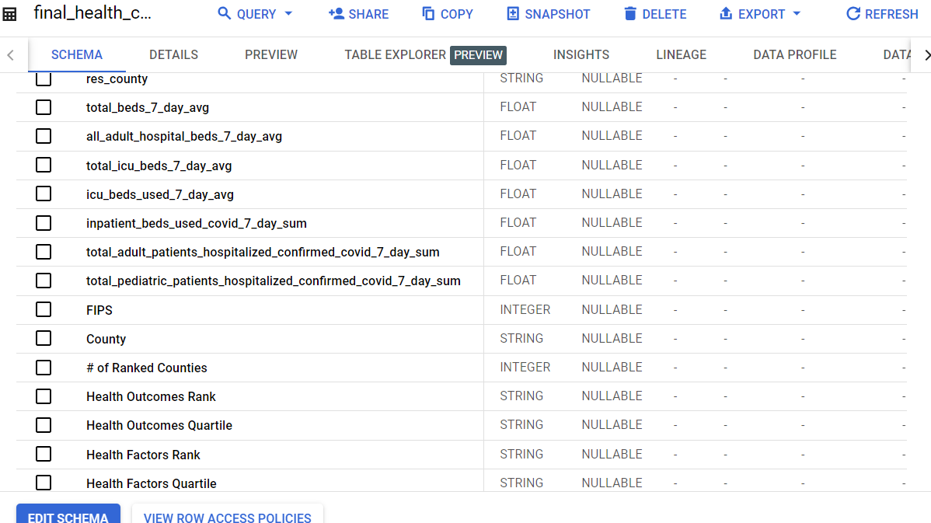
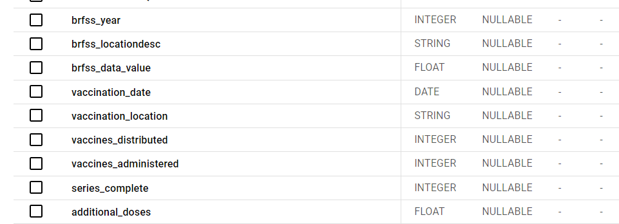

Slide 8
Conclusion
The merged dataset is a useful instrument for studying the health status inequality in the USA.
Knowledge acquired contributes to enhanced policy formulation, resource management, better health of people in the society, vaccination rates, and behavioral factors..
This is going to inform future health research and the Department of Health and Human Services in their decision-making.

